Slide 1
Solving Problems Involving Polynomials and Polynomial
Equations

Slide 2
Solving Problems Involving Polynomials and Polynomial Equations
There are many situations in the real world that can be modeled using polynomial functions. Study the following examples.
Example 1: The area of a rectangular garden is x² + 4x - 32 square feet. If the length is x + 8 feet, find a binomial that represents the width.

Slide 3
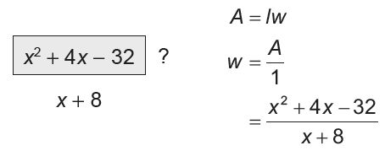
Solving Problems Involving Polynomials and Polynomial Equations
Solution:
We are given A = x² + 4x - 32 and l = x + 8.
The area of a rectangle is the product of its length and width.
Area formula or a rectangle.
Divide both sides by l.
Substitute the given information for A and I.

Slide 4
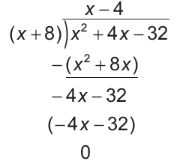
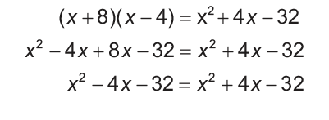
Solving Problems Involving Polynomials and Polynomial Equations
Cont.
Use long division to solve for the width. Check the result.
The width of the garden is x - 4 ft.

Slide 5
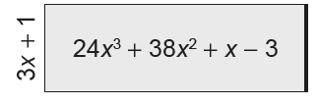
Solving Problems Involving Polynomials and Polynomial Equations
Example 2: A rectangular garden has an area of 24x³ + 38x² + x - 3 square feet. If its width is 3x + 1 feet, write a polynomial to represent its length.

Slide 6
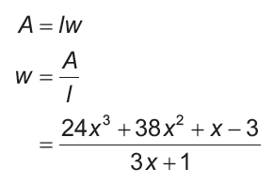
Solving Problems Involving Polynomials and Polynomial Equations
Solution:
The area, A, of a rectangle is given by:
Replace A with 24x³ + 38x² + x - 3 and w with 3x + 1.

Slide 7
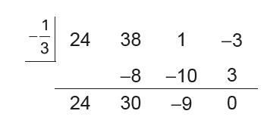

Solving Problems Involving Polynomials and Polynomial Equations
Use synthetic division to get the quotient. The divisor is 3x + 1 or x = − 1/3.
The quotient is or 8x2 + 10x - 3.
Thus, the length of the rectangular garden is 8x2 + 10x - 3 ft.

Slide 8
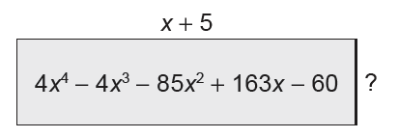
Solving Problems Involving Polynomials and Polynomial Equations
Example 3: A rectangle with a length of (x + 5) centimeters has an area of
(4x4 - 4x3 - 85x2 + 163x - 60) square centimeters. Write a polynomial that represents
its width.

Slide 9
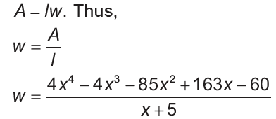
Solving Problems Involving Polynomials and Polynomial Equations
The area, A, of a rectangle is given by:
Replace A with 4x⁴ - 4x³ - 85x² + 163x - 60 and l with x + 5.

Slide 10
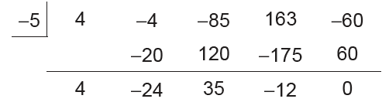
Solving Problems Involving Polynomials and Polynomial Equations
Use synthetic division to get the quotient. The divisor is x + 5, so c = -5..
The quotient is 4x² - 24x² + 35 - 12. Hence, the width of the rectangle is (4x³ - 24x² + 35x - 12) cm.

Slide 11
Solving Problems Involving Polynomials and Polynomial Equations
Use synthetic division to get the quotient. The divisor is x + 5, so c = -5..
The quotient is 4x² - 24x² + 35 - 12. Hence, the width of the rectangle is (4x³ - 24x² + 35x - 12) cm.

Slide 12
Solving Problems Involving Polynomials and Polynomial Equations
Example 4: If you travel a distance of (x³ - 13x - 12) kilometers at a rate of (x + 3) kilometer per hour, write a polynomial that represents the number of hours you traveled.

Slide 13
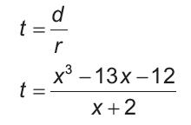
Solving Problems Involving Polynomials and Polynomial Equations
Solution:
The distance, d, traveled is given by:
d = rt. Thus,
Replace d with x² - 13x - 12 and r with x + 3.

Slide 14
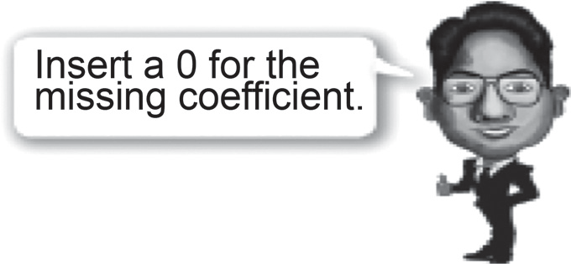
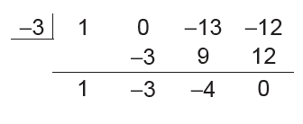
Solving Problems Involving Polynomials and Polynomial Equations
Use synthetic division to get the quotient.
The quotient is x² - 3x - 4. Hence, the number of hours you have traveled is (x² - 3x - 4) hours.

Slide 15
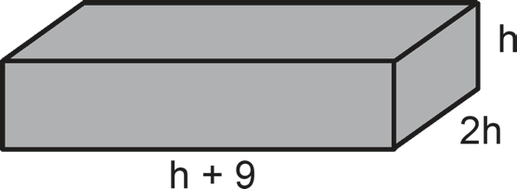
Solving Problems Involving Polynomials and Polynomial Equations
Example 5: The volume of a rectangular block is 88 cubic inches. The width of the block is twice the height, and the length is 9 inches more than the height. If the dimensions of the block are integers, find the dimensions.

Slide 16
Solving Problems Involving Polynomials and Polynomial Equations
Let h = the height of the block in inches
w = width, l = length
w = 2h, l = h + 9
V = lwh Substitute 88 for V, h + 9 for l, and 2h for w .
88 = (h + 9)(2h)(h) Simplify.
88 = 2h³ + 18h² Subtract 88 from each side of the equation.
0 = 2h³ +18h² − 88 Divide each side by 2 and apply the symmetric property of equality.
h3 + 9h2 − 44 = 0 Solve for h.
The possible rational roots are ±1, ±2, ±4, ±11, ±22, ±44.

Slide 17
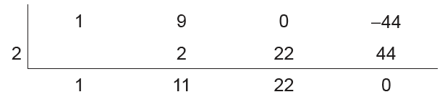
Solving Problems Involving Polynomials and Polynomial Equations
Cont.
Since the block’s dimensions must be positive, we take only the positive real roots. Use synthetic substitution and a chart to find one rational zero.
Let us find out if 2 is a root. By synthetic division, we have the following.
Therefore, 2 is a root. The other roots are not integers. Thus, we will only consider h = 2. The dimensions of the block are h = 2, l = h + 9 = 2 + 9 = 11 , and w = 2h = 2(2) = 4. Hence, the block is 11 units by 4 units by 2 units.

