Slide 1
Graphs of Polynomial Functions

Slide 2
Graphs of Polynomial Functions
A polynomial of degree n is a function in standard form as
f (x) = an x^{n} + an - 1x^{n - 1} + … + a1x¹ + a0
where a is a real number also called coefficient and n is a positive integer. A polynomial is written in standard form if the terms are arranged in descending order (from highest power to lowest power), reading from left to right. Note that anx^{n} is the leading term with an as the leading coefficient, and a0 is the constant.
Note that the graph of a first-degree polynomial function (linear function) is a line with exactly one root. Moreover, the graph of a second-degree polynomial function (quadratic function) is a parabola with at most two roots, the graph of third-degree function (cubic function) has three roots, and so on.

Slide 3
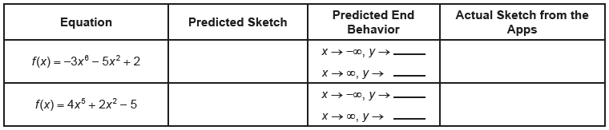
Graphs of Polynomial Functions
Consider the degree and leading coefficient of the following polynomial functions. Sketch their graphs to predict the end behavior of the graph. You may use graphing applications such as GeoGebra or Desmos to check the actual graphs.
What can you say about their graphs? What are your observations of your predicted graph as compared to the actual sketch using graphing applications?

Slide 4
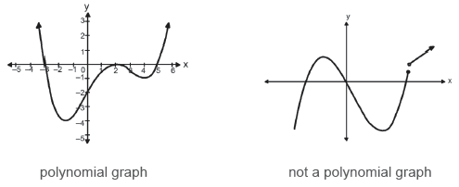
Graphs of Polynomial Functions
The graphs of polynomial functions are continuous and have smooth curves.

Slide 5
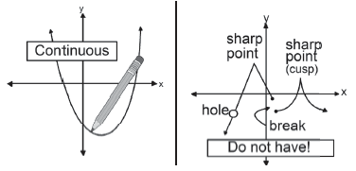
Graphs of Polynomial Functions
A graph is said to be continuous if you can draw the entire function without lifting your pencil from your paper. While it is considered a smooth graph when the graph does not contain holes, breaks, or sharp point corners. Consider the illustrations below:

Slide 6
Graphs of Polynomial Functions
The concept of zeroes of polynomial functions will help us determine the turning points of its graph. Zeroes of polynomial functions are the solutions of linear functions or the x-intercepts of any polynomial function. In the polynomial function f (x) = (x - 1)²(x - 5), 1, 1, and 5 are the zeroes of the polynomial and are considered as the solution set of the function.
You will notice that 1 appears twice as the zeroes of the given polynomial function. This can be written as 1 with multiplicity of 2. Multiplicity refers to the number of times that the factors appear in the polynomial. Therefore, the zeroes of the given polynomials are 5 and 1 with multiplicity of 2.

Slide 7
Graphs of Polynomial Functions
Example 1: List the zeroes with their multiplicities and the turning points of the polynomial function
y = 3(x + 5)³(x + 2)⁴(x - 1)²(x – 5).
Solution:
The zeroes of the function are the solutions of the linear factors. Solving each factor gives:
x + 5 = 0 ⇒ x = -5 with multiplicity 3 (because it occurs thrice)
x + 2 = 0 ⇒ x = -2 with multiplicity 4 (because it occurs four times)
x - 1 = 0 ⇒ x = 1 with multiplicity 2 (because it occurs twice)
x - 5 = 0 ⇒ x = 5 with multiplicity 1 (because it occurs once)

Slide 8
Graphs of Polynomial Functions
Note that the multiplicity of each zero is the number of times that its corresponding factor appears. In other words, multiplicities are the powers of linear factors. If a polynomial contains a factor of the form (x - h)p, the behavior near the x-intercept h is determined by the power p. We say that x = h is a zero of multiplicity p.
Furthermore, since the degree of the polynomial is 10, then the number of the turning point is 9. Turning points are points at which the graph changes direction from increasing to decreasing or vice versa. A polynomial of degree n can have at most n − 1 turning points.
The graph of a polynomial function will touch the x-axis and bounces off of the axis at zeroes with even multiplicities. On the other hand, the graph will cross through the x-axis at zeroes with odd multiplicities. While the graph crosses x-axis and appears almost linear at the intercept, it is a single zero. Note that the sum of the multiplicities is the degree of the polynomial function.

Slide 9
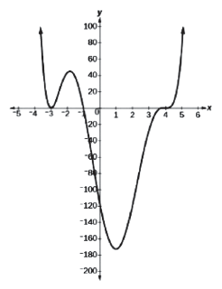
Graphs of Polynomial Functions
Example 2: Identify the zero/es and multiplicity/ies of the graph at the right.
Solution:
Starting from the left, the fi rst zero occurs at x = -3. The
graph touches the x-axis, so the multiplicity of the zero must be
even. That is, the zero of -3 has multiplicity 2.
The next zero occurs at x = -1. The graph looks almost
linear at this point. This is a single zero of multiplicity 1 because
it passes through the x-axis.
The last zero occurs at x = 4. The graph crosses the
x-axis, so the multiplicity of the zero must be odd.

Slide 10
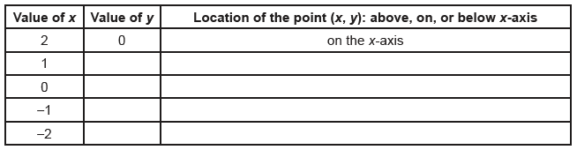
End Behavior of Polynomial Graph
In your previous lesson, you learned that the graph of a quadratic equation is a parabola that opens upward when the leading coefficient is positive and opens downward when the leading coefficient is negative. In the next activity, you will investigate how the behavior of the other polynomial function graph is affected when the value of the leading coefficient changes.
Activity 1: Even Degree Polynomials
Example: Quadratic functions f (x) = ax²
Quartic functions f (x) = ax⁴
Given the function f (x) = (x + 3)(x - 4)(x - 2)(x + 1), complete the table below.

Slide 11
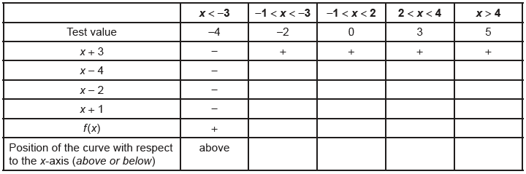
End Behavior of Polynomial Graph
The following table can be transformed into a “table of signs” table by using the roots of the function. The roots x = -3, x = 4, x = 2, and x = -1 are also the x-intercepts of the graph.
Given: f (x) = (x + 3)(x - 4)(x - 2)(x + 1)
Sketch the graph.

Slide 12
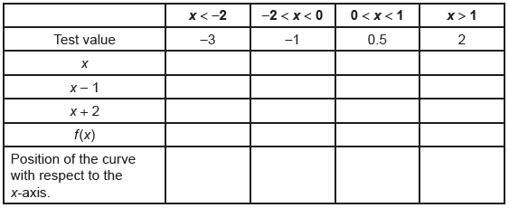
End Behavior of Polynomial Graph
Activity 2: Odd Degree Polynomials
Example: Cubic Functions f (x) = ax 3
Graph (manually or by a graphing tool) and observe the changes of the following functions:
a. f (x) = x³ b. f (x) = 2x³ + 3 c. f (x) = -2x³ – 3
Using the table of signs, sketch the graph of f (x) = x(x - 1)(x + 2):
Sketch the graph.

Slide 13
End Behavior of Polynomial Graph
Activity 3: Determine the end behavior of the polynomial functions below by using the value of the leading coefficient and degree.
1. f (x) = -4x³ - 3x² + 5x + 6
sign of the leading coefficient – ______________
degree – ______________
end behavior – x → -∞, f (x) → ______________ and x → ∞, f (x) → ______________
2. p(x) = x⁶ - 7x⁵ + x³ - 2
sign of the leading coefficient – ______________
degree – ______________
end behavior – x → -∞, f (x) → ______________ and x → ∞, f (x) → ______________

Slide 14
End Behavior of Polynomial Graph
The previous activities relate the even and odd degrees of polynomial equations and their corresponding end behavior. You have observed that the graph of even degree polynomials behave, on their ends, like a parabola, while odd degree polynomials behave, on their ends, like the graph of a cubic function.
Even degree polynomial functions with positive leading coefficients have both ends upward and ends downward when the leading coefficient is negative. The left part of the graph of polynomial functions with an odd degree and a positive leading coefficient ends downward, while its right ends upward. But when an odd degree polynomial function has a negative leading coefficient, then its left portion ends upward and right portion ends downward.

Slide 15
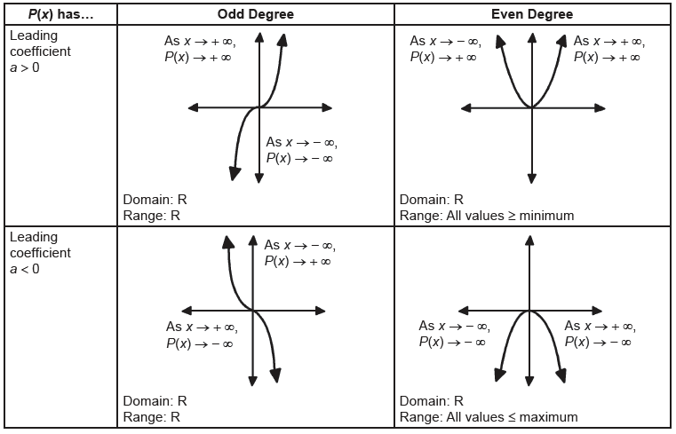
End Behavior of Polynomial Graph

