Slide 1
Problems Involving Polynomial Functions

Slide 2
Problems Involving Polynomial Functions
Polynomial functions are widely used to represent real-life problems. To solve word problems involving polynomial functions, consider the following steps:
Step 1: Write the equation of polynomial functions in standard form.
Step 2: Set the function to zero.
Step 3: Use factoring strategies or the Quadratic Formula to solve the equation and use the Zero Product Property to solve for the values of the unknown.
Step 4: Check your answer if it is appropriate to the needed information in the problem.
Step 5: Graph if necessary.

Slide 3
Problems Involving Polynomial Functions
Let us consider the following examples:
Example 1: A car started to travel 8 kilometers from City 1 to City 2. The table below shows the readings of the time (in minutes) from City 1 and the corresponding distance (in kilometers) from City 1.
a. Plot the graph.
b. By drawing a tangent, find the approximate speed of the car 5 minutes after it has left City 1.
c. Using the slope of the graph, compare and describe briefly the motion of the car during the first 4 minutes and the last 4 minutes of the journey.

Slide 4
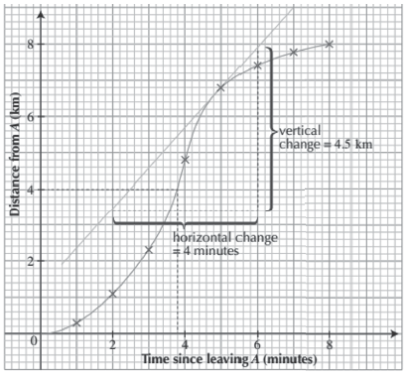
Problems Involving Polynomial Functions
Solution:
a.

Slide 5

Problems Involving Polynomial Functions
b. The slope of the tangent at the point 4 minutes after it left City 1 gives the speed at that particular point. It is called the instantaneous speed. A tangent is drawn to the curve at the point 4 minutes after it has left City 1.
Slope, m = vertical change
horizontal change
Therefore, the speed of the car is around 67.5 km/h.
c. During the first 4 minutes, the speed of the car increases as the slope of the curve increases. Meanwhile, during the last 4 minutes, the speed of the car decreases as the slope of the curve decreases.

Slide 6
Problems Involving Polynomial Functions
Example 2: Mario shoots a trick basketball shot upward that is represented by the equation h = -16t² + 32t + 48, where h is the height of the ball in feet, and t is the time in seconds. How long will it take for Mario’s basketball to hit the ground?
Solution:
Note that h represents the height of the ball at any given time, so when an object hits the ground, its height above the ground is zero. Therefore, h = 0
h = -16t² + 32t + 48
0 = -16t² + 32t + 48 Set h = 0.
0 = -16(t² + 2t – 3) Factor out the GCF (-16).
0 = -16(t - 3)(t + 1) Factor the trinomial.
0 = (t - 3)(t + 1) Divide both sides by -16.
t + 1 = 0 t - 3 = 0 Set each linear factor to 0.
t = -1 t = 3 Solve for the values of x.
Since t represents time, it cannot be negative. Therefore, the time for the ball to hit the ground is 3 seconds.

Slide 7
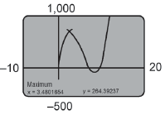
Problems Involving Polynomial Functions
Example 3: A man plans to construct an open box from 18.5 feet by 24.5 feet sheet of metal by cutting squares from the corners and folding up the sides. Find the maximum volume of the box and the corresponding dimensions.
Solution:
Use the formula for volume: V = lwh
Find the formula to represent the volume: V(x) = x(18.5 - 2x)
(24.5 – 2x)
Graph V(x). Note that the values of x that are greater than
9.25 or are less than 0 do not make sense for this problem.
The graph has a local maximum of about 704 when x =
3.48. So, the largest open box will have a volume of 704 cubic feet.

