Slide 1
Square of a Binomial

Slide 2
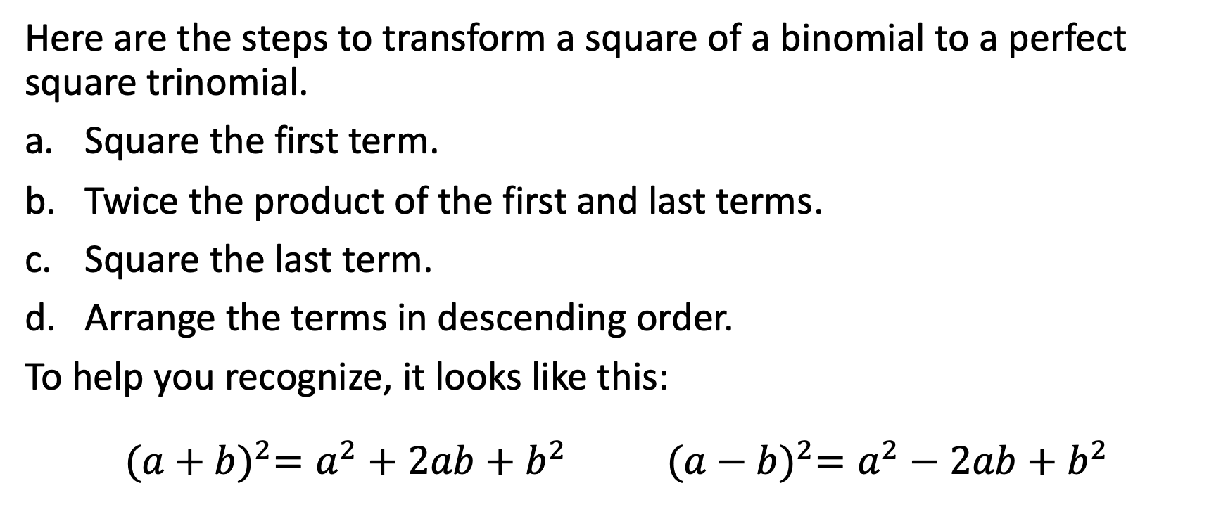
Square of a Binomial
Here are the steps to transform a square of a binomial to a perfect square trinomial.
Square the first term.
Twice the product of the first and last terms.
Square the last term.
Arrange the terms in descending order.
To help you recognize, it looks like this:
$${(a+b)}^{2}=a^{2}+2ab+b^{2} {(a−b)}^{2}=a^{2}−2ab+b^{2}$$

Slide 3
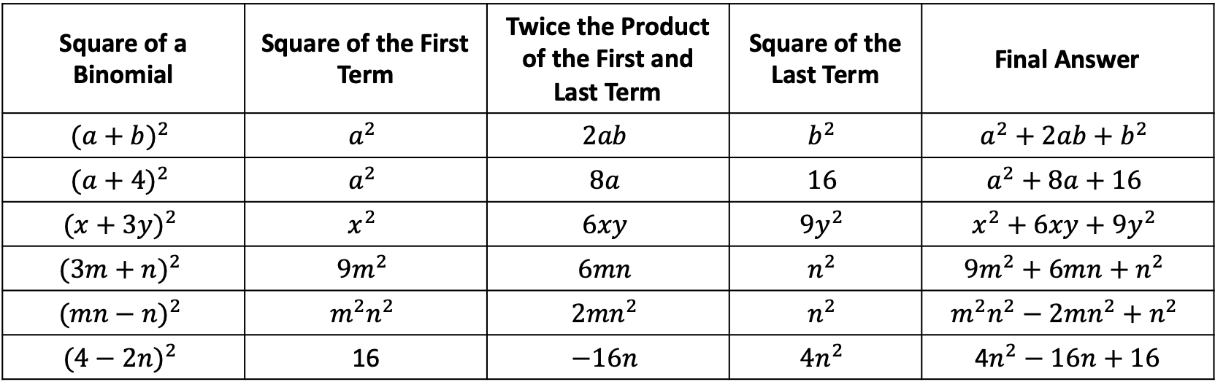
Square of a Binomial
Find the trinomial product of the following.
Square of a Binomial | Square of the First Term | Twice the Product of the First and Last Term | Square of the Last Term | Final Answer
$${(a+b)}^{2}$$ | $$a^{2}$$ | $$2ab$$ | $$b^{2}$$ | $$a^{2}+2ab+b^{2}$$
$${(a+4)}^{2}$$ | $$a^{2}$$ | $$8a$$ | $$16$$ | $$a^{2}+8a+16$$
$${(x+3y)}^{2}$$ | $$x^{2}$$ | $$6xy$$ | $${9y}^{2}$$ | $$x^{2}+6xy+{9y}^{2}$$
$${(3m+n)}^{2}$$ | $${9m}^{2}$$ | $$6mn$$ | $$n^{2}$$ | $${9m}^{2}+6mn+n^{2}$$
$${(mn−n)}^{2}$$ | $$m^{2}n^{2}$$ | $$2{mn}^{2}$$ | $$n^{2}$$ | $$m^{2}n^{2}−2mn^{2}+n^{2}$$
$${(4−2n)}^{2}$$ | 16 | $$−16n$$ | $${4n}^{2}$$ | 4$n^{2}−16n+16$

Slide 4
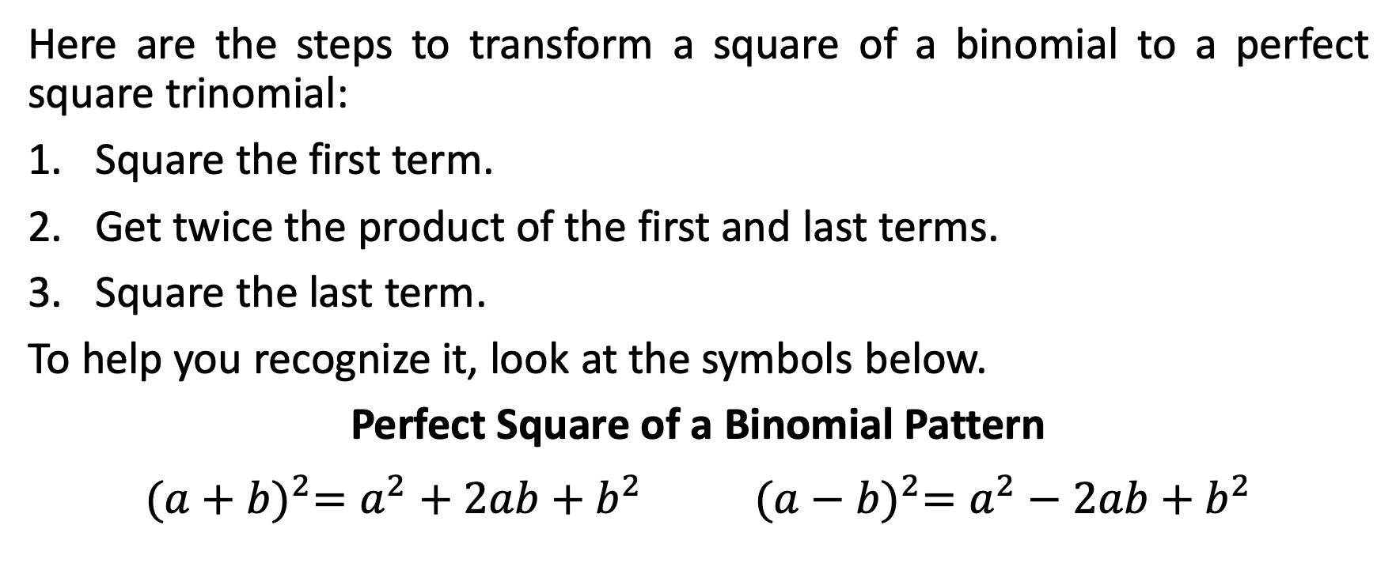
Square of a Binomial
Here are the steps to transform a square of a binomial to a perfect square trinomial:
Square the first term.
Get twice the product of the first and last terms.
Square the last term.
To help you recognize it, look at the symbols below.
Perfect Square of a Binomial Pattern
$${(a+b)}^{2}=a^{2}+2ab+b^{2} {(a−b)}^{2}=a^{2}−2ab+b^{2}$$

Slide 5
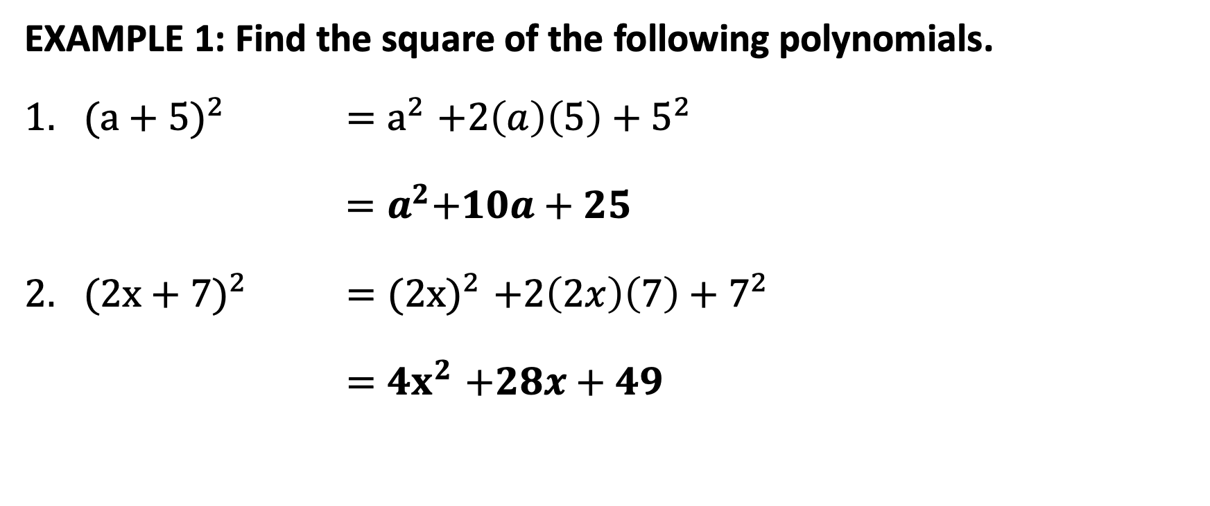
Square of a Binomial
EXAMPLE 1: Find the square of the following polynomials.
${(a+5)}^{2}$ ${=a}^{2}+2\left(a\right)\left(5\right)+5^{2}$
${ =a}^{2}+10a+25$
${(2x+7)}^{2}$ ${=(2x)}^{2}+2\left(2x\right)\left(7\right)+7^{2}$
${=4x}^{2}+28x+49$

Slide 6
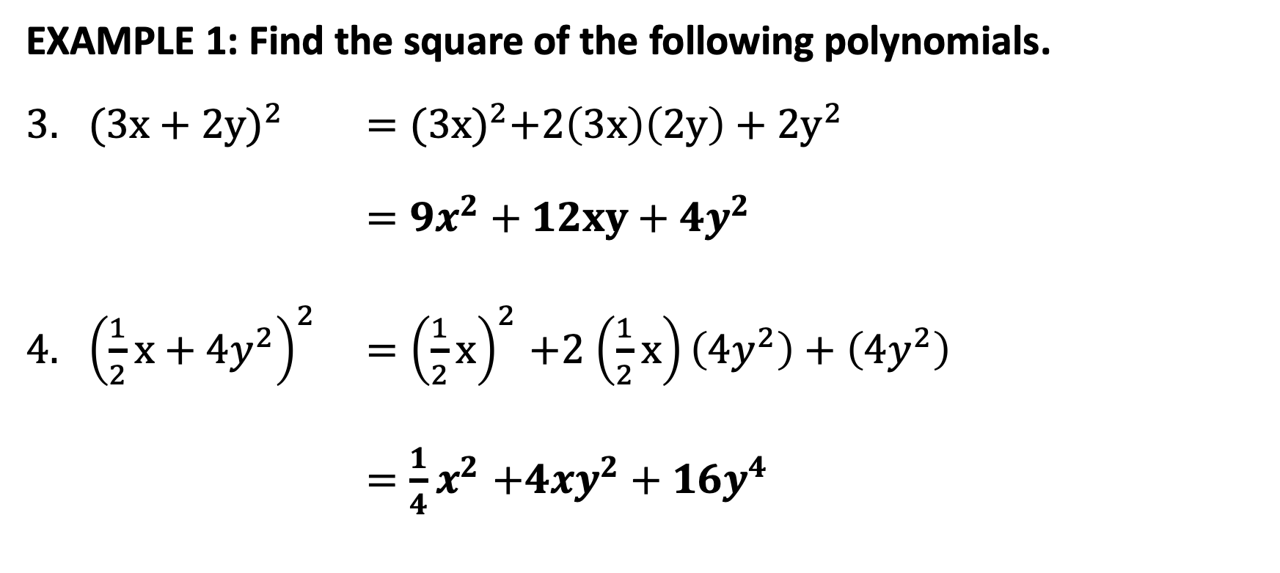
Square of a Binomial
EXAMPLE 1: Find the square of the following polynomials.
${(3x+2y)}^{2}$ $={(3x)}^{2}+2\left(3x\right)\left(2y\right)+$ ${2y}^{2}$
$={9x}^{2}+12xy+$ ${4y}^{2}$
${\left(\frac{1}{2}x+{4y}^{2}\right)}^{2}$ ${=\left(\frac{1}{2}x\right)}^{2}+2$ $\left(\frac{1}{2}x\right)\left(4y^{2}\right)+$ $\left(4y^{2}\right)$
${=\frac{1}{4}x}^{2}+{4xy}^{2}+{16y}^{4}$

Slide 7
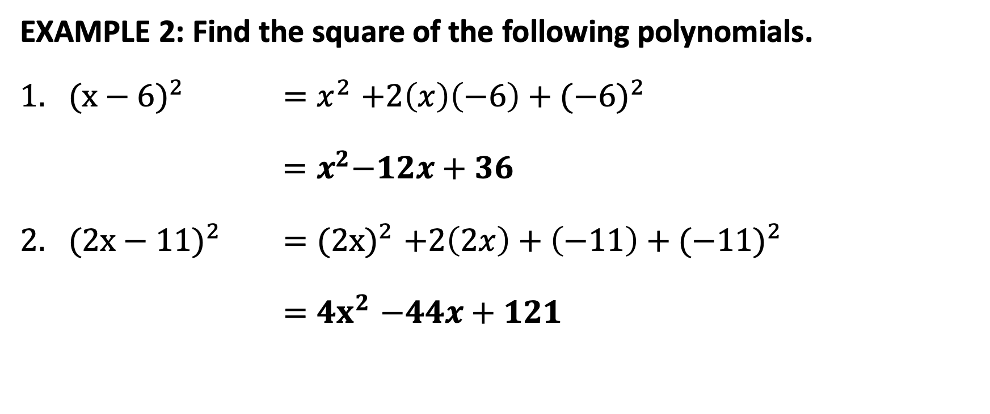
Square of a Binomial
EXAMPLE 2: Find the square of the following polynomials.
${(x−6)}^{2}$ ${=x}^{2}+2\left(x\right)\left(−6\right)+{(−6)}^{2}$
${ =x}^{2}−12x+36$
${(2x−11)}^{2}$ ${=(2x)}^{2}+2\left(2x\right)+\left(−11\right)+({−11)}^{2}$
${=4x}^{2}−44x+121$

Slide 8
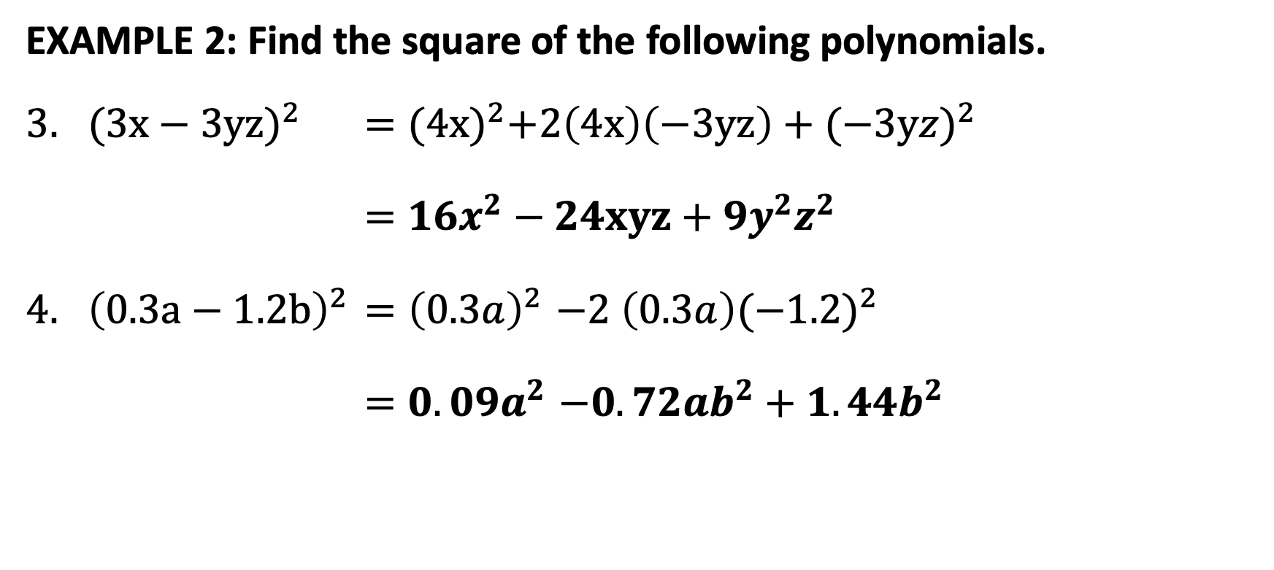
Square of a Binomial
EXAMPLE 2: Find the square of the following polynomials.
${(3x−3yz)}^{2}$ $={(4x)}^{2}+2\left(4x\right)\left(−3yz\right)+(−{3yz)}^{2}$
$={16x}^{2}−24xyz+$ ${9y}^{2}z^{2}$
${\left(0.3a−1.2b\right)}^{2}$ ${=\left(0.3a\right)}^{2}−2$ $\left(0.3a\right){(−1.2)}^{2}$
${=0.09a}^{2}−{0.72ab}^{2}+{1.44b}^{2}$

Slide 9
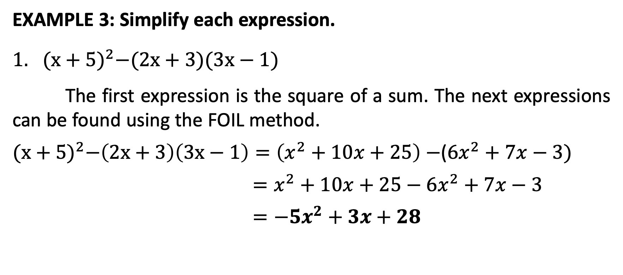
Square of a Binomial
EXAMPLE 3: Simplify each expression.
${(x+5)}^{2}−(2x+3)(3x−1)$
The first expression is the square of a sum. The next expressions can be found using the FOIL method.
${(x+5)}^{2}−\left(2x+3\right)\left(3x−1\right)=\left(x^{2}+10x+25\right)−$(${6x}^{2}+7x−3)$
$=x^{2}+10x+25−{6x}^{2}+7x−3$
$={−5x}^{2}+3x+28$

Slide 10
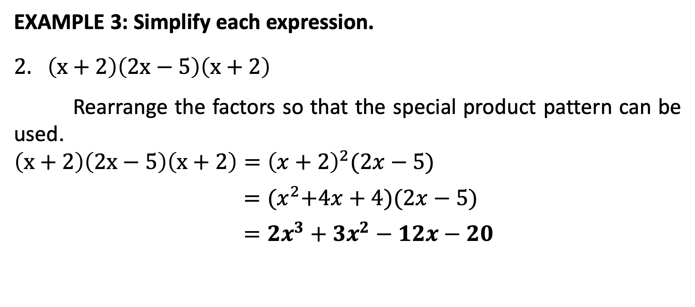
Square of a Binomial
EXAMPLE 3: Simplify each expression.
$\left(x+2\right)\left(2x−5\right)\left(x+2\right)$
Rearrange the factors so that the special product pattern can be used.
$$\left(x+2\right)\left(2x−5\right)\left(x+2\right)={\left(x+2\right)}^{2}(2x−5)$$
$={(x}^{2}+4x+4)(2x−5)$
$={2x}^{3}+$ ${3x}^{2}−12x−20$

