Slide 1
Cube of a Binomial

Slide 2
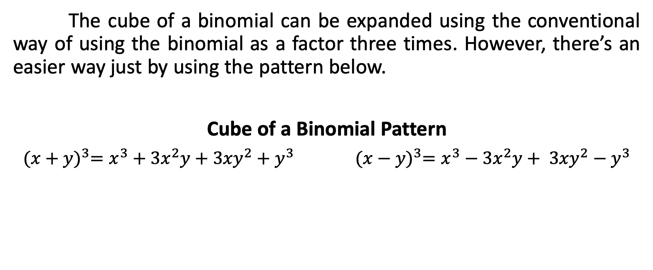
Cube of a Binomial
The cube of a binomial can be expanded using the conventional way of using the binomial as a factor three times. However, there’s an easier way just by using the pattern below.
Cube of a Binomial Pattern
${(x+y)}^{3}=x^{3}+{3x}^{2}y+$ ${3xy}^{2}+$ $y^{3} {(x−y)}^{3}=x^{3}−{3x}^{2}y+ {3xy}^{2}−y^{3}$

Slide 3
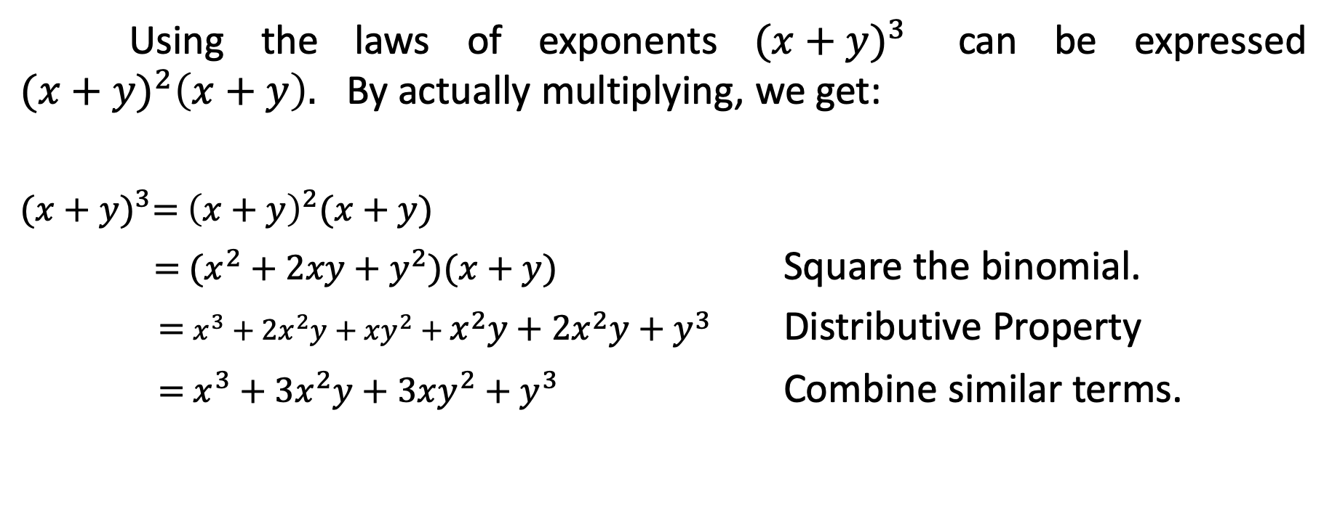
Cube of a Binomial
Using the laws of exponents ${(x+y)}^{3}$ can be expressed ${(x+y)}^{2}{\left(x+y\right).}^{}$By actually multiplying, we get:
${(x+y)}^{3}=$ ${\left(x+y\right)}^{2}(x+y)$
$=$ $(x^{2}+2xy+y^{2})(x+y)$ Square the binomial.
$=$ $x^{3}+2x^{2}y+xy^{2}+x^{2}y+2x^{2}y+y^{3}$ Distributive Property
$=$ $x^{3}+3x^{2}y+3xy^{2}+y^{3}$ Combine similar terms.

Slide 4
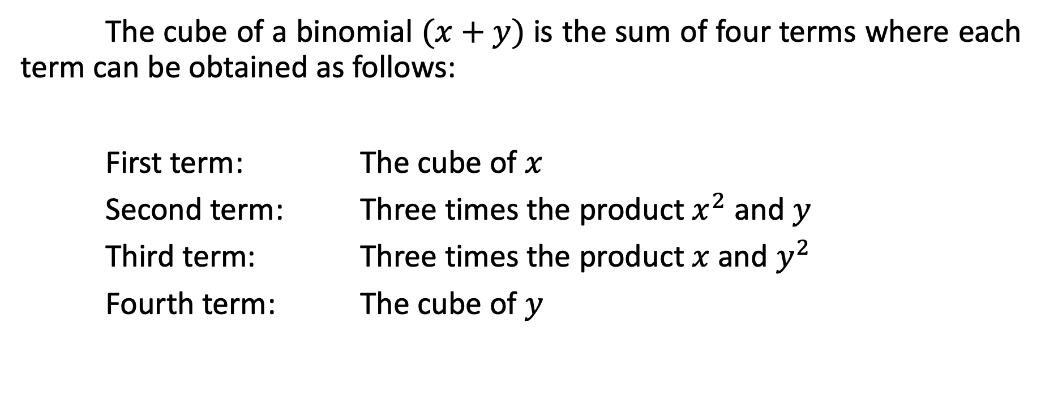
Cube of a Binomial
The cube of a binomial $(x+y)$ is the sum of four terms where each term can be obtained as follows:
First term: The cube of $x$
Second term: Three times the product $x^{2}$ and $y$
Third term: Three times the product $x$ and $y^{2}$
Fourth term: The cube of $y$

Slide 5

Cube of a Binomial
Find the cube of the following binomials.
${(3x+4)}^{3}$
${(2x−5y)}^{3}$
${({5x}^{2}+y)}^{3}$
${[a+\left(2b+3\right)]}^{3}$

Slide 6
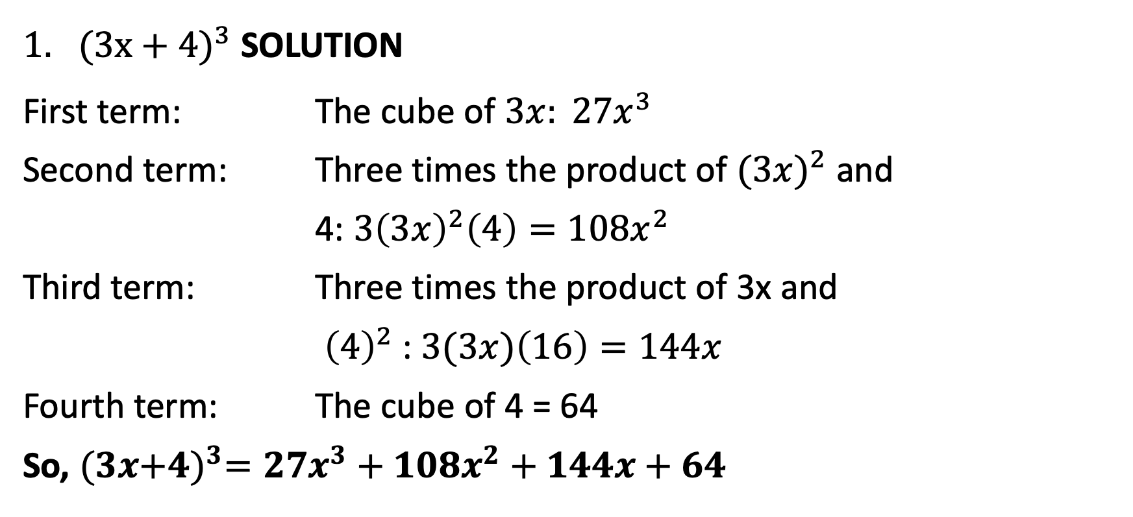
Cube of a Binomial
${(3x+4)}^{3}$ SOLUTION
First term: The cube of $3x: {27x}^{3}$
Second term: Three times the product of ${(3x)}^{2}$ and
4: $3{\left(3x\right)}^{2}\left(4\right)={108x}^{2}$
Third term: Three times the product of 3x and
${\left(4\right)}^{2}$: $3(3x)\left(16\right)=144x$
Fourth term: The cube of 4 = 64
So, $(3x{+4)}^{3}={27x}^{3}+{108x}^{2}+144x+64$

Slide 7
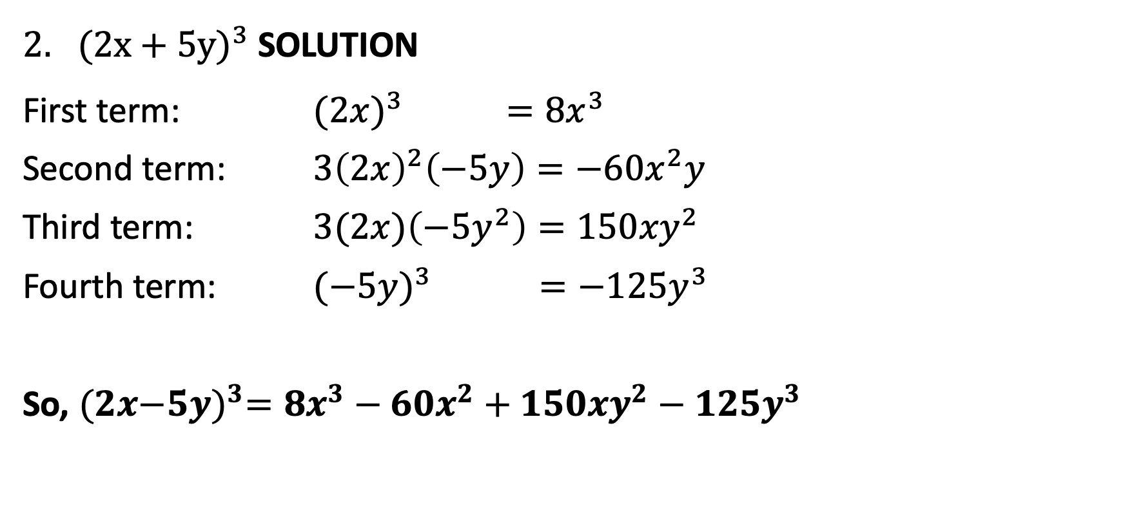
Cube of a Binomial
${(2x+5y)}^{3}$ SOLUTION
First term: ${(2x)}^{3}$ $={8x}^{3}$
Second term: ${3\left(2x\right)}^{2}\left(−5y\right)=−60x^{2}y$
Third term: $3(2x)\left({−5y}^{2}\right)=150{xy}^{2}$
Fourth term: ${(−5y)}^{3} =−125y^{3}$
So, $(2x{−5y)}^{3}={8x}^{3}−60x^{2}+{150xy}^{2}−125y^{3}$

Slide 8

Cube of a Binomial
${({5x}^{2}+y)}^{3}$ SOLUTION
$={{(5x}^{2})}^{3}+$ ${{3(5x}^{2})}^{2}\left(3y\right)+{3(5x}^{2}){( 3y)}^{2}+{(3y)}^{3}$
$={125x}^{6}+$ ${225x}^{4}y+{135x}^{2}y^{2}+{27y}^{3}$

Slide 9
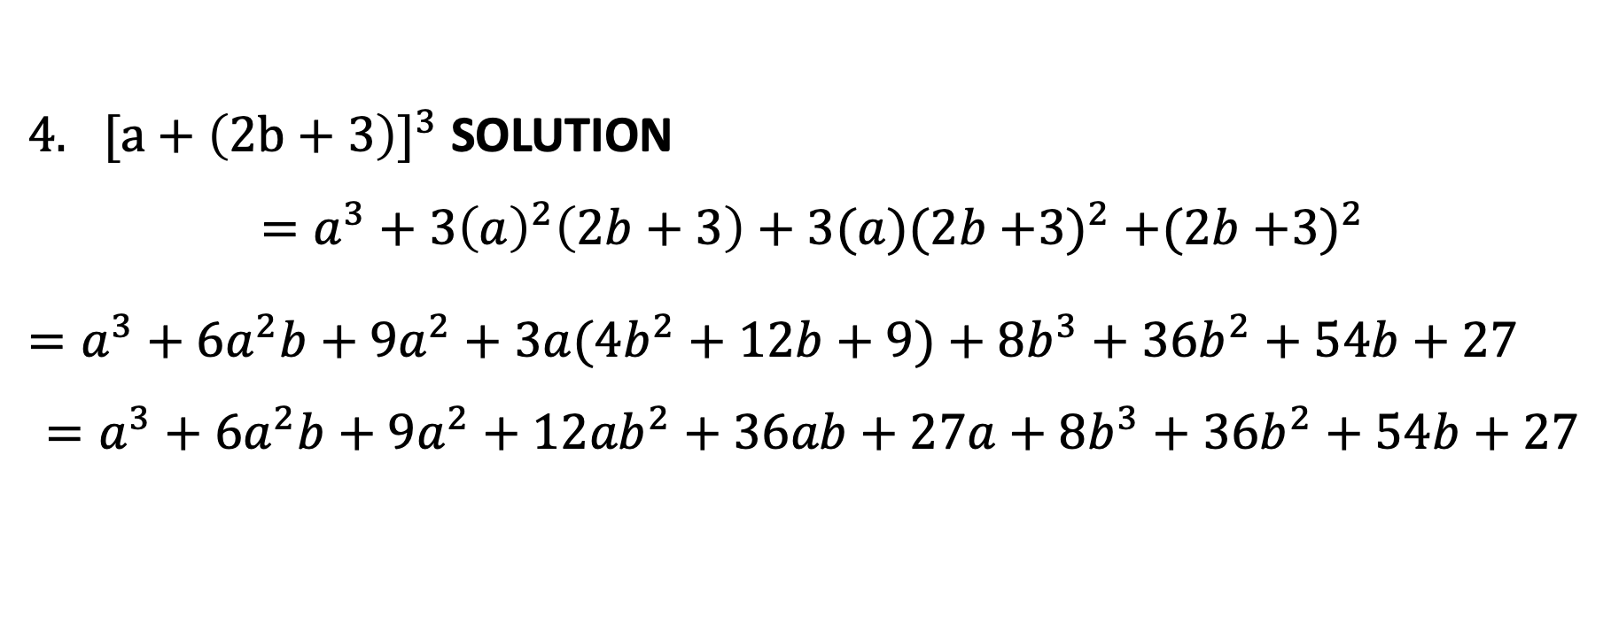
Cube of a Binomial
${[a+\left(2b+3\right)]}^{3}$ SOLUTION
$$=a^{3}+{3\left(a\right)}^{2}\left(2b+3\right)+3(a)(2b{+3)}^{2}+(2b{+3)}^{2}$$
$=a^{3}+{6a}^{2}b+{9a}^{2}+{3a(4b}^{2}+12b+9)+{8b}^{3}+$ ${36b}^{2}+54b+27$
$$=a^{3}+{6a}^{2}b+{9a}^{2}+{12ab}^{2}+36ab+27a+{8b}^{3}+{36b}^{2}+54b+27$$

Slide 10
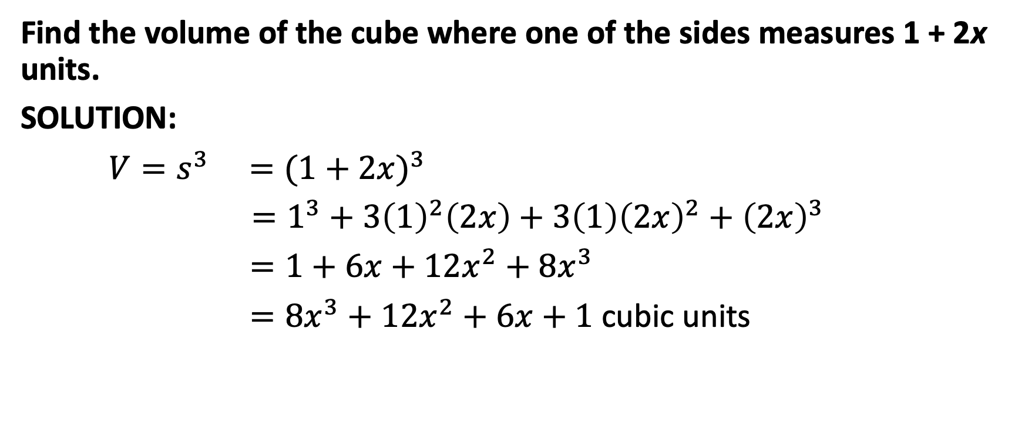
Cube of a Binomial
Find the volume of the cube where one of the sides measures 1 + 2x units.
SOLUTION:
$V=s^{3} ={(1+2x)}^{3}$
$={1^{3}+3\left(1\right)}^{2}\left(2x\right)+3\left(1\right){\left(2x\right)}^{2}+{\left(2x\right)}^{3}$
$=1+6x+{12x}^{2}+{8x}^{3}$
$={8x}^{3}+$ ${12x}^{2}+6x+1$ cubic units

