Slide 1

ADDITION AND SUBTRACTION OF POLYNOMIALS

Slide 2


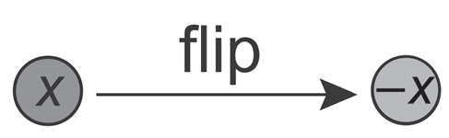
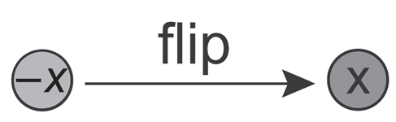
BASIC ALGEBRAIC RULES
Algebra disc has two sides. If one side shows the number 1, the other side shows the number -1.
Similarly, for an algebra disc where one side shows the variable x, the other side will show -x.
To obtain the negative of x, we fl ip the disc with x as shown:
To obtain the negative of -x, we flip the disc with -x as shown:
We write -(x) = -x.
We write -(-x) = x.

Slide 3



BASIC ALGEBRAIC RULES
If we put two discs x and -x together, we will get a zero pair.
We can use algebra discs to represent algebraic terms, e.g., we use three x discs to represent 3x.
We use three discs to represent -3x.
We write x + (-x) = 0.
3x = x + x + x
-3x = (-x) + (-x) + (-x)

Slide 4
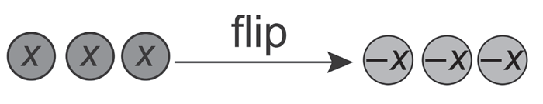
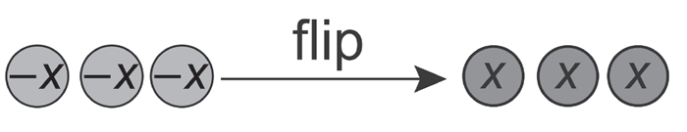
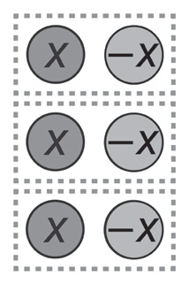
BASIC ALGEBRAIC RULES
To obtain the negative of 3x, i.e., (-3x), we flip the three x discs as shown:
To obtain the negative of -3x, i.e., -(-3x), we flip the three -x discs as shown:
What happens if we put three x discs and three -x discs together?
We write -(3x) = -3x.
We write -(-3x) = 3x.
We write 3x + (-3x) = 0.

Slide 5
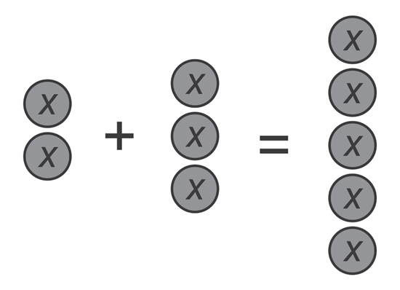
ADDITION OF LIKE AND UNLIKE TERMS
In algebra, like terms are terms that have the same variables. Examples of like terms are 2x and 5x, 7y and -2y, and xy and yx. When two terms are not like terms, they are known as unlike terms. Some examples of unlike terms are 2x and 2y, x²y, and y²x.
We will show how to carry out the addition of linear expressions using algebra discs.
Example 1: 2x + 3x
Therefore, 2x + 3x = 5x.

Slide 6
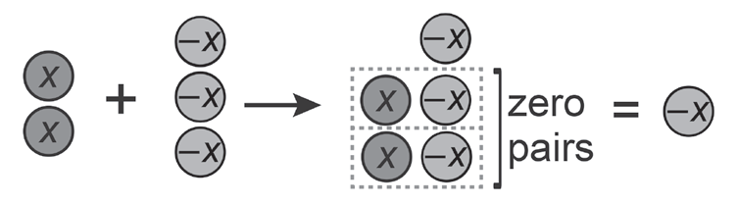
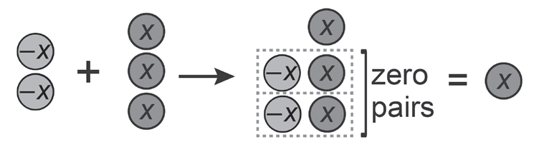
ADDITION OF LIKE AND UNLIKE TERMS
Example 2: 2x + (-3x)
Therefore, 2x + (-3x) = -x.
Example 3: -2x + 3x
Therefore, -2x + 3x = x.

Slide 7
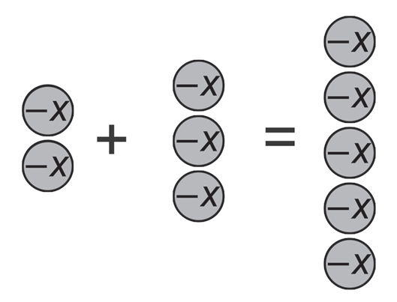
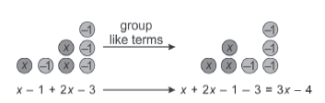
ADDITION OF LIKE AND UNLIKE TERMS
Example 4: -2x + (-3x)
Therefore, -2x + (-3x) = -5x.
Example 5: (x – 1) + (2x – 3)
Therefore, (x -1) + (2x - 3) = (x + 2x) +
(-1 - 3) (group like terms) = 3x - 4

Slide 8
ADDITION OF LIKE AND UNLIKE TERMS
Example 7: (2x² – 3x + 11) + (7x² – 3x – 4)
= 2x² + 7x² – 3x – 3x + 11 – 4 (group like terms)
= 9x² – 6x + 7

Slide 9
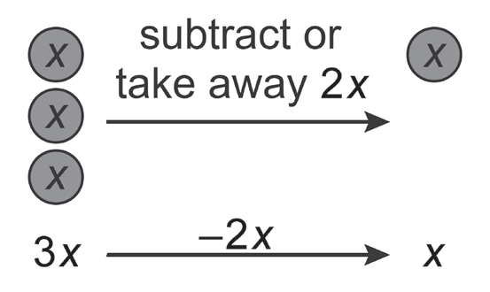
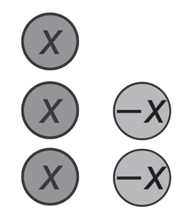
SUBTRACTION OF LIKE AND UNLIKE TERMS
Example 8: 3x – 2x
Therefore, 3x -2x = x
As 3x + (- 2x) = x , we can write 3x – 2x as 3x + (-2x) and represent 3x – 2x using algebra discs:

Slide 10
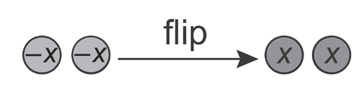
SUBTRACTION OF LIKE AND UNLIKE TERMS
Example 9: 3x – (- 2x)
To obtain the negative of -2x, i.e., -(-2x), we flip the discs as shown:
we write - (-2x) = 2x
Therefore, 3x - (-2x) = 3x + 2x
= 5x

Slide 11
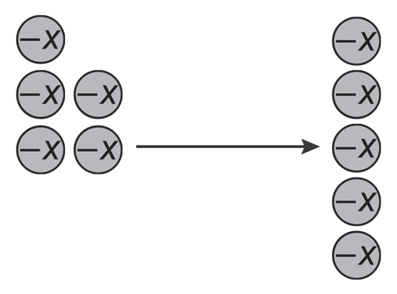
SUBTRACTION OF LIKE AND UNLIKE TERMS
Example 10: -3x –2x = 3x +(2x)
Therefore, -3x -2x = -3x + (-2x)
= -5x

Slide 12
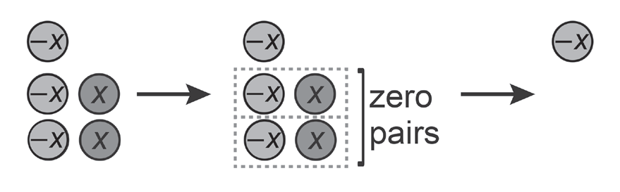
SUBTRACTION OF LIKE AND UNLIKE TERMS
Example 11: -3x –(-2x)
As -(-2x) = 2x, -3x -(-2x) = -3x + 2x
Therefore, -3x -(-2x) = -3x + 2x
= -x

Slide 13
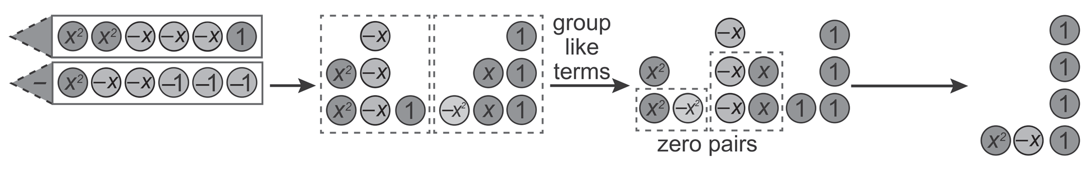
SUBTRACTION OF LIKE AND UNLIKE TERMS
Example 12: 2x² -3x + 1 – (x² – 2x - 3)
Solution:
(2x² – 3x + 1) – (x² – 2x – 3) = 2x² – 3x + 1 -x² + 2x + 3
= 2x2– x² – 3x + 2x + 1 + 3 (put together like terms)
= x2 -x + 4
Therefore, 2x² – 3x + 1 – (x² – 2x – 3) = x² – x + 4

Slide 14
ACTIVITY

Slide 15
INSTRUCTION: Perform the indicated operation.
1. Simplify the expression 9y + 3 – 4x – 2y -3x – 5 by combining like terms.
a. Group like terms: (9y - _____) (-4x - _____) (3 - _____)
b. Combine like terms:( ___ y) + (- ___ x) + ( ___)
c. Final Answer: ________________________
2. Add: (10a + 10b – 3c) + (7a + 6b + 9c)
a. Rewrite the expression without the parenthesis. __________________ + __________________
b. Group like terms: (10a + _____) + (10b + _____) + (-3c + _____)
c. Combine like terms: (______) + (______) + (______)
d. Final Answer:________________________________
3. Subtract: (12x + 7) - (3x - 13)
a. Get the opposite of the subtrahend: (3x - 13) _______________________
b. Rewrite as an addition problem. (12x + 7) + (_______________)
c. Rewrite the expression without the parenthesis. __________________ + __________________
d. Group like terms: ________________________________
e. Combine like terms: ________________________________
f. Final Answer: ________________________________

