Slide 1
MULTIPLICATION AND DIVISION OF POLYNOMIALS

Slide 2
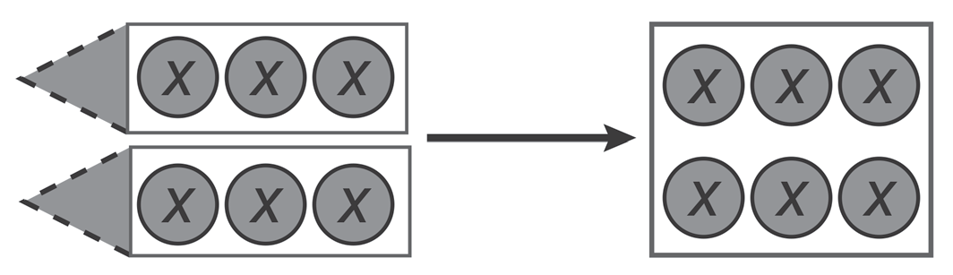
MULTIPLYING A MONOMIAL BY ANOTHER MONOMIAL
2(3x) can be represented by 2 groups of 3x:
Therefore, 2(3x) = 6x.
Notice that the 6 in ‘6x’ is obtained by multiplying 3 by 2. In general, when we multiply a monomial by another monomial containing the same variable, the coefficients and the variable are multiplied separately.
2(3x)
6x

Slide 3
MULTIPLYING A MONOMIAL BY ANOTHER MONOMIAL
RULE: when we multiply a monomial by another monomial containing the same variable, the coefficients and the variable are multiplied separately.
Example 1: (x³y5 )(x⁵y⁶ ) = (x³ ⁺ ⁵ )(y⁶ ⁺ ⁵ )
= (x8 )(y11) Multiply the literal coefficients.
= x8y11 Multiply the results.
Example 2: (-6x¹²y⁹z⁷ )(-9x⁸y¹⁴z¹⁹ )
= [(-6)(-9)](x¹²⁺⁸ )(y⁹⁺¹⁴ )(z⁷⁺¹⁹) Rearrange the coefficients and the variables accordingly.
= 54(x²⁰)(y²³)(z²⁶) Multiply the numerical and literal coefficients.
= 54x²⁰y²³z²⁶ Multiply the results.

Slide 4
MULTIPLYING A MONOMIAL BY ANOTHER MONOMIAL
RULE: when we multiply a monomial by another monomial containing the same variable, the coefficients and the variable are multiplied separately.
Example 3: (5x⁹y⁵ )(-3xy¹² )(-2x⁷y)
= [(5)(-3)(-2)](x⁹⁺¹⁺⁷ )(y⁵⁺¹²⁺¹) Rearrange the coefficients and the variables
accordingly.
= 30(x¹⁷ )(y¹⁸ ) Multiply the numerical and literal coefficients.
= 30x¹⁷y¹⁸ Multiply the results.

Slide 5
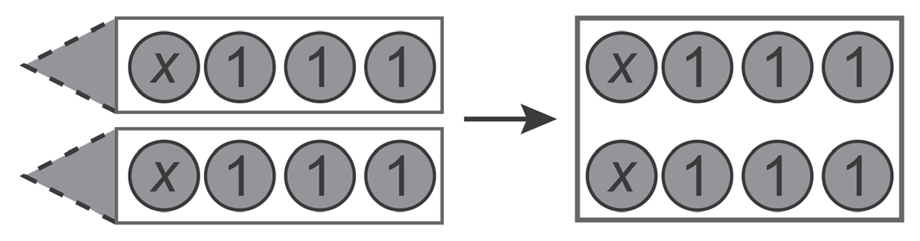
MULTIPLYING A MONOMIAL BY POLYNOMIAL
You have learned how to expand the linear expression 2(x + 3) by representing it as 2 groups of
(x + 3) using algebra discs:
Therefore, 2(x + 3) = 2x + 6.
We can expand quadratic expressions of similar forms using algebra discs.
2(x + 3)
2x + 6

Slide 6
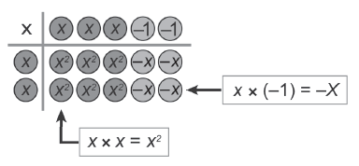
MULTIPLYING A MONOMIAL BY POLYNOMIAL
RULE: We can also simplify quadratic expressions involving the expansion of a quadratic expression using algebra discs.
Example 5: 2x(3x - 2)
We multiply each disc in 3x - 2 by 2x.
Therefore, 2x(3x-2) = 2x(3x) + 2x(-2)
= 6x2- 4x.

Slide 7

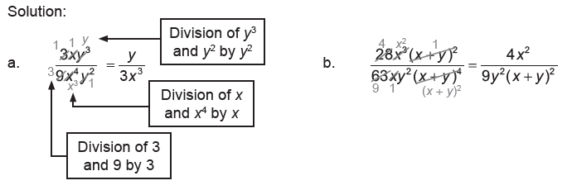
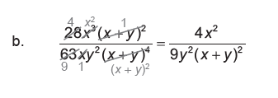
DIVIDING A MONOMIAL BY ANOTHER MONOMIAL
RULE: We obtain the results of dividing monomials by another monomial by dividing the numerators and the denominators by their common terms. The final answers should be in the simplest forms, that is, the numerators and the denominators have no common terms except 1.
Example 6: Simplify each of the following.

Slide 8
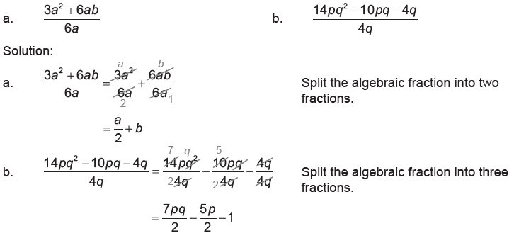
DIVIDING A POLYNOMIAL BY A MONOMIAL
RULE: To divide a polynomial by a monomial, we split the fraction and divide each term of the polynomial by the monomial. This is explained by multiplying the polynomial by the reciprocal of the monomial and applying the distributive law.
Example 7: Simplify each of the following.

Slide 9
ACTIVITY

Slide 10
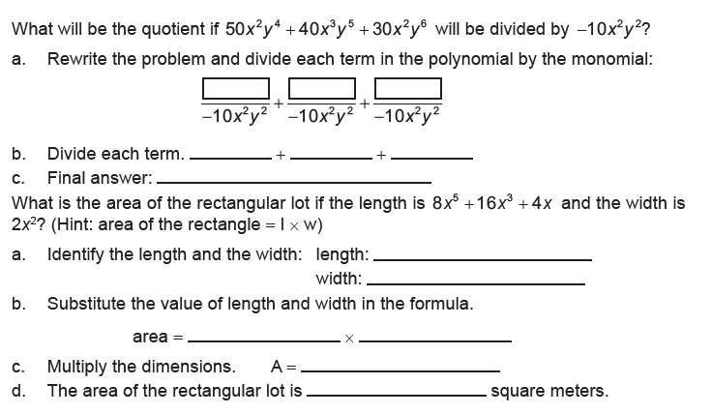
INSTRUCTION: Solve each problem.
1.
2.

Slide 11
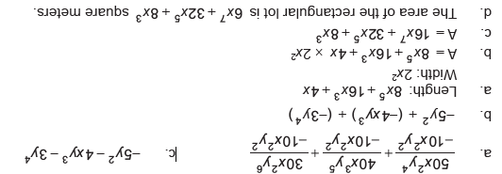
ANSWER KEY:
INSTRUCTION: Solve each problem.
1.
2.

