Slide 1
Product of Two Binomials

Slide 2
Product of Two Binomials
The product of two binomials can be obtained using either the algebra tiles or FOIL method.
Using the FOIL (First, Outer, Inner, Last) method:
Get the product of the first terms.
Get the product of the outer terms.
Get the product of the inner terms.
Get the product of the last terms.

Slide 3
Product of Two Binomials
There are different methods that we can use in multiplying two binomials. Study the following examples to know more about the product of two binomials.

Slide 4

Product of Two Binomials
Example 1: The product of (x + 3) and (x + 5) can be solved using different methods.
Using algebraic titles
$x^{2}+8x+15$

Slide 5
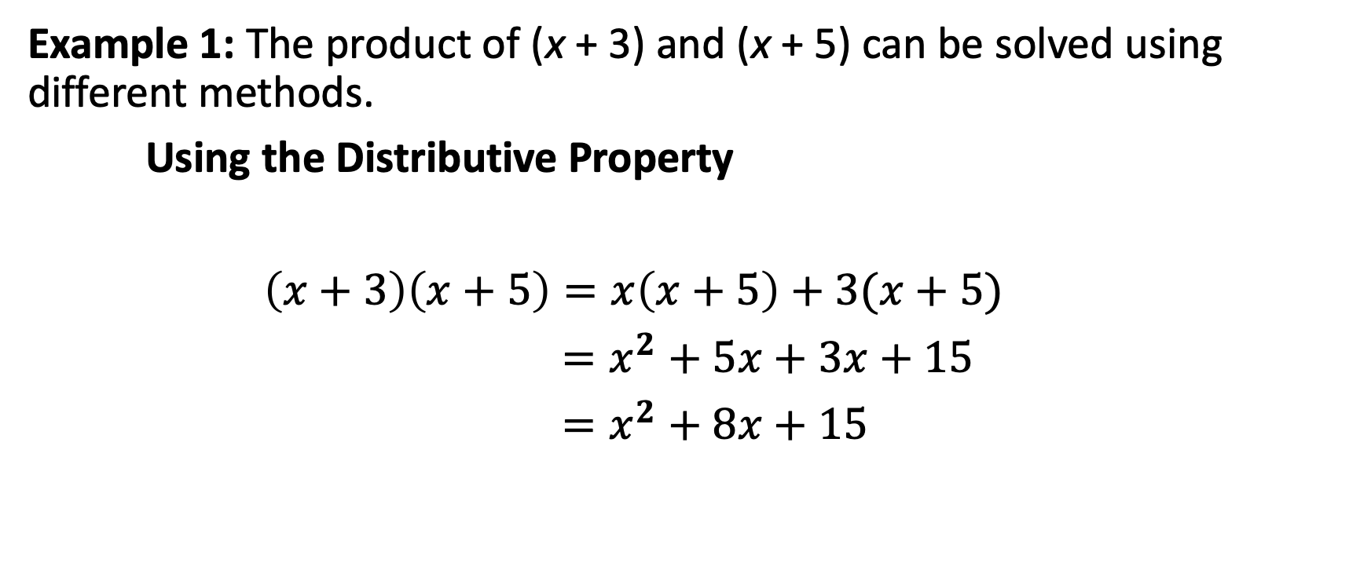
Product of Two Binomials
Example 1: The product of (x + 3) and (x + 5) can be solved using different methods.
Using the Distributive Property
$\left(x+3\right)\left(x+5\right)=x\left(x+5\right)+3(x+5)$
$=x^{2}+5x+3x+15$
$=x^{2}+8x+15$

Slide 6
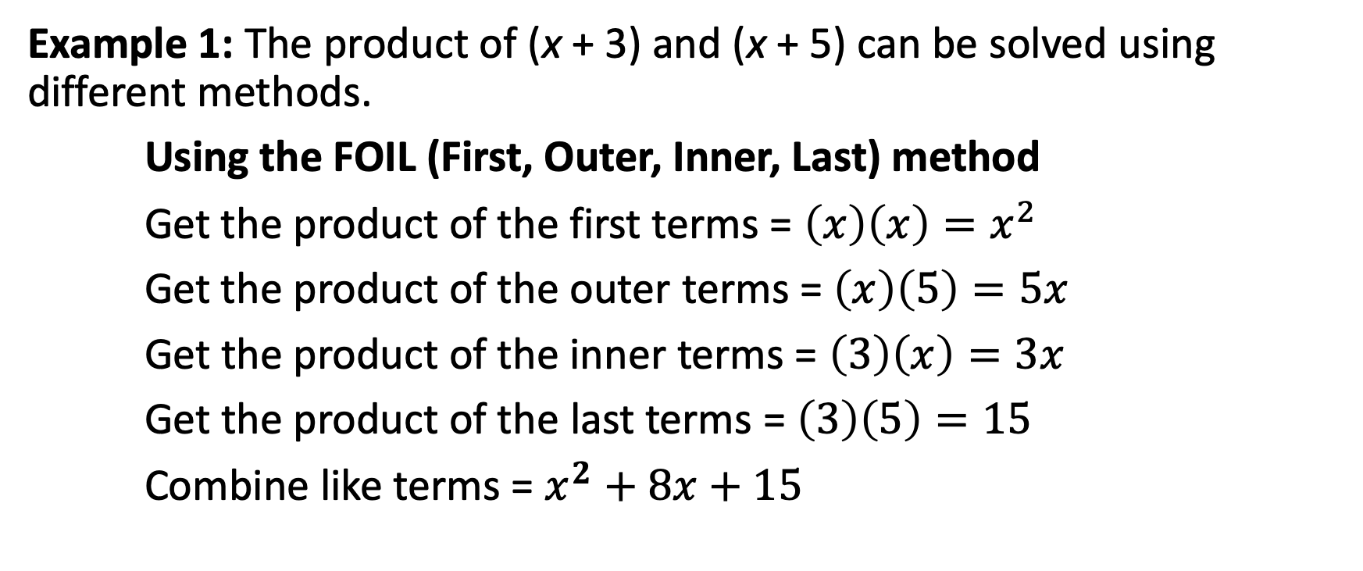
Product of Two Binomials
Example 1: The product of (x + 3) and (x + 5) can be solved using different methods.
Using the FOIL (First, Outer, Inner, Last) method
Get the product of the first terms = $\left(x\right)\left(x\right)=x^{2}$
Get the product of the outer terms = $\left(x\right)\left(5\right)=5x$
Get the product of the inner terms = $\left(3\right)\left(x\right)=3x$
Get the product of the last terms = $\left(3\right)\left(5\right)=15$
Combine like terms = $x^{2}+8x+15$

Slide 7

Product of Two Binomials
Example 2: Find the product of 2x – 1 and x – 4.
Using algebra tiles
$$x^{2}−9x+4$$

Slide 8
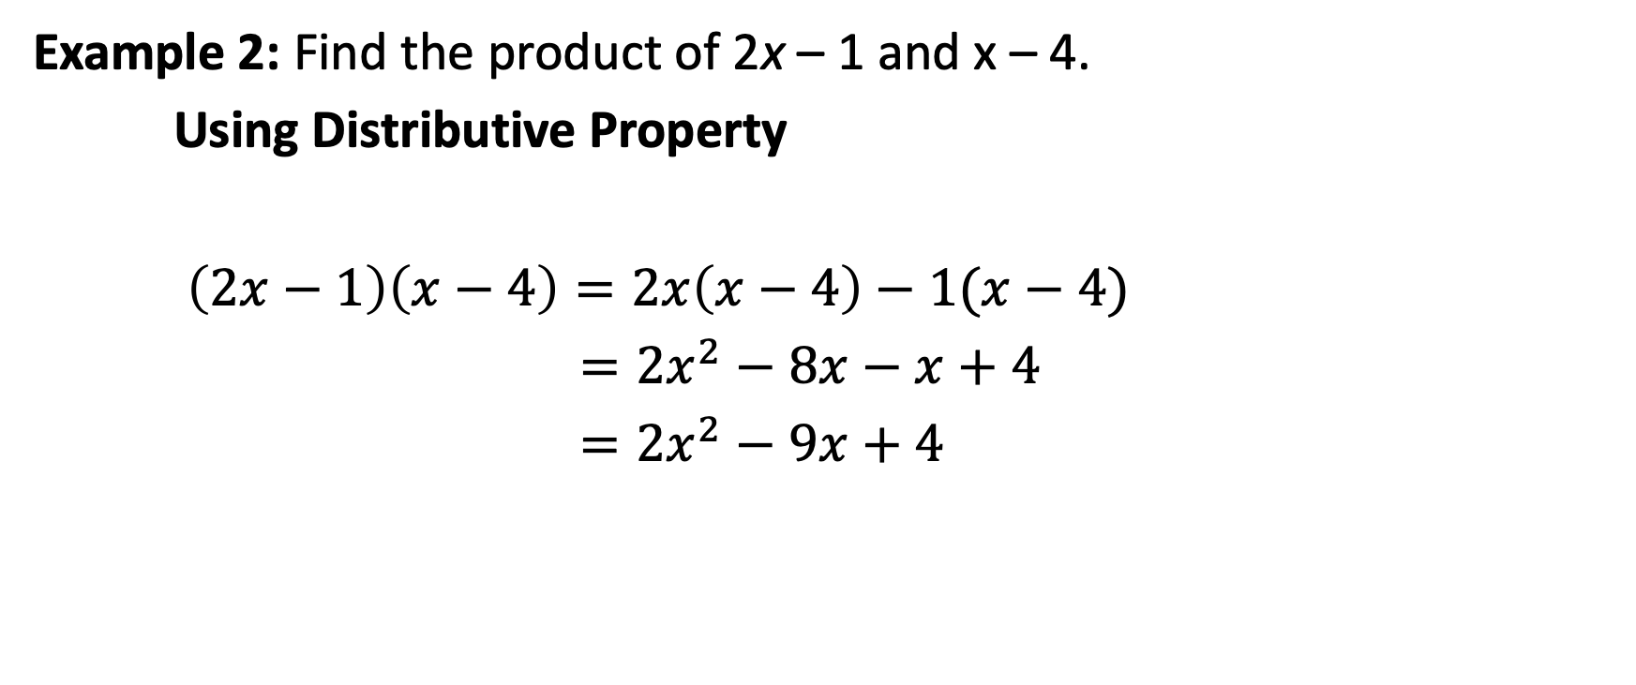
Product of Two Binomials
Example 2: Find the product of 2x – 1 and x – 4.
Using Distributive Property
$\left(2x−1\right)\left(x−4\right)=2x\left(x−4\right)−1(x−4)$
$={2x}^{2}−8x−x+4$
$={2x}^{2}−9x+4$

Slide 9
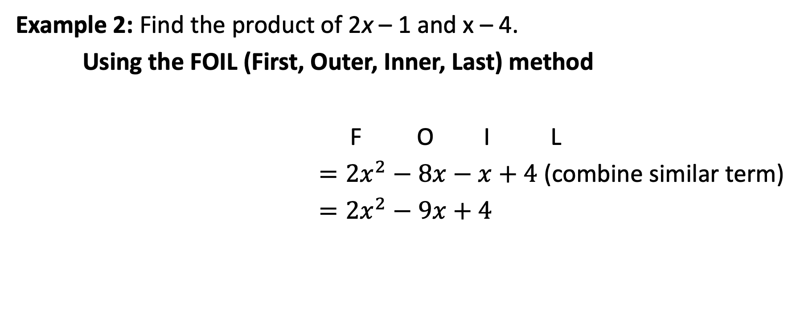
Product of Two Binomials
Example 2: Find the product of 2x – 1 and x – 4.
Using the FOIL (First, Outer, Inner, Last) method
F O I L
$={2x}^{2}−8x−x+4$ (combine similar term)
$={2x}^{2}−9x+4$

