Slide 1
Factoring Polynomials with Common Monomial Factors

Slide 2
Factoring Polynomials with Common Monomial Factors
Factoring a polynomial is the process of rewriting a polynomial as a product of polynomials of smaller degree.
The GCF of two or more monomials is the common factor having the greatest numerical factor and with variables having the least degree.

Slide 3

Factoring Polynomials with Common Monomial Factors
Example of factoring polynomials:
$$x^{2}+2x=x(x+2)$$
${4x}^{2}+6x=2x(2x+3)$
3$x^{2}+6x=3x(x+2)$

Slide 4

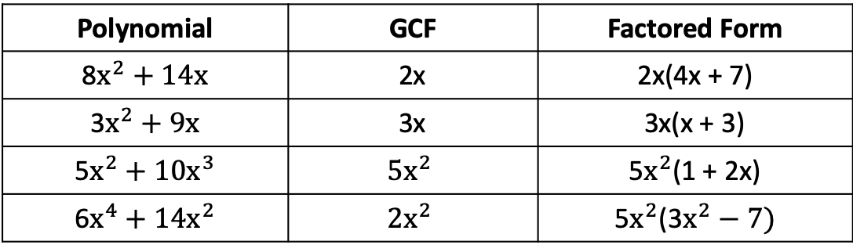
Factoring Polynomials with Common Monomial Factors
The greatest common factor (GCF) of $x^{2}$ and 2x is x. For the polynomial $x^{2}$ + 2x, the factored form is x (x + 2). Here are other examples.
Polynomial | GCF | Factored Form
8$x^{2}+14x$ | 2x | 2x(4x + 7)
3$x^{2}+9x$ | 3x | 3x(x + 3)
5$x^{2}+\text{10}x^{3}$ | $$\text{5}x^{2}$$ | 5$x^{2}$(1 + 2x)
6$x^{4}+14x^{2}$ | $$\text{2}x^{2}$$ | 5$x^{2}$(3$x^{2}−7)$

Slide 5
Factoring Polynomials with Common Monomial Factors
Factoring and GCF
Factoring is finding two or more factors of a number or a polynomial.
The GCF of two or more monomials (a monomial is an expression with one term) is the common factor having the greatest numerical factor and with variables having the least degree.

Slide 6
Factoring Polynomials with Common Monomial Factors
The term axⁿ is the GCF of the terms of a polynomial with one variable x and integer numerical coefficient if:
a is the greatest integer that divides each of the coefficients of the polynomial; and
n is the smallest exponent of x in all the terms of the polynomial.

Slide 7

Factoring Polynomials with Common Monomial Factors
Find the GCF of each pair of monomials.
6a and 18ab b. 10a and 12$a^{2}b$ c. $−8x^{2}y$ and 16xy

Slide 8
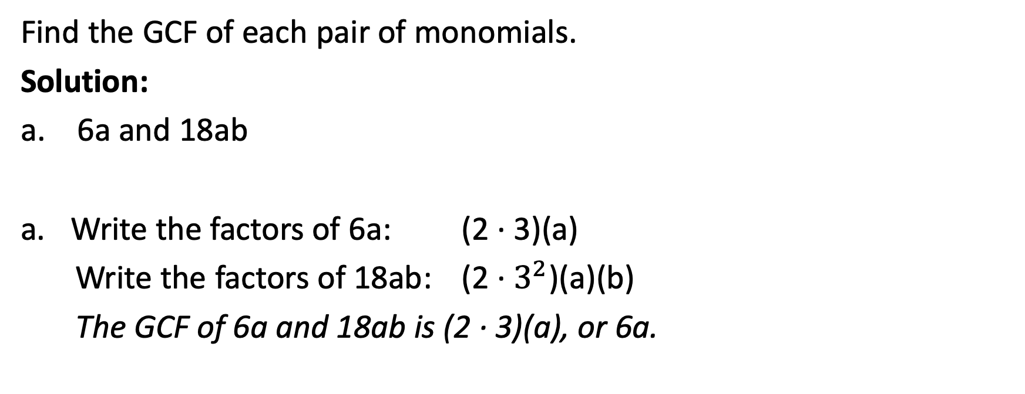
Factoring Polynomials with Common Monomial Factors
Find the GCF of each pair of monomials.
Solution:
a. 6a and 18ab
Write the factors of 6a: (2 · 3)(a)
Write the factors of 18ab: (2 · $3^{2}$)(a)(b)
The GCF of 6a and 18ab is (2 · 3)(a), or 6a.

Slide 9
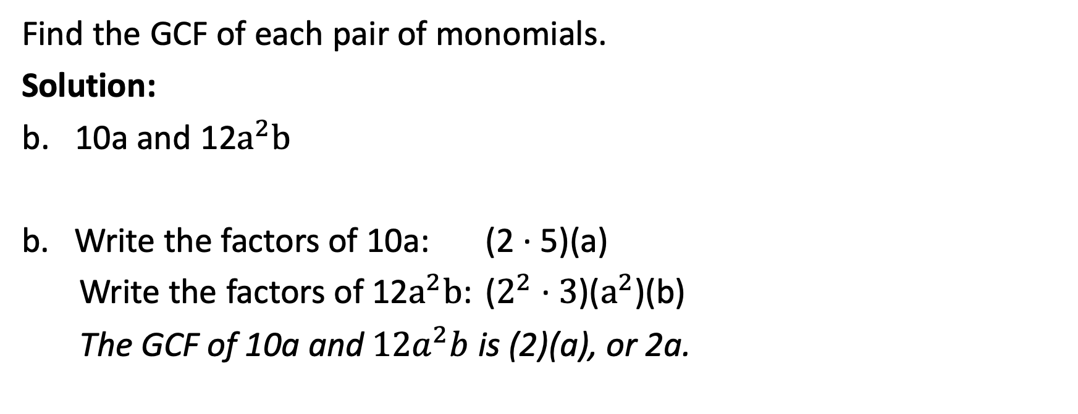
Factoring Polynomials with Common Monomial Factors
Find the GCF of each pair of monomials.
Solution:
b. 10a and 12$a^{2}b$
Write the factors of 10a: (2 · 5)(a)
Write the factors of 12$a^{2}b$: ($2^{2}$ · $3$)($a^{2}$)(b)
The GCF of 10a and ${12a}^{2}b$ is (2)(a), or 2a.

Slide 10
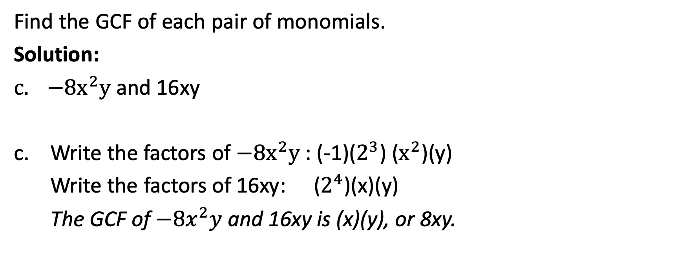
Factoring Polynomials with Common Monomial Factors
Find the GCF of each pair of monomials.
Solution:
$−8x^{2}y$ and 16xy
c. Write the factors of $−8x^{2}y$ : (-1)($2^{3}$) ($x^{2}$)(y)
Write the factors of 16xy: ($2^{4}$)(x)(y)
The GCF of $−8x^{2}y$ and 16xy is (x)(y), or 8xy.

Slide 11

Factoring Polynomials with Common Monomial Factors
Factor completely.
    3x + 6
    $15x^{2}y^{3}−$ $33xy^{3}$
    $\text{12}a^{2}b^{4}\text{– 16}a^{3}b^{2}\text{+ 20}a^{5}b^{3}$

Slide 12
Factoring Polynomials with Common Monomial Factors
Factor completely.
    3x + 6
Solution: Find the GCF of each term of 3x + 6.
prime factorization of 3x: (3)(x)
prime factorization of 6: (3)(2)
The GCF is 3. 3x + 6 = 3(x) + 3(2) Use the GCF to write the polynomial.
= 3(x+2) Use the Distributive Property.
So, 3x + 6 = 3(x +2).

Slide 13
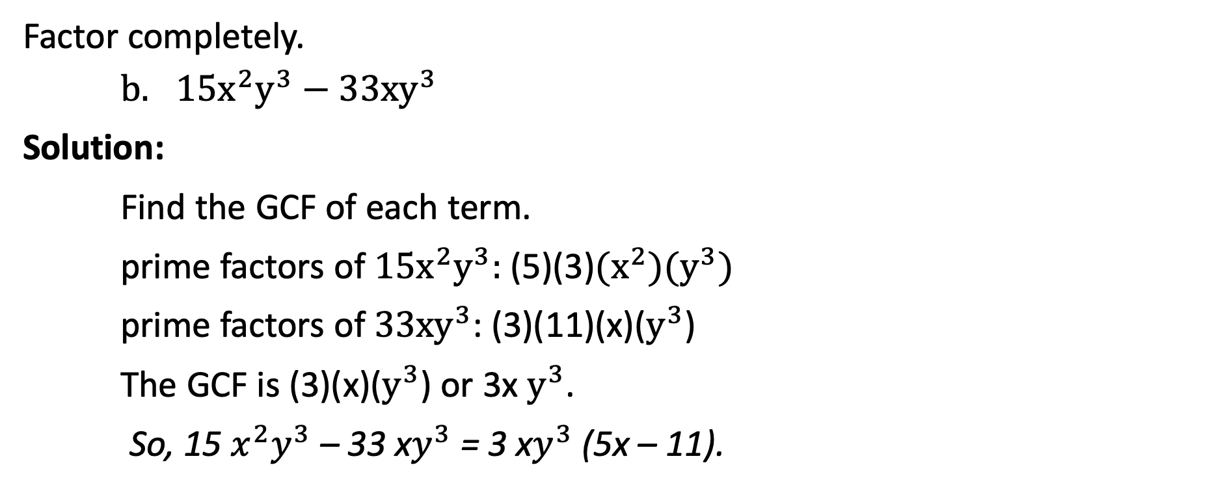
Factoring Polynomials with Common Monomial Factors
Factor completely.
    $15x^{2}y^{3}−$ $33xy^{3}$
Solution:
Find the GCF of each term.
prime factors of $15x^{2}y^{3}:$ (5)(3)$(x^{2})(y^{3})$
prime factors of $33xy^{3}$: (3)(11)(x)($y^{3}$)
The GCF is (3)(x)($y^{3}$) or 3x $y^{3}$.
So, 15 $x^{2}y^{3}$ – 33 x$y^{3}$ = 3 x$y^{3}$ (5x – 11).

Slide 14
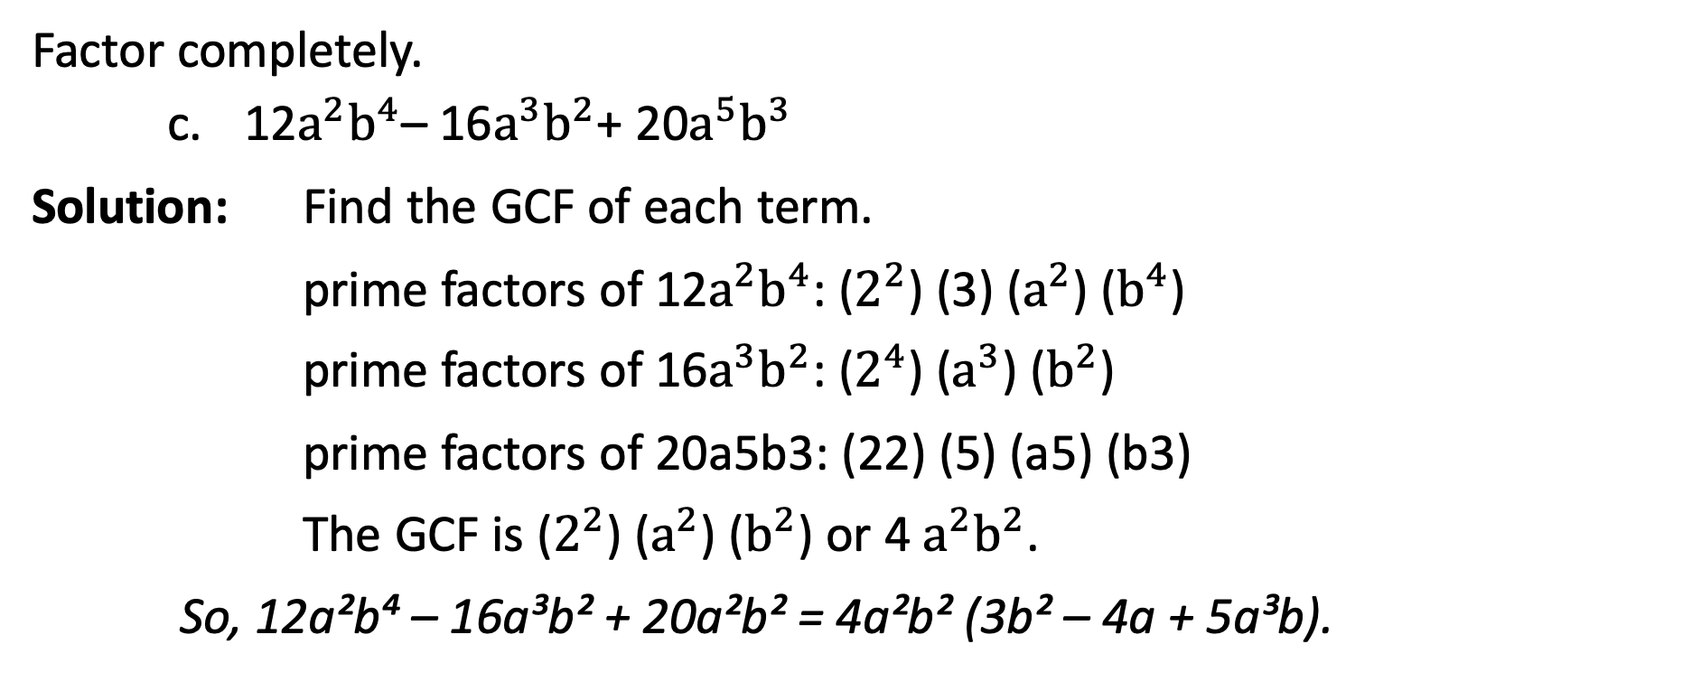
Factoring Polynomials with Common Monomial Factors
Factor completely.
    $\text{12}a^{2}b^{4}\text{– 16}a^{3}b^{2}\text{+ 20}a^{5}b^{3}$
Solution: Find the GCF of each term.
prime factors of $\text{12}a^{2}b^{4}$: ($2^{2}$) (3) ($a^{2}$) ($b^{4}$)
prime factors of $\text{16}a^{3}b^{2}$: ($2^{4}$) ($a^{3}$) ($b^{2}$)
prime factors of 20a5b3: (22) (5) (a5) (b3)
The GCF is ($2^{2}$) ($a^{2}$) ($b^{2}$) or 4 $a^{2}b^{2}$.
So, 12a²b⁴ – 16a³b² + 20a²b² = 4a²b² (3b² – 4a + 5a³b).

Slide 15
Factoring Polynomials with Common Monomial Factors
Factor each polynomial.
    7a(a + 3) – c (a + 3)
    4(3b – 1) + 5a(1 – 3b) + 4c(3b – 1)
    p³(n + 2) + 2p²(n + 2) – 5p(n + 2)
    6x² (y + 2)² + 12x(y + 2)⁴

Slide 16
Factoring Polynomials with Common Monomial Factors
Factor each polynomial.
Solution:
    7a(a + 3) – c (a + 3) The binomial (a + 3) is common to both terms.
    =(a + 3)(7a – c) Factor.

Slide 17
Factoring Polynomials with Common Monomial Factors
Factor each polynomial.
Solution:
  4(3b – 1) + 5a(1 – 3b) + 4c(3b – 1) Use the fact that 1 – 3b = –(3b – 1)
  = 4(3b – 1) – 5a(3b – 1) + 4c(3b – 1) Rewrite 1 – 3b.
  = (3b – 1)(4 – 5a + 4c) The binomial factor (3b – 1) is
  common to all three terms

Slide 18
Factoring Polynomials with Common Monomial Factors
Factor each polynomial.
Solution:
  p³(n + 2) + 2p²(n + 2) – 5p(n + 2) p and (n + 2) are common
  to all the three terms.
  = p(n + 2)(p² + 2p – 5) Factor.

Slide 19
Factoring Polynomials with Common Monomial Factors
Factor each polynomial.
Solution:
    6x² (y + 2)² + 12x(y + 2)⁴ 6x and (y + 2)² are common to
    both terms.
    = 6x(y + 2)²[x + 2 (7 + 2)²] Factor.

