Slide 1
Factoring the Difference of Two Squares

Slide 2
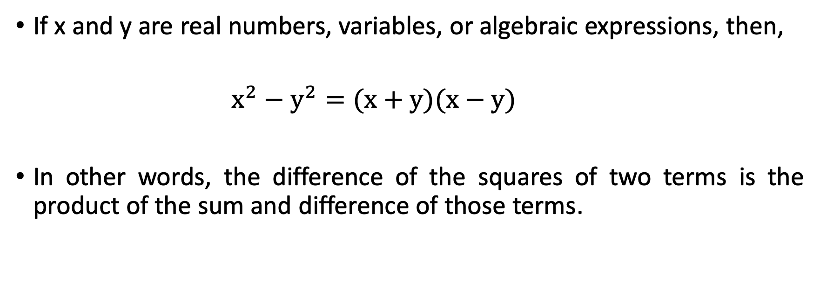
Factoring the Difference of Two Squares
If x and y are real numbers, variables, or algebraic expressions, then,
    $x^{2}−y^{2}=(x+y)(x−y)$
In other words, the difference of the squares of two terms is the product of the sum and difference of those terms.

Slide 3
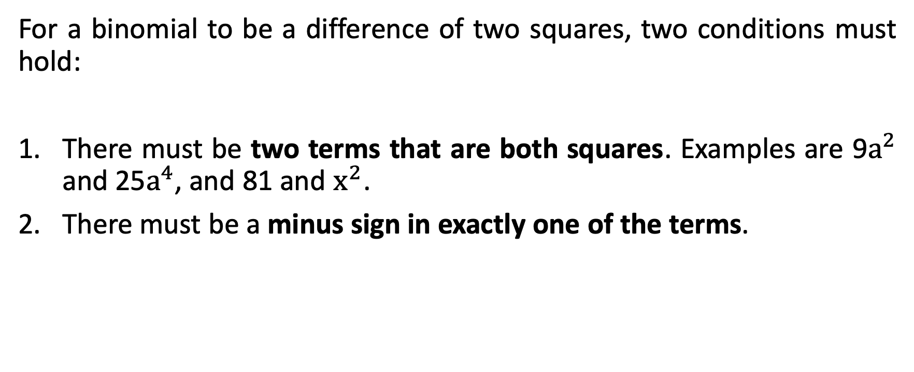
Factoring the Difference of Two Squares
For a binomial to be a difference of two squares, two conditions must hold:
There must be two terms that are both squares. Examples are 9$a^{2}$ and 25$a^{4}$, and 81 and $x^{2}$.
There must be a minus sign in exactly one of the terms.

Slide 4

Factoring the Difference of Two Squares
State whether or not each expression is a difference of two squares.
    9$x^{2}−100$ b. $−16x^{2}+25$

Slide 5

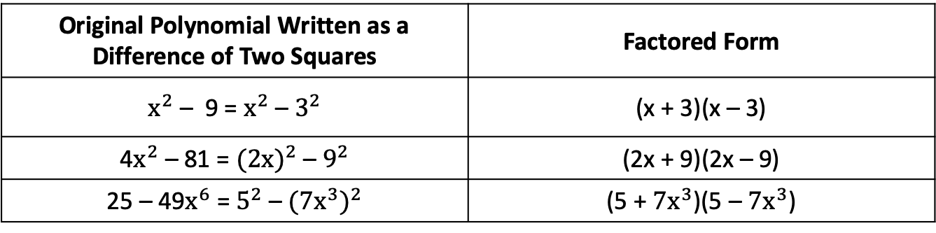
Factoring the Difference of Two Squares
You recognize a difference of two squares as two perfect square terms separated by a minus sign. If the binomial you want to factor matches the pattern $x^{2}$ – $y^{2}$, then, the factors are x + y and x – y. Here are some examples.
Original Polynomial Written as a Difference of Two Squares | Factored Form
$x^{2}$ – 9 = $x^{2}$ – $3^{2}$ | (x + 3)(x – 3)
4$x^{2}$ – 81 = ${(2x)}^{2}$ – $9^{2}$ | (2x + 9)(2x – 9)
25 – 49$x^{6}$ = $5^{2}$ – ${(7x^{3})}^{2}$ | (5 + $7x^{3}$)(5 – $7x^{3}$)

Slide 6
Factoring the Difference of Two Squares
NOTE:
For a variable to be a perfect square, it must be raised to an even power. The perfect integer squares less than 300 are 1, 4, 9, 16, 25, 36, 49, 64, 81, 100, 121, 144, 169,196, 225, 256, and 289.

Slide 7

Factoring the Difference of Two Squares
Factor each completely.
    4$a^{2}$ – 49
    9$x^{2}$ – 25$y^{4}$
    81 – 4$p^{6}q^{4}$

Slide 8
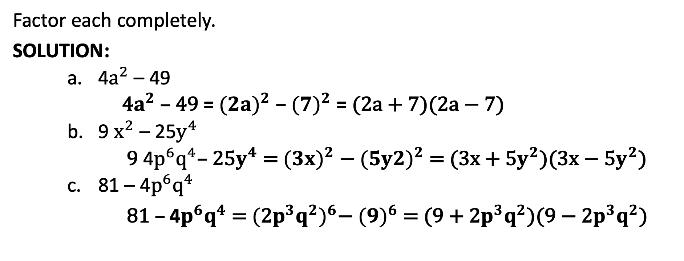
Factoring the Difference of Two Squares
Factor each completely.
SOLUTION:
    4$a^{2}$ – 49
    4$a^{2}$ – 49 = ${(2a)}^{2}$ − ${(7)}^{2}$ = (2a + 7)(2a − 7)
    9 $x^{2}$ – 25$y^{4}$
      9 4$p^{6}q^{4}$– 25$y^{4}$ = ${(3x)}^{2}$ − ${(5y2)}^{2}$ = (3x + 5$y^{2}$)(3x − 5$y^{2}$)
    81 – 4$p^{6}q^{4}$
81 – 4$p^{6}q^{4}$ = ${(\text{2}p^{3}q^{2})}^{6}$− ${(9)}^{6}$= (9 + $\text{2}p^{3}q^{2}$)(9 − $\text{2}p^{3}q^{2}$)

Slide 9

Factoring the Difference of Two Squares
Factor each completely.
a. 20$x^{3}$ – 5x b. 112 – 175$m^{4}$ c. 100$x^{4}$ – 9$x^{6}$

Slide 10
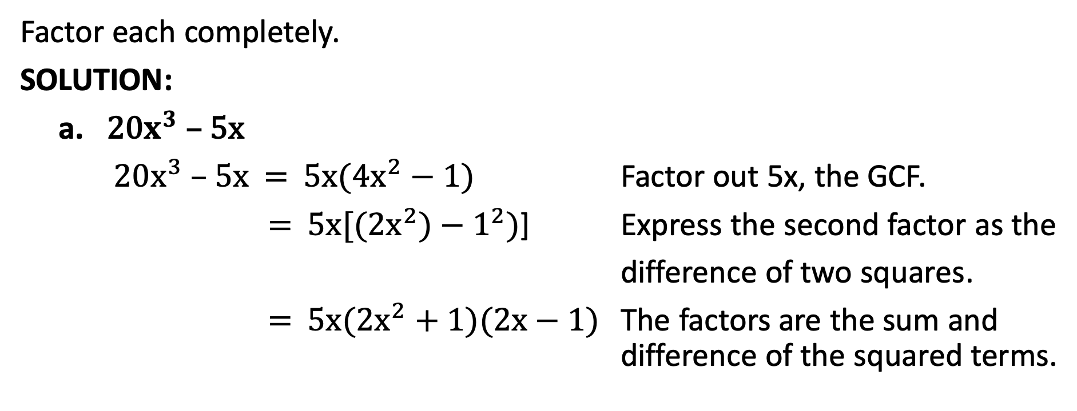
Factoring the Difference of Two Squares
Factor each completely.
SOLUTION:
a. 20$x^{3}$ – 5x
20$x^{3}$ – 5x = 5x(4$x^{2}−1)$ Factor out 5x, the GCF.
= 5x[(2$x^{2})−1^{2})$] Express the second factor as the
difference of two squares.
= 5x(2$x^{2}+1)(2x−1)$ The factors are the sum and difference of the squared terms.

Slide 11
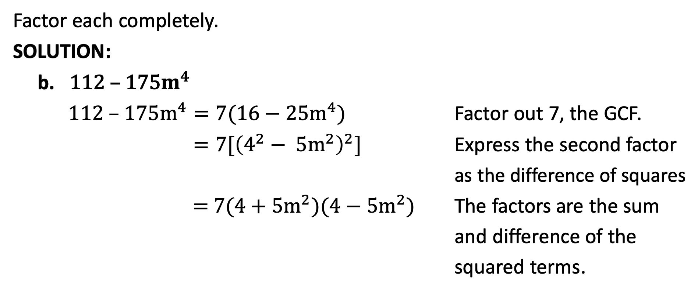
Factoring the Difference of Two Squares
Factor each completely.
SOLUTION:
b. 112 – 175$m^{4}$
112 – 175$m^{4}=7(16−$ 25$m^{4})$ Factor out 7, the GCF.
$=7[{\left(4^{2}−\text{ 5}m^{2}\right)}^{2}]$ Express the second factor
as the difference of squares
= 7(4 + $\text{5}m^{2})(4−$ $\text{5}m^{2}$) The factors are the sum
and difference of the
squared terms.

Slide 12
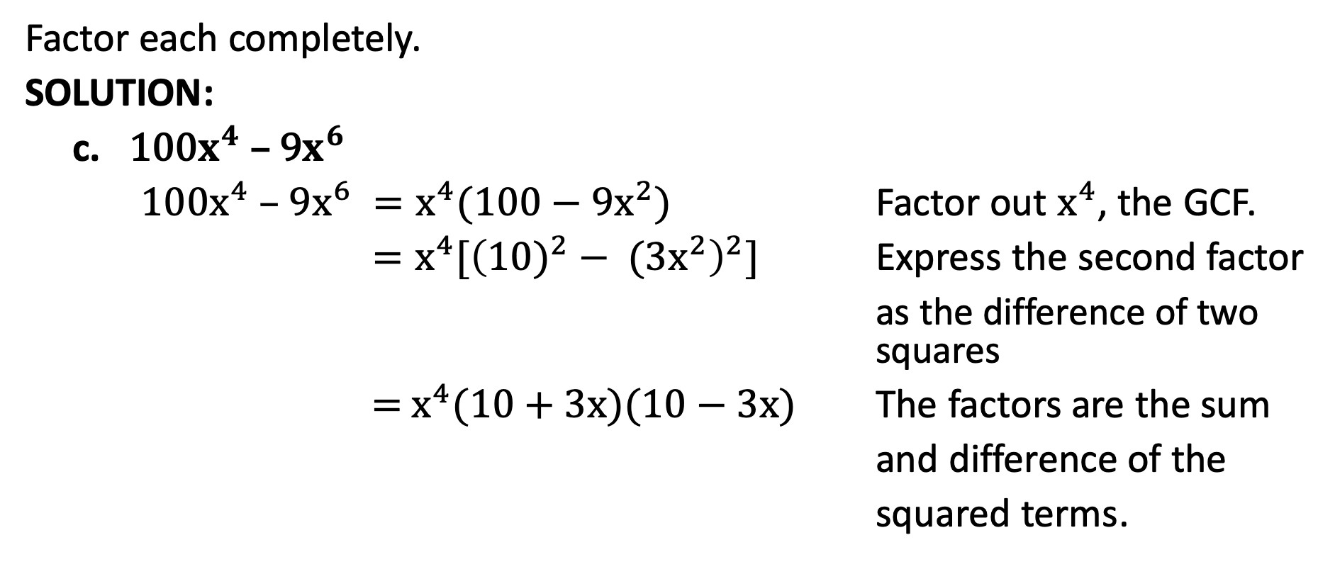
Factoring the Difference of Two Squares
Factor each completely.
SOLUTION:
c. 100$x^{4}$ – 9$x^{6}$
100$x^{4}$ – 9$x^{6} =x^{4}(100−$ 9$x^{2})$ Factor out $x^{4}$, the GCF.
$=x^{4}[{\left({10)}^{2}− \text{(}3x^{2}\right)}^{2}]$ Express the second factor
as the difference of two squares
= $x^{4}$(10 + $\text{3}\text{x})(10−$ $3x$) The factors are the sum
and difference of the
squared terms.

Slide 13
Factoring the Difference of Two Squares
After you have factored a difference of two squares, you can sometimes continue factoring. Factoring completely means to continue factoring until no further factors can be found.

Slide 14

Factoring the Difference of Two Squares
Factor each completely.
a. 1 – 81$x^{8}$ b. $x^{4}y^{8} −z^{4}$

Slide 15
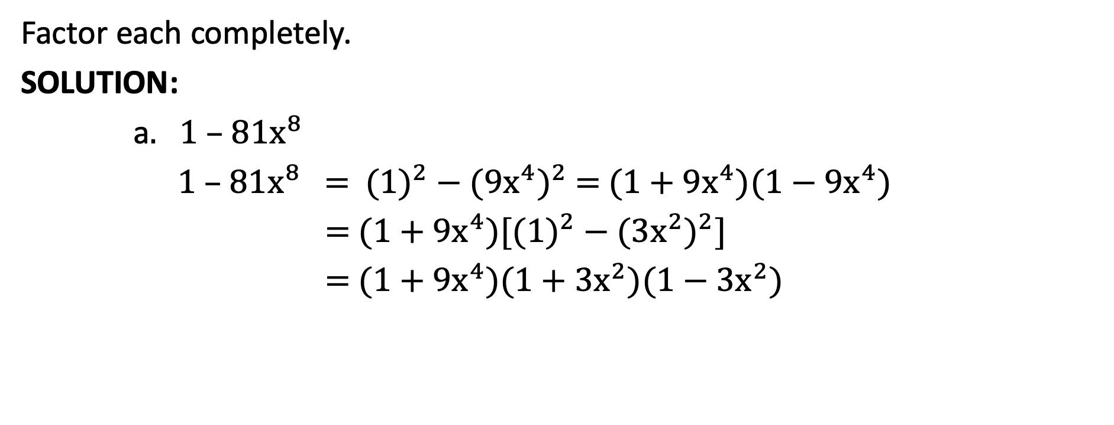
Factoring the Difference of Two Squares
Factor each completely.
SOLUTION:
a. 1 – 81$x^{8}$
1 – 81$x^{8}$ = ${(1)}^{2}$− ${\text{(9}x^{4}\text{)}}^{2}$ = (1 + $\text{9}x^{4}$)(1 − $\text{9}x^{4}$)
= (1 + $\text{9}x^{4}$)[${(1)}^{2}$− ${({3x}^{2})}^{2}$]
= (1 + $\text{9}x^{4}$)(1 + ${3x}^{2}$)(1 − ${3x}^{2}$)

Slide 16
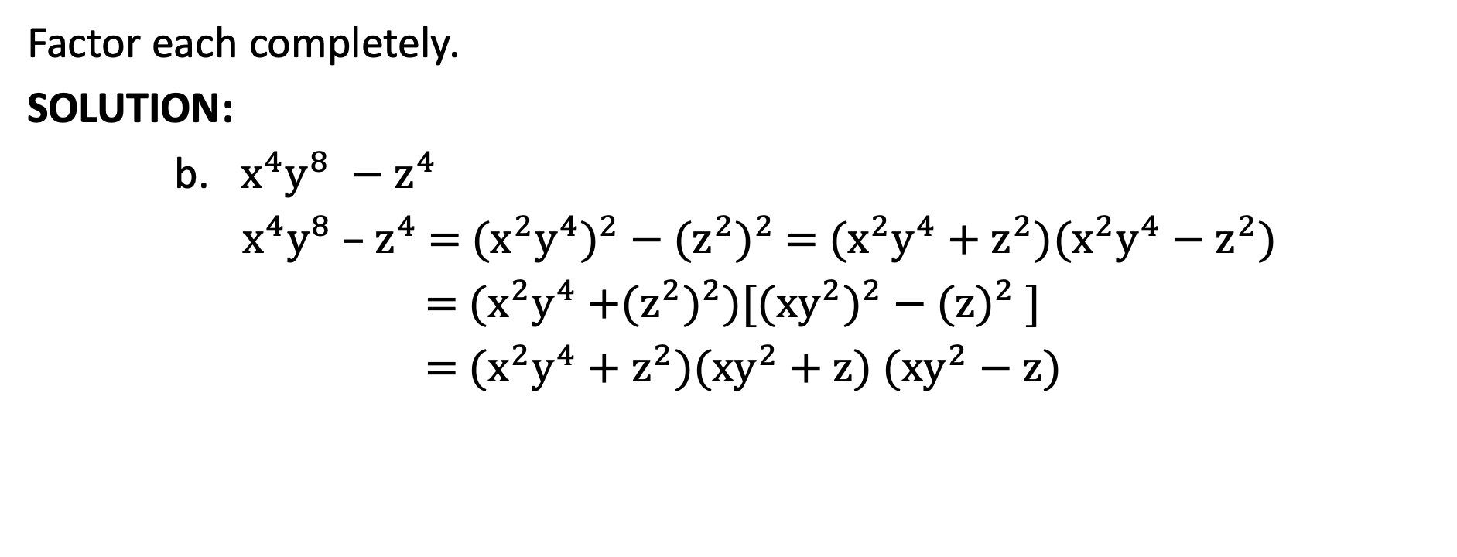
Factoring the Difference of Two Squares
Factor each completely.
SOLUTION:
b. $x^{4}y^{8} −z^{4}$
$x^{4}y^{8}$ – $z^{4}$ = ${\text{(}x^{2}y^{4}\text{)}}^{2}$ − ${\text{(}z^{2}\text{)}}^{2}$ = ($x^{2}y^{4}$ + $z^{2}$)($x^{2}y^{4}−$ $z^{2}$)
= ($x^{2}y^{4}$ +${\text{(}z^{2}\text{)}}^{2}$)[${\text{(}{xy}^{2}\text{)}}^{2}$ − ${\text{(}\text{z}\text{)}}^{2}$ ]
= ($x^{2}y^{4}$ + $z^{2})\text{(}xy^{2}+z\text{)}$ $\text{(}xy^{2}−z\text{)}$

Slide 17
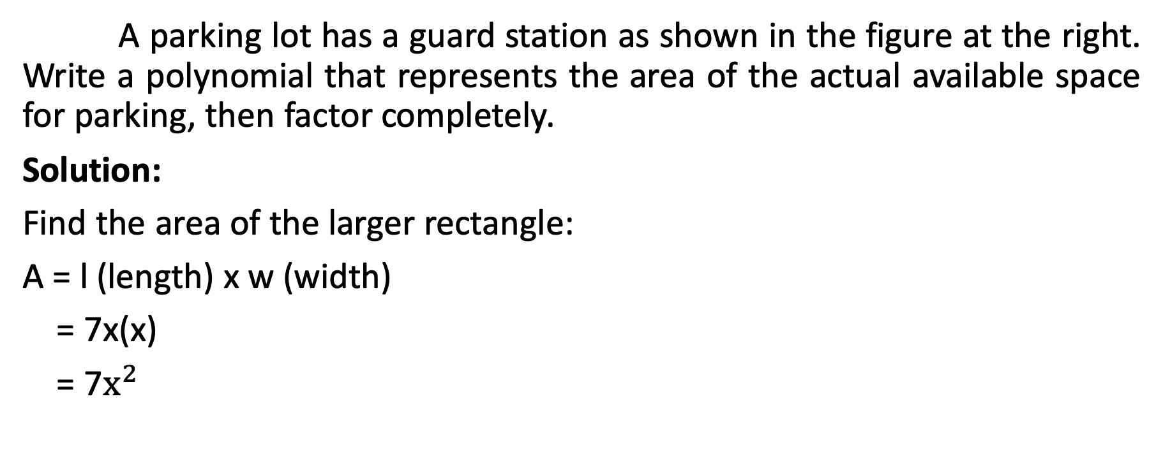
Factoring the Difference of Two Squares
A parking lot has a guard station as shown in the figure at the right. Write a polynomial that represents the area of the actual available space for parking, then factor completely.
Solution:
Find the area of the larger rectangle:
A = l (length) x w (width)
= 7x(x)
= 7$x^{2}$

Slide 18
Factoring the Difference of Two Squares
A parking lot has a guard station as shown in the figure at the right. Write a polynomial that represents the area of the actual available space for parking, then factor completely.
Solution:
Find the area of the smaller triangle:
A = lw
= 7(4)
= 28

Slide 19
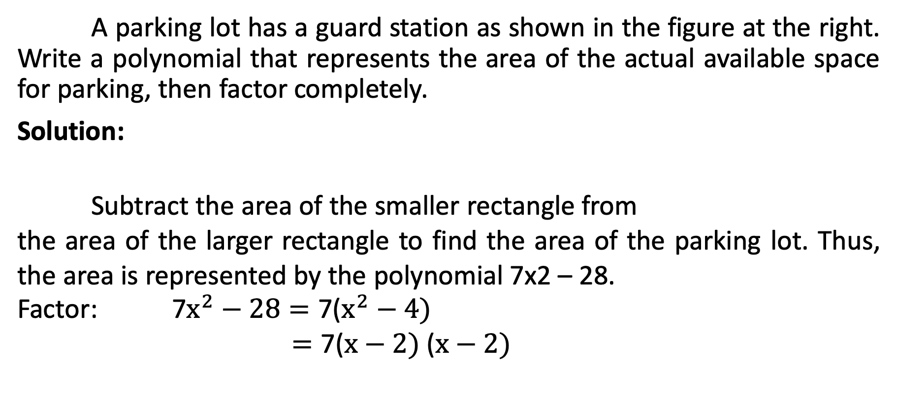
Factoring the Difference of Two Squares
A parking lot has a guard station as shown in the figure at the right. Write a polynomial that represents the area of the actual available space for parking, then factor completely.
Solution:
Subtract the area of the smaller rectangle from
the area of the larger rectangle to find the area of the parking lot. Thus, the area is represented by the polynomial 7x2 – 28.
Factor: 7$x^{2}−28=\text{7}\text{(}x^{2}−4)$
$=\text{7}\text{(}x−2)$ $\text{(}x−2)$

