Slide 1
Factoring the Sum and Difference of Two Cubes

Slide 2
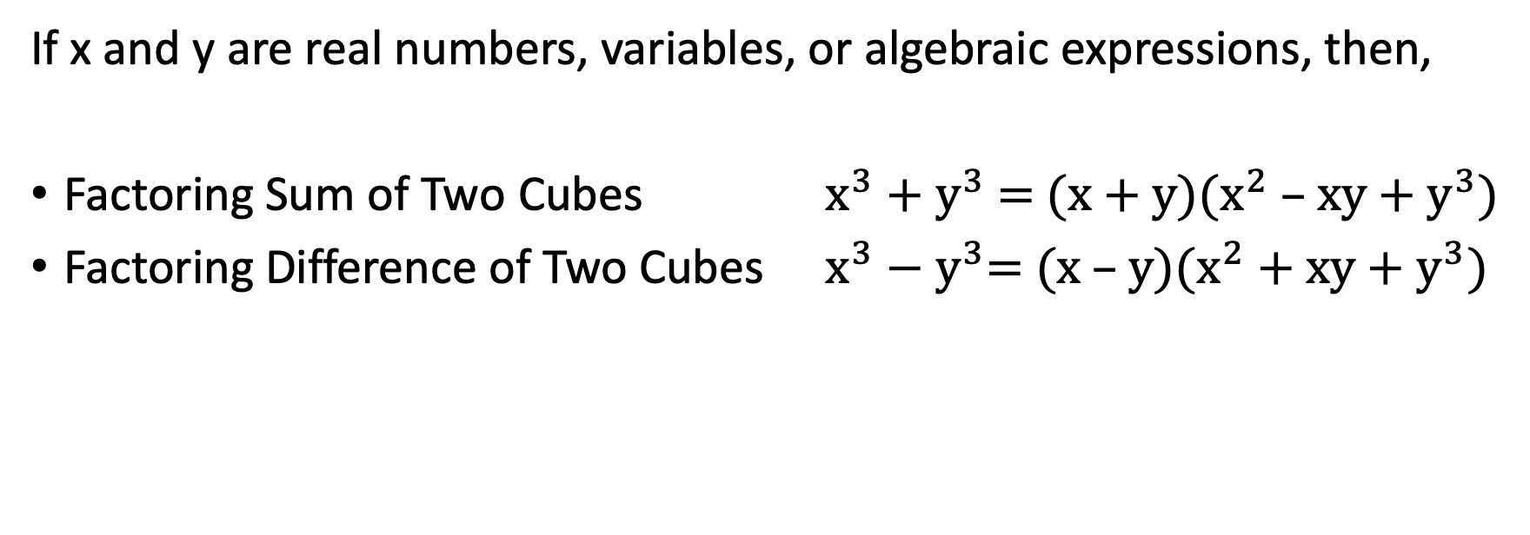
Factoring the Sum and Difference of Two Cubes
If x and y are real numbers, variables, or algebraic expressions, then,
Factoring Sum of Two Cubes $x^{3}+y^{3}$ = (x + y)($x^{2}$ – xy + $y^{3}$)
Factoring Difference of Two Cubes $x^{3}−y^{3}$= (x – y)($x^{2}$ + xy + $y^{3}$)

Slide 3
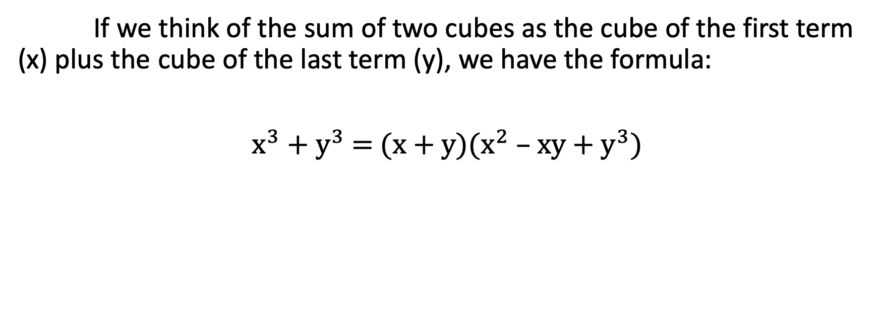
Factoring the Sum and Difference of Two Cubes
If we think of the sum of two cubes as the cube of the first term (x) plus the cube of the last term (y), we have the formula:
$x^{3}+y^{3}$ = (x + y)($x^{2}$ – xy + $y^{3}$)

Slide 4
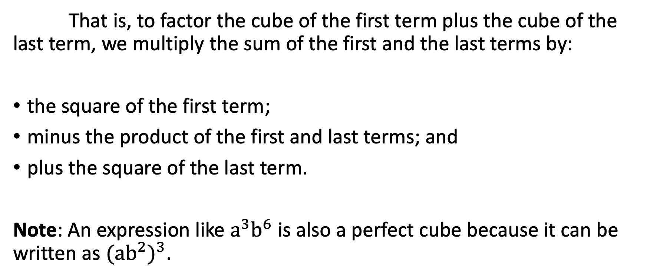
Factoring the Sum and Difference of Two Cubes
That is, to factor the cube of the first term plus the cube of the last term, we multiply the sum of the first and the last terms by:
the square of the first term;
minus the product of the first and last terms; and
plus the square of the last term.
Note: An expression like $a^{3}b^{6}$ is also a perfect cube because it can be written as ${({ab}^{2})}^{3}$.

Slide 5

Factoring the Sum and Difference of Two Cubes
Factor each completely.
    $a^{3}+64$ b. ${ 8b}^{3}+$ ${ 27c}^{3}$

Slide 6
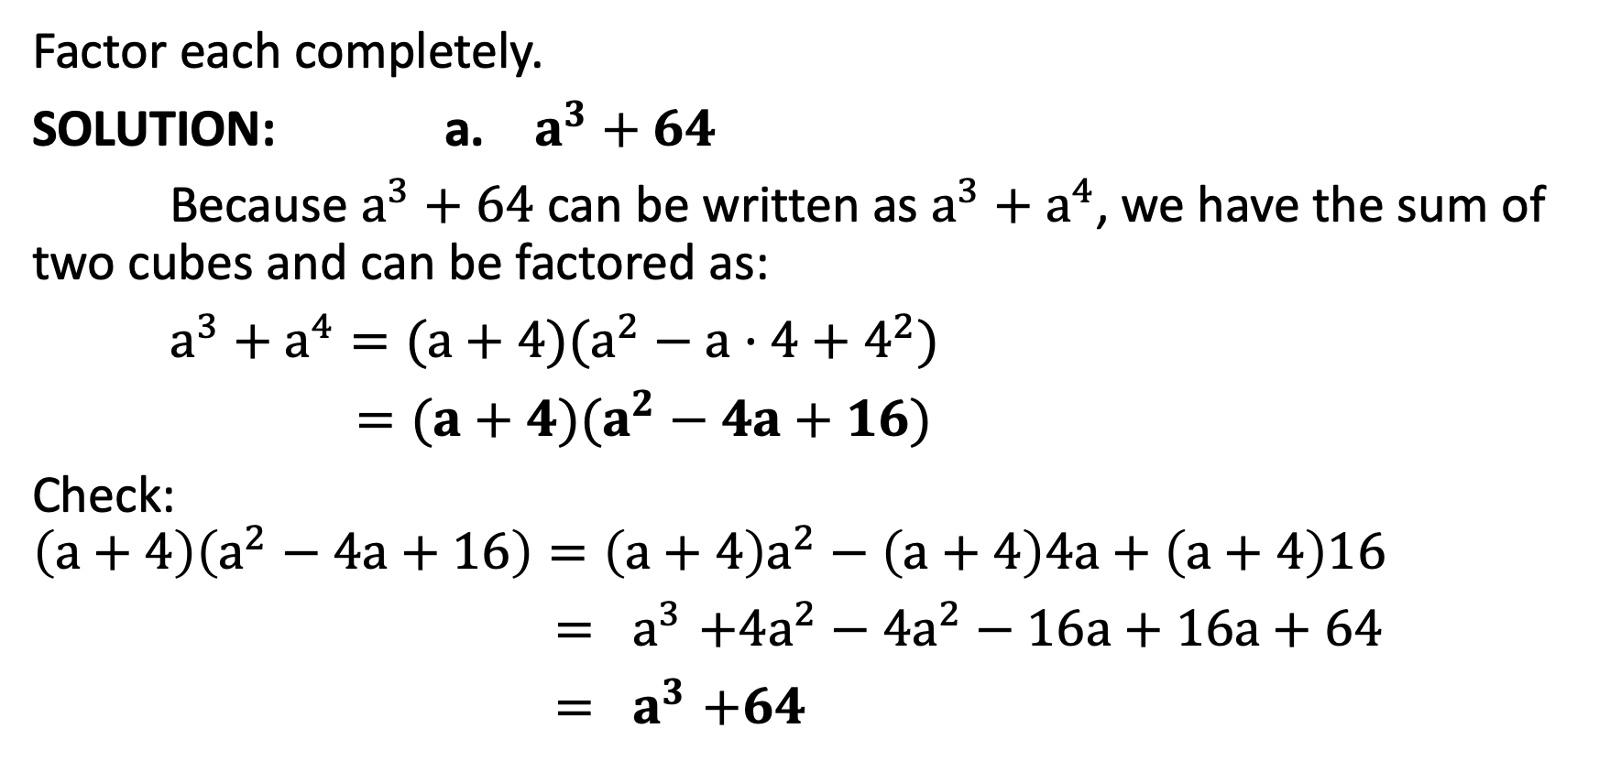
Factoring the Sum and Difference of Two Cubes
Factor each completely.
SOLUTION: a. $a^{3}+64$
Because $a^{3}+64$ can be written as $a^{3}+a^{4}$, we have the sum of two cubes and can be factored as:
$a^{3}+a^{4}=(a+4)(a^{2}−a·4+4^{2})$
$=(a+4)(a^{2}−4a+16)$
Check:
$$\left(a+4\right)\left(a^{2}−4a+16\right)=\left(a+4\right)a^{2}−\left(a+4\right)4a+\left(a+4\right)16$$
${= a}^{3}+{4a}^{2}−$ ${4a}^{2}−16a+16a+64$
${= a}^{3}+64$

Slide 7
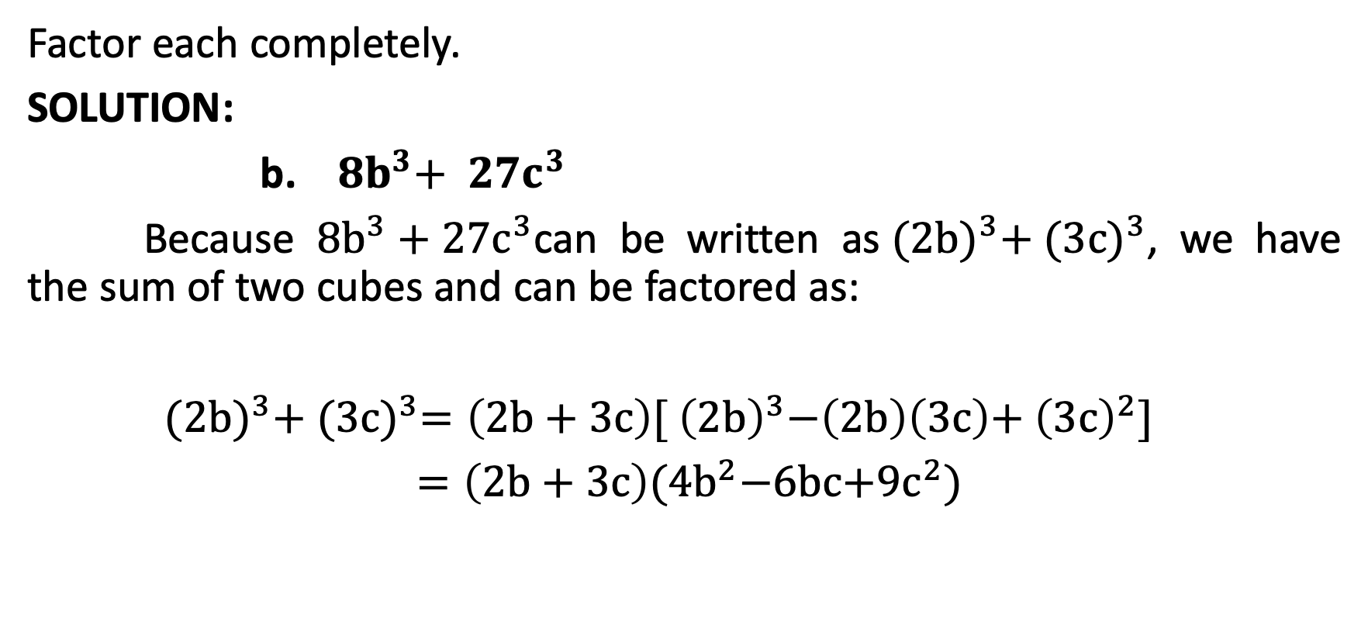
Factoring the Sum and Difference of Two Cubes
Factor each completely.
SOLUTION:
b. ${ 8b}^{3}+$ ${ 27c}^{3}$
Because ${8b}^{3}+{ 27c}^{3}$can be written as${ (2b)}^{3}+{ (3c)}^{3}$, we have the sum of two cubes and can be factored as:
${ (2b)}^{3}+{ (3c)}^{3}=\left(2b+3c\right)[{ \left(2b\right)}^{3}−\left(2b\right)\left(3c\right)+{ \left(3c\right)}^{2}]$
$=\left(2b+3c\right){(4b}^{2}−6bc{+9c}^{2})$

Slide 8
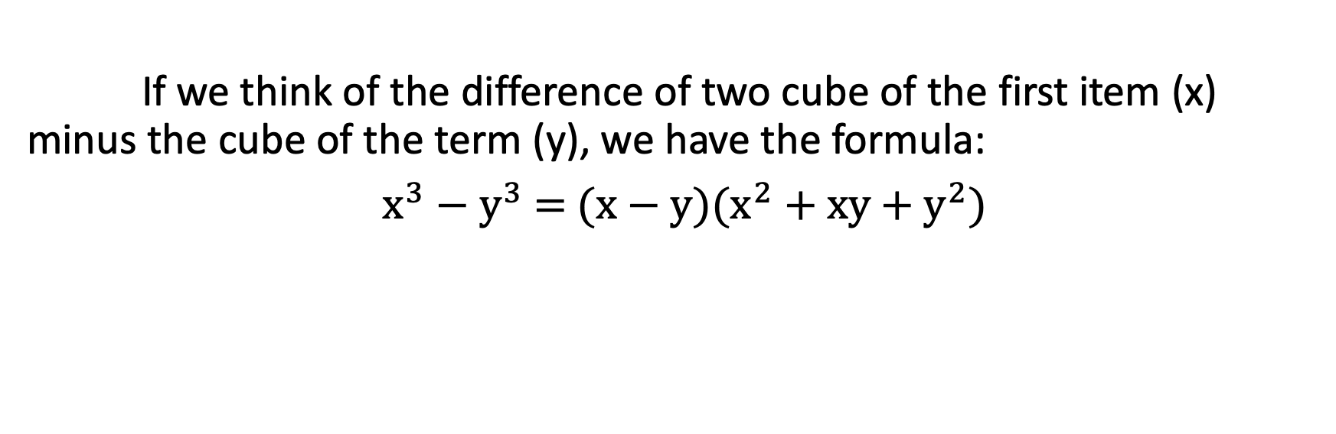
Factoring the Sum and Difference of Two Cubes
If we think of the difference of two cube of the first item (x) minus the cube of the term (y), we have the formula:
$x^{3}−y^{3}$ = (x $−$ y)($x^{2}$ + xy + $y^{2}$)

Slide 9
Factoring the Sum and Difference of Two Cubes
This indicates that to factor the cube of the first term minus the cube of the last term, we multiply the difference between the first and the last terms by:
the square of the first term;
plus the product of the first and last terms; and
plus the square of the last term.

Slide 10

Factoring the Sum and Difference of Two Cubes
Factor each completely.
${27c}^{3}−d^{3}$ b. ${ 8e}^{3}f^{6}−$ ${ 125g}^{3}$ c. 64$−$ ${ p}^{6}$

Slide 11
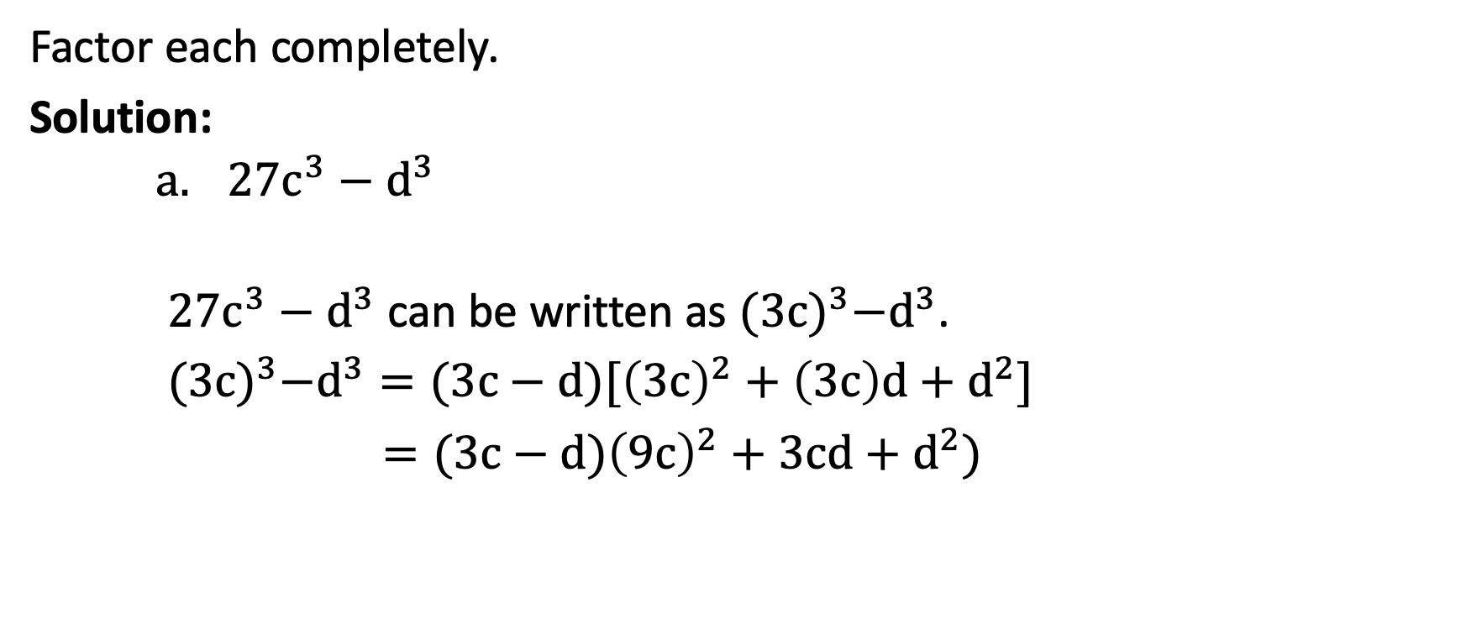
Factoring the Sum and Difference of Two Cubes
Factor each completely.
Solution:
    ${27c}^{3}−d^{3}$
${27c}^{3}−d^{3}$ can be written as ${(3c)}^{3}−d^{3}$.
${(3c)}^{3}−d^{3}=(3c−d)[{\left(3c\right)}^{2}+\left(3c\right)d+d^{2}]$
$=(3c−d){\left(9c\right)}^{2}+3cd+d^{2})$

Slide 12
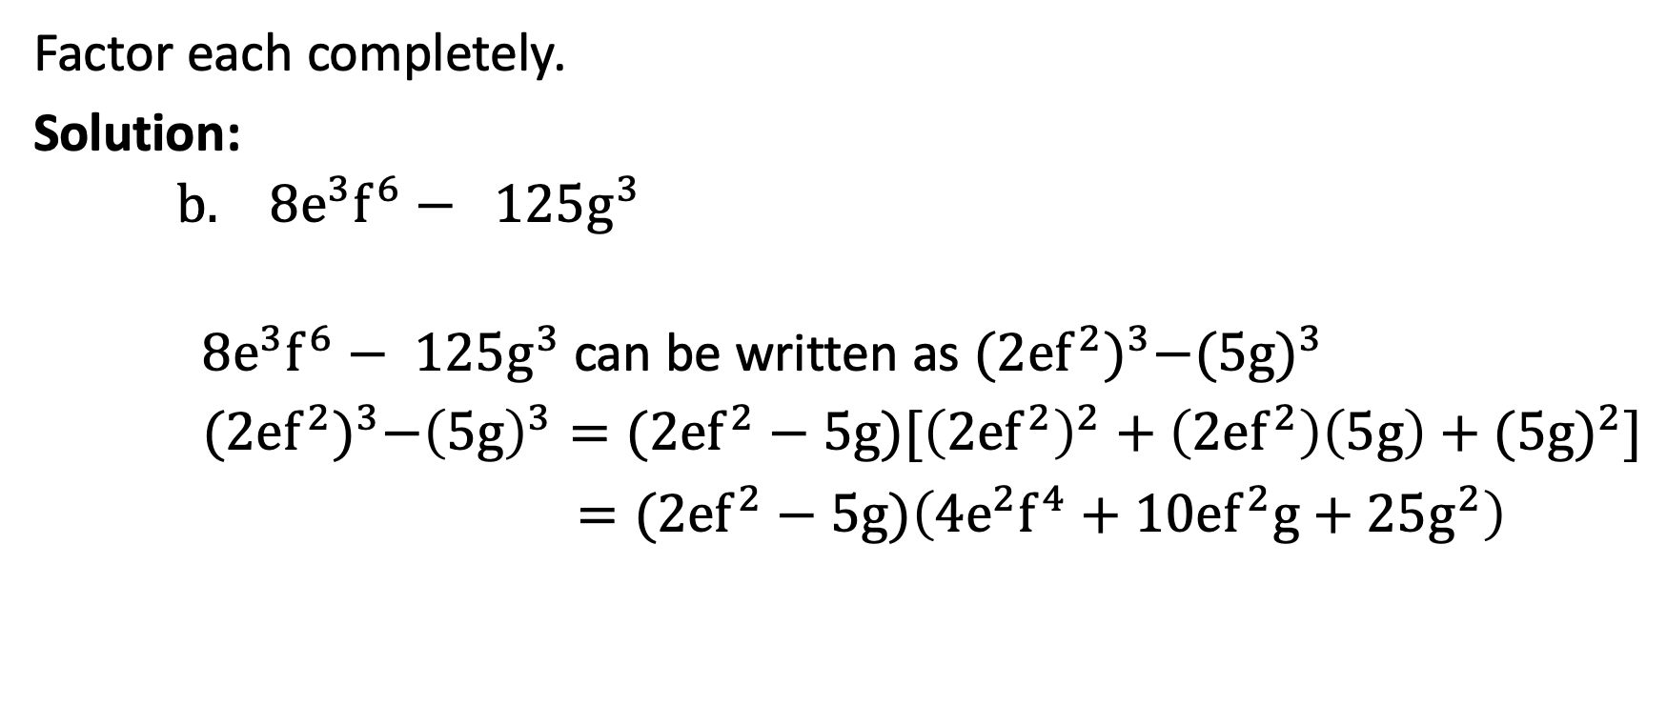
Factoring the Sum and Difference of Two Cubes
Factor each completely.
Solution:
    ${ 8e}^{3}f^{6}− { 125g}^{3}$
${ 8e}^{3}f^{6}−$ ${ 125g}^{3}$ can be written as ${(2ef^{2})}^{3}−{(5g)}^{3}$
${(2ef^{2})}^{3}−{\left(5g\right)}^{3}=(2ef^{2}−5g)[{\left(2ef^{2}\right)}^{2}+\left(2ef^{2}\right)\left(5g\right)+$ ${(5g)}^{2}]$
$=(2ef^{2}−5g)\left(4e^{2}f^{4}+10ef^{2}g+25g^{2}\right)$

Slide 13

Factoring the Sum and Difference of Two Cubes
Factor each completely.
Solution:
    $\text{64}− { p}^{6}$
64$−$ ${ p}^{6}=$ ${ 4}^{3}−{{ (p}^{2})}^{3}$
$=$ ${ (4−p}^{2}){{(16+4p}^{2}+p^{4})}^{}$
$=(2+p)(2−p) ({(16+4p}^{2}+p^{4}$) Factor out 4$−$ ${ p}^{2}$.

