Slide 1
Factoring Perfect Square Trinomials

Slide 2
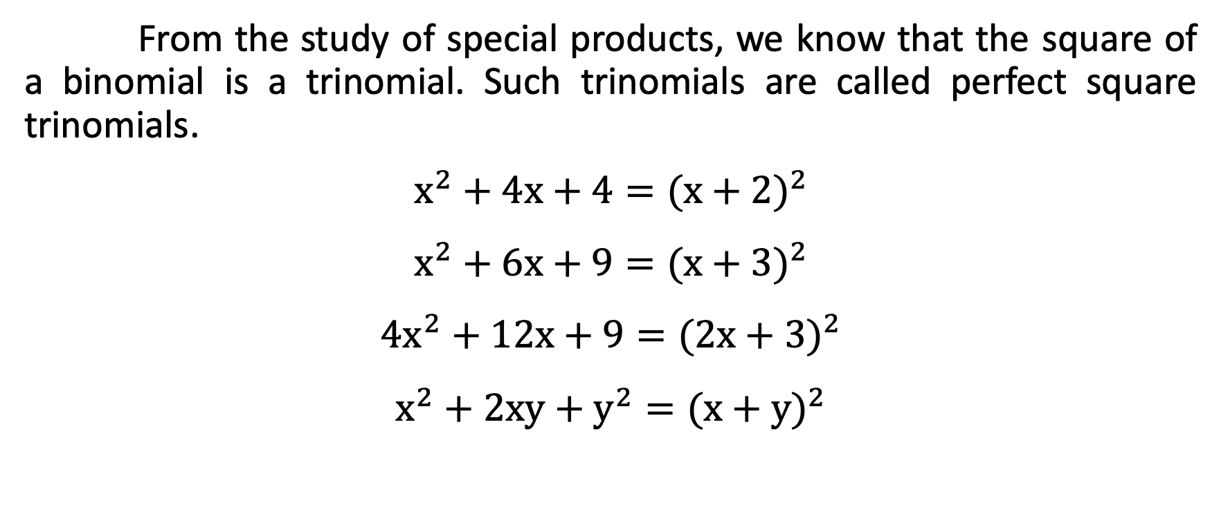
Factoring Perfect Square Trinomials
From the study of special products, we know that the square of a binomial is a trinomial. Such trinomials are called perfect square trinomials.
$$x^{2}+4x+4={(x+2)}^{2}$$
$$x^{2}+6x+9={(x+3)}^{2}$$
$${4x}^{2}+12x+9={(2x+3)}^{2}$$
$$x^{2}+2xy+y^{2}={(x+y)}^{2}$$

Slide 3
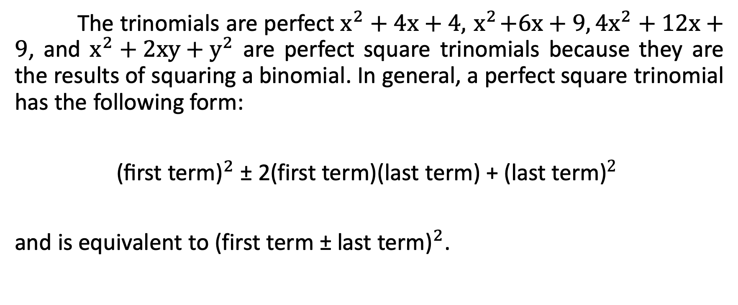
Factoring Perfect Square Trinomials
The trinomials are perfect $x^{2}+4x+4,{ x}^{2}+6x+9,{4x}^{2}+12x+9$, and $x^{2}+2xy+y^{2}$ are perfect square trinomials because they are the results of squaring a binomial. In general, a perfect square trinomial has the following form:
${\text{(}\text{first} \text{term}\text{)}}^{2}$ ± 2(first term)(last term) + (${\text{last} \text{term}\text{)}}^{2}$
and is equivalent to (first term ± ${\text{last} \text{term}\text{)}}^{2}$.

Slide 4
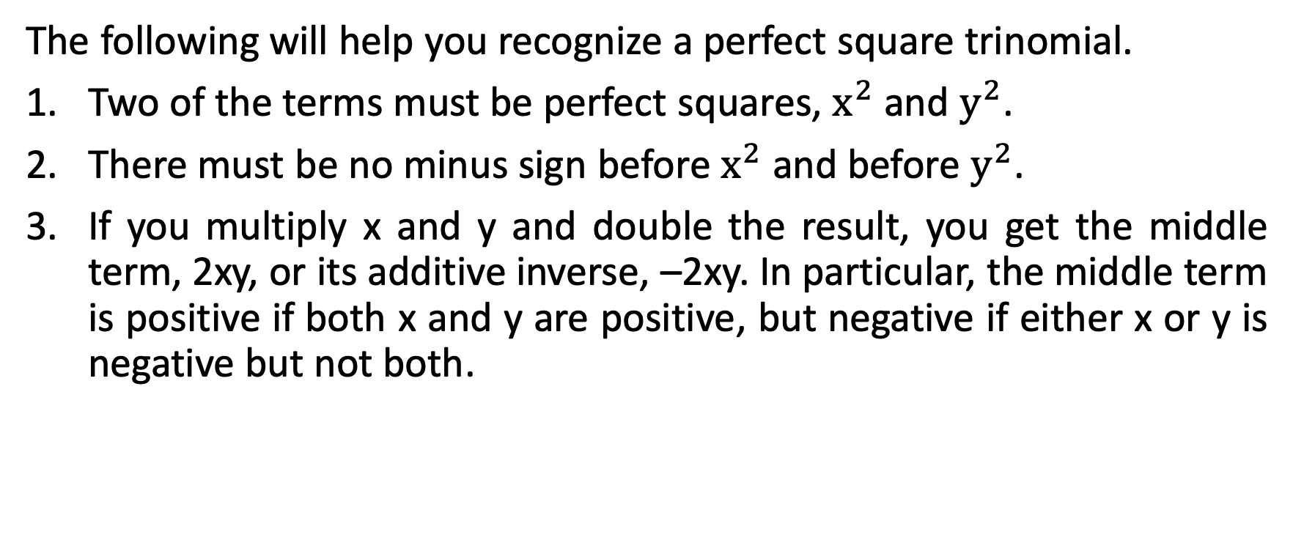
Factoring Perfect Square Trinomials
The following will help you recognize a perfect square trinomial.
Two of the terms must be perfect squares, $x^{2}$ and $y^{2}$.
There must be no minus sign before $x^{2}$ and before $y^{2}$.
If you multiply x and y and double the result, you get the middle term, 2xy, or its additive inverse, –2xy. In particular, the middle term is positive if both x and y are positive, but negative if either x or y is negative but not both.

Slide 5
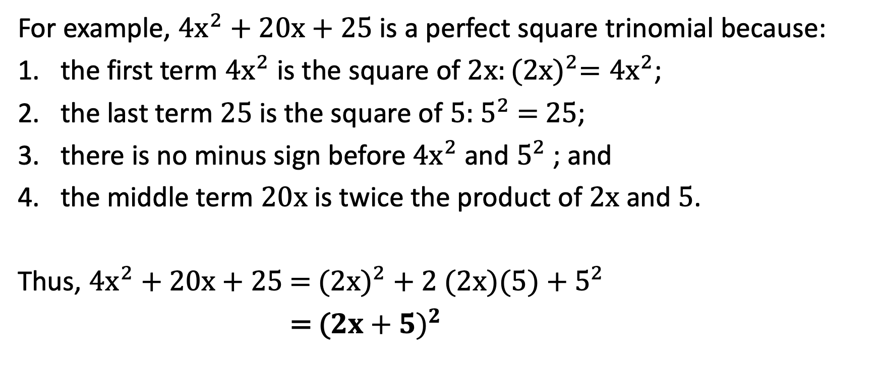
Factoring Perfect Square Trinomials
For example, ${4x}^{2}+20x+25$ is a perfect square trinomial because:
the first term ${4x}^{2}$ is the square of $2x:{(2x)}^{2}={4x}^{2}$;
the last term 25 is the square of 5: $5^{2}$ = 25;
there is no minus sign before ${4x}^{2}$ and $5^{2}$ ; and
the middle term 20x is twice the product of 2x and 5.
Thus, ${4x}^{2}$ + 20x + 25 = (${2x)}^{2}$ + 2 (2x)(5) + $5^{2}$
= (${2x+5)}^{2}$

Slide 6

Factoring Perfect Square Trinomials
Which of the following are perfect square trinomials?
$x^{2}+16x+64$ b. ${9x}^{2}$– 30xy + 25$y^{2}$ c. $x^{2}$ + 5x + 6

Slide 7
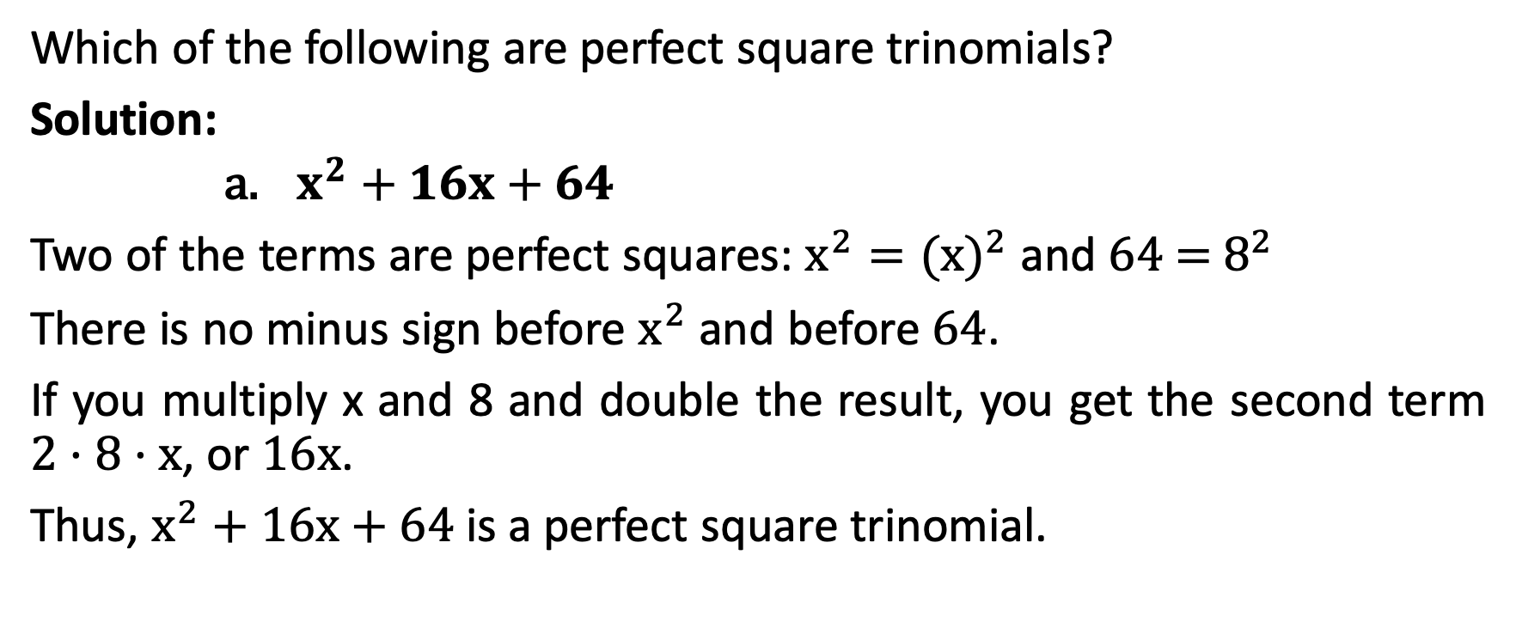
Factoring Perfect Square Trinomials
Which of the following are perfect square trinomials?
Solution:
      $x^{2}+16x+64$
Two of the terms are perfect squares: $x^{2}={(x)}^{2}$ and 64 = $8^{2}$
There is no minus sign before $x^{2}$ and before 64.
If you multiply x and 8 and double the result, you get the second term 2 · 8 · x, or 16x.
Thus, $x^{2}$ + 16x + 64 is a perfect square trinomial.

Slide 8
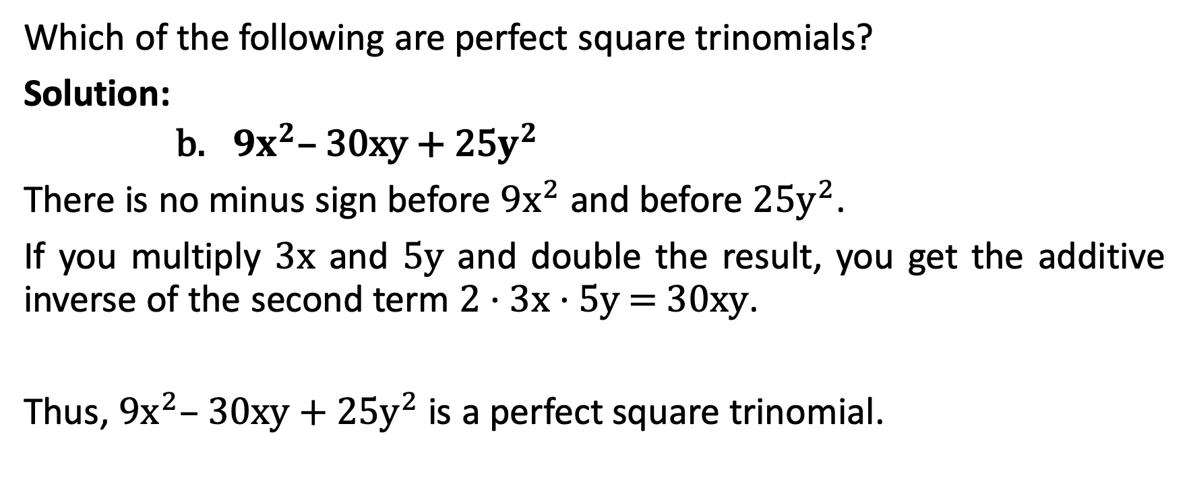
Factoring Perfect Square Trinomials
Which of the following are perfect square trinomials?
Solution:
      ${9x}^{2}$– 30xy + 25$y^{2}$
There is no minus sign before ${9x}^{2}$ and before 25$y^{2}$.
If you multiply 3x and 5y and double the result, you get the additive inverse of the second term 2 · 3x · 5y = 30xy.
Thus, ${9x}^{2}$– 30xy + 25$y^{2}$is a perfect square trinomial.

Slide 9
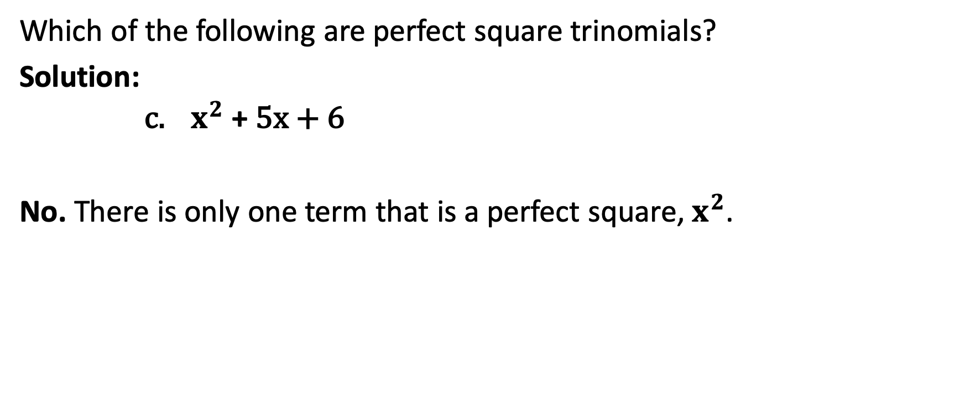
Factoring Perfect Square Trinomials
Which of the following are perfect square trinomials?
Solution:
      $x^{2}$ + 5x + 6
No. There is only one term that is a perfect square, $x^{2}$.

Slide 10

Factoring Perfect Square Trinomials
Factor each completely.
$x^{2}+10x+25$ b. ${16x}^{2}$– 72x + 81 c. ${25m}^{2}$ + 20mn + ${4n}^{2}$

Slide 11
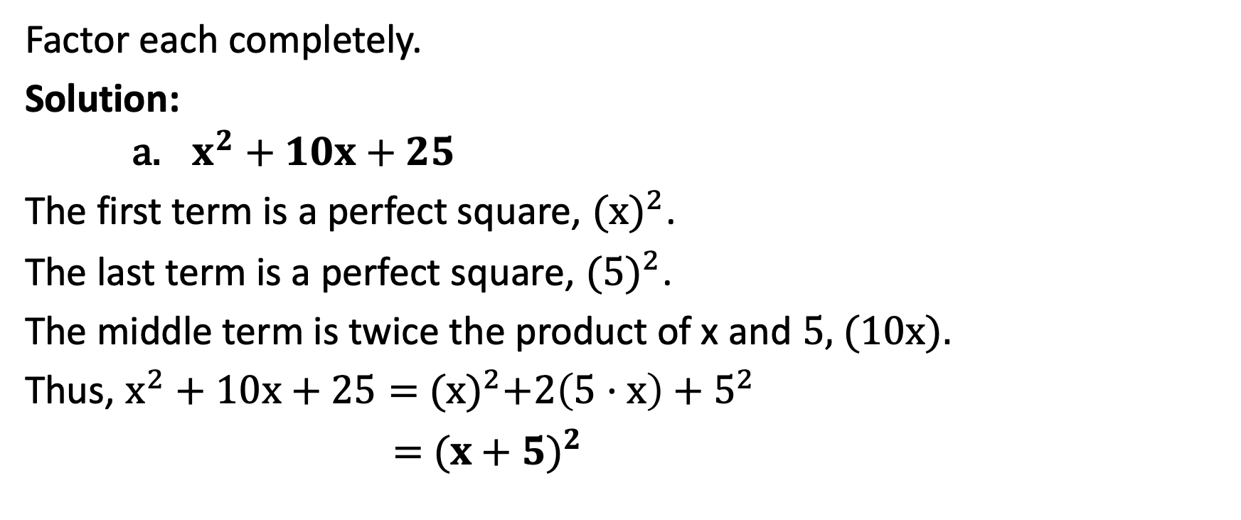
Factoring Perfect Square Trinomials
Factor each completely.
Solution:
    $x^{2}+10x+25$
The first term is a perfect square, ${(x)}^{2}$.
The last term is a perfect square, ${(5)}^{2}$.
The middle term is twice the product of x and 5, (10x).
Thus, $x^{2}+10x+25=$ ${(x)}^{2}+2\left(5·x\right)+$ $5^{2}$
$=$ ${(x+5)}^{2}$

Slide 12


Factoring Perfect Square Trinomials
Factor each completely.
Solution:
    ${16x}^{2}\text{– 72}\text{x}\text{ + 81}$
The first term is a perfect square, ${(4x)}^{2}$.
The last term is a perfect square, ${(9)}^{2}$.
The middle term is twice the product of 4x and 9, (72x).
Thus, 16$x^{2}+72x+81=$ ${(4x)}^{2}+2\left(4x·9\right)+$ $9^{2}$
$=$ ${(4x+9)}^{2}$
${16x}^{2}$– 72x + 81

Slide 13
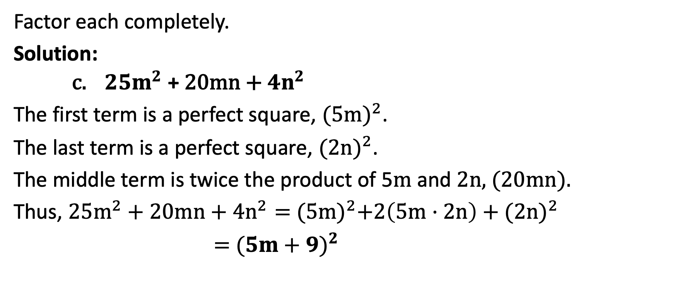
Factoring Perfect Square Trinomials
Factor each completely.
Solution:
    ${25m}^{2}\text{ + }\text{20}\text{mn}\text{ + }{4n}^{2}$
The first term is a perfect square, ${(5m)}^{2}$.
The last term is a perfect square, ${(2n)}^{2}$.
The middle term is twice the product of 5m and 2n, (20mn).
Thus, ${25m}^{2}+20mn+{4n}^{2}=$ ${(5m)}^{2}+2\left(5m·2n\right)+{(2n)}^{2}$
$=$ ${(5m+9)}^{2}$

Slide 14

Factoring Perfect Square Trinomials
Factor each completely.
${4x}^{3}−{24x}^{2}+36x$
${27a}^{2}$+ 72ab + ${48b}^{2}$
${64c}^{2}d^{4}+$ 160 ${cd}^{2}e$ + ${100e}^{2}$

Slide 15
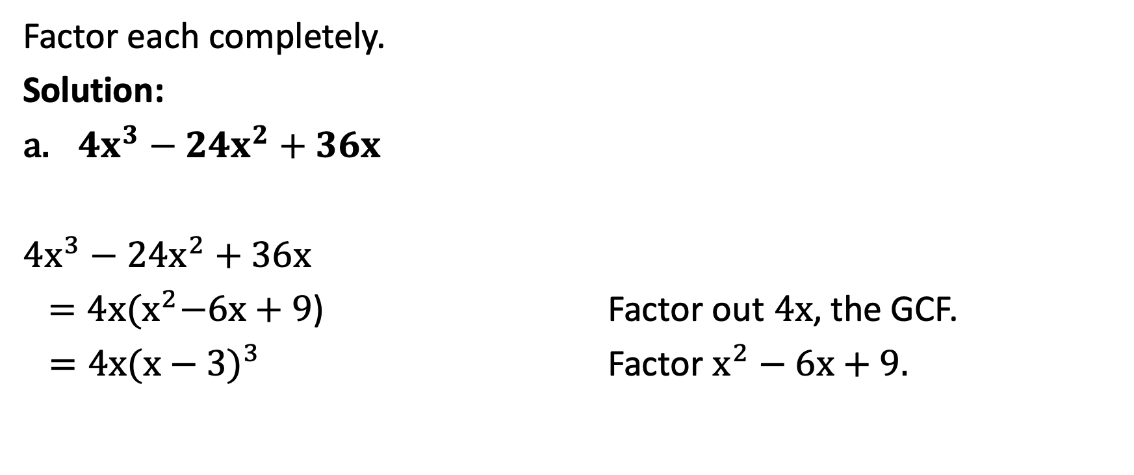
Factoring Perfect Square Trinomials
Factor each completely.
Solution:
${4x}^{3}−{24x}^{2}+36x$
${4x}^{3}−{24x}^{2}+36x$
${ =4x(x}^{2}−6x+9$) Factor out 4x, the GCF.
$=4x{(x−3)}^{3}$ Factor $x^{2}−6x+9.$

Slide 16
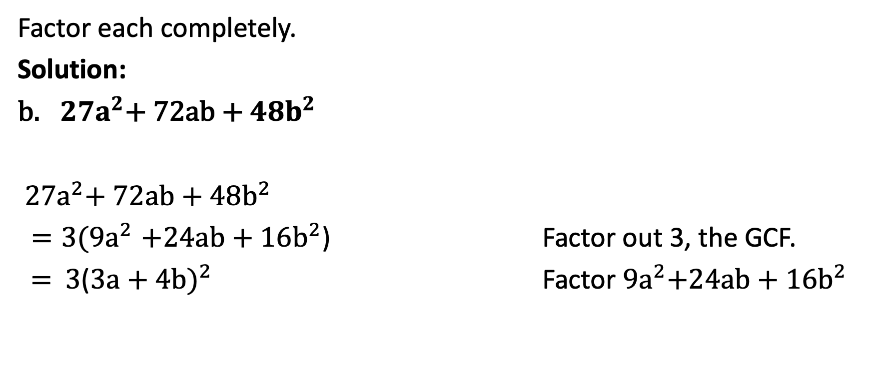
Factoring Perfect Square Trinomials
Factor each completely.
Solution:
${27a}^{2}$+ 72ab + ${48b}^{2}$
${27a}^{2}$+ 72ab + ${48b}^{2}$
${=3(9a}^{2}+24ab+{16b}^{2}$) Factor out 3, the GCF.
= 3(${3a+4b)}^{2}$ Factor${ 9a}^{2}+24ab+{16b}^{2}$

Slide 17
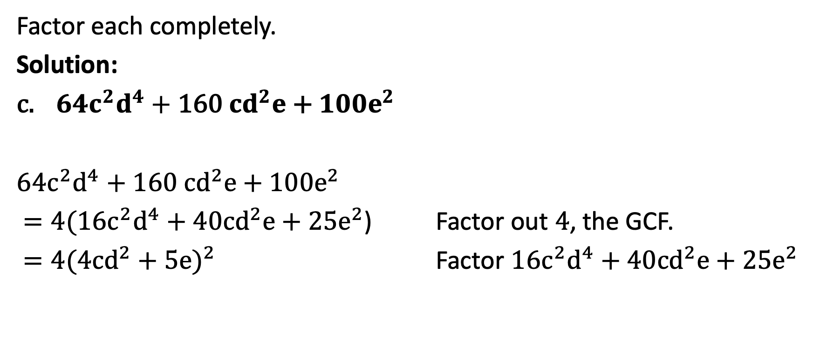
Factoring Perfect Square Trinomials
Factor each completely.
Solution:
${64c}^{2}d^{4}+$ 160 ${cd}^{2}e$ + ${100e}^{2}$
${64c}^{2}d^{4}+$ 160 ${cd}^{2}e$ + ${100e}^{2}$
$=4({16c}^{2}d^{4}+$ 40${cd}^{2}e+{25e}^{2}$) Factor out 4, the GCF.
$=4(4cd^{2}+$ ${5e)}^{2}$ Factor ${16c}^{2}d^{4}+$ 40${cd}^{2}e+{25e}^{2}$

Slide 18
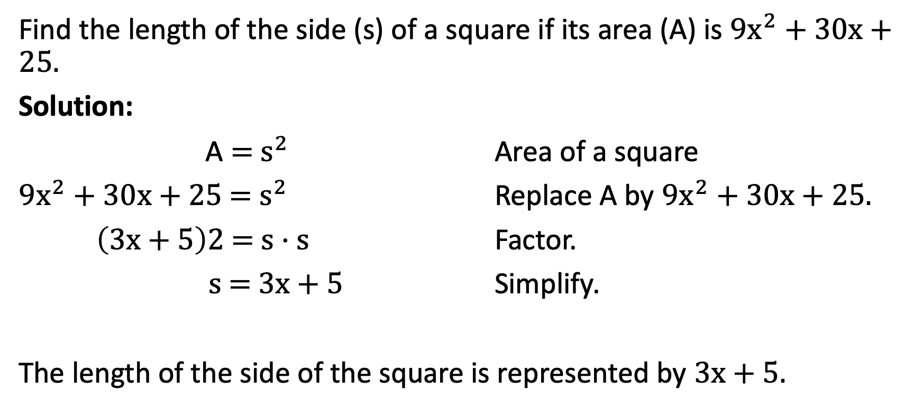
Factoring Perfect Square Trinomials
Find the length of the side (s) of a square if its area (A) is ${9x}^{2}$ + 30x + 25.
Solution:
A = $s^{2}$ Area of a square
${9x}^{2}$ + 30x + 25 = $s^{2}$ Replace A by ${9x}^{2}$ + 30x + 25.
$\left(3x+5\right)2$ = s · s Factor.
$s$ = 3x + 5 Simplify.
The length of the side of the square is represented by 3x + 5.

