Slide 1

Factoring Quadratic Trinomials in the Form ${ax}^{2}+bx+c$, where a = 1

Slide 2
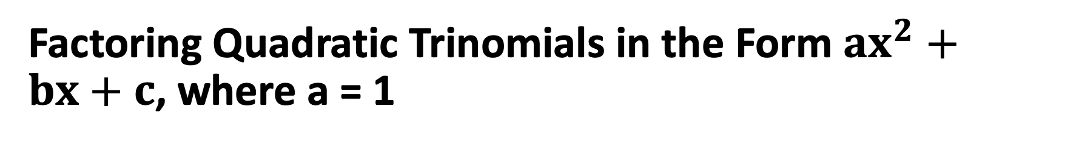
Factoring Quadratic Trinomials in the Form ${ax}^{2}+bx+c$, where a = 1
If the constant term (c) is not a perfect square, the trinomial cannot be factored into a square of a binomial. It may, however, be factored into a product of two different binomials.

Slide 3
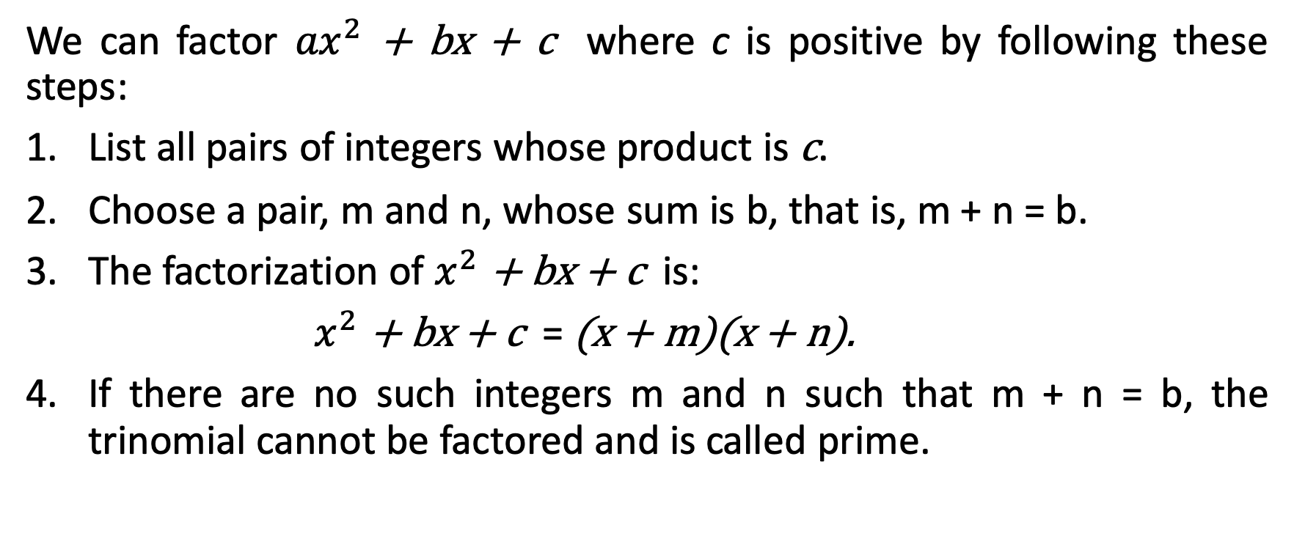
Factoring Quadratic Trinomials in the Form ${ax}^{2}+bx+c$, where a = 1
We can factor ${ax}^{2}$ + bx + c where c is positive by following these steps:
List all pairs of integers whose product is c.
Choose a pair, m and n, whose sum is b, that is, m + n = b.
The factorization of $x^{2}$ + bx + c is:
$x^{2}$ + bx + c = (x + m)(x + n).
If there are no such integers m and n such that m + n = b, the trinomial cannot be factored and is called prime.

Slide 4

Factoring Quadratic Trinomials in the Form ${ax}^{2}+bx+c$, where a = 1
Factor each polynomial completely.
  $x^{2}$ + 10x + 16 b. $x^{2}−$ 9x + 18

Slide 5
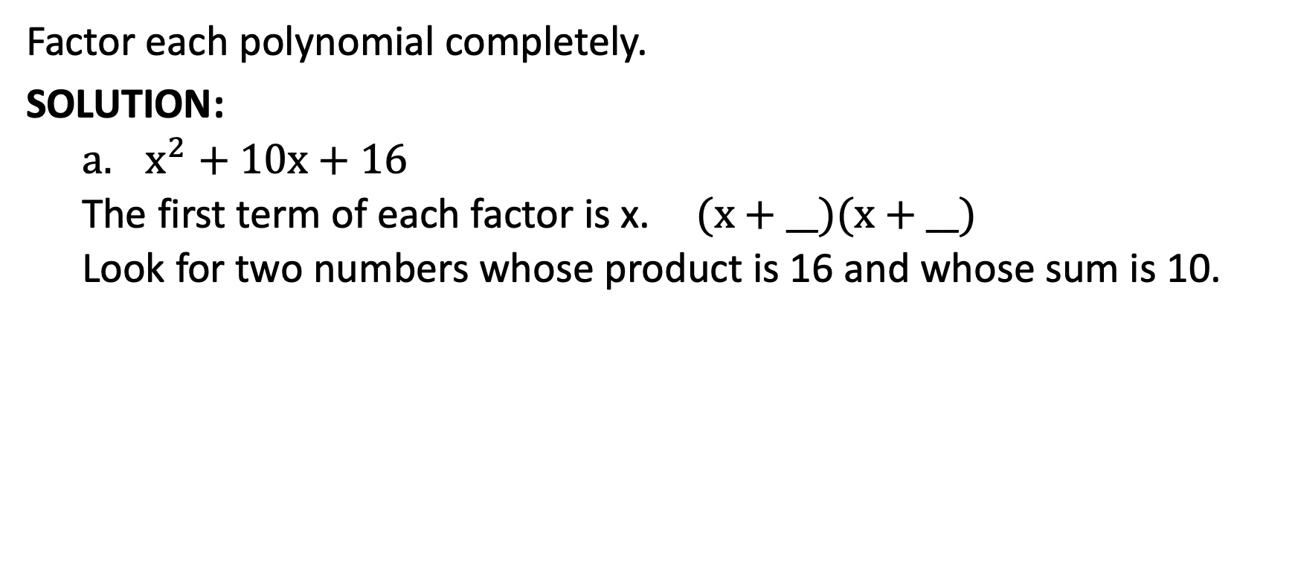
Factoring Quadratic Trinomials in the Form ${ax}^{2}+bx+c$, where a = 1
Factor each polynomial completely.
SOLUTION:
  $x^{2}$ + 10x + 16
  The first term of each factor is x. (x + __)(x + __)
  Look for two numbers whose product is 16 and whose sum is 10.
Factors of 16 | Sum
1, 16 | 17
2, 8 | 10
4, 4 | 8
The numbers we need are 2 and 8.

Slide 6
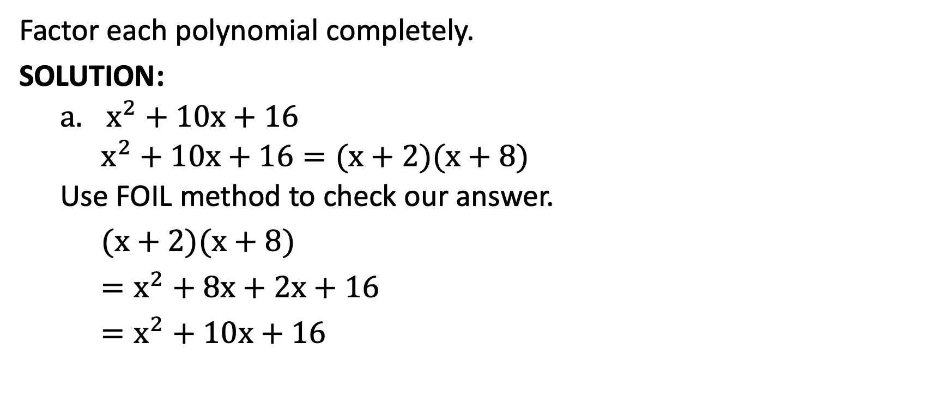
Factoring Quadratic Trinomials in the Form ${ax}^{2}+bx+c$, where a = 1
Factor each polynomial completely.
SOLUTION:
  $x^{2}$ + 10x + 16
  $x^{2}+10x+16=(x+2)(x+8)$
  Use FOIL method to check our answer.
$(x+2)(x+8)$
$=x^{2}+8x+2x+16$
$=x^{2}+10x+16$

Slide 7
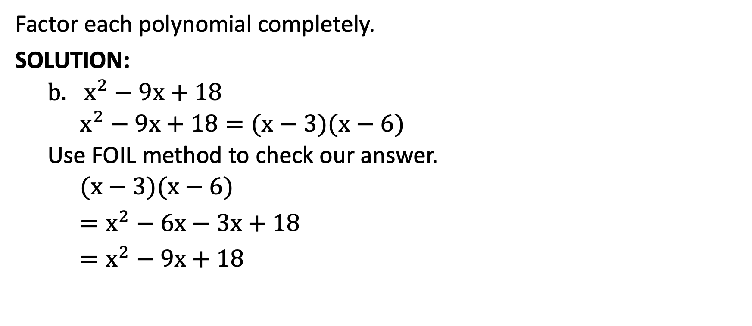
Factoring Quadratic Trinomials in the Form ${ax}^{2}+bx+c$, where a = 1
Factor each polynomial completely.
SOLUTION:
  $x^{2}−$ 9x + 18
  $x^{2}−\text{9}\text{x}\text{ + 18}=(x−3)(x−6)$
  Use FOIL method to check our answer.
  $(x−3)(x−6)$
$=x^{2}−6x−3x+18$
$=x^{2}−9x+18$

Slide 8

Factoring Quadratic Trinomials in the Form ${ax}^{2}+bx+c$, where a = 1
Factor each polynomial completely.
SOLUTION:
  $x^{2}−$ 9x + 18
  The coefficient of the middle term is negative. You need two negative numbers whose product is 18 and whose sum is –9.
Factors of 18 | Sum
–1, 18 | –19
–2, –9 | –11
–3, –6 | –9
The numbers we need are – 3 and –6.

Slide 9

Factoring Quadratic Trinomials in the Form ${ax}^{2}+bx+c$, where a = 1
Factor each trinomial completely.
  $x^{2}−2$x $−$ 24 b. $x^{2}+$ 3x $−$ 10

Slide 10
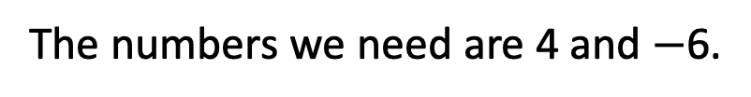
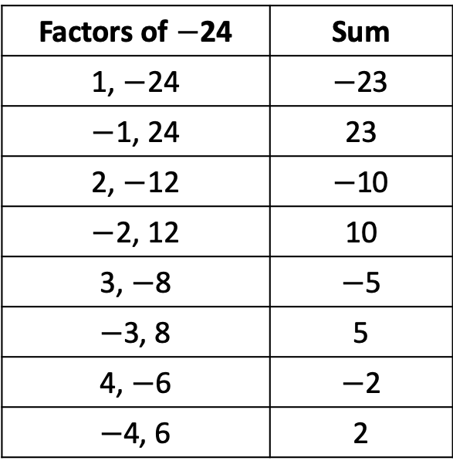

Factoring Quadratic Trinomials in the Form ${ax}^{2}+bx+c$, where a = 1
Factor each trinomial completely.
SOLUTION:
  $x^{2}−2$x $−$ 24
Factors of $−$24 | Sum
1, $−$24 | $−$23
$−$1, 24 | 23
2, $−$12 | $−$10
$−$2, 12 | 10
3, $−$8 | $−$5
$−$3, 8 | 5
4, $−$6 | $−$2
$−$4, 6 | 2
Find two numbers whose product is -24 and whose sum is -2. For the product to be negative, one factor must be positive, and the other negative.
The numbers we need are 4 and $−$6.

Slide 11
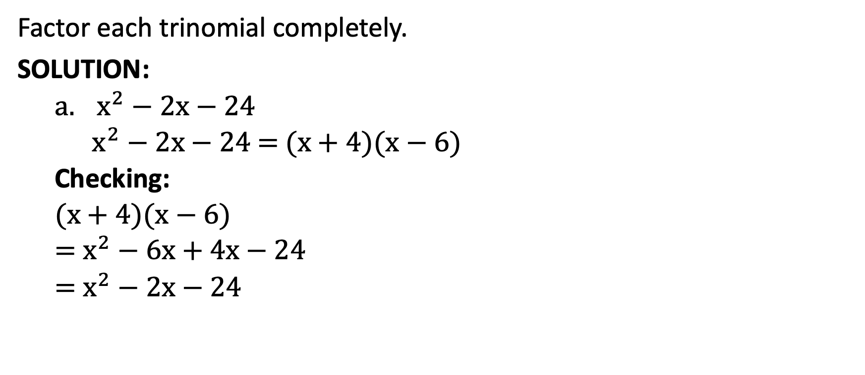
Factoring Quadratic Trinomials in the Form ${ax}^{2}+bx+c$, where a = 1
Factor each trinomial completely.
SOLUTION:
  $x^{2}−2$x $−$ 24
  $x^{2}−2$x $−$ 24 = (x + 4)(x $−$ 6)
  Checking:
  (x + 4)(x $−$ 6)
  = $x^{2}−6$x + 4x $−$ 24
  = $x^{2}−2$x $−$ 24

Slide 12

Factoring Quadratic Trinomials in the Form ${ax}^{2}+bx+c$, where a = 1
Factor each trinomial completely.
SOLUTION:
  $x^{2}+$ 3x $−$ 10
Find two numbers whose product is -10 and whose sum is 3.
Factors of –10 | Sum
1, –10 | –9
–1, 10 | 9
2, –5 | –3
–2, 5 | 3
The numbers we need are – 2 and 5.

Slide 13
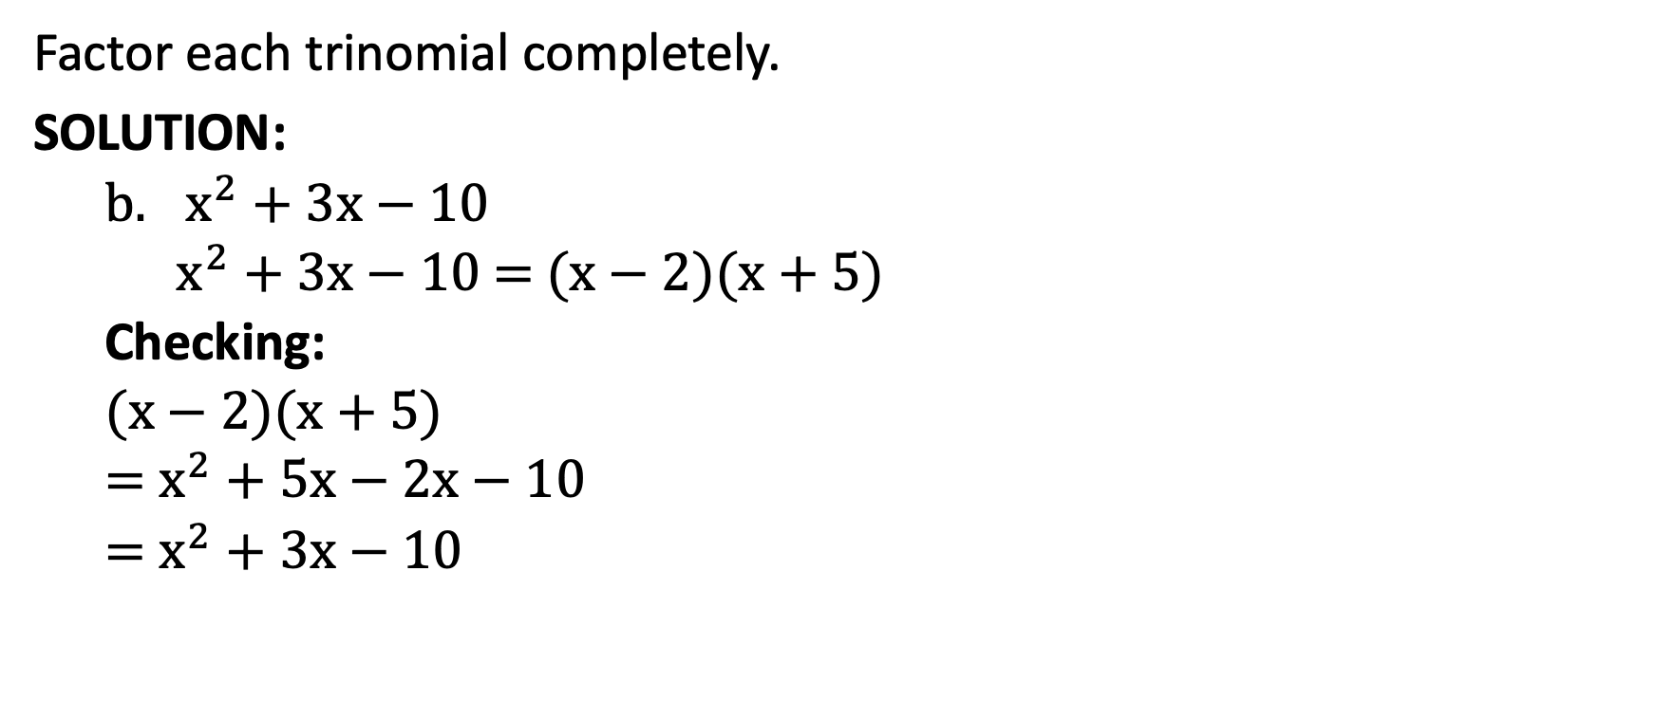
Factoring Quadratic Trinomials in the Form ${ax}^{2}+bx+c$, where a = 1
Factor each trinomial completely.
SOLUTION:
  $x^{2}+$ 3x $−$ 10
  $x^{2}+$ 3x $−$ 10 = (x $−$ 2)(x $+$ 5)
  Checking:
  (x $−$ 2)(x $+$ 5)
  = $x^{2}+5$x $−$ 2x $−$ 10
  = $x^{2}+3$x $−$ 10

Slide 14
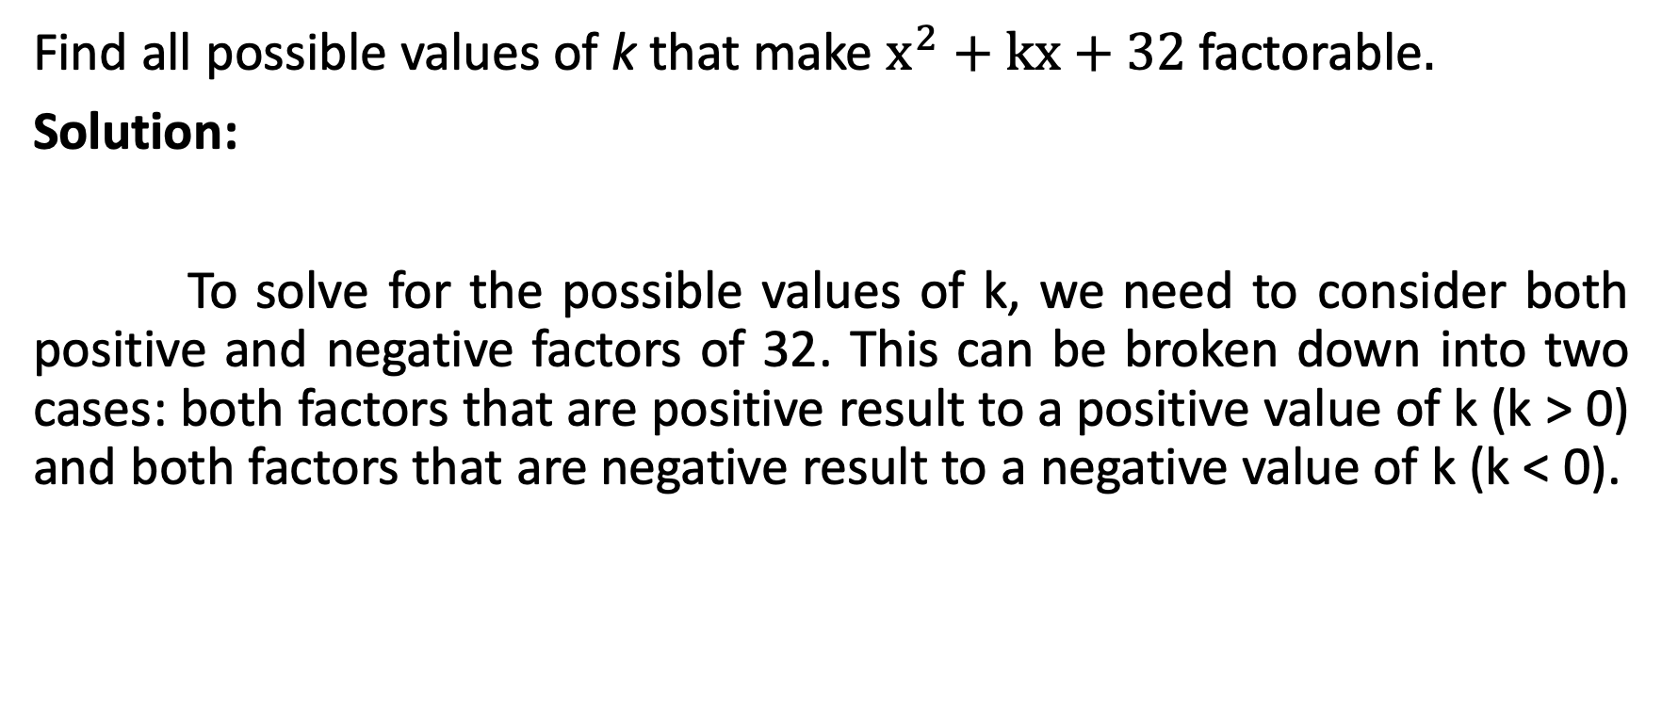
Factoring Quadratic Trinomials in the Form ${ax}^{2}+bx+c$, where a = 1
Find all possible values of k that make $x^{2}+$ kx $+$ 32 factorable.
Solution:
To solve for the possible values of k, we need to consider both positive and negative factors of 32. This can be broken down into two cases: both factors that are positive result to a positive value of k (k > 0) and both factors that are negative result to a negative value of k (k < 0).

Slide 15




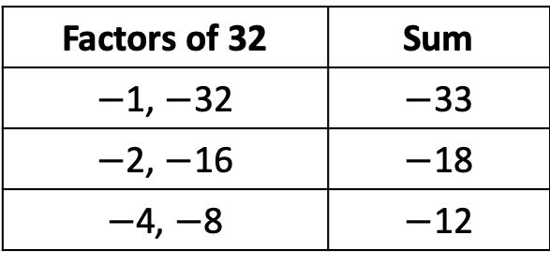



Factoring Quadratic Trinomials in the Form ${ax}^{2}+bx+c$, where a = 1
Find all possible values of k that make $x^{2}+$ kx $+$ 32 factorable.
Solution:
For k > 0:
Factors of 32 | Sum
1, 32 | 17
2, 16 | 10
4, 8 | 8
$x^{2}+$ 33x $+$ 32 = (x + 1)(x + 32)
$x^{2}+$ 18x $+$ 32 = (x + 2)(x + 16)
$x^{2}+$ 12x $+$ 32 = (x + 4)(x + 8)
For k < 0:
Factors of 32 | Sum
$−$1, $−$32 | $−$33
$−$2, $−$16 | $−$18
$−$4, $−$8 | $−$12
$x^{2}−$ 33x $+$ 32 = (x $−$1)(x $−$32)
$x^{2}−$ 18x $+$ 32 = (x $−$2)(x $−$16)
$x^{2}−$ 12x $+$ 32 = (x $−$4)(x $−$8)
Thus, k can be ± 33, ±18, and ±12.

Slide 16
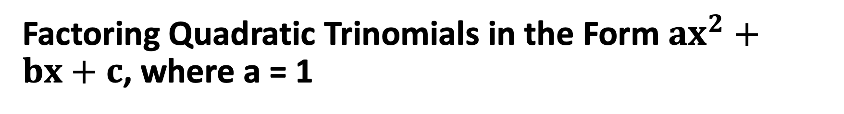
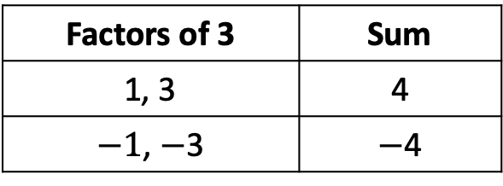
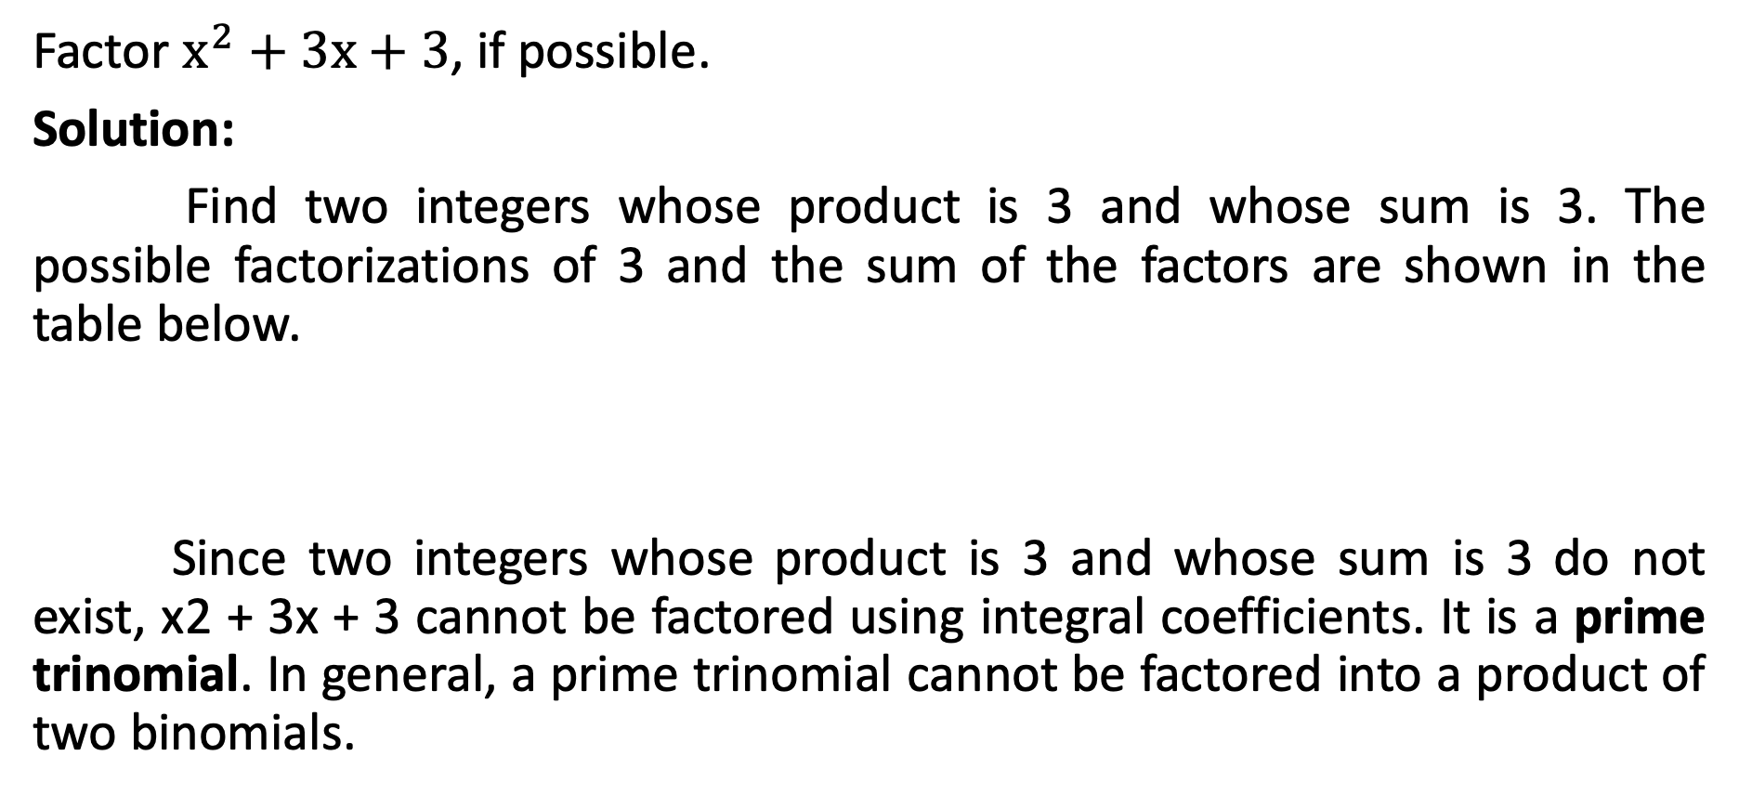
Factoring Quadratic Trinomials in the Form ${ax}^{2}+bx+c$, where a = 1
Factor $x^{2}+$ 3x $+$ 3, if possible.
Solution:
Find two integers whose product is 3 and whose sum is 3. The possible factorizations of 3 and the sum of the factors are shown in the table below.
Since two integers whose product is 3 and whose sum is 3 do not exist, x2 + 3x + 3 cannot be factored using integral coefficients. It is a prime trinomial. In general, a prime trinomial cannot be factored into a product of two binomials.
Factors of 3 | Sum
1, 3 | 4
$−1$, $−$3 | $−$4

Slide 17
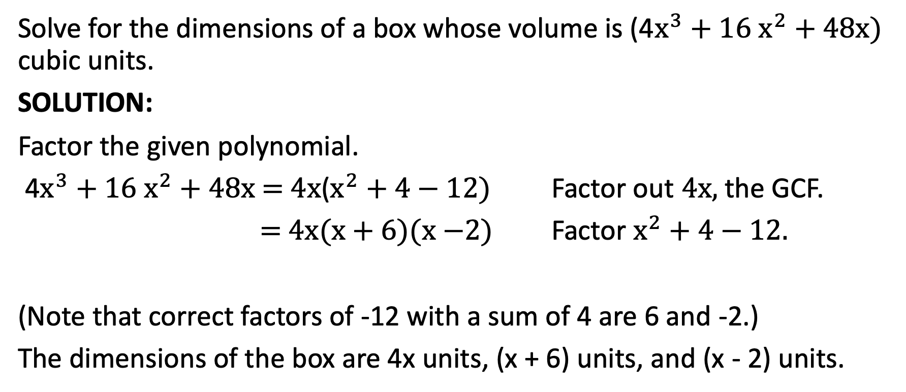
Factoring Quadratic Trinomials in the Form ${ax}^{2}+bx+c$, where a = 1
Solve for the dimensions of a box whose volume is (4$x^{3}+$ 16 $x^{2}$ $+$ 48x) cubic units.
SOLUTION:
Factor the given polynomial.
4$x^{3}+$ 16 $x^{2}$ $+$ 48x = 4x($x^{2}+$ 4$−$ 12) Factor out 4x, the GCF.
= 4x(x$+$ 6)($x−$2) Factor $x^{2}+$ 4$−$ 12.
(Note that correct factors of -12 with a sum of 4 are 6 and -2.)
The dimensions of the box are 4x units, (x + 6) units, and (x - 2) units.

