Slide 1

Factoring Quadratic Trinomials in the Form ${ax}^{2}+bx+c$, where a ≠ 1

Slide 2
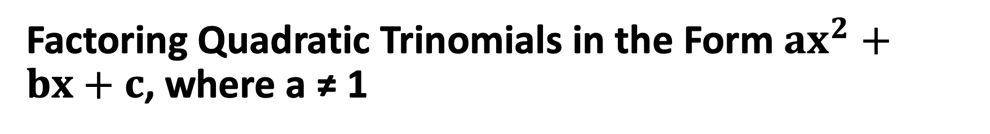
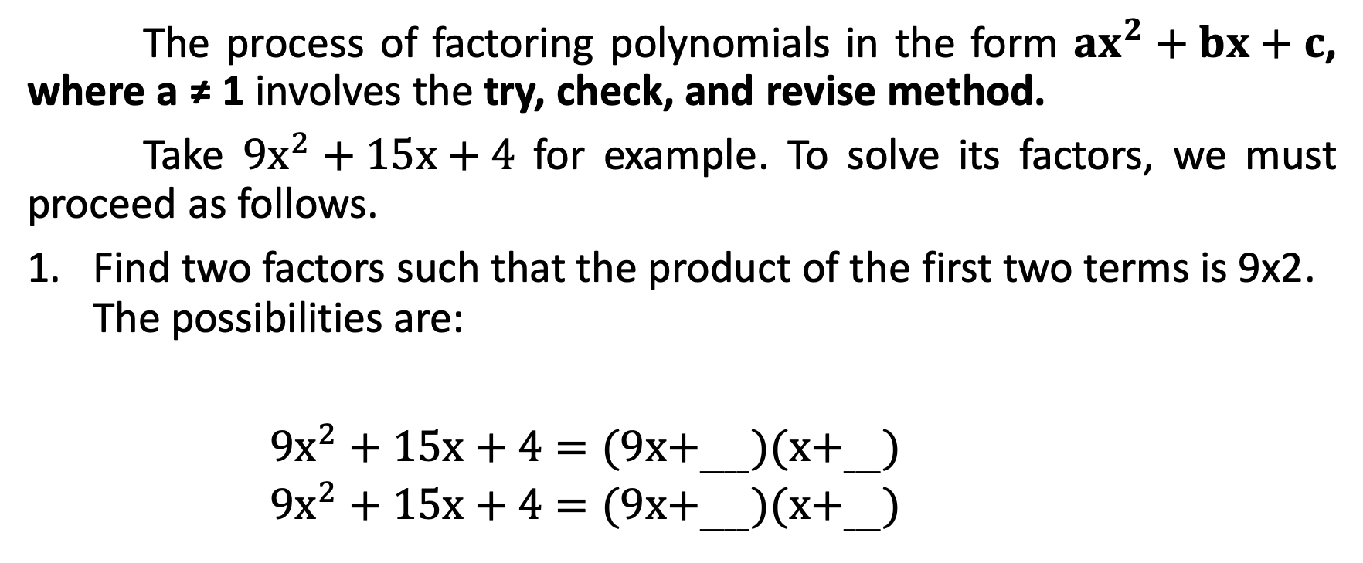
Factoring Quadratic Trinomials in the Form ${ax}^{2}+bx+c$, where a ≠ 1
The process of factoring polynomials in the form ${ax}^{2}+bx+c$, where a ≠ 1 involves the try, check, and revise method.
Take ${9x}^{2}+15x+4$ for example. To solve its factors, we must proceed as follows.
Find two factors such that the product of the first two terms is 9x2. The possibilities are:
${9x}^{2}+15x+4=(9x+_{____})(x+_{___})$
      ${9x}^{2}+15x+4=(9x+_{____})(x+_{___})$

Slide 3
Factoring Quadratic Trinomials in the Form ${ax}^{2}+bx+c$, where a ≠ 1
The product of the last two terms in each factor must be 4. Since the constant, 4, is positive, the constant terms of the binomials have the same sign as the coefficient of x. The possible pair factors of 4, are 1 and 4 and 2 and 2.
Write the factors of 4 together with the factors of 9x2. Determine the middle term of each product using the FOIL method.

Slide 4
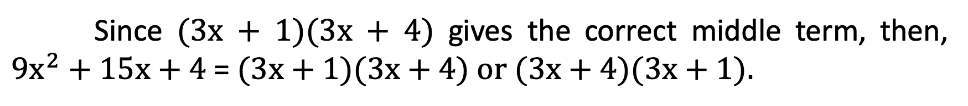
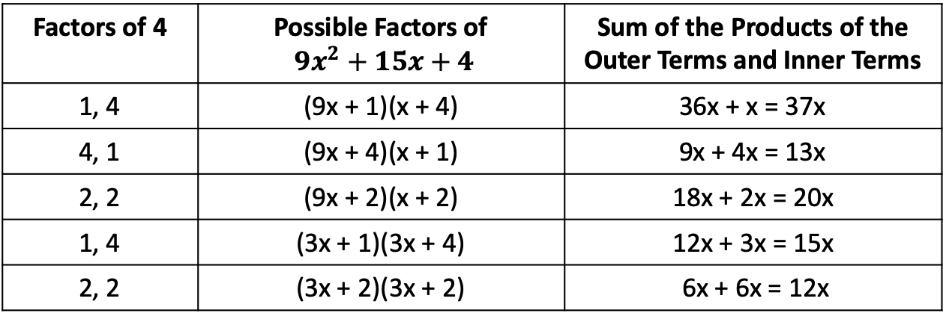
Factoring Quadratic Trinomials in the Form ${ax}^{2}+bx+c$, where a ≠ 1
Factors of 4 | Possible Factors of ${9x}^{2}+15x+4$ | Sum of the Products of the Outer Terms and Inner Terms
1, 4 | (9x + 1)(x + 4) | 36x + x = 37x
4, 1 | (9x + 4)(x + 1) | 9x + 4x = 13x
2, 2 | (9x + 2)(x + 2) | 18x + 2x = 20x
1, 4 | (3x + 1)(3x + 4) | 12x + 3x = 15x
2, 2 | (3x + 2)(3x + 2) | 6x + 6x = 12x
This is the required middle term
Since (3x + 1)(3x + 4) gives the correct middle term, then, ${9x}^{2}+15x+4$= (3x + 1)(3x + 4) or (3x + 4)(3x + 1).

Slide 5
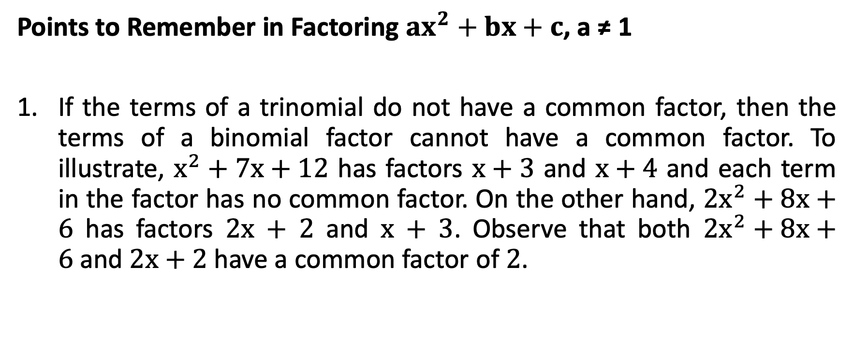
Factoring Quadratic Trinomials in the Form ${ax}^{2}+bx+c$, where a ≠ 1
Points to Remember in Factoring ${ax}^{2}+bx+c$, a ≠ 1
If the terms of a trinomial do not have a common factor, then the terms of a binomial factor cannot have a common factor. To illustrate, $x^{2}+7x+12$ has factors $x+3$ and $x+4$ and each term in the factor has no common factor. On the other hand, ${2x}^{2}+8x+6$ has factors 2x + 2 and x + 3. Observe that both ${2x}^{2}+8x+6$and 2x + 2 have a common factor of 2.

Slide 6
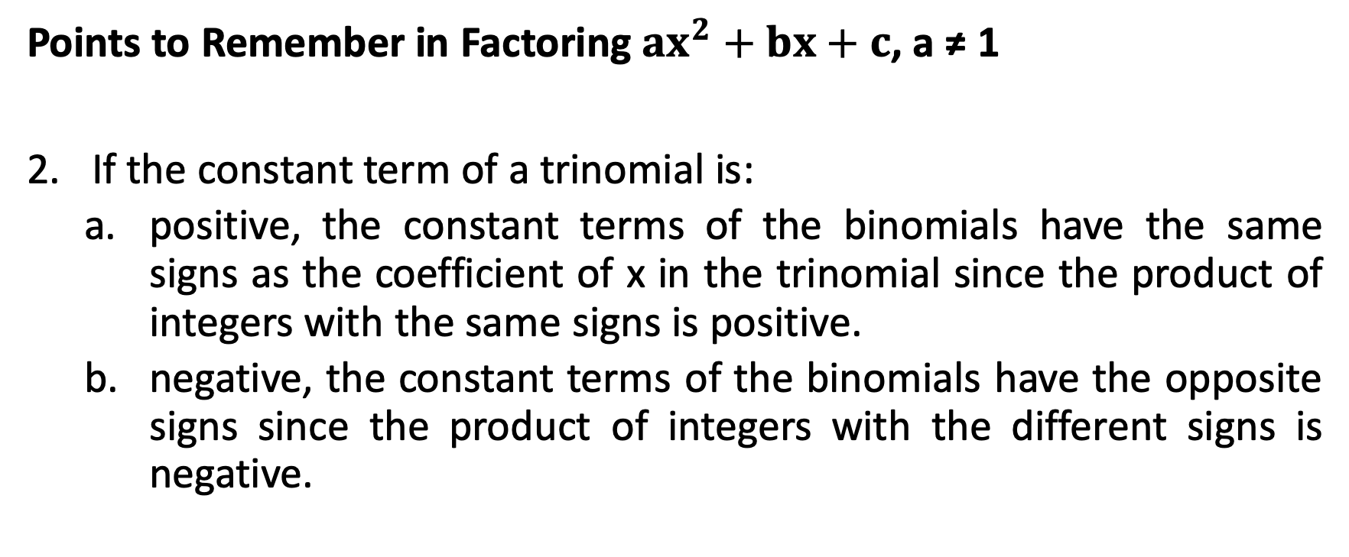
Factoring Quadratic Trinomials in the Form ${ax}^{2}+bx+c$, where a ≠ 1
Points to Remember in Factoring ${ax}^{2}+bx+c$, a ≠ 1
If the constant term of a trinomial is:
  positive, the constant terms of the binomials have the same signs as the coefficient of x in the trinomial since the product of integers with the same signs is positive.
  negative, the constant terms of the binomials have the opposite signs since the product of integers with the different signs is negative.

Slide 7

Factoring Quadratic Trinomials in the Form ${ax}^{2}+bx+c$, where a ≠ 1
Factor each trinomial completely.
a. ${3x}^{2}−x−10$ b. ${8x}^{2}+17x+2$ c. ${2x}^{2}−13x+15$

Slide 8
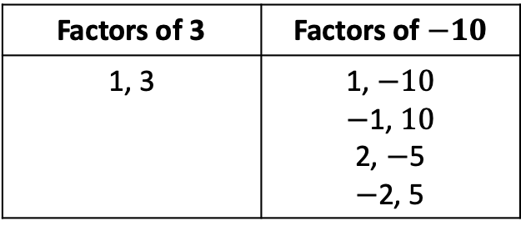
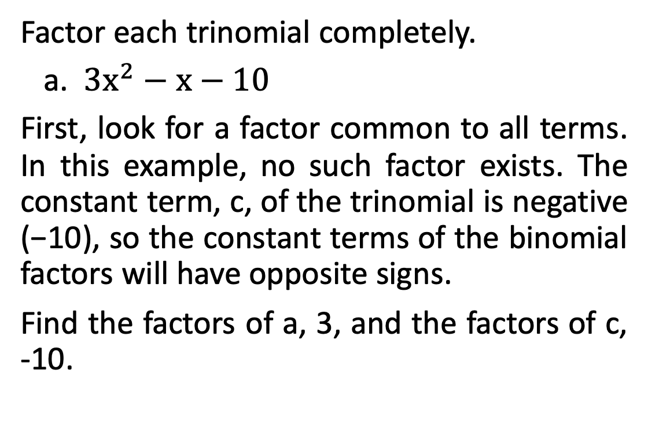
Factoring Quadratic Trinomials in the Form ${ax}^{2}+bx+c$, where a ≠ 1
Factor each trinomial completely.
a. ${3x}^{2}−x−10$
First, look for a factor common to all terms. In this example, no such factor exists. The constant term, c, of the trinomial is negative (−10), so the constant terms of the binomial factors will have opposite signs.
Find the factors of a, 3, and the factors of c, -10.
Factors of 3 | Factors of $−10$
1, 3 | 1, $−10$ $−$1, $10$ 2, $−$5 $−$2, 5

Slide 9
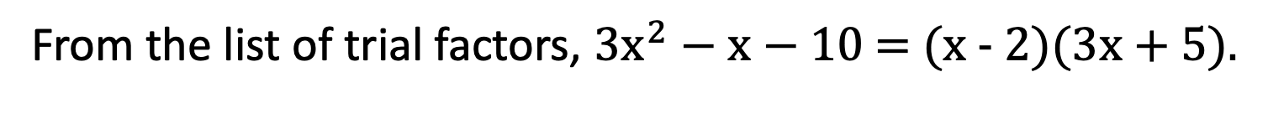
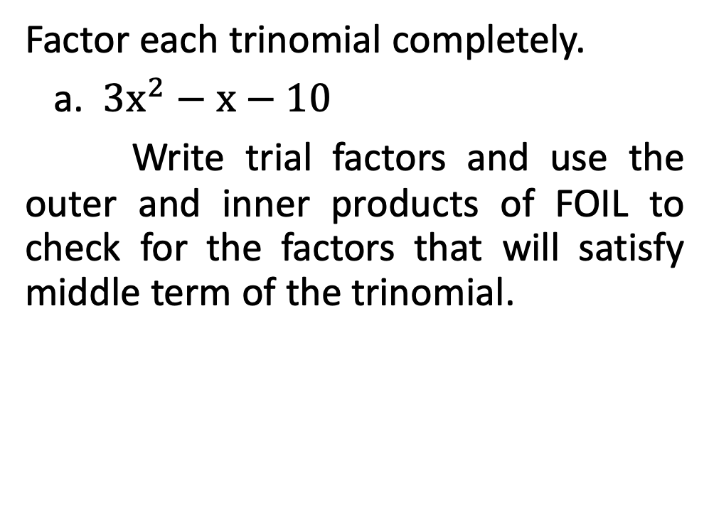
Factoring Quadratic Trinomials in the Form ${ax}^{2}+bx+c$, where a ≠ 1
Factor each trinomial completely.
a. ${3x}^{2}−x−10$
Write trial factors and use the outer and inner products of FOIL to check for the factors that will satisfy middle term of the trinomial.
Trial Factors | Middle Term
(x + 1)(3x - 10) (x - 1)(3x + 10) (x + 2)(3x - 5) (x - 2)(3x + 5) (3x + 1)(x - 10) (3x - 1)(x + 10) (3x + 2)(x - 5) (3x - 2)(x + 5) | -10x + 3x = -7x 10x - 3x = 7x -5x + 6x = x 5x - 6x = -x -30x + x = -29x 30x - x = 29x -15x + 2x = -13x 15x - 2x = 13x
From the list of trial factors, ${3x}^{2}−x−10$= (x - 2)(3x + 5).

Slide 10
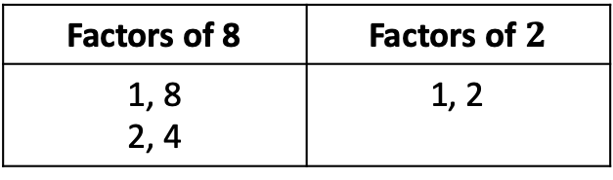
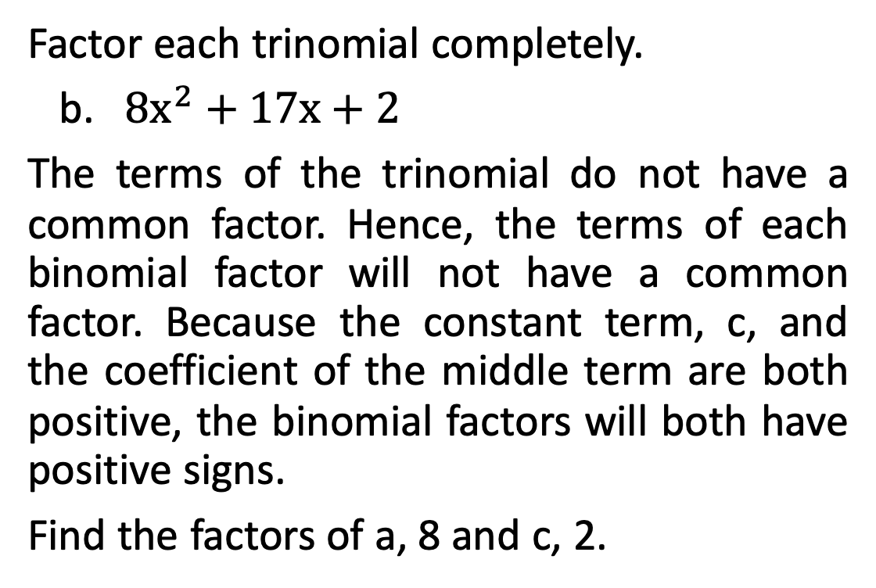
Factoring Quadratic Trinomials in the Form ${ax}^{2}+bx+c$, where a ≠ 1
Factor each trinomial completely.
b.${ 8x}^{2}$ + 17x + 2
The terms of the trinomial do not have a common factor. Hence, the terms of each binomial factor will not have a common factor. Because the constant term, c, and the coefficient of the middle term are both positive, the binomial factors will both have positive signs.
Find the factors of a, 8 and c, 2.
Factors of 8 | Factors of $2$
1, 8 2, 4 | 1, 2

Slide 11
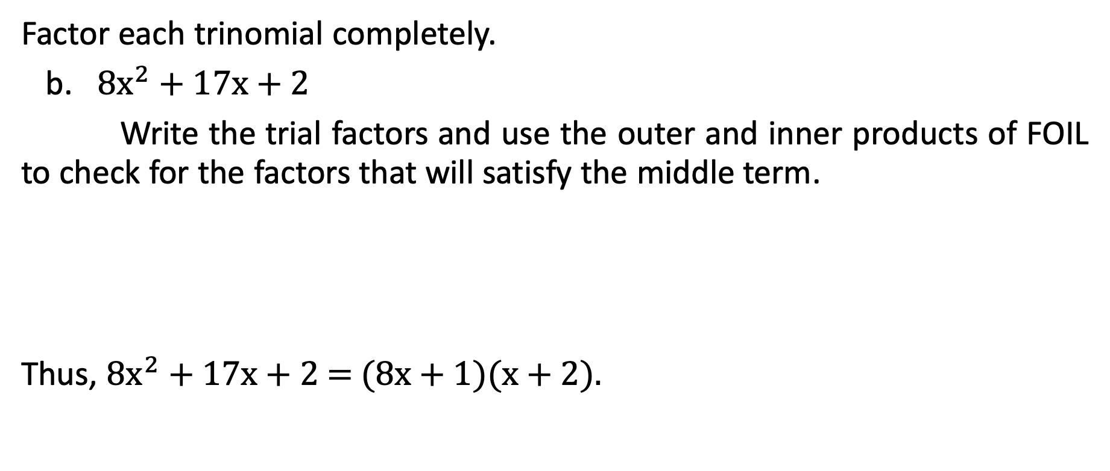
Factoring Quadratic Trinomials in the Form ${ax}^{2}+bx+c$, where a ≠ 1
Factor each trinomial completely.
b. ${8x}^{2}$ + 17x + 2
Write the trial factors and use the outer and inner products of FOIL to check for the factors that will satisfy the middle term.
Thus, ${8x}^{2}$ + 17x + 2 = (8x + 1)(x + 2).
Trial Factors | Middle Term
(x + 1)(8x + 2) (2x + 1)(4x + 2) (8x + 1)(x + 2) | 2x + 8x = 10x 4x + 4x = 8x 16x + x = 17x

Slide 12
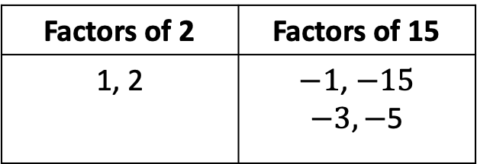

Factoring Quadratic Trinomials in the Form ${ax}^{2}+bx+c$, where a ≠ 1
Factor each trinomial completely.
c. ${2x}^{2}−13x+15$
The terms have no common factors. Because c is positive and b is negative, only the negative factors of 15 need to be tried.
Factors of 2 | Factors of 15
1, 2 | $−1$, $−15$ $−3,−$5

Slide 13
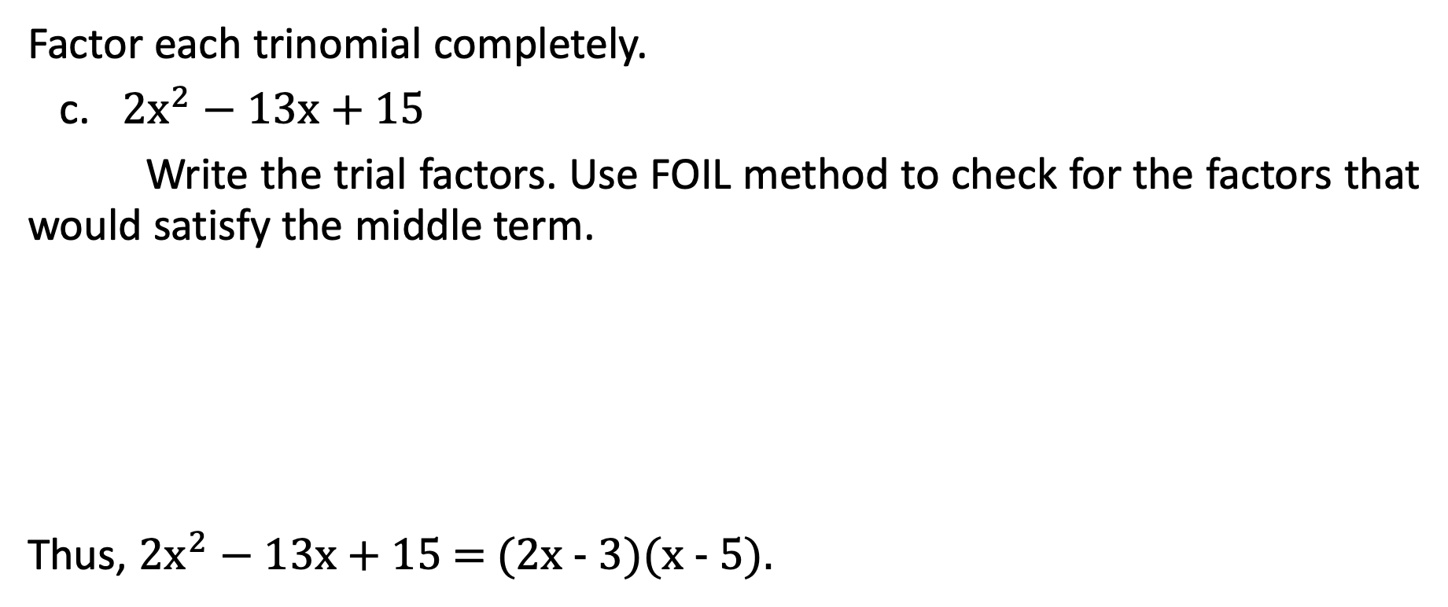
Factoring Quadratic Trinomials in the Form ${ax}^{2}+bx+c$, where a ≠ 1
Factor each trinomial completely.
c. ${2x}^{2}−13x+15$
Write the trial factors. Use FOIL method to check for the factors that would satisfy the middle term.
Thus, ${2x}^{2}−13x+15$= (2x - 3)(x - 5).
Trial Factors | Middle Term
(x - 1)(2x - 15) (x - 3)(2x - 5) (2x - 1)(x - 15) (2x - 3)(x - 5) | -15x - 2x = -17x -5x - 6x = -11x -5x - 6x = -11x -10x - 3x = -13x

Slide 14
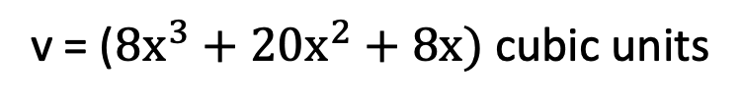
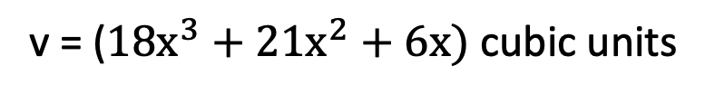
Factoring Quadratic Trinomials in the Form ${ax}^{2}+bx+c$, where a ≠ 1
Solve for the dimensions of the figures below using the equation of their respective volumes.
a. b.
v = (${18x}^{3}+{21x}^{2}+6x)$ cubic units
v = (${8x}^{3}+{20x}^{2}+8x)$ cubic units

Slide 15
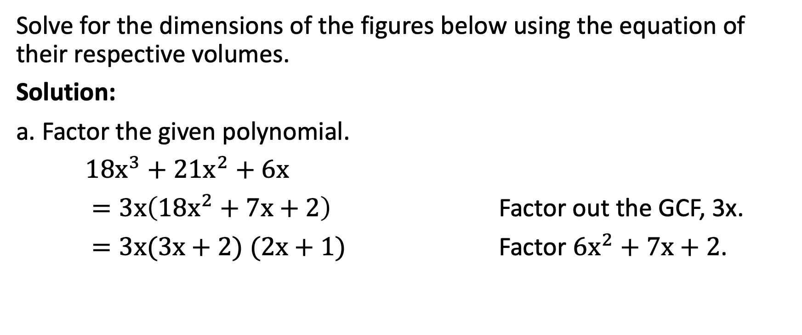
Factoring Quadratic Trinomials in the Form ${ax}^{2}+bx+c$, where a ≠ 1
Solve for the dimensions of the figures below using the equation of their respective volumes.
Solution:
a. Factor the given polynomial.
${18x}^{3}+{21x}^{2}+6x$
$=3x\left({18x}^{2}+7x+2\right)$ Factor out the GCF, 3x.
$=3x(3x+2)$ $(2x+1)$ Factor ${6x}^{2}+7x+2$.

Slide 16
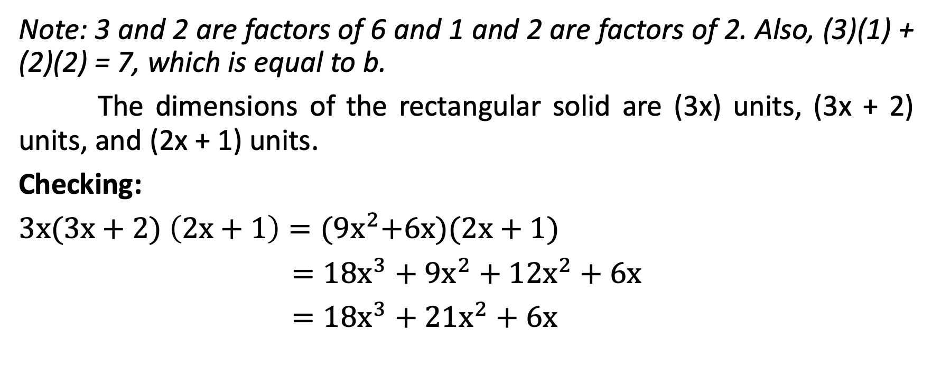
Factoring Quadratic Trinomials in the Form ${ax}^{2}+bx+c$, where a ≠ 1
Note: 3 and 2 are factors of 6 and 1 and 2 are factors of 2. Also, (3)(1) + (2)(2) = 7, which is equal to b.
The dimensions of the rectangular solid are (3x) units, (3x + 2) units, and (2x + 1) units.
Checking:
$3x(3x+2)$ $\left(2x+1\right)={(9x}^{2}+6x)(2x+1)$
$={18x}^{3}+{9x}^{2}+{12x}^{2}+6x$
$={18x}^{3}+{21x}^{2}+6x$

Slide 17
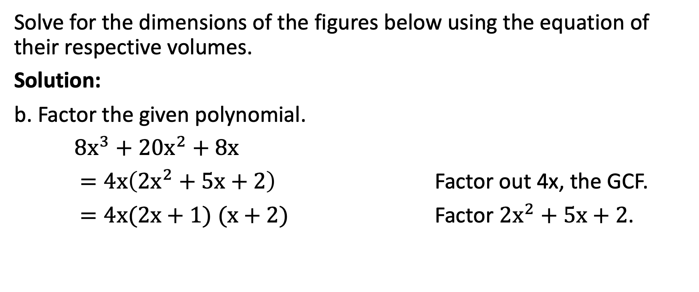
Factoring Quadratic Trinomials in the Form ${ax}^{2}+bx+c$, where a ≠ 1
Solve for the dimensions of the figures below using the equation of their respective volumes.
Solution:
b. Factor the given polynomial.
${8x}^{3}+{20x}^{2}+8x$
$=4x\left({2x}^{2}+5x+2\right)$ Factor out 4x, the GCF.
$=4x(2x+1)$ $(x+2)$ Factor ${2x}^{2}+5x+2$.

Slide 18
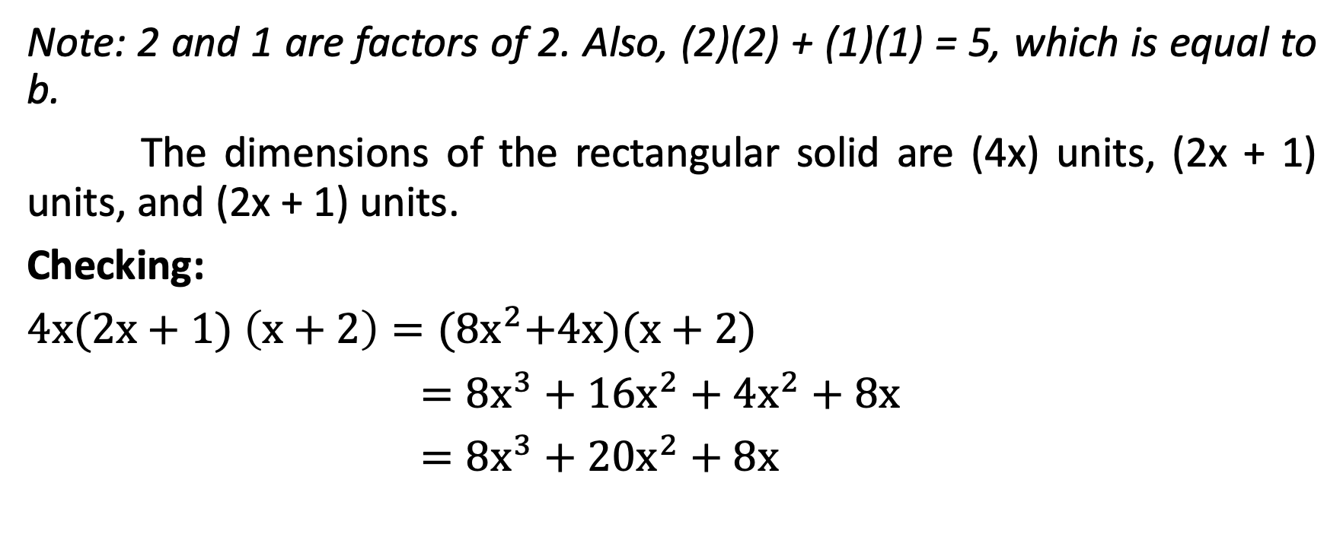
Factoring Quadratic Trinomials in the Form ${ax}^{2}+bx+c$, where a ≠ 1
Note: 2 and 1 are factors of 2. Also, (2)(2) + (1)(1) = 5, which is equal to b.
The dimensions of the rectangular solid are (4x) units, (2x + 1) units, and (2x + 1) units.
Checking:
$4x(2x+1)$ $\left(x+2\right)={(8x}^{2}+4x)(x+2)$
$={8x}^{3}+{16x}^{2}+{4x}^{2}+8x$
$={8x}^{3}+{20x}^{2}+8x$

Slide 19
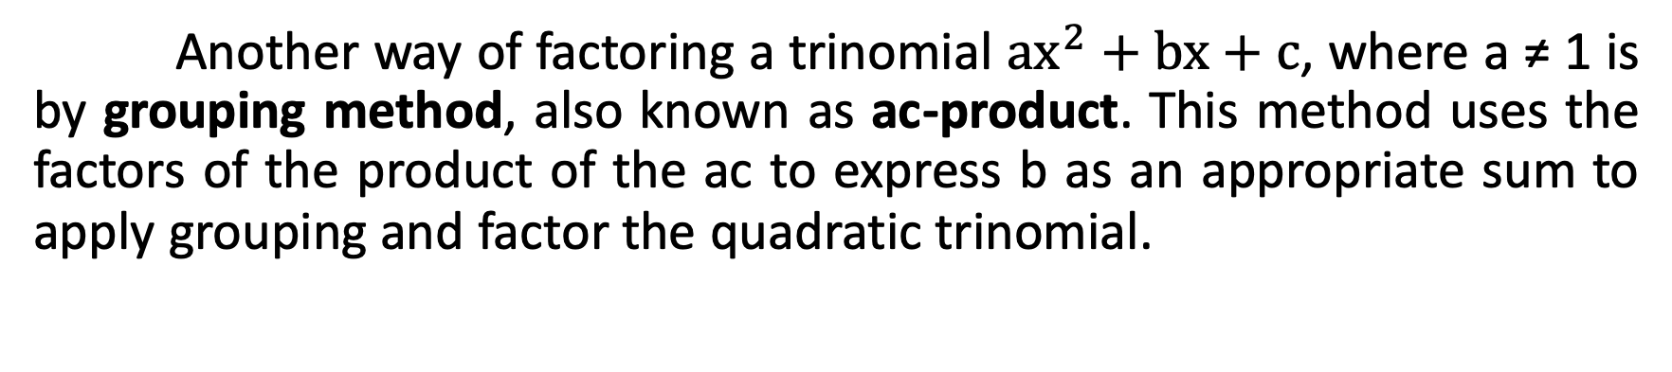
Factoring Quadratic Trinomials in the Form ${ax}^{2}+bx+c$, where a ≠ 1
Another way of factoring a trinomial ${ax}^{2}+bx+c$, where a ≠ 1 is by grouping method, also known as ac-product. This method uses the factors of the product of the ac to express b as an appropriate sum to apply grouping and factor the quadratic trinomial.

Slide 20
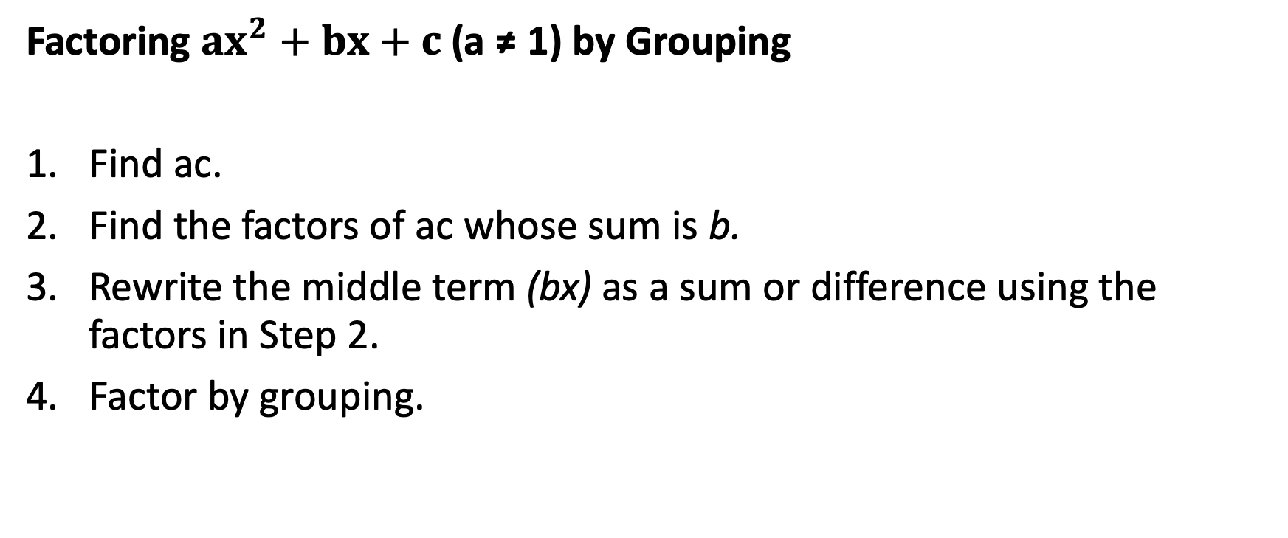
Factoring Quadratic Trinomials in the Form ${ax}^{2}+bx+c$, where a ≠ 1
Factoring ${ax}^{2}+bx+c$(a ≠ 1) by Grouping
Find ac.
Find the factors of ac whose sum is b.
Rewrite the middle term (bx) as a sum or difference using the factors in Step 2.
Factor by grouping.

Slide 21

Factoring Quadratic Trinomials in the Form ${ax}^{2}+bx+c$, where a ≠ 1
Factor each trinomial using ac-product or factoring by grouping method.
a. ${2x}^{2}+15x+28$ b. ${6x}^{2}+7x+20$

Slide 22
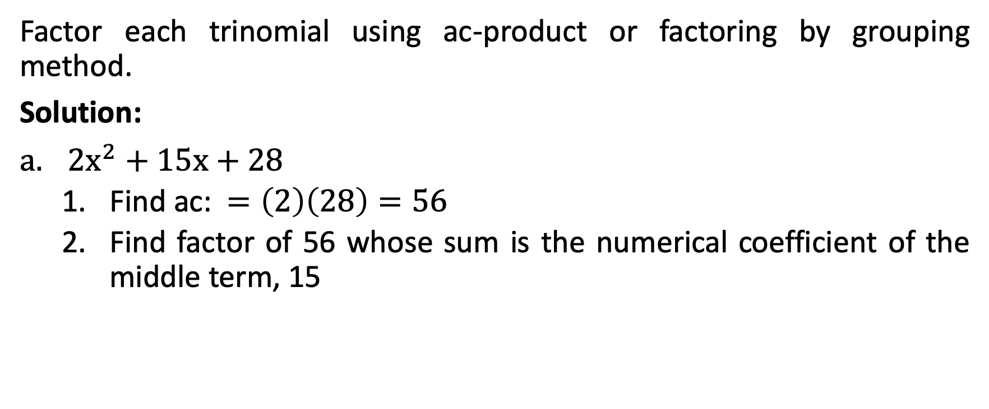
Factoring Quadratic Trinomials in the Form ${ax}^{2}+bx+c$, where a ≠ 1
Factor each trinomial using ac-product or factoring by grouping method.
Solution:
${2x}^{2}+15x+28$
  Find ac: $=\left(2\right)\left(28\right)=56$
  Find factor of 56 whose sum is the numerical coefficient of the middle term, 15
Factors of 56 | Sum
1, 56 2, 28 4, 14 7, 8 | 57 30 18 15

Slide 23
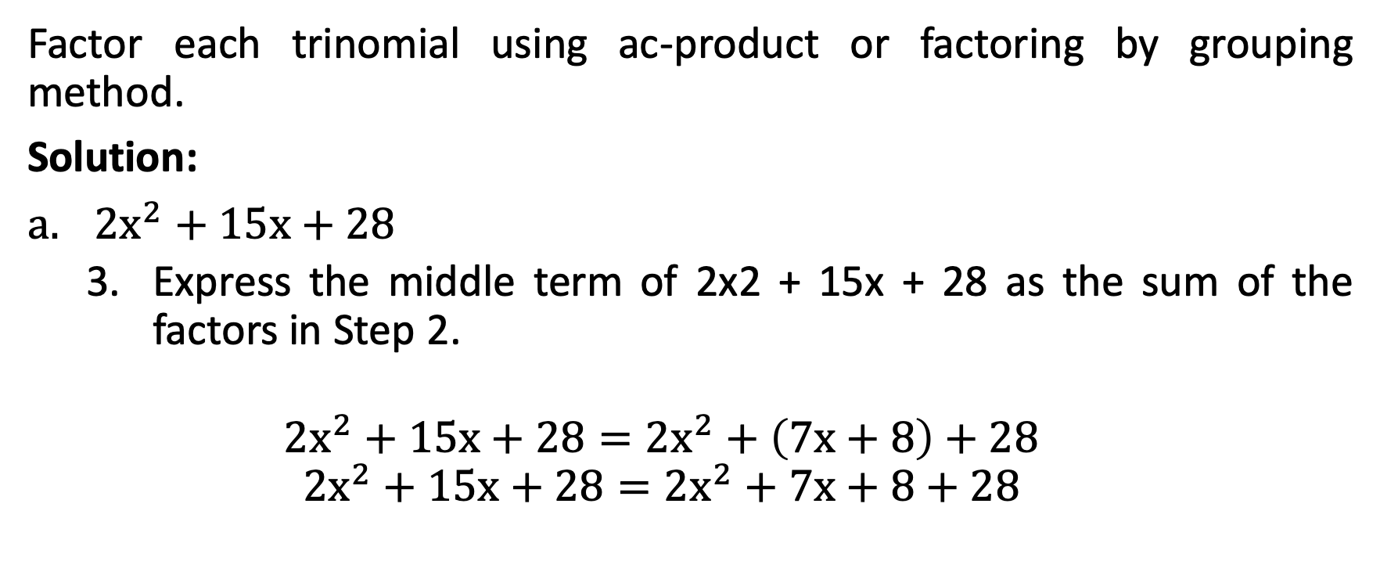
Factoring Quadratic Trinomials in the Form ${ax}^{2}+bx+c$, where a ≠ 1
Factor each trinomial using ac-product or factoring by grouping method.
Solution:
${2x}^{2}+15x+28$
  Express the middle term of 2x2 + 15x + 28 as the sum of the factors in Step 2.
  $${2x}^{2}+15x+28={2x}^{2}+\left(7x+8\right)+28$$
  $${2x}^{2}+15x+28={2x}^{2}+7x+8+28$$

Slide 24
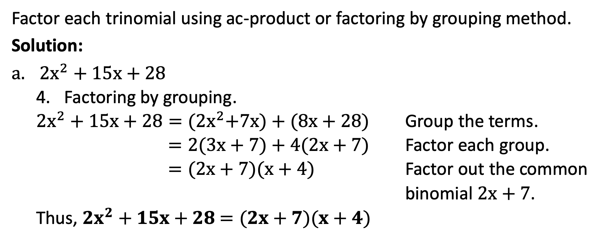
Factoring Quadratic Trinomials in the Form ${ax}^{2}+bx+c$, where a ≠ 1
Factor each trinomial using ac-product or factoring by grouping method.
Solution:
${2x}^{2}+15x+28$
  Factoring by grouping.
  ${2x}^{2}+15x+28={(2x}^{2}+7x)+(8x+28)$ Group the terms.
  $=2(3x+7)+4(2x+7)$ Factor each group.
  $=(2x+7)(x+4)$ Factor out the common
  binomial $2x+7$.
  Thus, ${2x}^{2}+15x+28$ $=(2x+7)(x+4)$

Slide 25
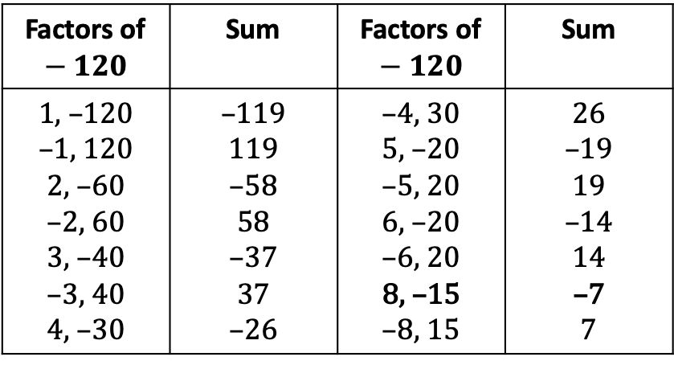
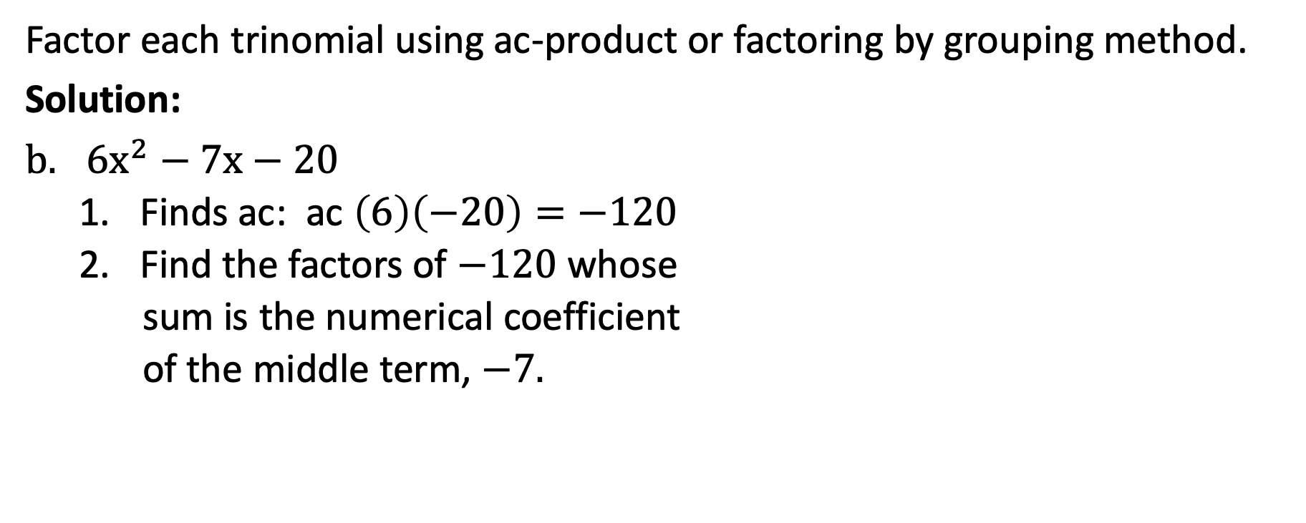
Factoring Quadratic Trinomials in the Form ${ax}^{2}+bx+c$, where a ≠ 1
Factor each trinomial using ac-product or factoring by grouping method.
Solution:
${6x}^{2}−7x−20$
  Finds ac: ac $\left(6\right)\left(−20\right)=−120$
  Find the factors of $−120$ whose
  sum is the numerical coefficient
  of the middle term, $−7.$
Factors of $−120$ | Sum | Factors of $−120$ | Sum
1, –120 –1, 120 2, –60 –2, 60 3, –40 –3, 40 4, –30 | –119 119 –58 58 –37 37 –26 | –4, 30 5, –20 –5, 20 6, –20 –6, 20 8, –15 –8, 15 | 26 –19 19 –14 14 –7 7

Slide 26
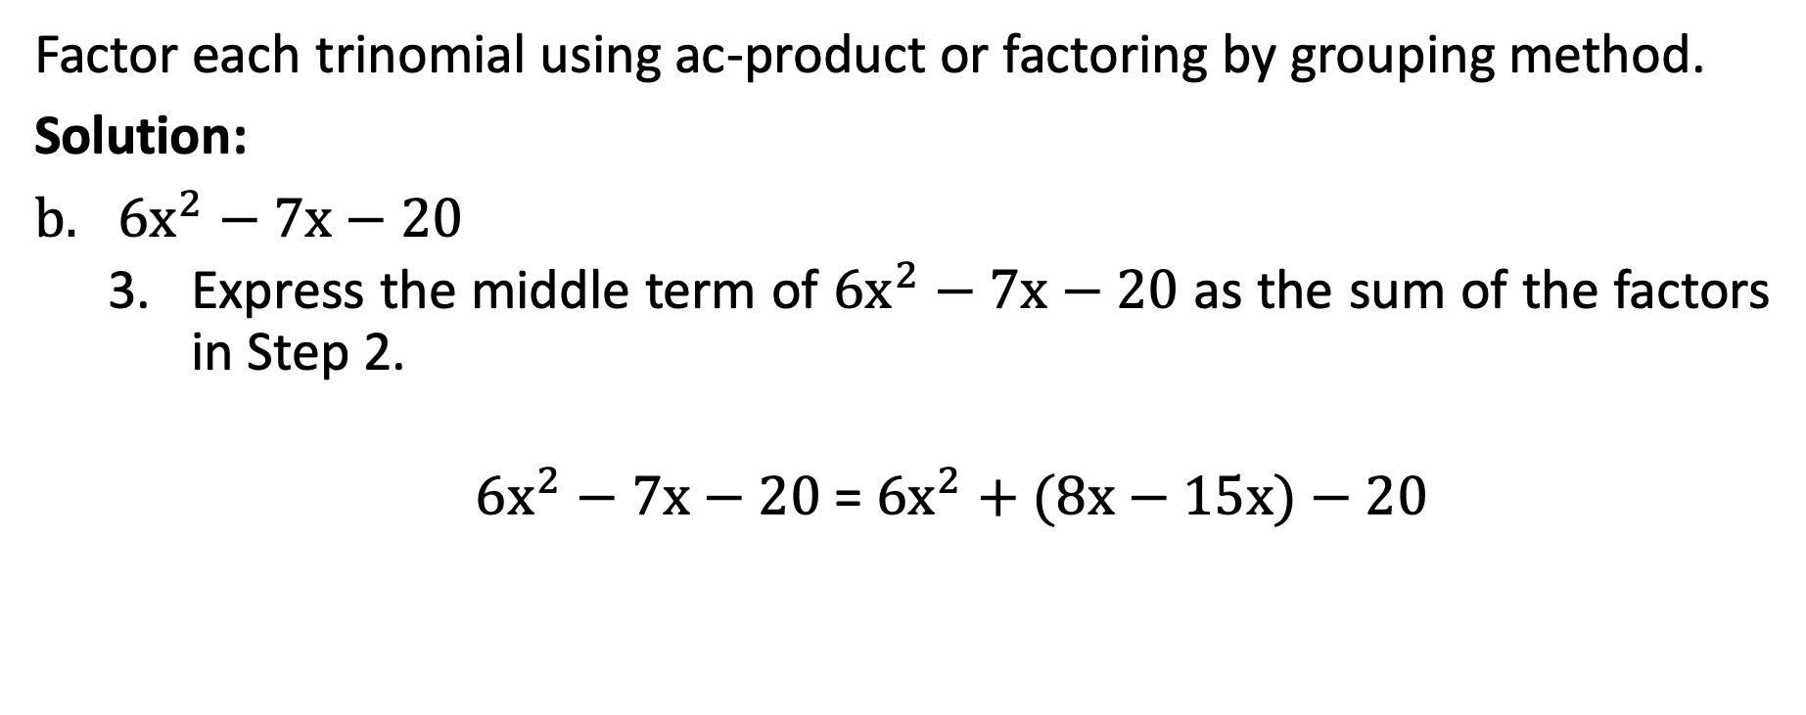
Factoring Quadratic Trinomials in the Form ${ax}^{2}+bx+c$, where a ≠ 1
Factor each trinomial using ac-product or factoring by grouping method.
Solution:
${6x}^{2}−7x−20$
  Express the middle term of ${6x}^{2}−7x−20$ as the sum of the factors in Step 2.
  ${6x}^{2}−7x−20$ = ${6x}^{2}+(8x−15x)−20$

Slide 27
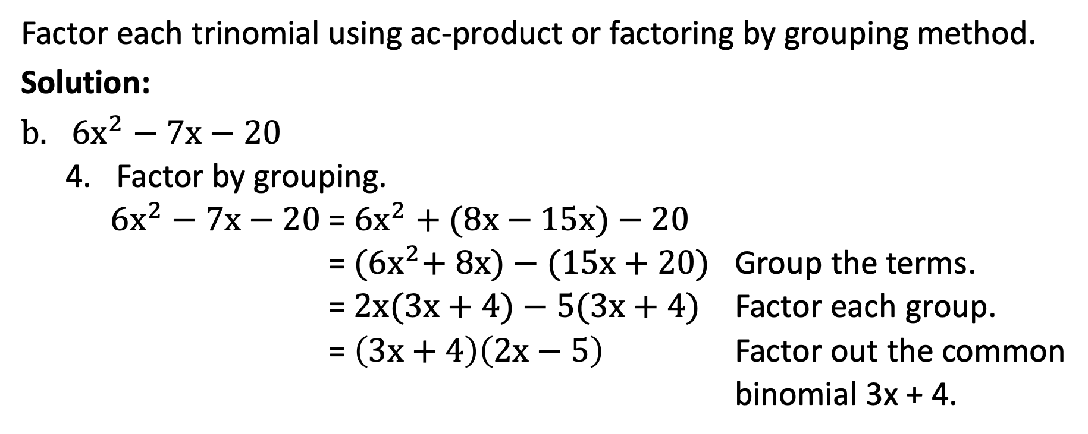
Factoring Quadratic Trinomials in the Form ${ax}^{2}+bx+c$, where a ≠ 1
Factor each trinomial using ac-product or factoring by grouping method.
Solution:
${6x}^{2}−7x−20$
  Factor by grouping.
  ${6x}^{2}−7x−20$ = ${6x}^{2}+(8x−15x)−20$
  = ${(6x}^{2}+ 8x)−(15x+20)$ Group the terms.
  = $2x(3x+4)−5(3x+4)$ Factor each group.
  = $\left(3x+4\right)\left(2x−5\right)$ Factor out the common
  binomial 3x + 4.

Slide 28
Factoring Quadratic Trinomials in the Form ${ax}^{2}+bx+c$, where a ≠ 1
Factor each trinomial using ac-product or factoring by grouping method.
Solution:
${6x}^{2}−7x−20$
  Factor by grouping.
  ${6x}^{2}−7x−20$ = ${6x}^{2}+(8x−15x)−20$
  = ${(6x}^{2}+ 8x)−(15x+20)$ Group the terms.
  = $2x(3x+4)−5(3x+4)$ Factor each group.
  = $\left(3x+4\right)\left(2x−5\right)$ Factor out the common
  binomial 3x + 4.

Slide 29
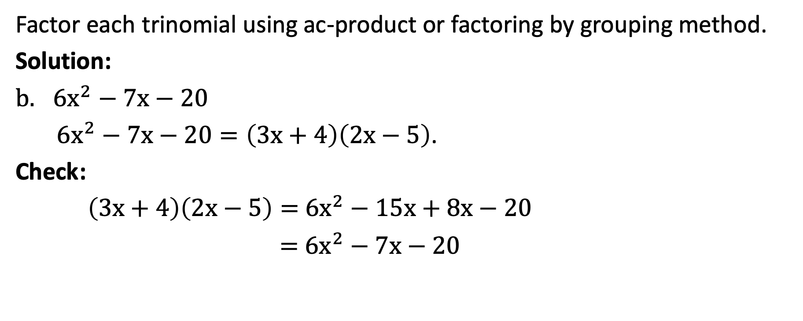
Factoring Quadratic Trinomials in the Form ${ax}^{2}+bx+c$, where a ≠ 1
Factor each trinomial using ac-product or factoring by grouping method.
Solution:
${6x}^{2}−7x−20$
${6x}^{2}−7x−20=\left(3x+4\right)\left(2x−5\right)$.
Check:
$\left(3x+4\right)\left(2x−5\right)=$ ${6x}^{2}−15x+8x−20$
$=$ ${6x}^{2}−7x−20$

