Slide 1
Problems Involving Rational Algebraic Expressions

Slide 2
Problems Involving Rational Algebraic Expressions
This section illustrates the application of operations on rational expressions in finding the perimeter and area of figures such as triangles and rectangles.
Find the perimeter of each figure.
1. 2.

Slide 3
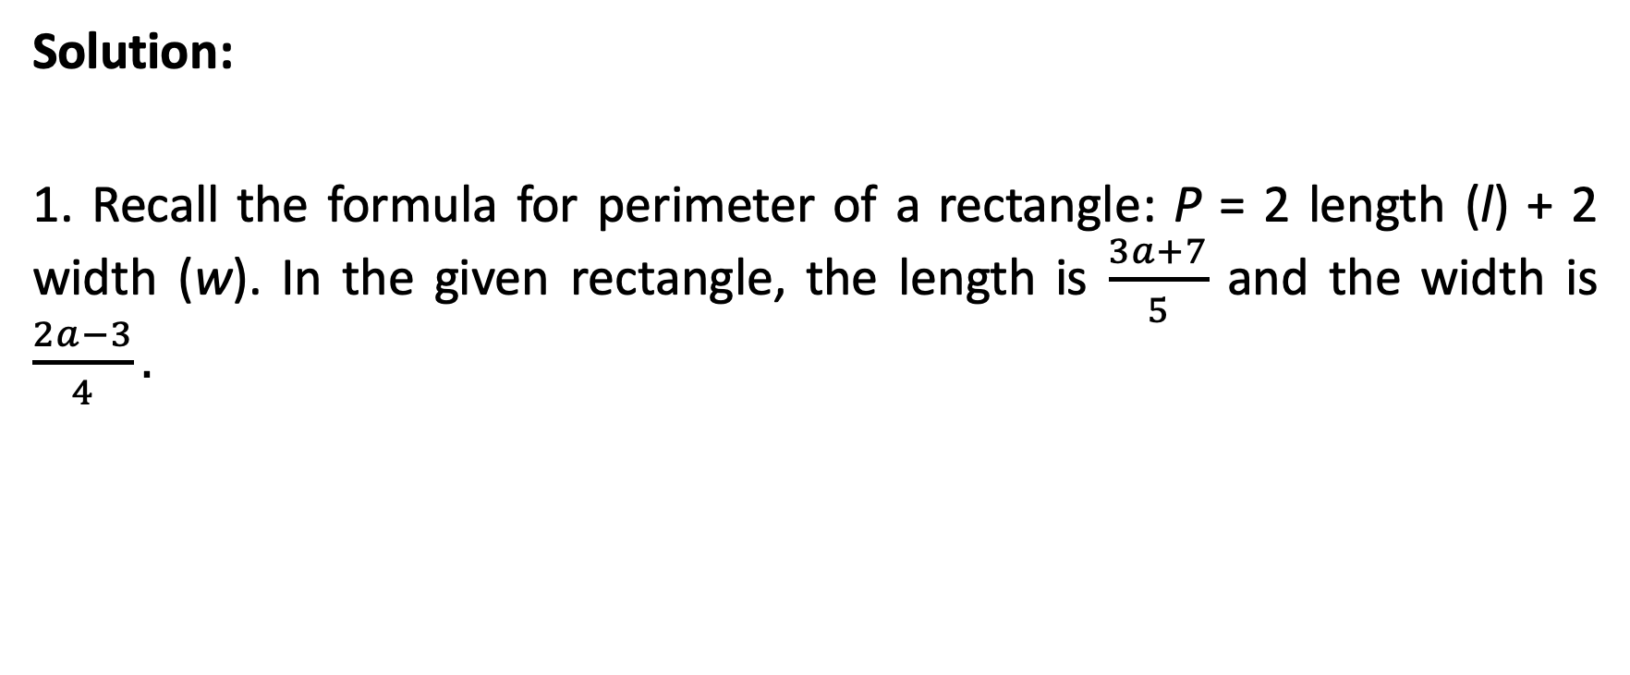
Problems Involving Rational Algebraic Expressions
Solution:
1. Recall the formula for perimeter of a rectangle: P = 2 length (l) + 2 width (w). In the given rectangle, the length is $\frac{3a+7}{5}$ and the width is $\frac{2a−3}{4}.$

Slide 4

Problems Involving Rational Algebraic Expressions
Solution:
P $=2\left(\frac{3a+7}{5}\right)+2\left(\frac{2a−3}{4}\right)$
$=2\left[\frac{4\left(3a+7\right)+5(2a−3)}{20}\right]$
$=2\left(\frac{12a+28+10a−15}{20}\right)$
$=2\left(\frac{22a+13}{20}\right)$
$=\frac{22a+13}{10}$
Substitute expressions for l and v.
Factor out 2. Find equivalent fractions with LCD of 20.
Use Distributive Property.
Combine similar terms in the numerator.
Simplify.

Slide 5
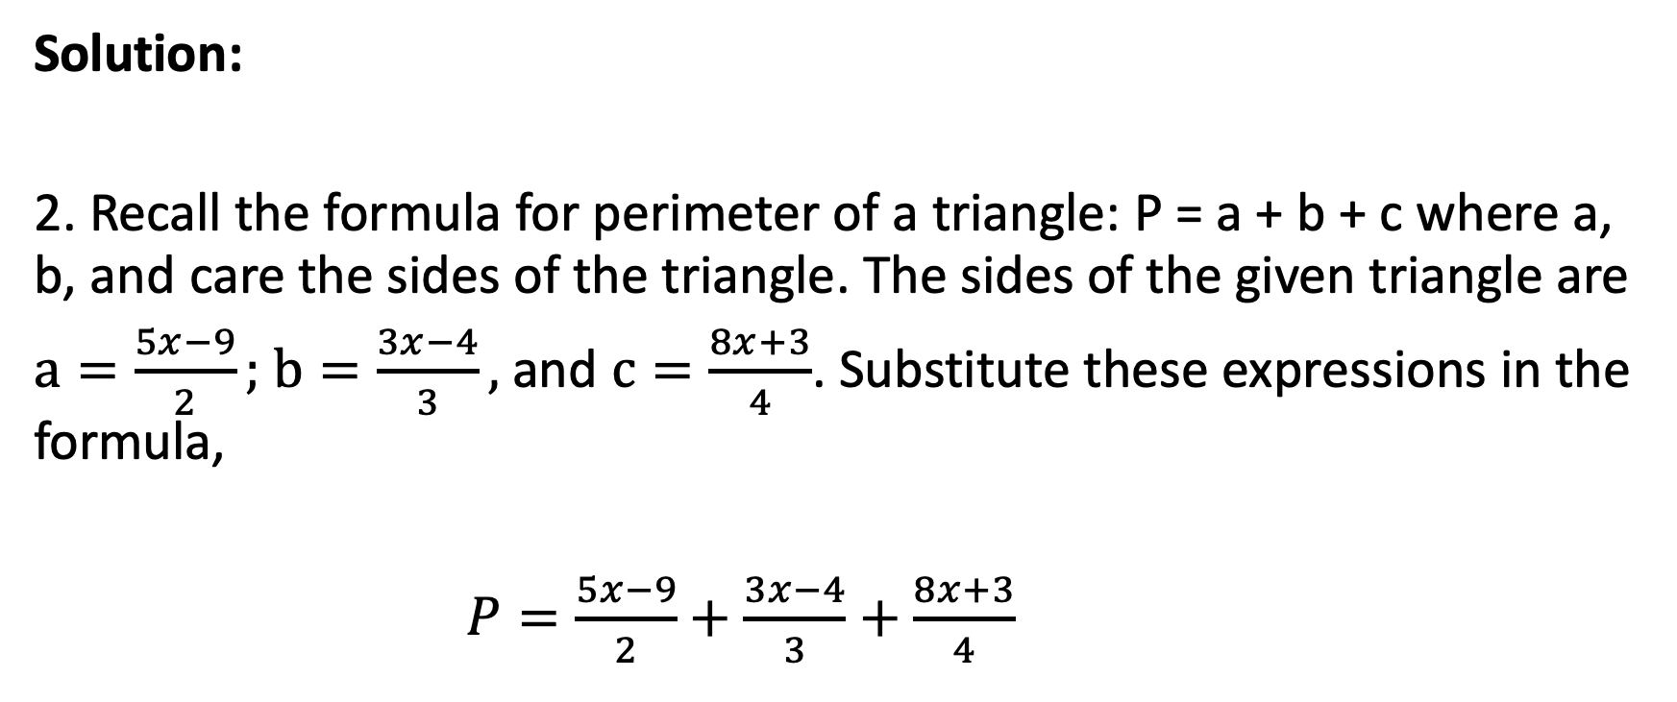
Problems Involving Rational Algebraic Expressions
Solution:
2. Recall the formula for perimeter of a triangle: P = a + b + c where a, b, and care the sides of the triangle. The sides of the given triangle are
$a=\frac{5x−9}{2};$ $b=\frac{3x−4}{3},$ and $c=\frac{8x+3}{4}$. Substitute these expressions in the formula,
$P=\frac{5x−9}{2}+\frac{3x−4}{3}+\frac{8x+3}{4}$

Slide 6
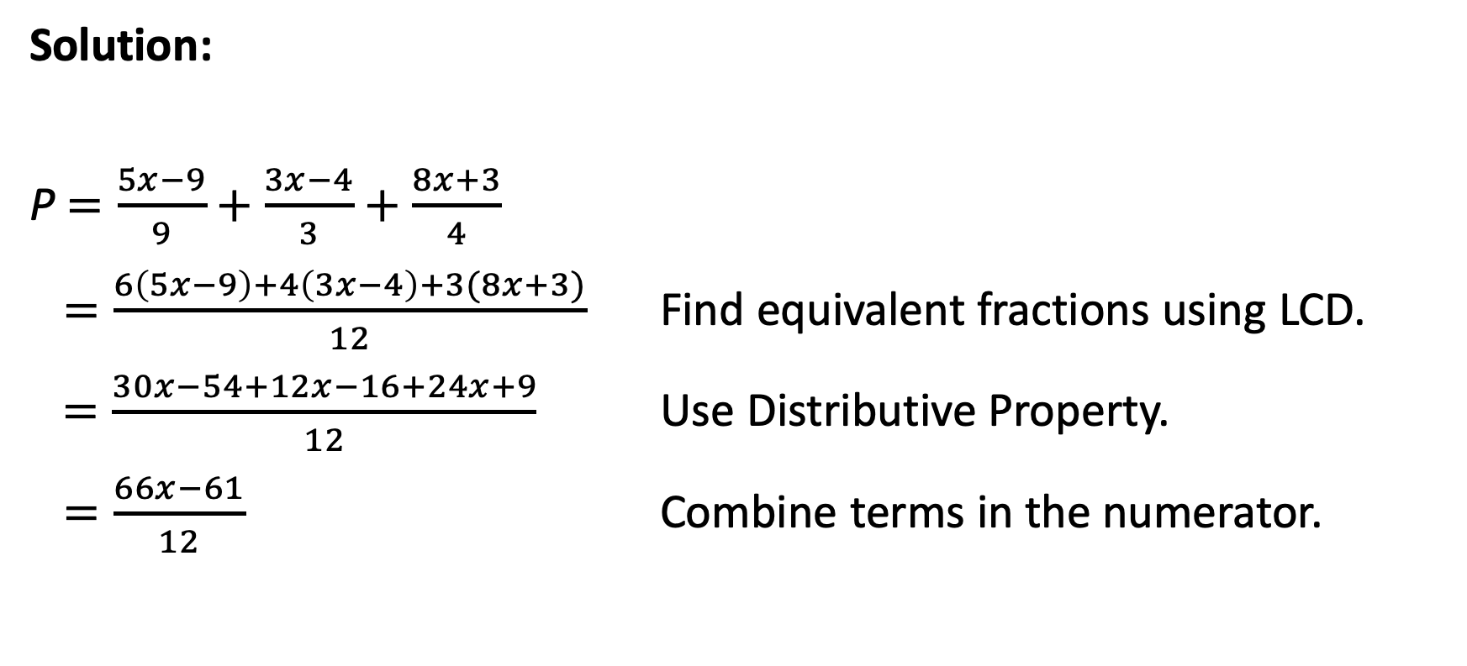
Problems Involving Rational Algebraic Expressions
Solution:
P $=\frac{5x−9}{9}+\frac{3x−4}{3}+\frac{8x+3}{4}$
$=\frac{6\left(5x−9\right)+4\left(3x−4\right)+3(8x+3)}{12}$ Find equivalent fractions using LCD.
$=\frac{30x−54+12x−16+24x+9}{12}$ Use Distributive Property.
$=\frac{66x−61}{12}$ Combine terms in the numerator.

Slide 7
Problems Involving Rational Algebraic Expressions
Find the area of each figure.
1. 2. 3.

Slide 8
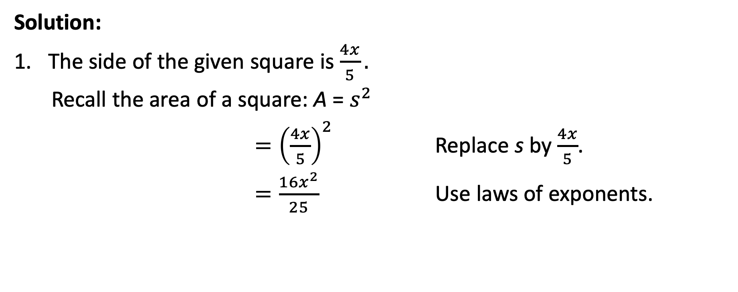
Problems Involving Rational Algebraic Expressions
Solution:
The side of the given square is $\frac{4x}{5}.$
Recall the area of a square: A = $s^{2}$
$={\left(\frac{4x}{5}\right)}^{2}$ Replace s by $\frac{4x}{5}$.
$=\frac{{16x}^{2}}{25}$ Use laws of exponents.

Slide 9
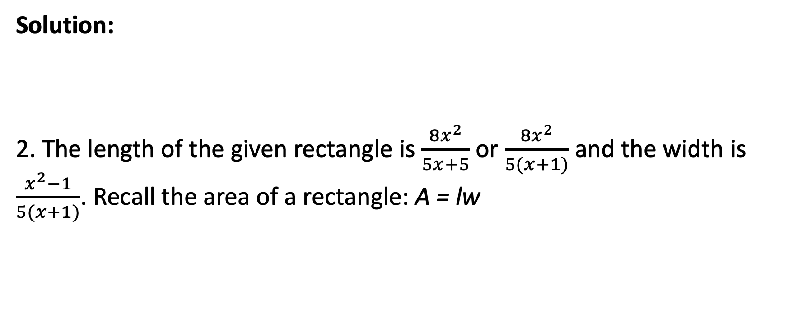
Problems Involving Rational Algebraic Expressions
Solution:
2. The length of the given rectangle is $\frac{{8x}^{2}}{5x+5}$or $\frac{{8x}^{2}}{5(x+1)}$ and the width is $\frac{x^{2}−1}{5(x+1)}$. Recall the area of a rectangle: A = lw

Slide 10
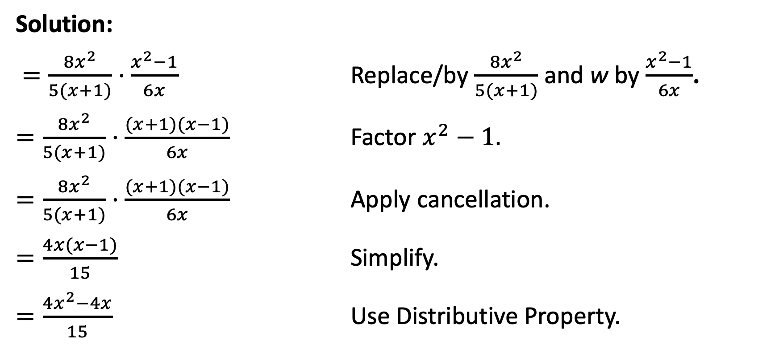
Problems Involving Rational Algebraic Expressions
Solution:
$=\frac{{8x}^{2}}{5(x+1)}·\frac{x^{2}−1}{6x}$ Replace/by $\frac{{8x}^{2}}{5(x+1)}$ and w by $\frac{x^{2}−1}{6x}$.
$=\frac{{8x}^{2}}{5(x+1)}·\frac{(x+1)(x−1)}{6x}$ Factor $x^{2}−1.$
$=\frac{{8x}^{2}}{5(x+1)}·\frac{(x+1)(x−1)}{6x}$ Apply cancellation.
$=\frac{4x(x−1)}{15}$ Simplify.
$=\frac{{4x}^{2}−4x}{15}$ Use Distributive Property.
4x
3

Slide 11
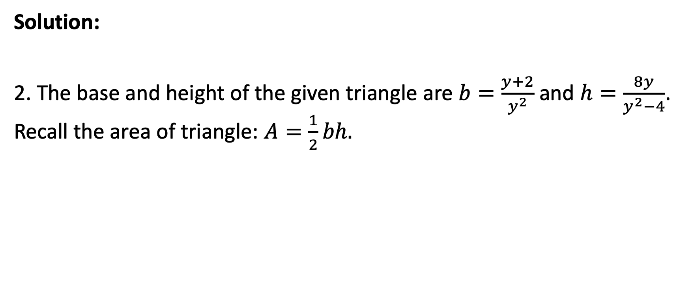
Problems Involving Rational Algebraic Expressions
Solution:
2. The base and height of the given triangle are $b=\frac{y+2}{y^{2}}$ and $h=\frac{8y}{y^{2}−4}$. Recall the area of triangle: $A=\frac{1}{2}bh.$

Slide 12
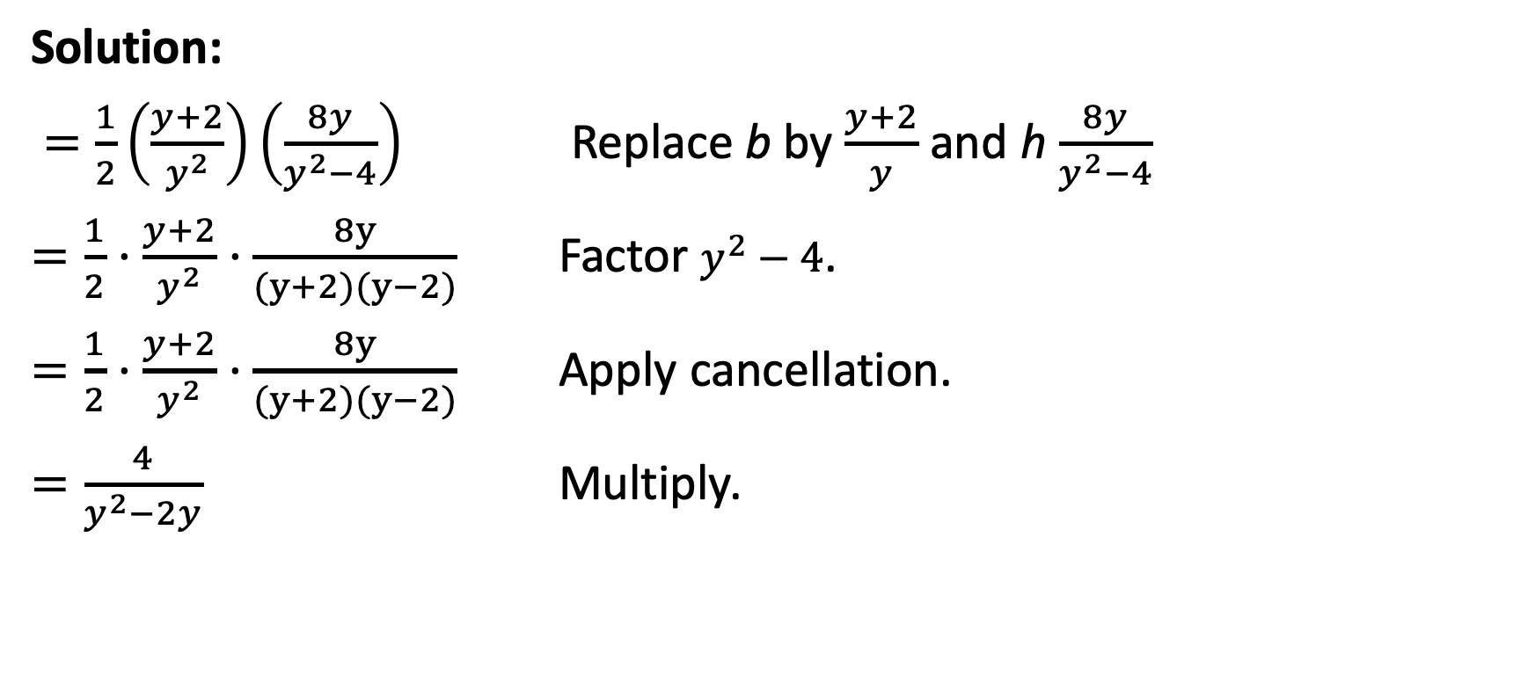
Problems Involving Rational Algebraic Expressions
Solution:
$=\frac{1}{2}\left(\frac{y+2}{y^{2}}\right)\left(\frac{8y}{y^{2}−4}\right)$ Replace b by $\frac{y+2}{y}$ and h $\frac{8y}{y^{2}−4}$
$=\frac{1}{2}·\frac{y+2}{y^{2}}·\frac{8y}{(y+2)(y−2)}$ Factor $y^{2}−4$.
$=\frac{1}{2}·\frac{y+2}{y^{2}}·\frac{8y}{(y+2)(y−2)}$ Apply cancellation.
$=\frac{4}{y^{2}−2y}$ Multiply.

Slide 13
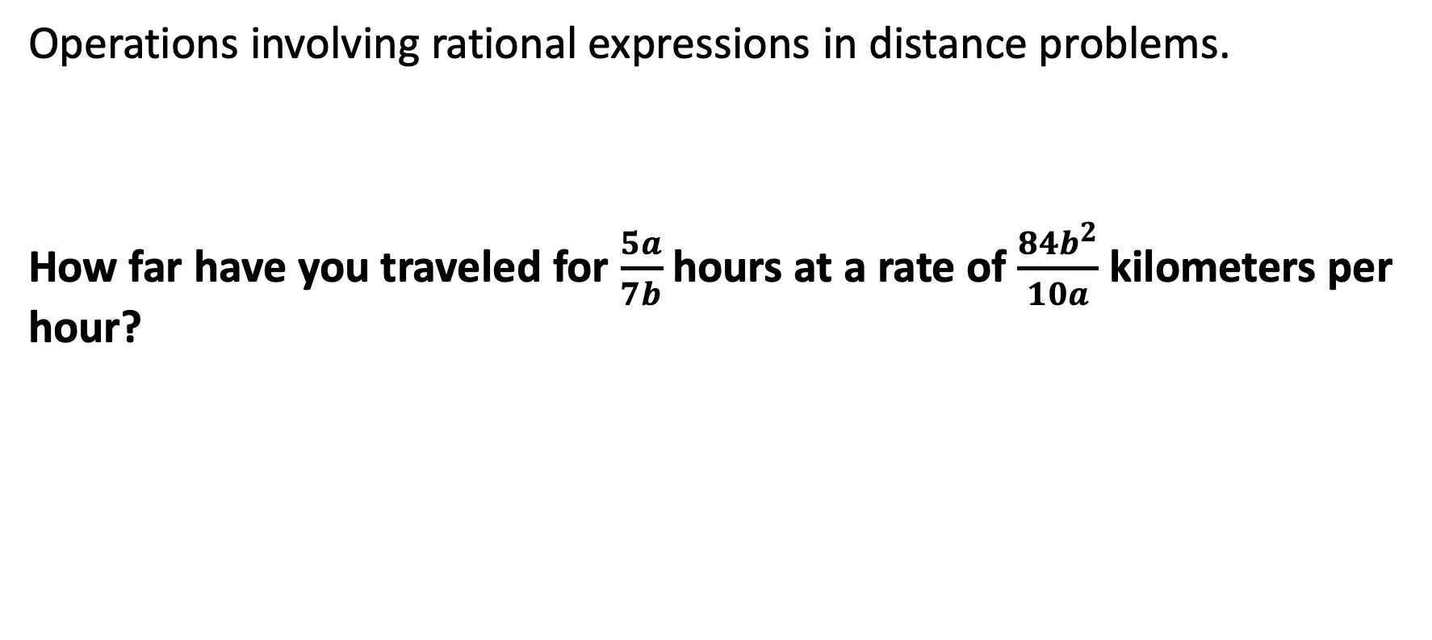
Problems Involving Rational Algebraic Expressions
Operations involving rational expressions in distance problems.
How far have you traveled for $\frac{5a}{7b}$ hours at a rate of $\frac{{84b}^{2}}{10a}$ kilometers per hour?

Slide 14
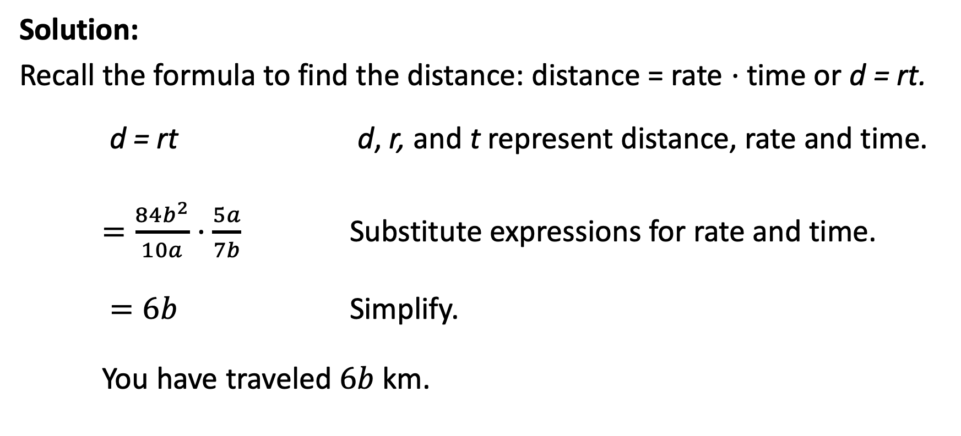
Problems Involving Rational Algebraic Expressions
Solution:
Recall the formula to find the distance: distance = rate ⋅ time or d = rt.
d = rt d, r, and t represent distance, rate and time.
$=\frac{{84b}^{2}}{10a}·\frac{5a}{7b}$ Substitute expressions for rate and time.
$=6b$ Simplify.
You have traveled $6b$ km.

