Slide 1
Rational Algebraic Expressions

Slide 2
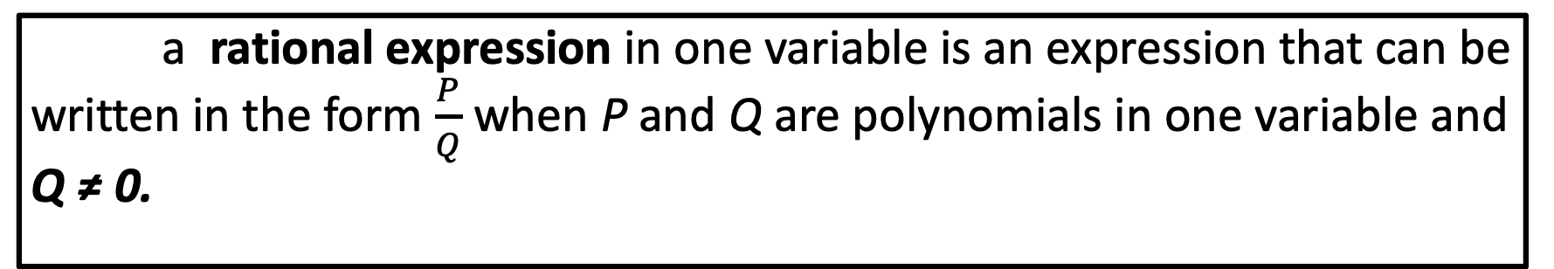
Rational Algebraic Expressions
a rational expression in one variable is an expression that can be written in the form $\frac{P}{Q}$ when P and Q are polynomials in one variable and Q ≠ 0.

Slide 3
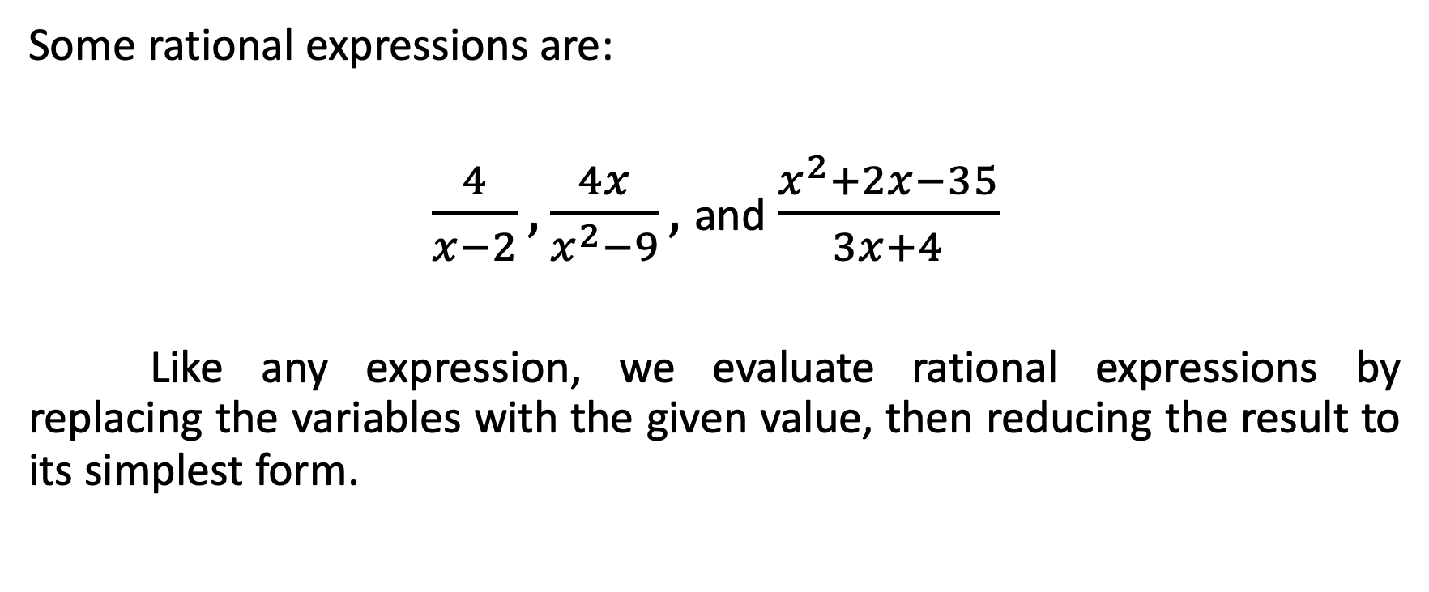
Rational Algebraic Expressions
Some rational expressions are:
$\frac{4}{x−2}, \frac{4x}{x^{2}−9},$and $\frac{x^{2}+2x−35}{3x+4}$
Like any expression, we evaluate rational expressions by replacing the variables with the given value, then reducing the result to its simplest form.

Slide 4
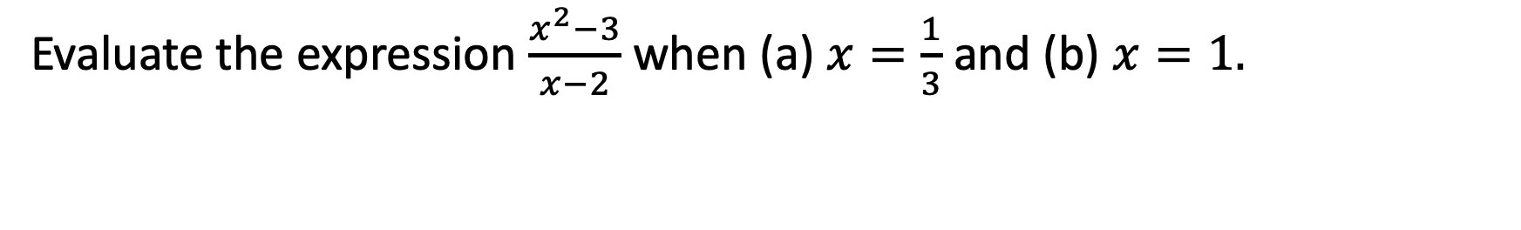
Rational Algebraic Expressions
Evaluate the expression $\frac{x^{2}−3}{x−2}$ when (a) $x=\frac{1}{3}$ and (b) $x=1.$

Slide 5
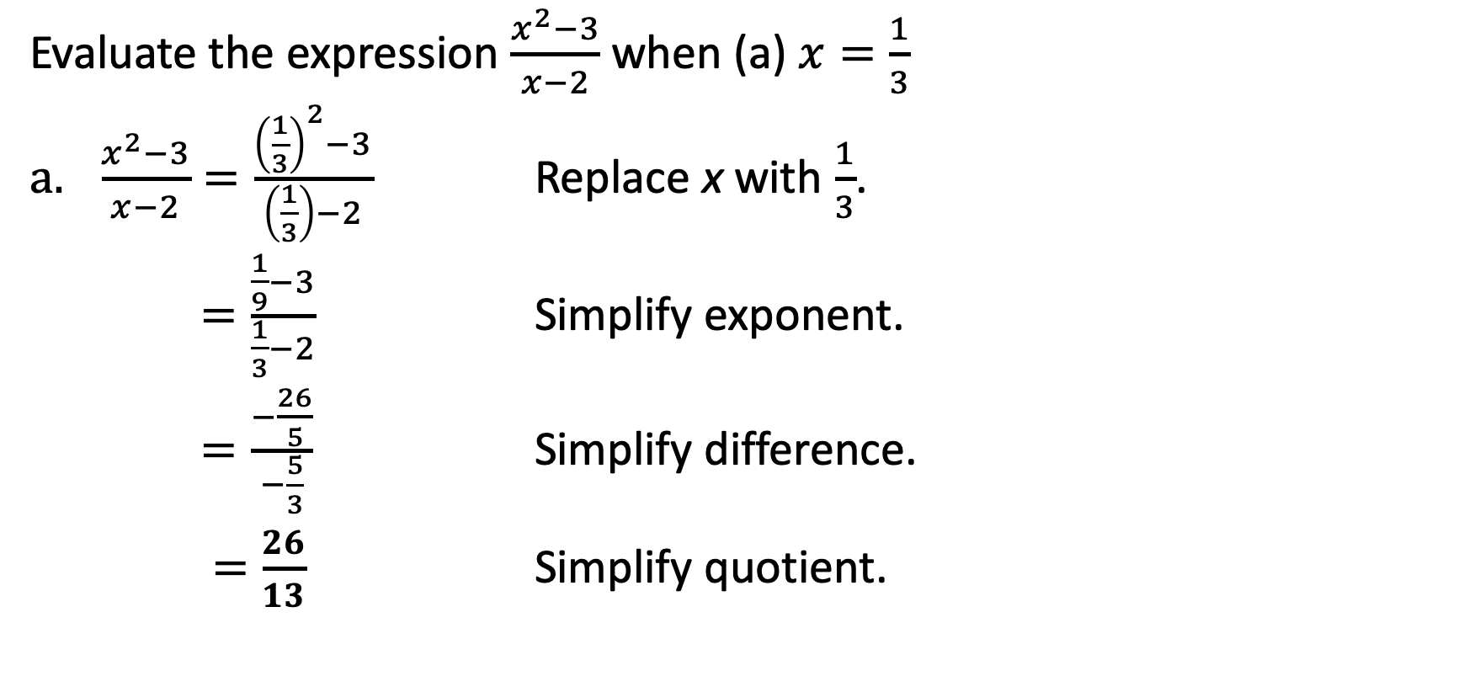
Rational Algebraic Expressions
Evaluate the expression $\frac{x^{2}−3}{x−2}$ when (a) $x=\frac{1}{3}$
$\frac{x^{2}−3}{x−2}=\frac{{\left(\frac{1}{3}\right)}^{2}−3}{\left(\frac{1}{3}\right)−2}$ Replace x with $\frac{1}{3}$.
$=\frac{\frac{1}{9}−3}{\frac{1}{3}−2}$ Simplify exponent.
$=\frac{−\frac{26}{5}}{−\frac{5}{3}}$ Simplify difference.
$=\frac{26}{13}$ Simplify quotient.

Slide 6
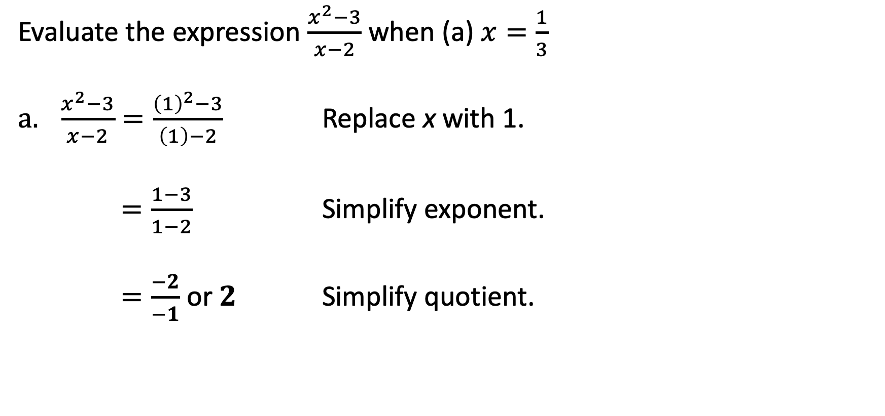
Rational Algebraic Expressions
Evaluate the expression $\frac{x^{2}−3}{x−2}$ when (a) $x=\frac{1}{3}$
$\frac{x^{2}−3}{x−2}=\frac{{\left(1\right)}^{2}−3}{\left(1\right)−2}$ Replace x with 1.
$=\frac{1−3}{1−2}$ Simplify exponent.
$=\frac{−2}{−1}$ or $2$ Simplify quotient.

Slide 7
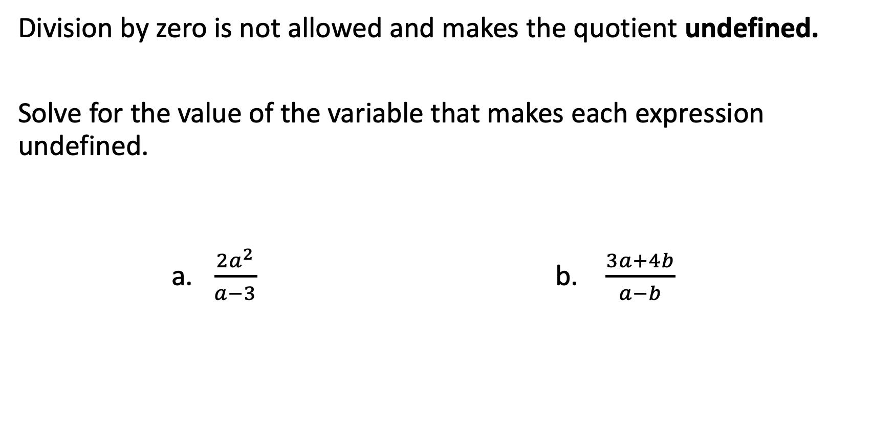
Rational Algebraic Expressions
Division by zero is not allowed and makes the quotient undefined.
Solve for the value of the variable that makes each expression undefined.
a. $\frac{{2a}^{2}}{a−3}$ b. $\frac{3a+4b}{a−b}$

Slide 8
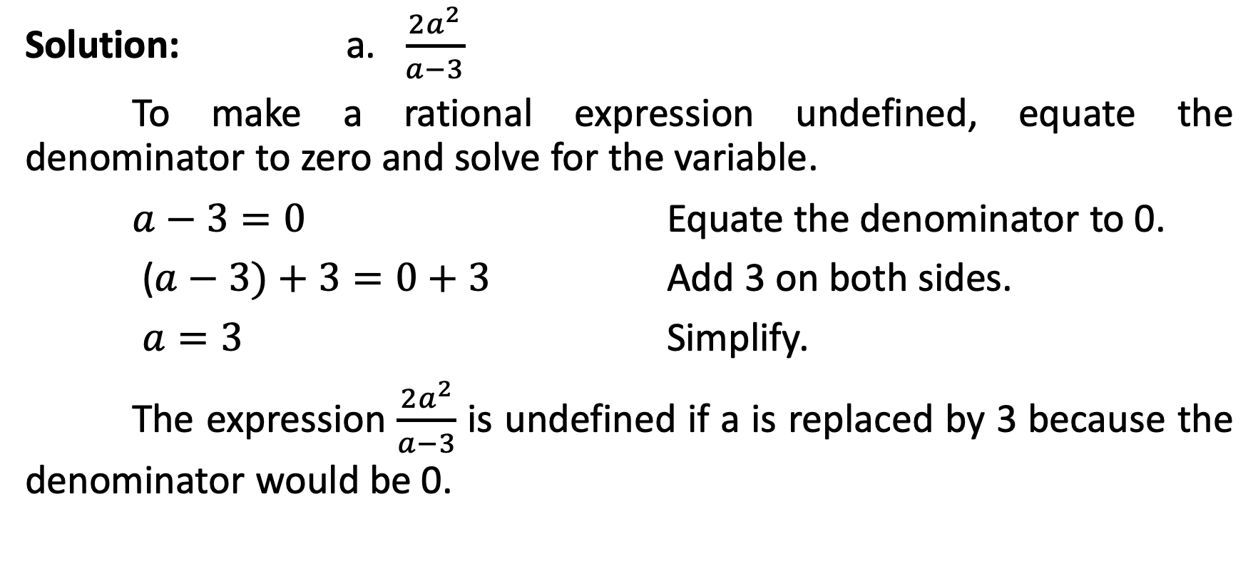
Rational Algebraic Expressions
Solution: a. $\frac{{2a}^{2}}{a−3}$
To make a rational expression undefined, equate the denominator to zero and solve for the variable.
$a−3=0$ Equate the denominator to 0.
($a−3)+3=0+3$ Add 3 on both sides.
$a=3$ Simplify.
The expression $\frac{{2a}^{2}}{a−3}$ is undefined if a is replaced by 3 because the denominator would be 0.

Slide 9
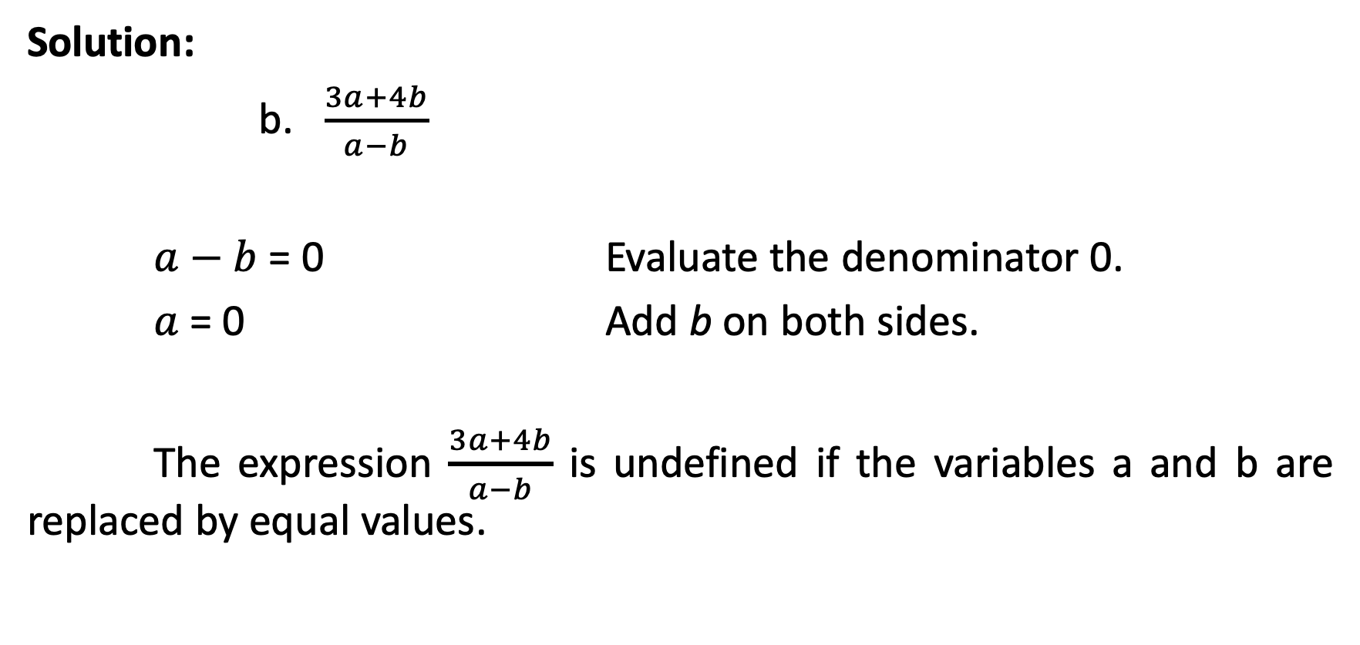
Rational Algebraic Expressions
Solution:
b. $\frac{3a+4b}{a−b}$
$a−b$ = 0 Evaluate the denominator 0.
$a$ = 0 Add b on both sides.
The expression $\frac{3a+4b}{a−b}$ is undefined if the variables a and b are replaced by equal values.

