Slide 1
Simplifying Rational Expressions

Slide 2
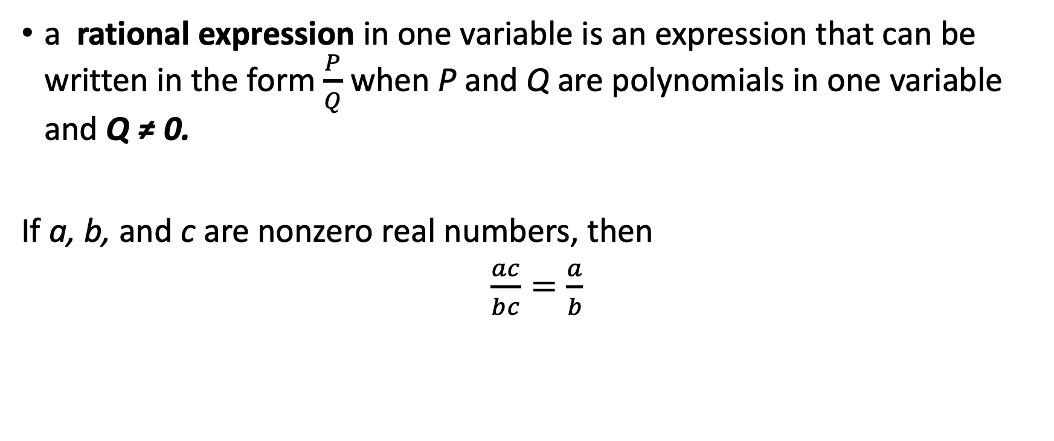
Simplifying Rational Expressions
a rational expression in one variable is an expression that can be written in the form $\frac{P}{Q}$ when P and Q are polynomials in one variable and Q ≠ 0.
If a, b, and c are nonzero real numbers, then
$\frac{ac}{bc}=\frac{a}{b}$

Slide 3
Simplifying Rational Expressions
Simplifying Rational Expressions
  Factor the numerator and denominator.
  Write a product of two rational expressions, one factor containing the GCF of the numerator and denominator, and the other containing the remaining factors.
  Cancel out factors common to the numerator and the denominator.
  Simplify the remaining fraction.
The quotient of any nonzero expression and its negative is –1.

Slide 4
Simplifying Rational Expressions
When all the common factors in the numerator and denominator of a fraction have been canceled out, we say that the fraction has been reduced to its lowest term. That is, the fraction is in its simplest form.

Slide 5
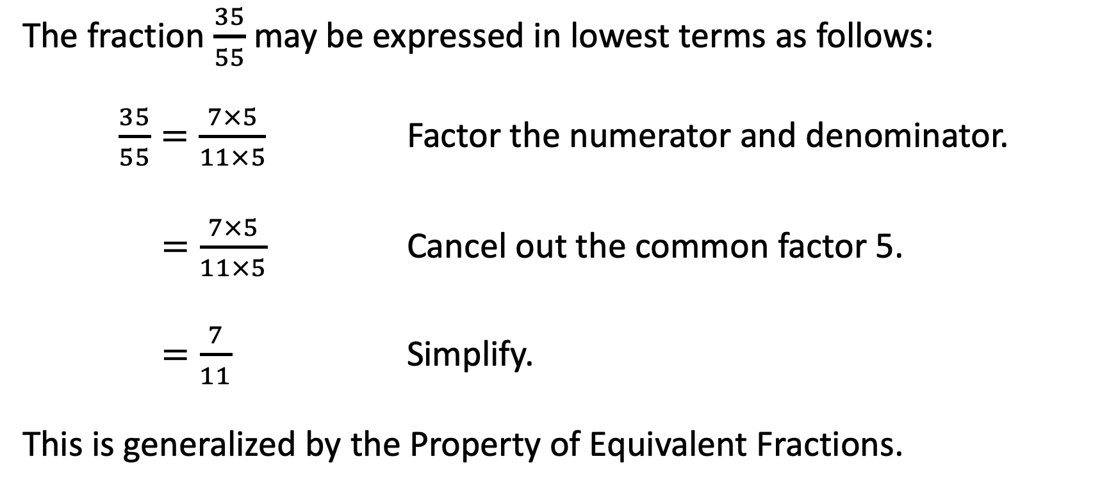
Simplifying Rational Expressions
The fraction $\frac{35}{55}$ may be expressed in lowest terms as follows:
$\frac{35}{55}=\frac{7×5}{11×5}$ Factor the numerator and denominator.
$=\frac{7×5}{11×5}$ Cancel out the common factor 5.
$=\frac{7}{11}$ Simplify.
This is generalized by the Property of Equivalent Fractions.

Slide 6
Simplifying Rational Expressions
When we divide common factors, we are actually using a shortcut method known as cancellation.
Cancellation is a method of dividing a factor in the numerator by the same factor in the denominator. Since dividing by the same factor always gives 1 as an answer, then the factors cancel each other.

Slide 7

Simplifying Rational Expressions
Simplify each rational equation.
  $\frac{40}{60}$ b. $\frac{{45a}^{2}b}{30ab}$ c. $\frac{a^{2}+2a}{30ab}$
        $\frac{9a+15}{{3a}^{2}+8a+5}$ e. $\frac{a\left(a+4\right)−4(a−1)}{a^{2}+4}$

Slide 8
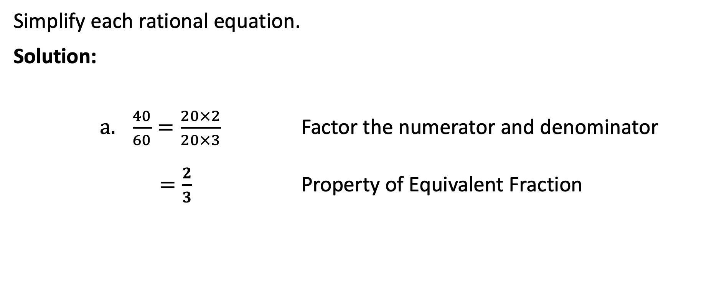
Simplifying Rational Expressions
Simplify each rational equation.
Solution:
      $\frac{40}{60}=\frac{20×2}{20×3}$ Factor the numerator and denominator
        $=\frac{2}{3}$ Property of Equivalent Fraction

Slide 9
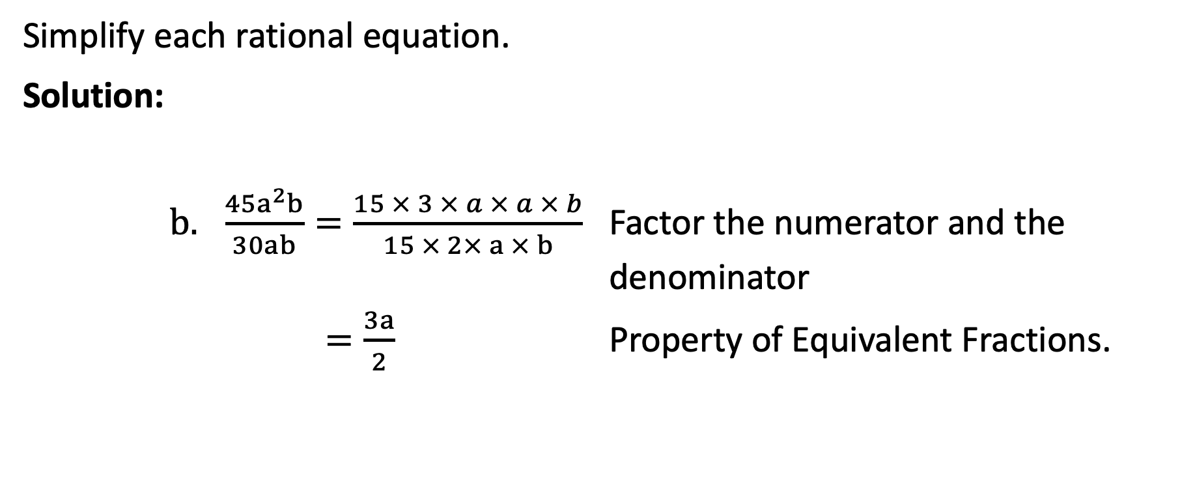
Simplifying Rational Expressions
Simplify each rational equation.
Solution:
      $\frac{{45a}^{2}b}{30ab}=\frac{15 × 3 × a × a × b}{15 × 2× a × b}$ Factor the numerator and the denominator
      $=\frac{3a}{2}$ Property of Equivalent Fractions.

Slide 10
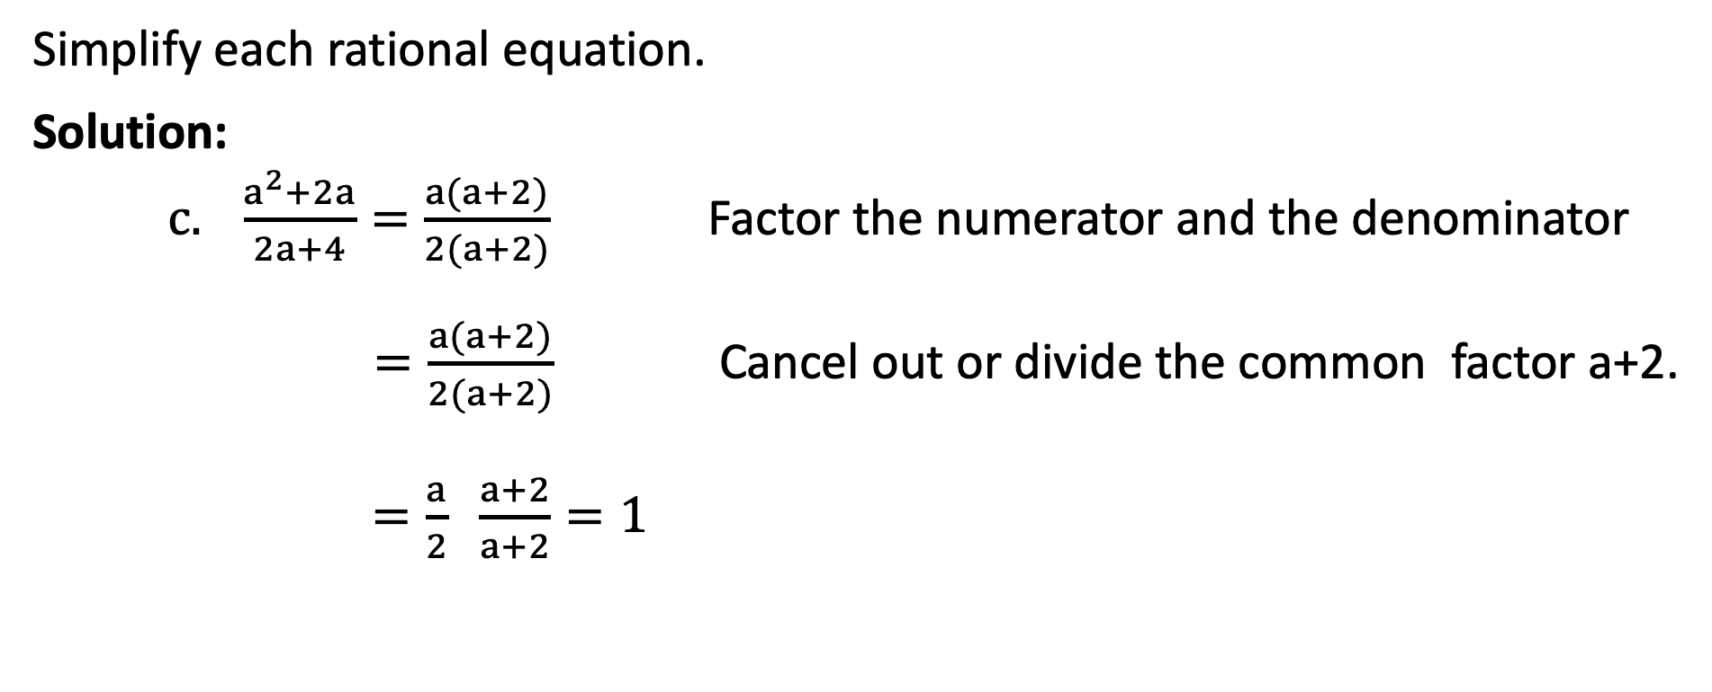
Simplifying Rational Expressions
Simplify each rational equation.
Solution:
    $\frac{a^{2}+2a}{2a+4}=\frac{a(a+2)}{2(a+2)}$ Factor the numerator and the denominator
      $=\frac{a(a+2)}{2(a+2)}$ Cancel out or divide the common factor a+2.
      $=\frac{a}{2} \frac{a+2}{a+2}=1$

Slide 11
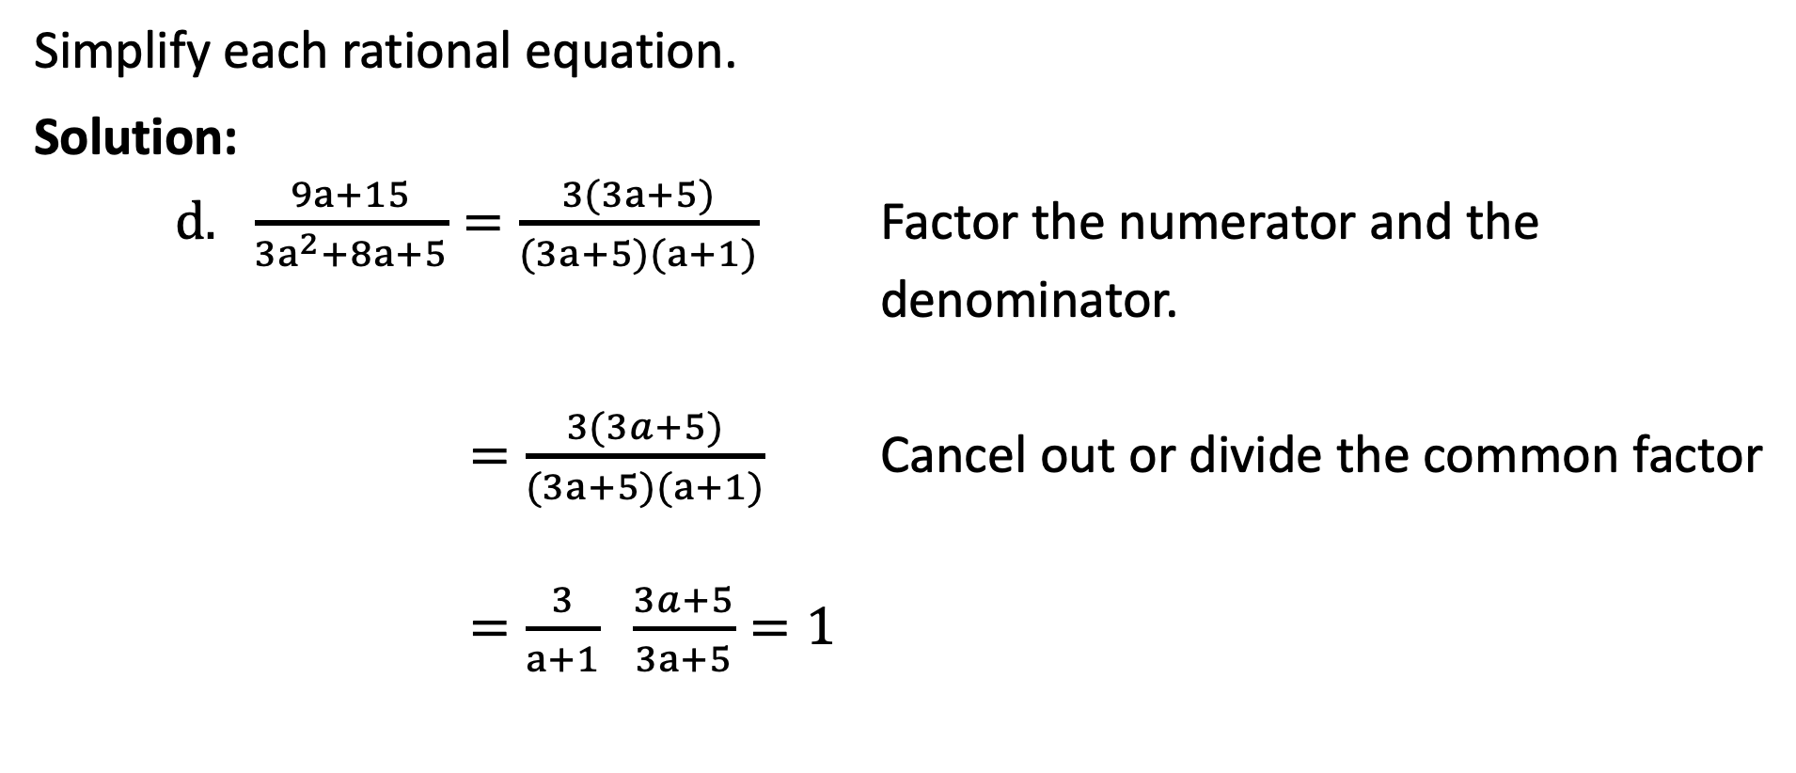
Simplifying Rational Expressions
Simplify each rational equation.
Solution:
    $\frac{9a+15}{{3a}^{2}+8a+5}=\frac{3(3a+5)}{(3a+5)(a+1)}$ Factor the numerator and the denominator.
    $=\frac{3(3a+5)}{(3a+5)(a+1)}$ Cancel out or divide the common factor
    $=\frac{3}{a+1} \frac{3a+5}{3a+5}=1$

Slide 12

Simplifying Rational Expressions
Simplify each rational equation.
Solution:
    $\frac{a\left(a+4\right)−4(a−1)}{a^{2}+4}=\frac{a^{2}+4a−4a+4}{a^{2}+4}$ Distributive Property
    $=\frac{a^{2}+4}{a^{2}+4}$ Combine like terms.
    $=1$ Divide.

Slide 13

Simplifying Rational Expressions
Simplify each rational equation.
$\frac{a^{2}+7a}{a+7}$ b. $\frac{4a−1}{1−4a}$ c. $\frac{{3b}^{2}−14b−24}{12−2b}$

Slide 14
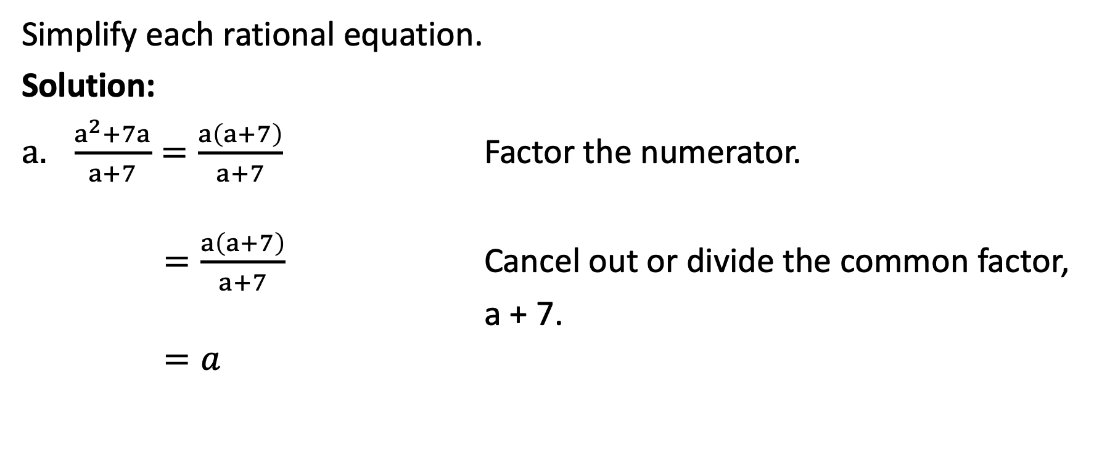
Simplifying Rational Expressions
Simplify each rational equation.
Solution:
$\frac{a^{2}+7a}{a+7}=\frac{a\left(a+7\right)}{a+7}$ Factor the numerator.
    $=\frac{a\left(a+7\right)}{a+7}$ Cancel out or divide the common factor,
    a + 7.
    $=a$

Slide 15
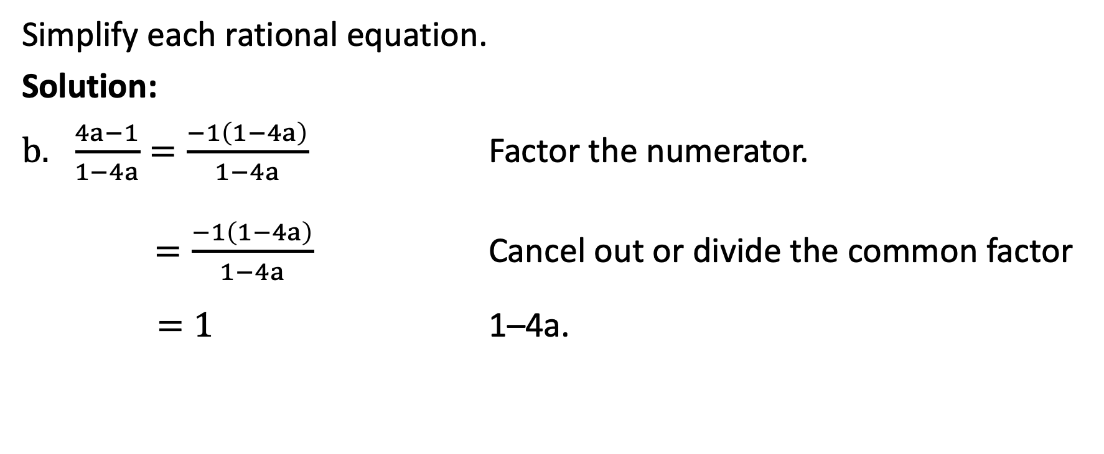
Simplifying Rational Expressions
Simplify each rational equation.
Solution:
$\frac{4a−1}{1−4a}=\frac{−1\left(1−4a\right)}{1−4a}$ Factor the numerator.
$=\frac{−1\left(1−4a\right)}{1−4a}$ Cancel out or divide the common factor $=1$ 1–4a.

Slide 16
Simplifying Rational Expressions
When the terms of two binomials are almost the same, except for the sign, the polynomials are called negatives of each other.
Observe that (a − b) and (b − a) are negatives of each other. Also, (4a − 1) and (1 − 4a) are negatives of each other. Each is an additive inverse of the other.
Division of Negatives
The quotient of any nonzero and its negative is –1.

Slide 17
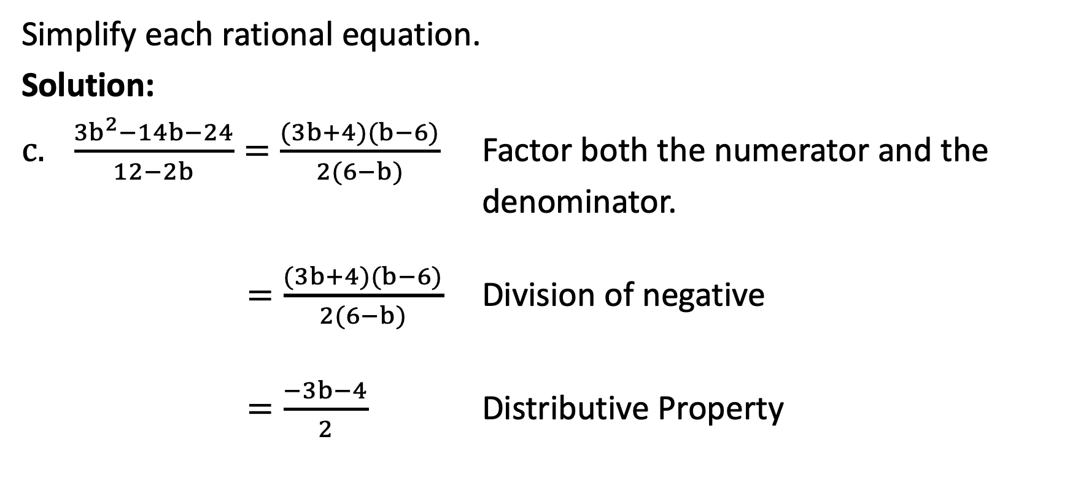
Simplifying Rational Expressions
Simplify each rational equation.
Solution:
$\frac{{3b}^{2}−14b−24}{12−2b}=\frac{(3b+4)(b−6)}{2(6−b)}$ Factor both the numerator and the denominator.
$=\frac{(3b+4)(b−6)}{2(6−b)}$ Division of negative
$=\frac{−3b−4}{2}$ Distributive Property

Slide 18
Simplifying Rational Expressions
The following example illustrates applications of rational expressions.
If Ben drives 200 kilometers in (x + 2) hours, what is his average speed?
If (x + 5) kilograms of mangoes cost ₱150.00, how much is the cost per kilogram?
If Elena can clean the entire room in (4x) hours, what part of the room can she clean per hour?

Slide 19
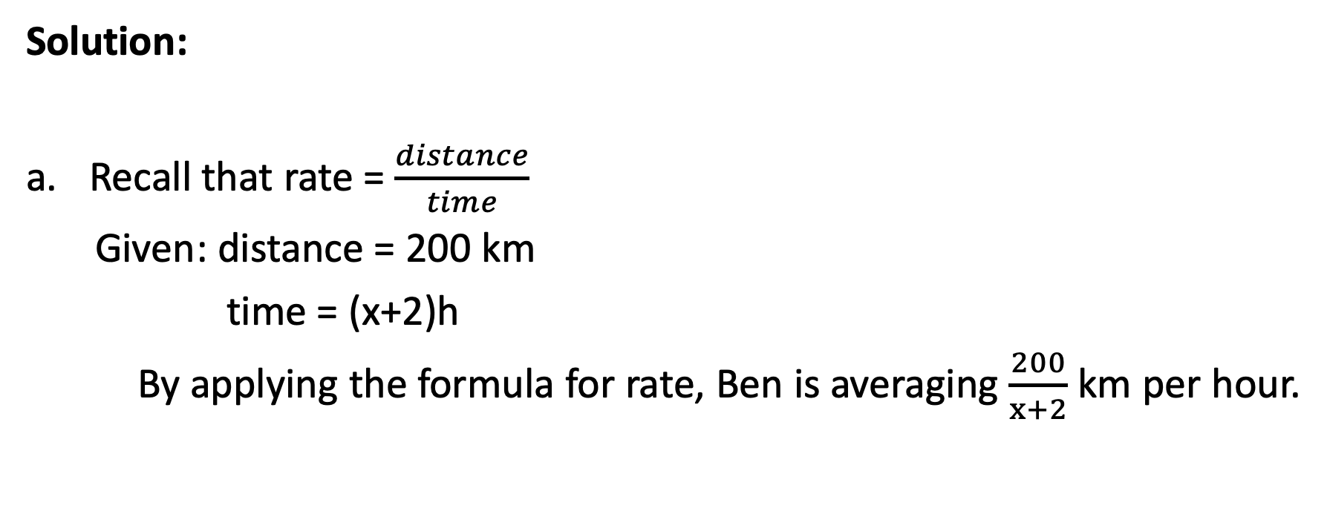
Simplifying Rational Expressions
Solution:
Recall that rate = $\frac{distance}{time}$
Given: distance = 200 km
time = (x+2)h
By applying the formula for rate, Ben is averaging $\frac{200}{x+2}$ km per hour.

Slide 20
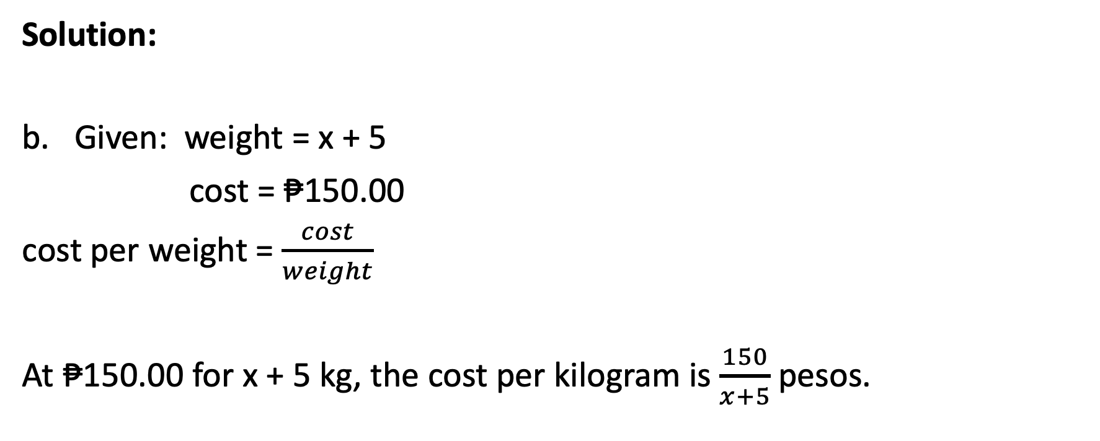
Simplifying Rational Expressions
Solution:
Given: weight = x + 5
cost = ₱150.00
cost per weight = $\frac{cost}{weight}$
At ₱150.00 for x + 5 kg, the cost per kilogram is $\frac{150}{x+5}$pesos.

Slide 21

Simplifying Rational Expressions
Solution:
Since the entire room is a whole, then it is equal to 1. Thus, Elena can clean $\left(\frac{1}{4x}\right)$ of the room per hour.

