Slide 1
Addition and Subtraction of Rational Algebraic Expression

Slide 2
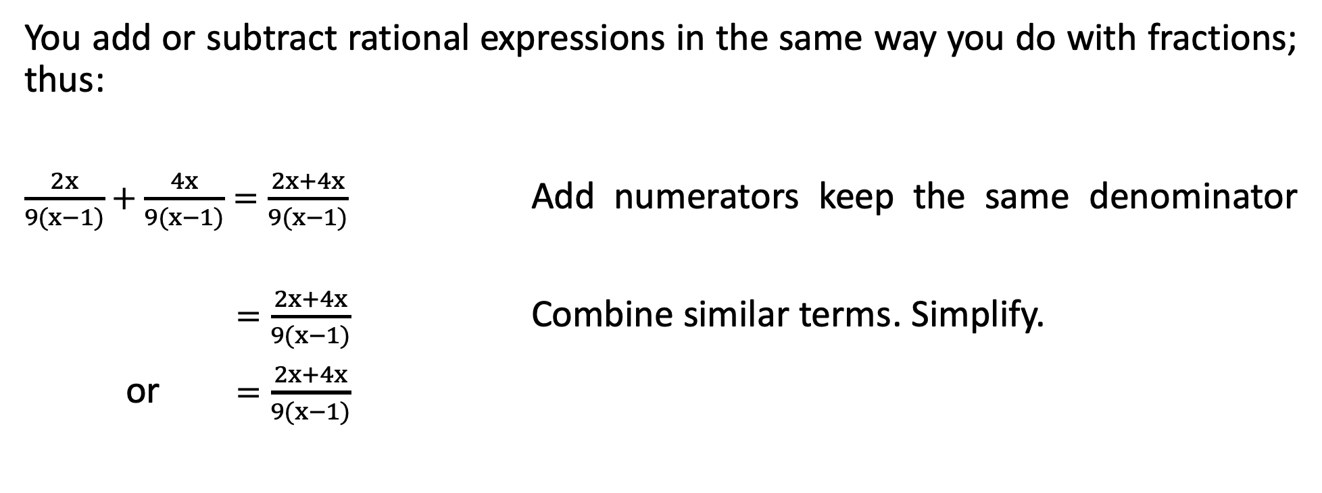
Addition and Subtraction of Rational Algebraic Expressions
You add or subtract rational expressions in the same way you do with fractions; thus:
$\frac{2x}{9(x−1)}+\frac{4x}{9(x−1)}=\frac{2x+4x}{9(x−1)}$ Add numerators keep the same denominator
$=\frac{2x+4x}{9(x−1)}$ Combine similar terms. Simplify.
or $=\frac{2x+4x}{9(x−1)}$

Slide 3
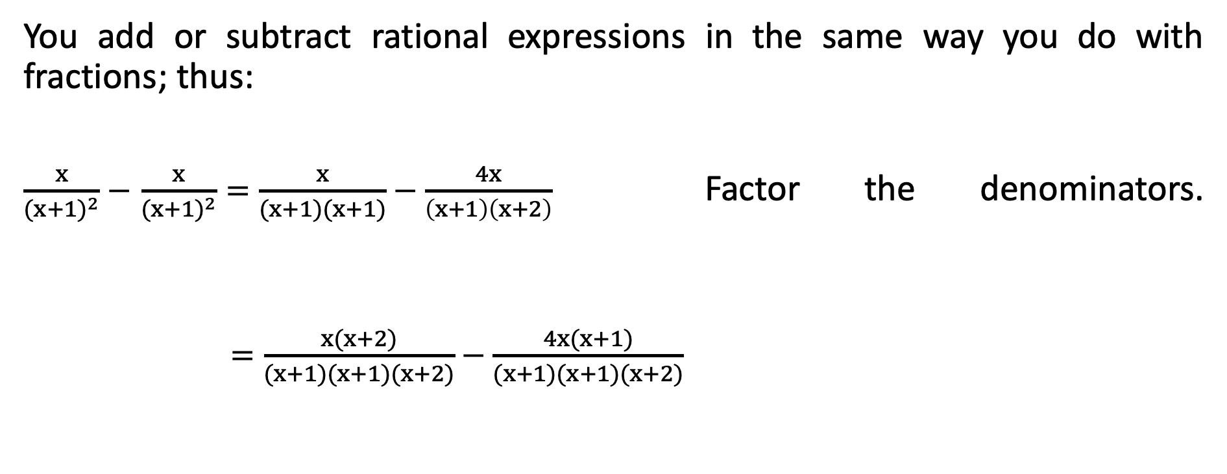
Addition and Subtraction of Rational Algebraic Expressions
You add or subtract rational expressions in the same way you do with fractions; thus:
$\frac{x}{{(x+1)}^{2}}−$ $\frac{x}{{(x+1)}^{2}}=\frac{x}{(x+1)(x+1)}−\frac{4x}{\left(x+1\right)\left(x+2\right)}$ Factor the denominators.
$=\frac{x(x+2)}{(x+1)(x+1)(x+2)}−\frac{4x(x+1)}{(x+1)(x+1)(x+2)}$
Transform into equivalent expressions with the same LCD.

Slide 4
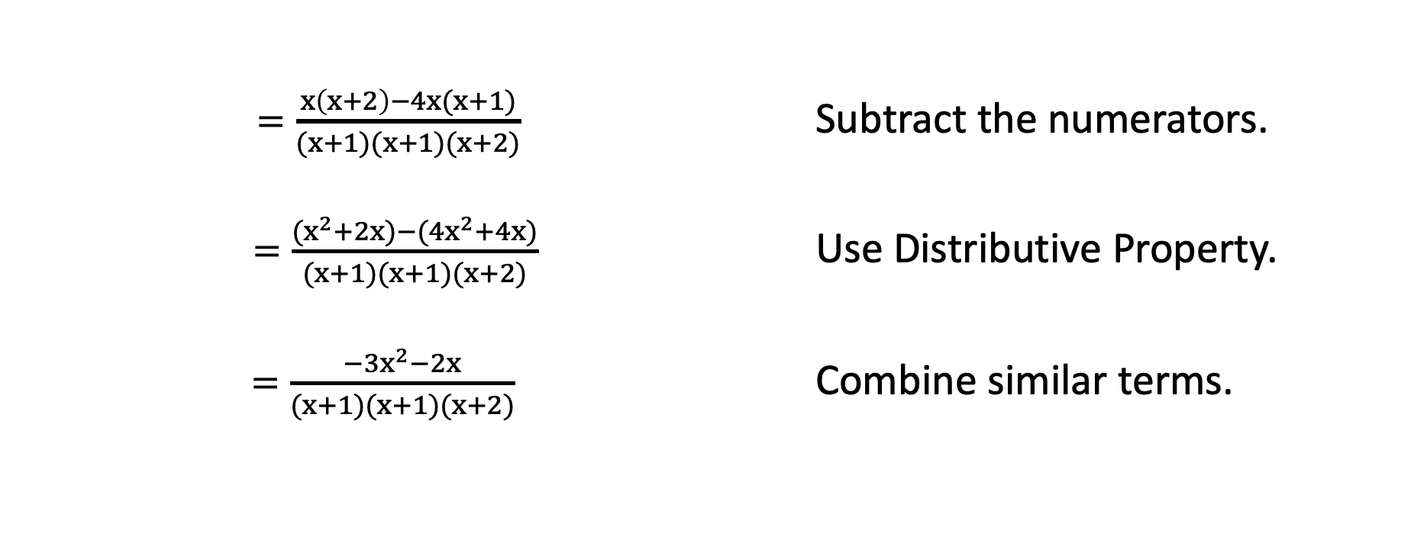
Addition and Subtraction of Rational Algebraic Expressions
$=\frac{x\left(x+2\right)−4x(x+1)}{(x+1)(x+1)(x+2)}$ Subtract the numerators.
$=\frac{{(x}^{2}+2x)−({4x}^{2}+4x)}{(x+1)(x+1)(x+2)}$ Use Distributive Property.
$=\frac{{−3x}^{2}−2x}{(x+1)(x+1)(x+2)}$ Combine similar terms.

Slide 5
Addition and Subtraction of Rational Algebraic Expressions
Adding or Subtracting Rational Expressions with Like Denominators
Add (or subtract) the numerators.
Copy the common denominator.
Simplify the result.

Slide 6

Addition and Subtraction of Rational Algebraic Expressions
Add the rational expressions.
    $\frac{2a}{4b}+\frac{3}{4b}$ 2. $\frac{10x}{13x+26}+\frac{16x}{13x+26}$

Slide 7

Addition and Subtraction of Rational Algebraic Expressions
Add the rational expressions.
Solution:
    $\frac{2a}{4b}+\frac{3}{4b}=\frac{2a+b}{4b}$ Add the numerators and keep the same denominator.

Slide 8


Addition and Subtraction of Rational Algebraic Expressions
Add the rational expressions.
Solution:
    $\frac{10x}{13x+26}+\frac{16x}{13x+26} =$ $\frac{16x}{13x+26}$
    $=$ $\frac{(13)(2x)}{13(x+2)}$
    $=$ $\frac{(13)(2x)}{13(x+2)}$
    $=$ $\frac{2x}{x+2}$
Add the numerators and keep the same denominator.
Factor both numerator and denominator.
$$\frac{13}{13}=1$$
Cancel out the common factor 13 since
Simplify.

Slide 9

Addition and Subtraction of Rational Algebraic Expressions
Subract the rational expressions.
Solution:
      $\frac{a}{a+3}−\frac{3}{a+3}$
        $=\frac{a−3}{a+3}$ Subtract the numerators and keep the denominator.

Slide 10

Addition and Subtraction of Rational Algebraic Expressions
Subract the rational expressions.
Solution:
2. $\frac{{9x}^{2}}{3x−5}−\frac{25}{3x−5}=\frac{{9x}^{2}−25}{3x−5}$
$=\frac{(3x+5)(3x−5)}{3x−5}$
$=\frac{(3x+5)(3x−5)}{3x−5}$
$=3x+5$
Subtract the numerators and keep the same denominator.
Factor the numerator.
Cancel out the common factor 3x–5 in both the numerator and denominator.
Simplify.

Slide 11
Addition and Subtraction of Rational Algebraic Expressions
Adding or Subtracting Rational Expressions with Different Denominators
Find the LCD.
Write the equivalent rational expression of each rational expression using the LCD.
Add or subtract the numerators and keep the LCD.
Simplify the result if possible.

Slide 12
Addition and Subtraction of Rational Algebraic Expressions
Finding the LCD
List the different denominators that appear in the rational expression.
Factor each denominator completely.
For each unique factor, compare the number of times it appears in each factorization. Write a factored form that includes each factor the greatest number of times it appears in the denominator factorizations.

Slide 13

Addition and Subtraction of Rational Algebraic Expressions
Find the LCM.
1. 4, 18 2. ${2x}^{2}{yz}^{3},{4x}^{4}y^{2}z, {8xyz}^{5}$
3. $3x−15, 4x−20$

Slide 14
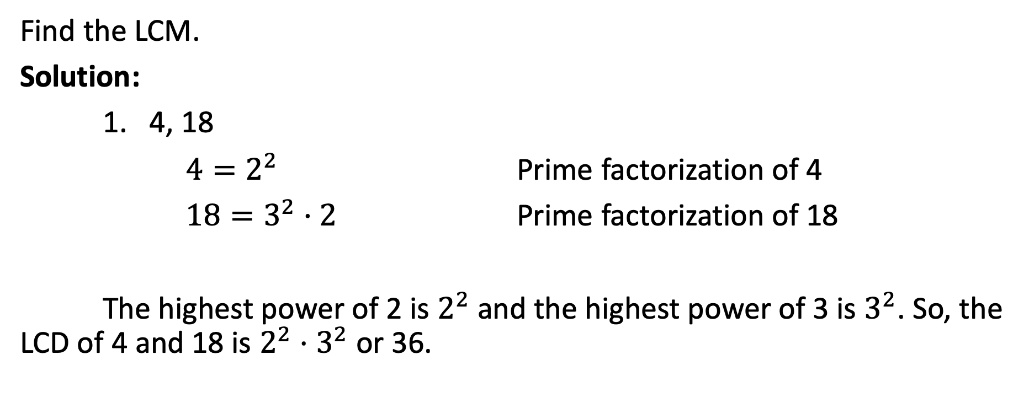
Addition and Subtraction of Rational Algebraic Expressions
Find the LCM.
Solution:
1. 4, 18
$4=2^{2}$ Prime factorization of 4
$18=3^{2}·2$ Prime factorization of 18
The highest power of 2 is $2^{2}$ and the highest power of 3 is $3^{2}$. So, the LCD of 4 and 18 is $2^{2}$ ⋅ $3^{2}$ or 36.

Slide 15
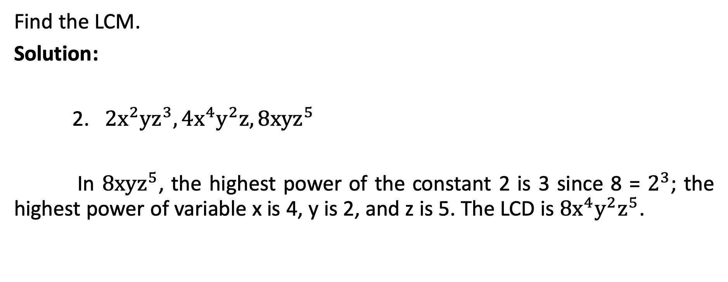
Addition and Subtraction of Rational Algebraic Expressions
Find the LCM.
Solution:
2. ${2x}^{2}{yz}^{3},{4x}^{4}y^{2}z, {8xyz}^{5}$
In ${8xyz}^{5}$, the highest power of the constant 2 is 3 since 8 = $2^{3}$; the highest power of variable x is 4, y is 2, and z is 5. The LCD is ${8x}^{4}y^{2}z^{5}$.

Slide 16
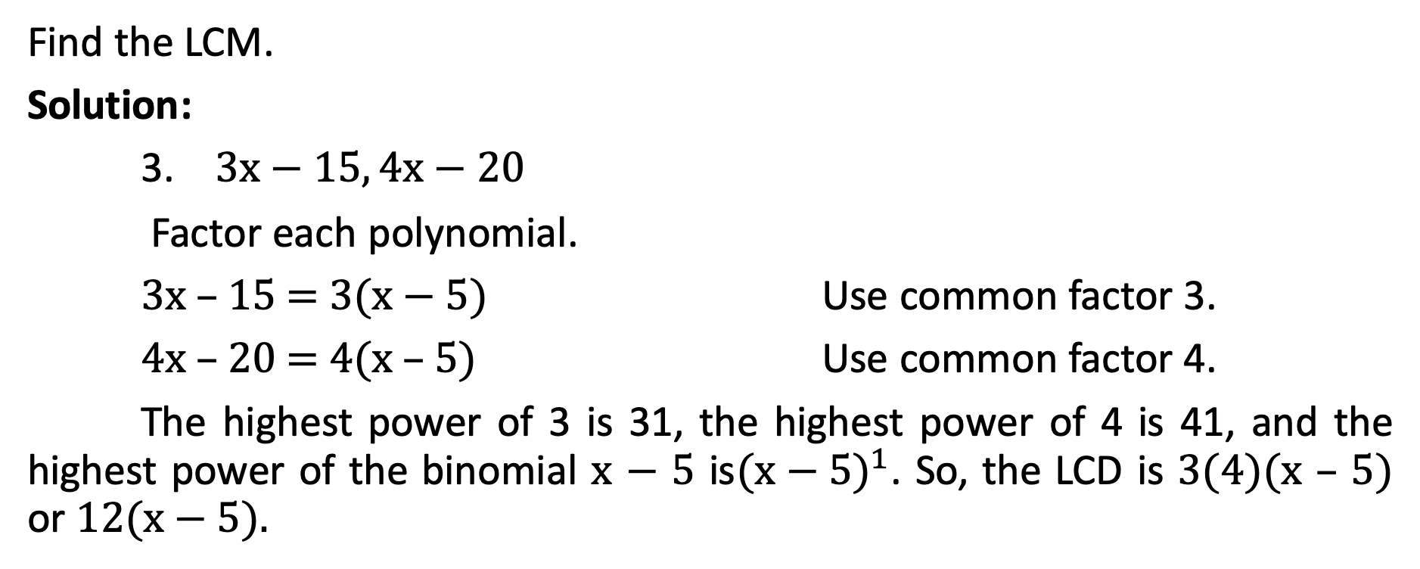
Addition and Subtraction of Rational Algebraic Expressions
Find the LCM.
Solution:
3. $3x−15, 4x−20$
Factor each polynomial.
3x – 15 = 3(x − 5) Use common factor 3.
4x – 20 = 4(x – 5) Use common factor 4.
The highest power of 3 is 31, the highest power of 4 is 41, and the highest power of the binomial x − 5 is${(x−5)}^{1}$. So, the LCD is 3(4)(x – 5) or 12(x − 5).

Slide 17
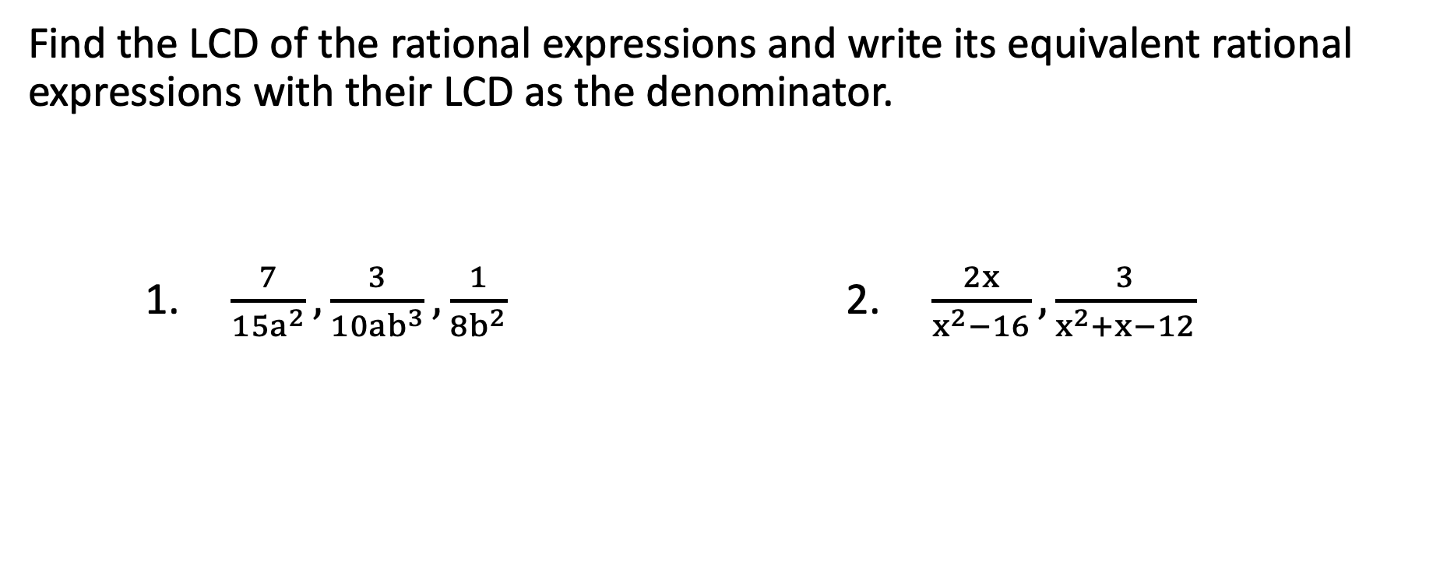
Addition and Subtraction of Rational Algebraic Expressions
Find the LCD of the rational expressions and write its equivalent rational expressions with their LCD as the denominator.
1. $\frac{7}{{15a}^{2}},\frac{3}{{10ab}^{3}},\frac{1}{{8b}^{2}}$ 2. $\frac{2x}{x^{2}−16},\frac{3}{x^{2}+x−12}$

Slide 18
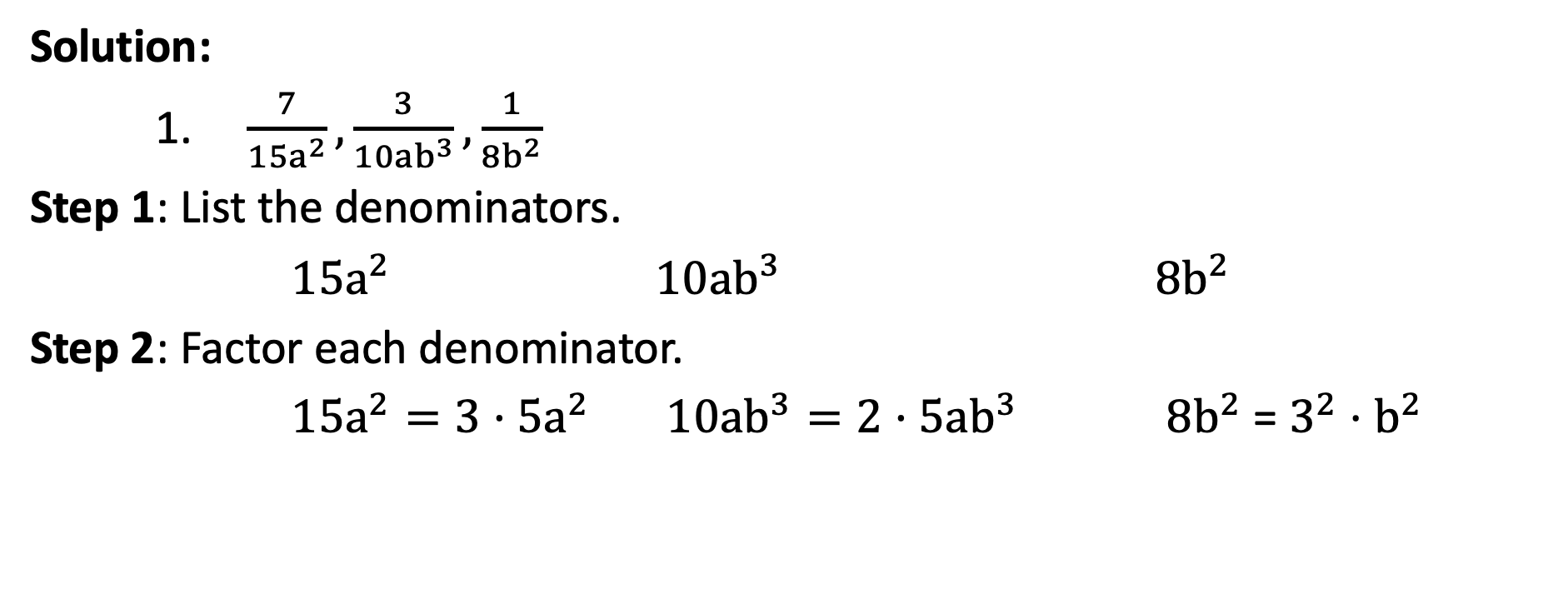
Addition and Subtraction of Rational Algebraic Expressions
Solution:
1. $\frac{7}{{15a}^{2}},\frac{3}{{10ab}^{3}},\frac{1}{{8b}^{2}}$
Step 1: List the denominators.
${15a}^{2}$ ${10ab}^{3}$ ${8b}^{2}$
Step 2: Factor each denominator.
${15a}^{2}=3·{5a}^{2}$ ${10ab}^{3}=2·{5ab}^{3}$ ${8b}^{2}$ = $3^{2}$ ⋅ $b^{2}$

Slide 19
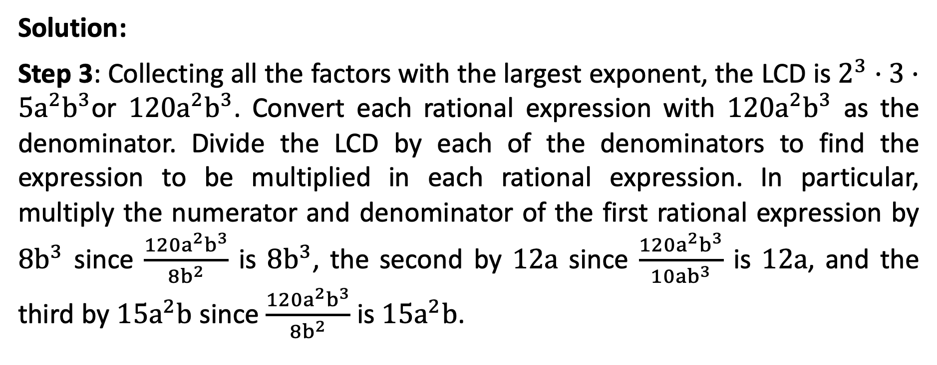
Addition and Subtraction of Rational Algebraic Expressions
Solution:
Step 3: Collecting all the factors with the largest exponent, the LCD is $2^{3}·3·{5a}^{2}b^{3}$or ${120a}^{2}b^{3}$. Convert each rational expression with ${120a}^{2}b^{3}$ as the denominator. Divide the LCD by each of the denominators to find the expression to be multiplied in each rational expression. In particular, multiply the numerator and denominator of the first rational expression by ${8b}^{3}$ since $\frac{{120a}^{2}b^{3}}{8b^{2}}$ is ${8b}^{3}$, the second by 12a since $\frac{{120a}^{2}b^{3}}{10ab^{3}}$ is 12a, and the third by ${15a}^{2}b$ since $\frac{{120a}^{2}b^{3}}{8b^{2}}$ is ${15a}^{2}b$.

Slide 20
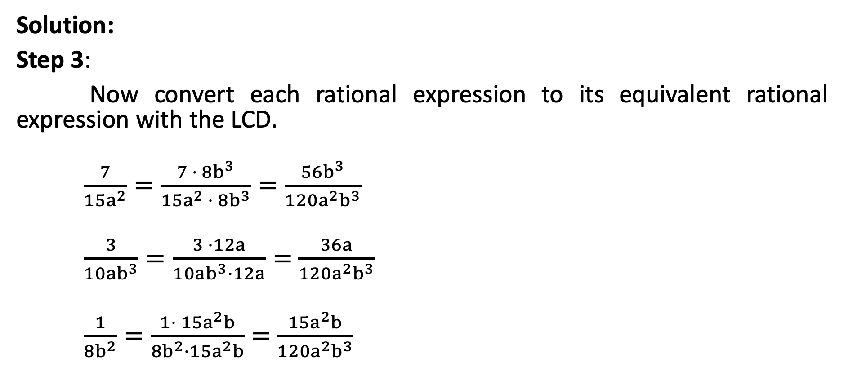
Addition and Subtraction of Rational Algebraic Expressions
Solution:
Step 3:
Now convert each rational expression to its equivalent rational expression with the LCD.
$\frac{7}{{15a}^{2}}=\frac{7 ·{ 8b}^{3}}{{15a}^{2}{ · 8b}^{3}}=\frac{{56b}^{3}}{{120a}^{2}b^{3}}$
$\frac{3}{{10ab}^{3}}=\frac{3 ·12a}{{10ab}^{3}·12a}=$ $\frac{36a}{{120a}^{2}b^{3}}$
$\frac{1}{{8b}^{2}}=\frac{1· {15a}^{2}b}{{8b}^{2}·{15a}^{2}b}=$ $\frac{{15a}^{2}b}{{120a}^{2}b^{3}}$

Slide 21

Addition and Subtraction of Rational Algebraic Expressions
Solution:
2. $\frac{2x}{x^{2}−16},\frac{3}{x^{2}+x−12}$
Step 1: Factor each denominator.
$2x$− 16 = (x + 4)(x − 4)
$2x$ + x − 12 = (x − 3)(x + 4)

Slide 22
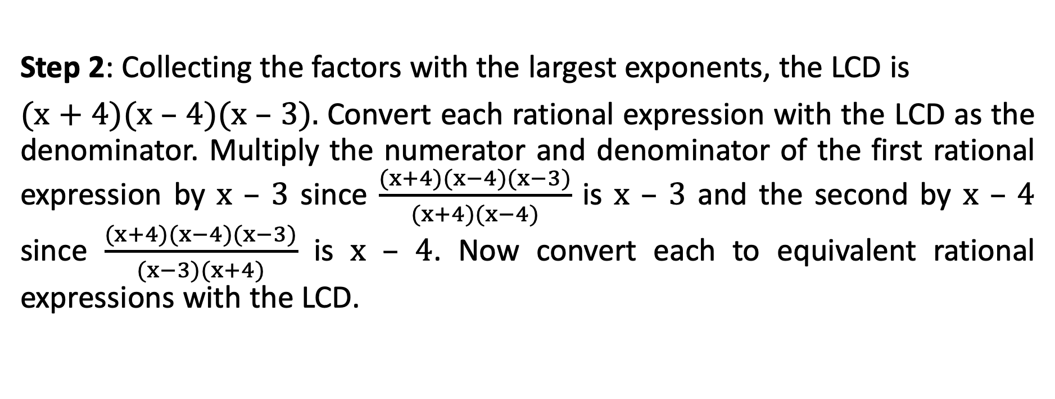
Addition and Subtraction of Rational Algebraic Expressions
Step 2: Collecting the factors with the largest exponents, the LCD is
(x + 4)(x – 4)(x – 3). Convert each rational expression with the LCD as the denominator. Multiply the numerator and denominator of the first rational expression by x – 3 since $\frac{(x+4)(x−4)(x−3)}{(x+4)(x−4)}$ is x – 3 and the second by x – 4 since $\frac{(x+4)(x−4)(x−3)}{(x−3)(x+4)}$ is x – 4. Now convert each to equivalent rational expressions with the LCD.

Slide 23
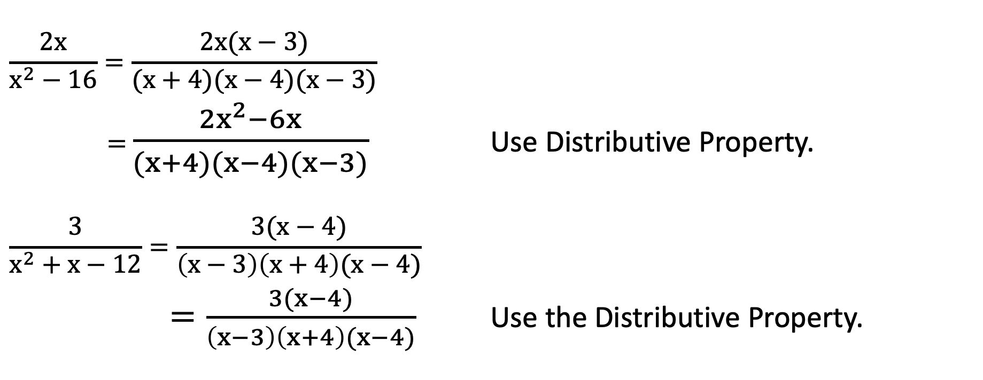
Addition and Subtraction of Rational Algebraic Expressions
$$\frac{2x}{x^{2}−16}=\frac{2x(x−3)}{(x+4)(x−4)(x−3)}$$
= $\frac{2x^{2}−6x}{(x+4)(x−4)(x−3)}$ Use Distributive Property.
$$\frac{3}{x^{2}+x−12}=\frac{3(x−4)}{\left(x−3\right)\left(x+4\right)(x−4)}$$
$=\frac{3(x−4)}{\left(x−3\right)\left(x+4\right)(x−4)}$ Use the Distributive Property.

Slide 24

Addition and Subtraction of Rational Algebraic Expressions
Add or subtract.
1. $\frac{2y}{{5x}^{2}}+\frac{3x}{4xy}$ 2. $\frac{3}{x+2}+\frac{x}{x^{2}−12}−\frac{4}{x^{2}+3x+2}$

Slide 25
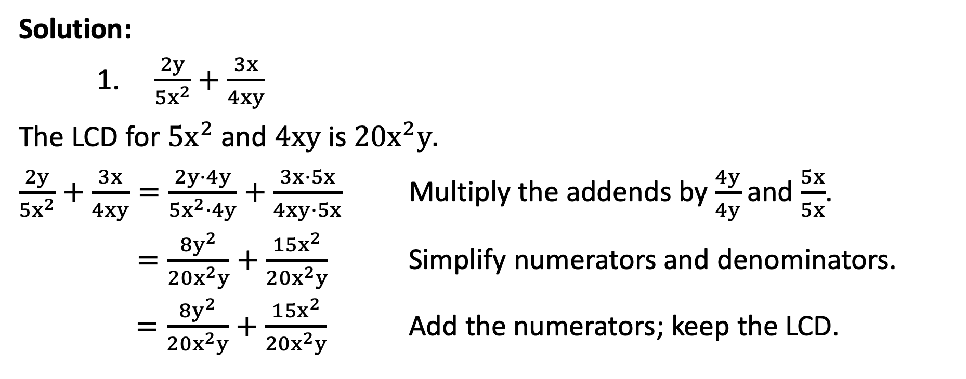
Addition and Subtraction of Rational Algebraic Expressions
Solution:
1. $\frac{2y}{{5x}^{2}}+\frac{3x}{4xy}$
The LCD for ${5x}^{2}$ and 4xy is ${20x}^{2}y.$
$\frac{2y}{{5x}^{2}}+\frac{3x}{4xy}=\frac{2y·4y}{{5x}^{2}·4y}+\frac{3x·5x}{4xy·5x}$ Multiply the addends by $\frac{4y}{4y}$and $\frac{5x}{5x}$.
$=\frac{{8y}^{2}}{{20x}^{2}y}+\frac{{15x}^{2}}{{20x}^{2}y}$ Simplify numerators and denominators.
$=\frac{{8y}^{2}}{{20x}^{2}y}+\frac{{15x}^{2}}{{20x}^{2}y}$ Add the numerators; keep the LCD.

Slide 26
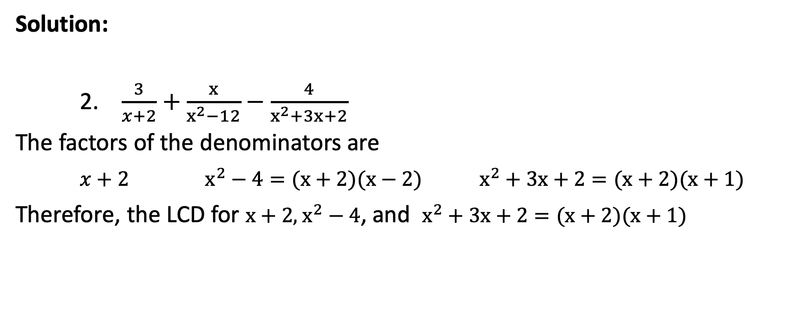
Addition and Subtraction of Rational Algebraic Expressions
Solution:
2. $\frac{3}{x+2}+\frac{x}{x^{2}−12}−\frac{4}{x^{2}+3x+2}$
The factors of the denominators are
$x+2$ $x^{2}−4=(x+2)(x−2)$ $x^{2}+3x+2=(x+2)(x+1)$
Therefore, the LCD for $x+2$,$x^{2}−4$, and $x^{2}+3x+2=(x+2)(x+1)$

Slide 27
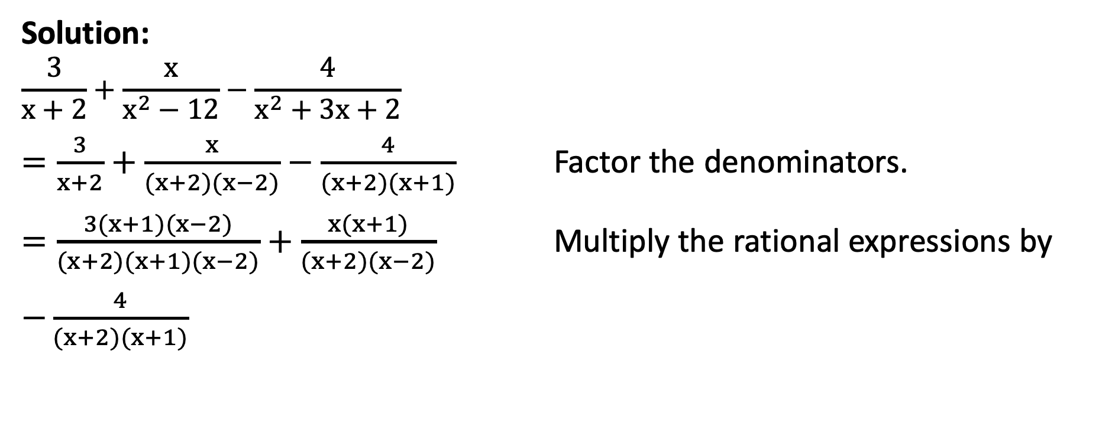
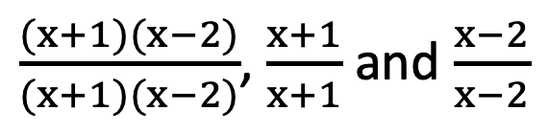
Addition and Subtraction of Rational Algebraic Expressions
Solution:
$$\frac{3}{x+2}+\frac{x}{x^{2}−12}−\frac{4}{x^{2}+3x+2}$$
$=\frac{3}{x+2}+\frac{x}{(x+2)(x−2)}−\frac{4}{(x+2)(x+1)}$ Factor the denominators.
$=\frac{3(x+1)(x−2)}{(x+2)(x+1)(x−2)}+\frac{x(x+1)}{(x+2)(x−2)}$ Multiply the rational expressions by
$−\frac{4}{(x+2)(x+1)}$
$\frac{(x+1)(x−2)}{(x+1)(x−2)}$, $\frac{x+1}{x+1}$ and $\frac{x−2}{x−2}$

Slide 28
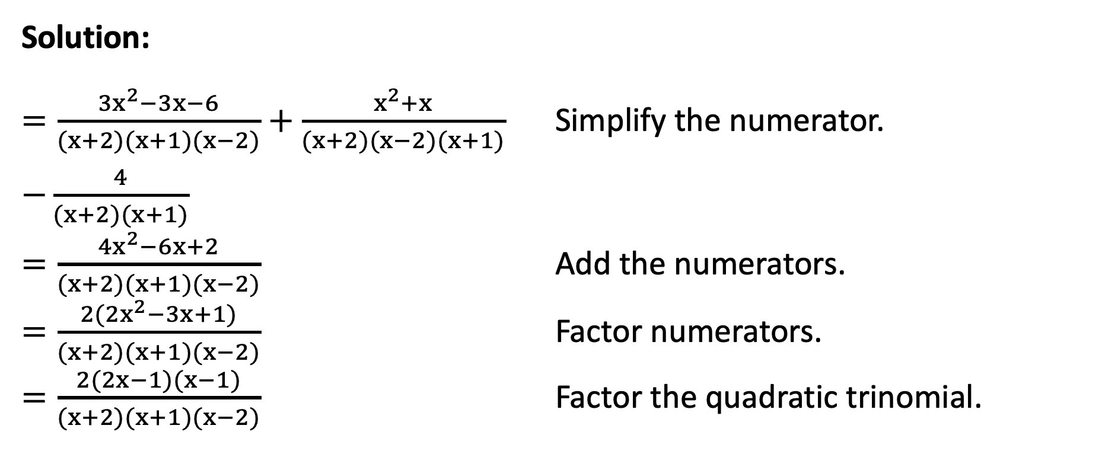
Addition and Subtraction of Rational Algebraic Expressions
Solution:
$=\frac{{3x}^{2}−3x−6}{(x+2)(x+1)(x−2)}+\frac{x^{2}+x}{(x+2)(x−2)(x+1)}$ Simplify the numerator.
$−\frac{4}{(x+2)(x+1)}$
$=\frac{{4x}^{2}−6x+2}{(x+2)(x+1)(x−2)}$ Add the numerators.
$=\frac{2({2x}^{2}−3x+1)}{(x+2)(x+1)(x−2)}$ Factor numerators.
$=\frac{2(2x−1)(x−1)}{(x+2)(x+1)(x−2)}$ Factor the quadratic trinomial.

