Slide 1
Multiplication and Division of Rational Algebraic Expression

Slide 2
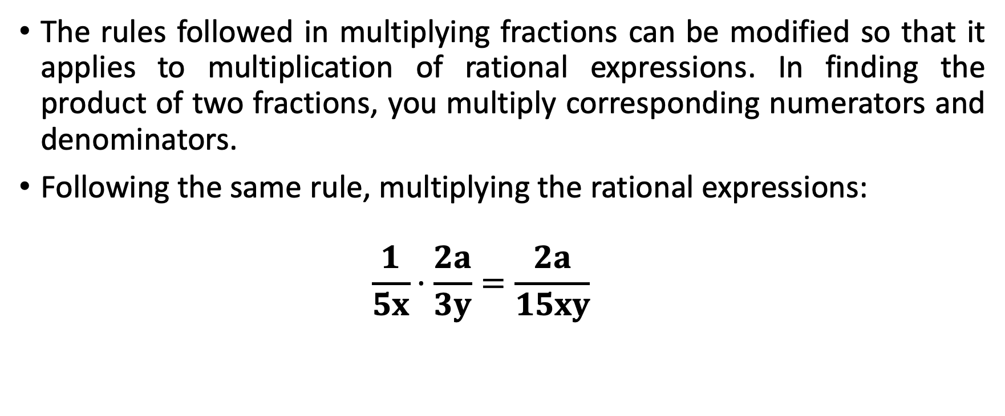
Multiplication and Division of Rational Algebraic Expressions
The rules followed in multiplying fractions can be modified so that it applies to multiplication of rational expressions. In finding the product of two fractions, you multiply corresponding numerators and denominators.
Following the same rule, multiplying the rational expressions:
  $$\frac{1}{5x}·\frac{2a}{3y}=\frac{2a}{15xy}$$

Slide 3
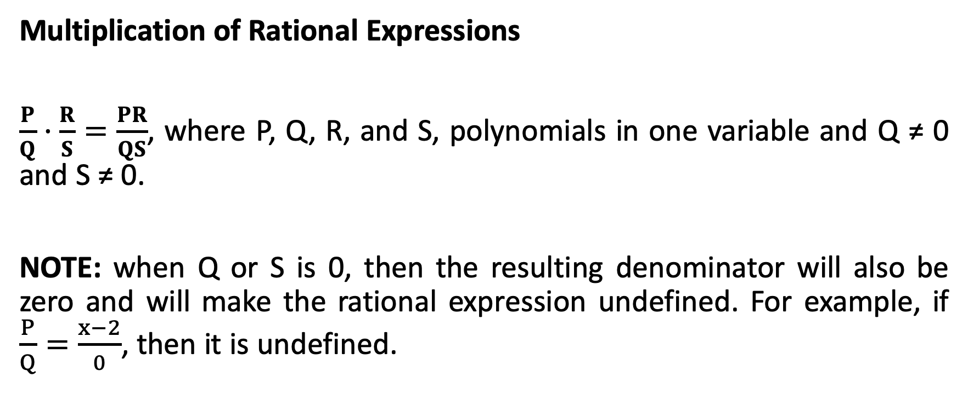
Multiplication and Division of Rational Algebraic Expressions
Multiplication of Rational Expressions
$\frac{P}{Q}·\frac{R}{S}=\frac{PR}{QS}$, where P, Q, R, and S, polynomials in one variable and Q ≠ 0 and S ≠ 0.
NOTE: when Q or S is 0, then the resulting denominator will also be zero and will make the rational expression undefined. For example, if $\frac{P}{Q}=\frac{x−2}{0}$, then it is undefined.

Slide 4
Multiplication and Division of Rational Algebraic Expressions
Multiplication of Rational Expressions
Write each numerator and denominator in factored form.
Cancel out factors common to the numerator and the denominator.
Multiply the remaining numerators and the remaining denominators.
Simplify if possible.

Slide 5

Multiplication and Division of Rational Algebraic Expressions
Multiply and simplify if necessary.
1. $\frac{{30b}^{2}}{6c}·\frac{{4c}^{2}}{{15b}^{4}}$ 2. $\frac{3x}{3y−12}·\frac{4y−16}{{12x}^{2}}$

Slide 6
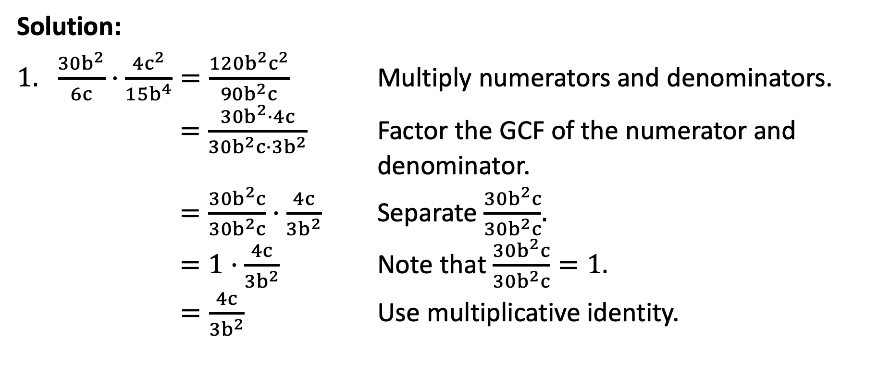
Multiplication and Division of Rational Algebraic Expressions
Solution:
$\frac{{30b}^{2}}{6c}·\frac{{4c}^{2}}{{15b}^{4}}=\frac{{120b}^{2}c^{2}}{{90b}^{2}c}$ Multiply numerators and denominators.
  $=\frac{{30b}^{2}·4c}{{30b}^{2}c·{3b}^{2}}$ Factor the GCF of the numerator and denominator.
  $=\frac{{30b}^{2}c}{{30b}^{2}c}$ · $\frac{4c}{{3b}^{2}}$ Separate $\frac{{30b}^{2}c}{{30b}^{2}c}$.
  $=1·\frac{4c}{{3b}^{2}}$ Note that $\frac{{30b}^{2}c}{{30b}^{2}c}=1.$
  $=\frac{4c}{{3b}^{2}}$ Use multiplicative identity.

Slide 7
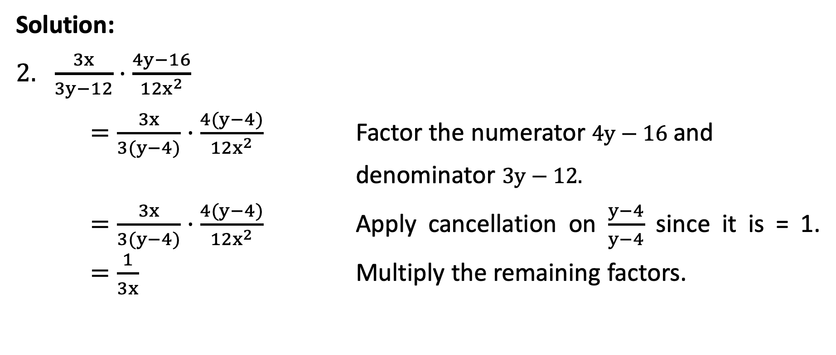
Multiplication and Division of Rational Algebraic Expressions
Solution:
$\frac{3x}{3y−12}·\frac{4y−16}{{12x}^{2}}$
$=\frac{3x}{3(y−4)}·\frac{4(y−4)}{{12x}^{2}}$ Factor the numerator $4y−16$ and denominator $3y−12.$
$=\frac{3x}{3(y−4)}·\frac{4(y−4)}{{12x}^{2}}$ Apply cancellation on $\frac{y−4}{y−4}$ since it is = 1. $=\frac{1}{3x}$ Multiply the remaining factors.

Slide 8
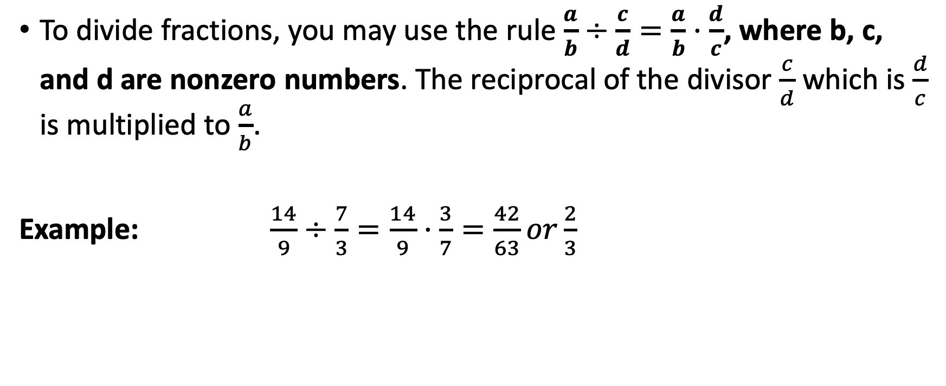
Multiplication and Division of Rational Algebraic Expressions
To divide fractions, you may use the rule $\frac{a}{b}÷\frac{c}{d}=\frac{a}{b}·\frac{d}{c}$, where b, c, and d are nonzero numbers. The reciprocal of the divisor $\frac{c}{d}$ which is $\frac{d}{c}$ is multiplied to $\frac{a}{b}$.
Example: $\frac{14}{9}÷\frac{7}{3}=\frac{14}{9}·\frac{3}{7}=\frac{42}{63}or\frac{2}{3}$

Slide 9
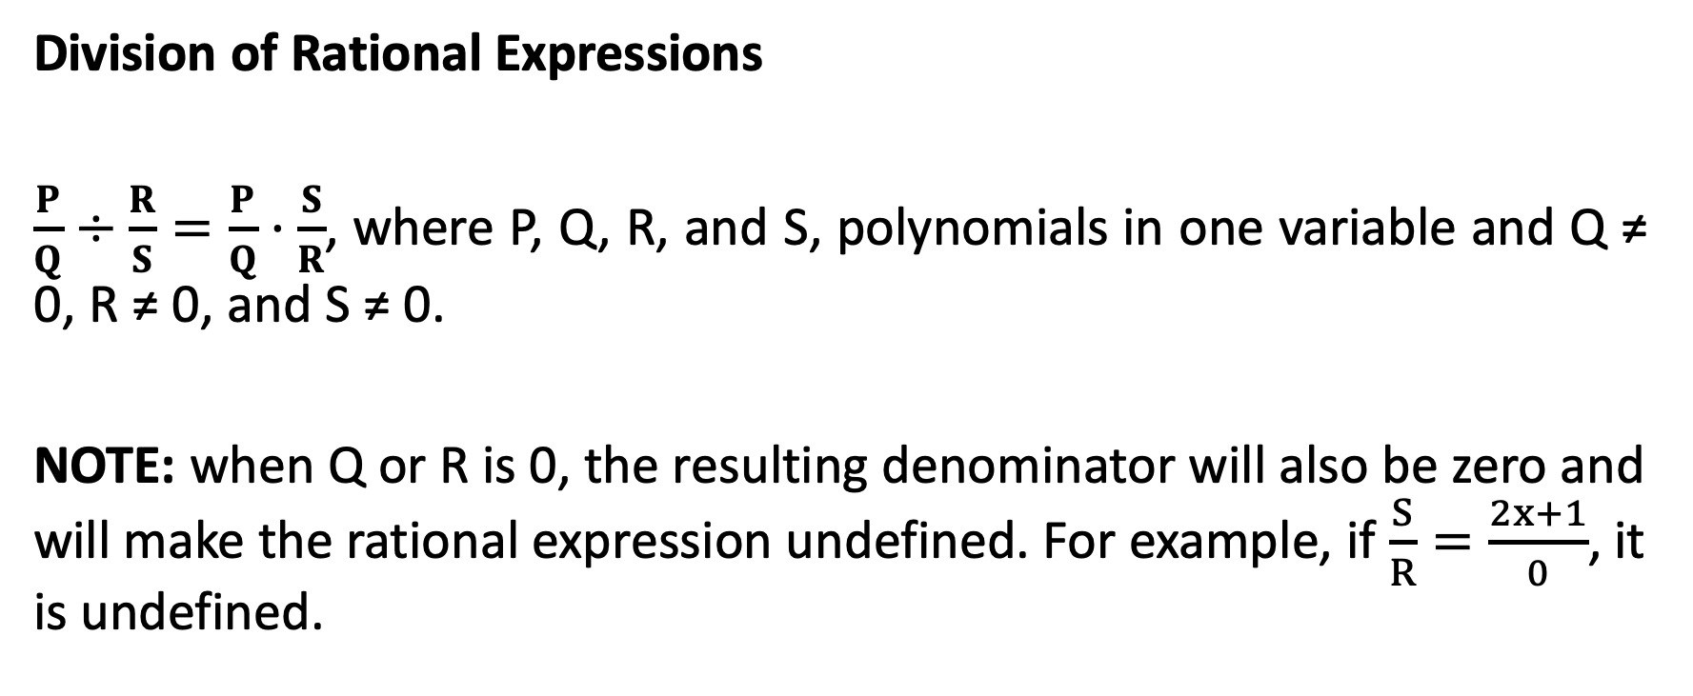
Multiplication and Division of Rational Algebraic Expressions
Division of Rational Expressions
$\frac{P}{Q}÷\frac{R}{S}=\frac{P}{Q}·\frac{S}{R}$, where P, Q, R, and S, polynomials in one variable and Q ≠ 0, R ≠ 0, and S ≠ 0.
NOTE: when Q or R is 0, the resulting denominator will also be zero and will make the rational expression undefined. For example, if $\frac{S}{R}=\frac{2x+1}{0}$, it is undefined.

Slide 10
Multiplication and Division of Rational Algebraic Expressions
Dividing of Rational Expressions
Write the equivalent multiplication statement using the reciprocal of the divisor.
Factor the numerator and denominator.
Cancel out factors common to the numerator and the denominator.
Multiply the remaining numerators and denominators.
Simplify if possible.

Slide 11

Multiplication and Division of Rational Algebraic Expressions
Divide and simplify.
1. $\frac{7}{6x}√$ $\frac{7}{12x}$ 2. $\frac{a^{5}}{4}√$ ${4a}^{2}$ 3. $\frac{16−x^{2}}{x^{2}+2x}÷$ $\frac{x−4}{x^{2}−4}$

Slide 12
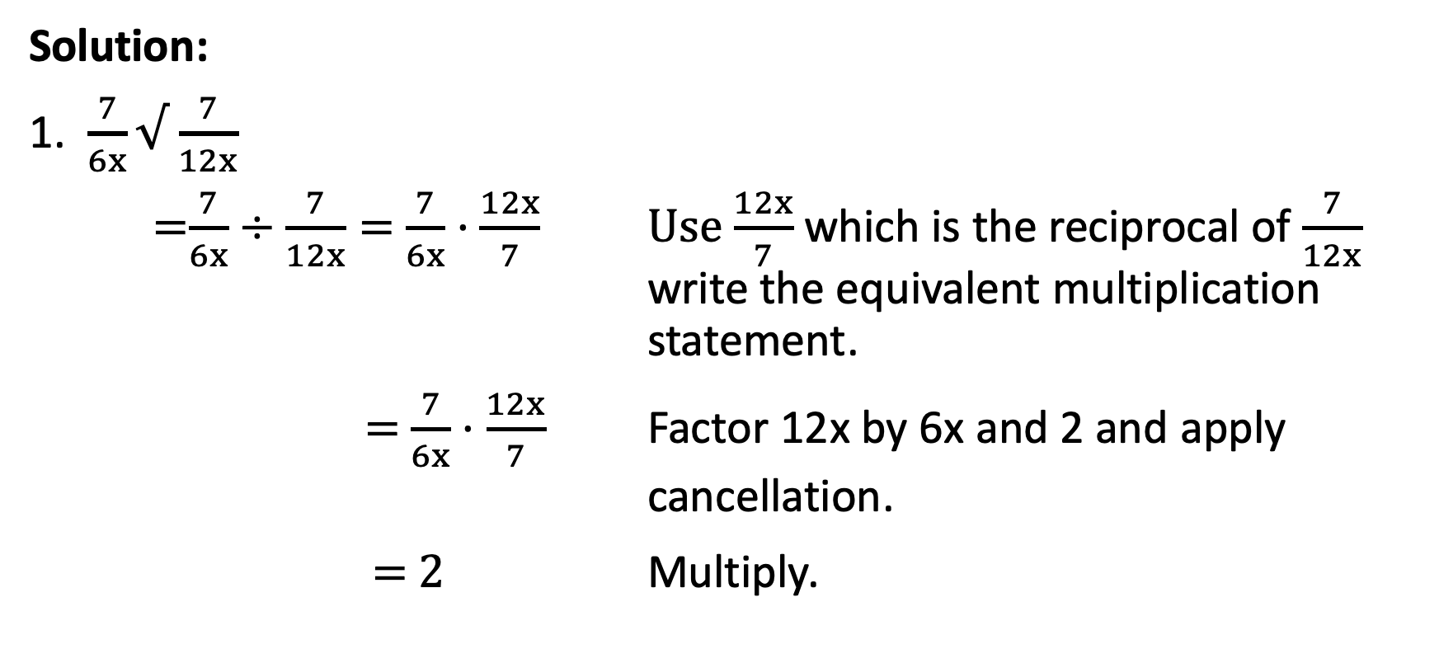
Multiplication and Division of Rational Algebraic Expressions
Solution:
1. $\frac{7}{6x}√$ $\frac{7}{12x}$
=$\frac{7}{6x}÷\frac{7}{12x}=$ $\frac{7}{6x}·\frac{12x}{7}$ Use $\frac{12x}{7}$ which is the reciprocal of $\frac{7}{12x}$ write the equivalent multiplication statement.
$=$ $\frac{7}{6x}·\frac{12x}{7}$ Factor 12x by 6x and 2 and apply cancellation.
$=$ $2$ Multiply.

Slide 13
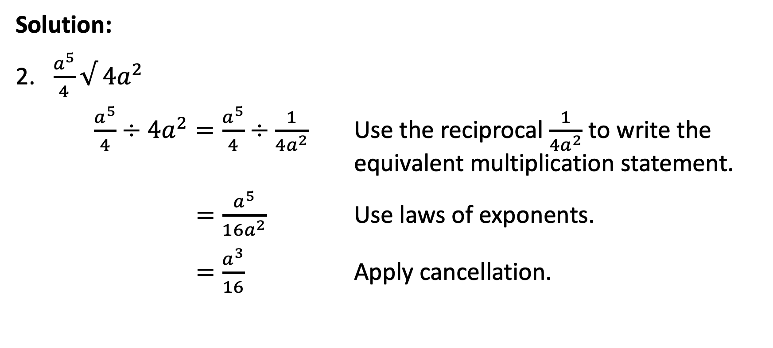
Multiplication and Division of Rational Algebraic Expressions
Solution:
2. $\frac{a^{5}}{4}√$ ${4a}^{2}$
$\frac{a^{5}}{4}÷$ ${4a}^{2}=\frac{a^{5}}{4}÷$ $\frac{1}{{4a}^{2}}$ Use the reciprocal $\frac{1}{{4a}^{2}}$ to write the equivalent multiplication statement.
$=\frac{a^{5}}{{16a}^{2}}$ Use laws of exponents.
$=\frac{a^{3}}{16}$ Apply cancellation.

Slide 14
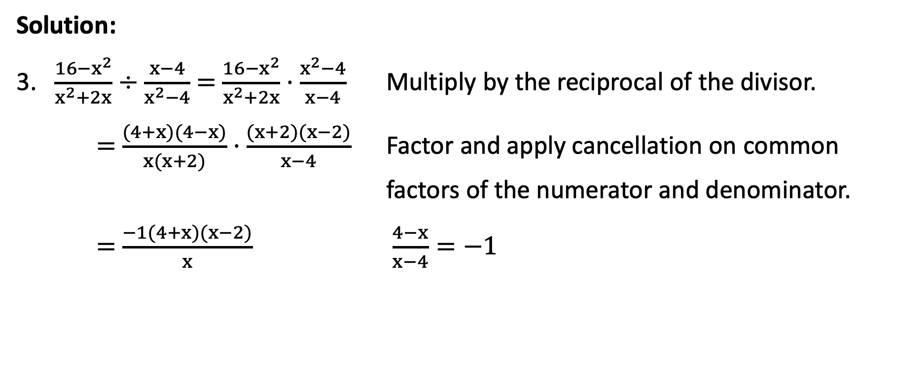
Multiplication and Division of Rational Algebraic Expressions
Solution:
3. $\frac{16−x^{2}}{x^{2}+2x}÷$ $\frac{x−4}{x^{2}−4}$ = $\frac{16−x^{2}}{x^{2}+2x}·$ $\frac{x^{2}−4}{x−4}$ Multiply by the reciprocal of the divisor.
= $\frac{(4+x)(4−x)}{x(x+2)}·$ $\frac{(x+2)(x−2)}{x−4}$ Factor and apply cancellation on common factors of the numerator and denominator.
= $\frac{−1(4+x)(x−2)}{x}$ $\frac{4−x}{x−4}=−1$

Slide 15

Multiplication and Division of Rational Algebraic Expressions
Solution:
= $\frac{−1(x^{2}+2x−8)}{x}$ Use FOIL method to get the product of (4+x)(x-2).
= $\frac{−x^{2}−2x+8}{x}$ Use Distributive Property.

Slide 16
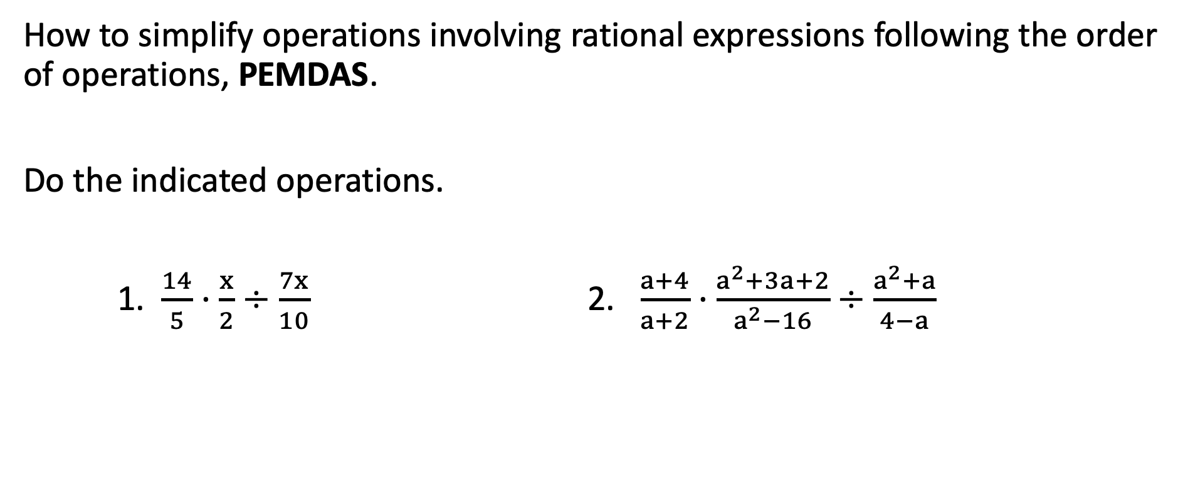
Multiplication and Division of Rational Algebraic Expressions
How to simplify operations involving rational expressions following the order of operations, PEMDAS.
Do the indicated operations.
1. $\frac{14}{5}·\frac{x}{2}$ $÷\frac{7x}{10}$ 2. $\frac{a+4}{a+2}·\frac{a^{2}+3a+2}{a^{2}−16}÷\frac{a^{2}+a}{4−a}$

Slide 17
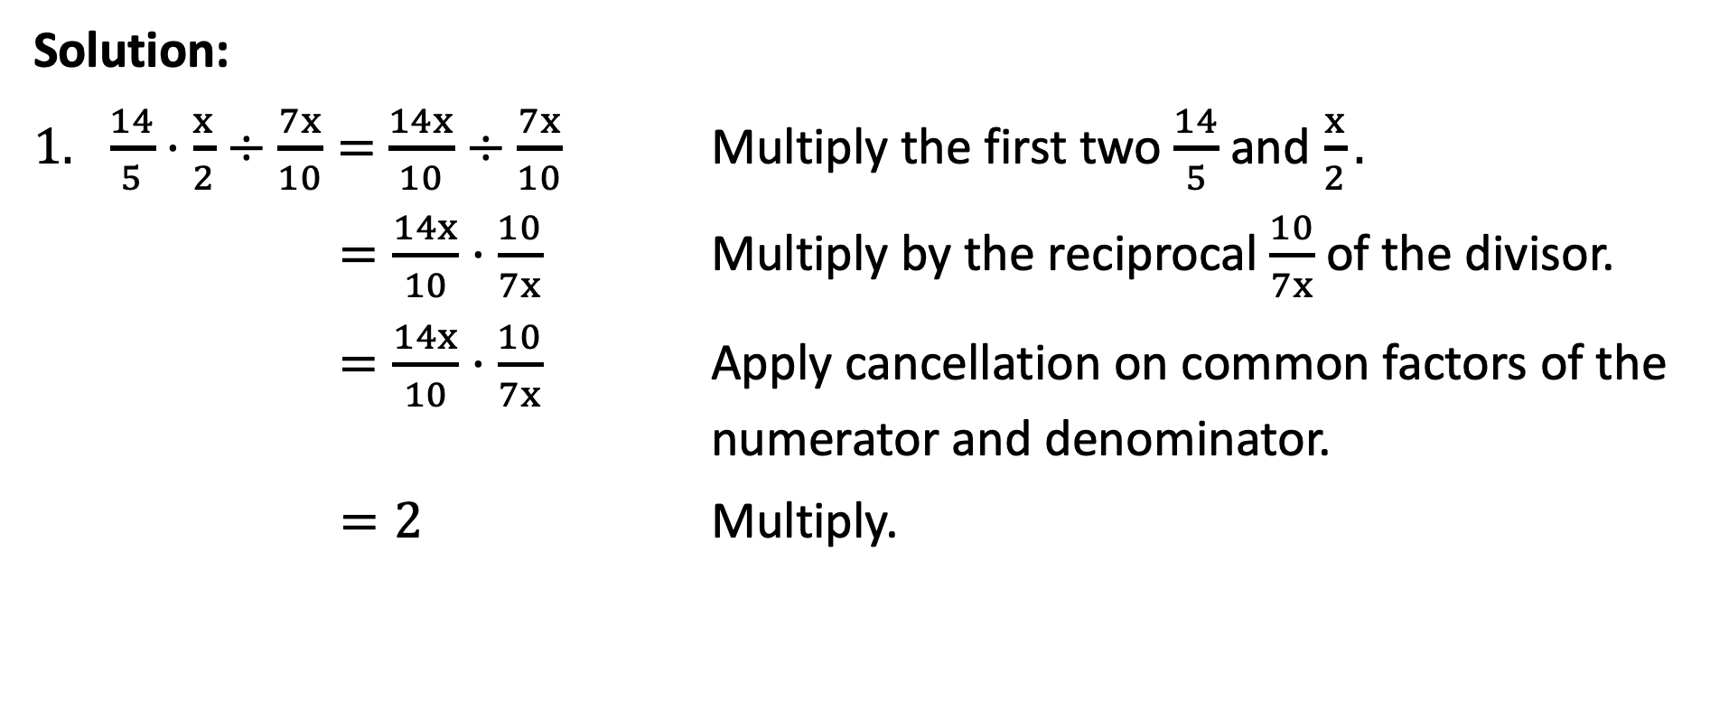
Multiplication and Division of Rational Algebraic Expressions
Solution:
$\frac{14}{5}·\frac{x}{2}$ $÷\frac{7x}{10}=$ $\frac{14x}{10}$ $÷\frac{7x}{10}$ Multiply the first two $\frac{14}{5}$ and $\frac{x}{2}.$
$=\frac{14x}{10}$ $·\frac{10}{7x}$ Multiply by the reciprocal $\frac{10}{7x}$ of the divisor.
$=\frac{14x}{10}$ $·\frac{10}{7x}$ Apply cancellation on common factors of the numerator and denominator.
$=2$ Multiply.

Slide 18
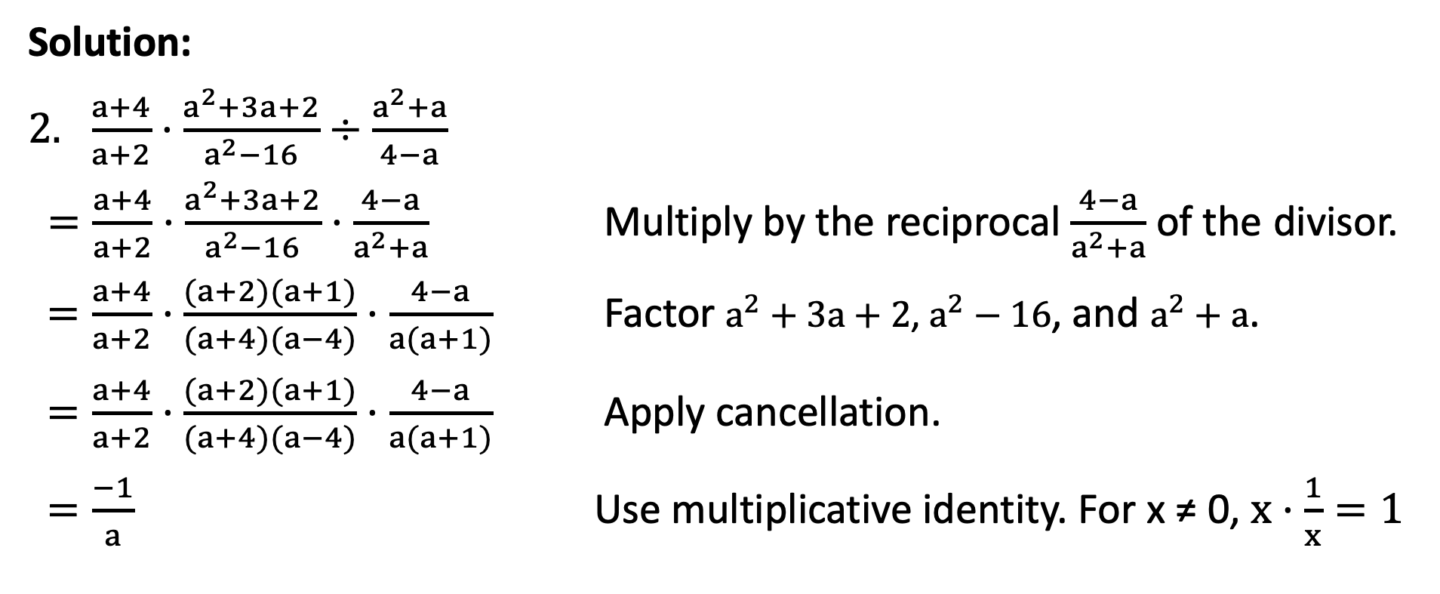
Multiplication and Division of Rational Algebraic Expressions
Solution:
$\frac{a+4}{a+2}·\frac{a^{2}+3a+2}{a^{2}−16}÷\frac{a^{2}+a}{4−a}$
$=\frac{a+4}{a+2}·\frac{a^{2}+3a+2}{a^{2}−16}·\frac{4−a}{a^{2}+a}$ Multiply by the reciprocal $\frac{4−a}{a^{2}+a}$ of the divisor.
$=\frac{a+4}{a+2}·\frac{(a+2)(a+1)}{(a+4)(a−4)}·\frac{4−a}{a(a+1)}$ Factor $a^{2}+3a+2$, $a^{2}−16$, and $a^{2}+a$.
$=\frac{a+4}{a+2}·\frac{(a+2)(a+1)}{(a+4)(a−4)}·\frac{4−a}{a(a+1)}$ Apply cancellation.
$=\frac{−1}{a}$ Use multiplicative identity. For x ≠ 0, $x·\frac{1}{x}=1$
-1

