Slide 1
Surface Area of Spheres

Slide 2
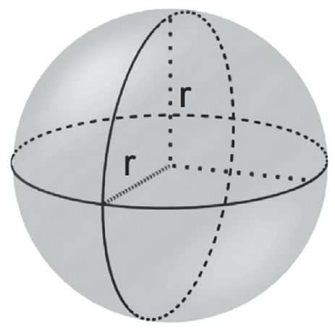
Surface Area of Spheres
A sphere is a set of all points in space that are at a fi xed distance from a given point. The fixed distance is called the radius, and the given point is called the center of the sphere. The surface area (SA) of a sphere with radius r is given by the formula:
SA = 4 x π x r².

Slide 3
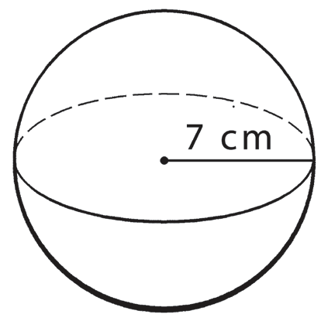
Surface Area of Spheres
Example 1: Find the surface area of the sphere. Use 3.14 for π.
Solution: r = 7 cm
SA = 4 x π x r²
= 4(3.14)(7)²
= 4(3.14)(49)
SA = 615.44 sq. cm or 615.44 cm²
Answer: The surface area of the sphere is 615.44 sq. cm or 615.44 cm².

Slide 4
Surface Area of Spheres
Example 2: The diameter of a sphere is 10 centimeters. What is the surface area of the sphere? Use 3.14 for π.
Given: d = 10 cm
Note: The radius (r) is half the diameter (d ) of the sphere.
r = d ÷ 2
= 10 ÷ 2
r = 5 cm

Slide 5
Surface Area of Spheres
Cont.
Solution:
SA = 4 x π x r²
= 4(3.14)(5)²
= 4(3.14)(25)
SA = 314 sq cm or 314 cm²
Answer: The surface area of the sphere is 314 sq. cm or 314 cm2.

Slide 6
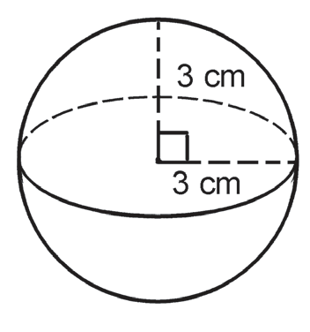
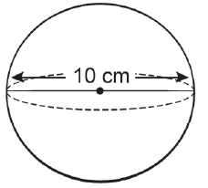
Surface Area of Spheres
Find the surface area of the following spheres. (Use 3.14 for π.)
1. 2.

Slide 7
Surface Area of Spheres
Key to correction.
1. 2.
SA = 113.04 cm² SA = 314 cm²

