Slide 1
Surface Area of Triangular and Other Pyramids

Slide 2
Surface Area of Triangular and Other Pyramids
Skylights are windows installed in a roof or ceiling. These allow light to enter the house, church, or building. How do you measure the amount of glass needed to make these skylights?

Slide 3
Surface Area of Triangular and Other Pyramids
Pyramids are named after the shape of their bases. Below are some examples of different types of pyramids.
triangular
pyramid
square
pyramid
pentagonal
pyramid
hexagonal
pyramid

Slide 4
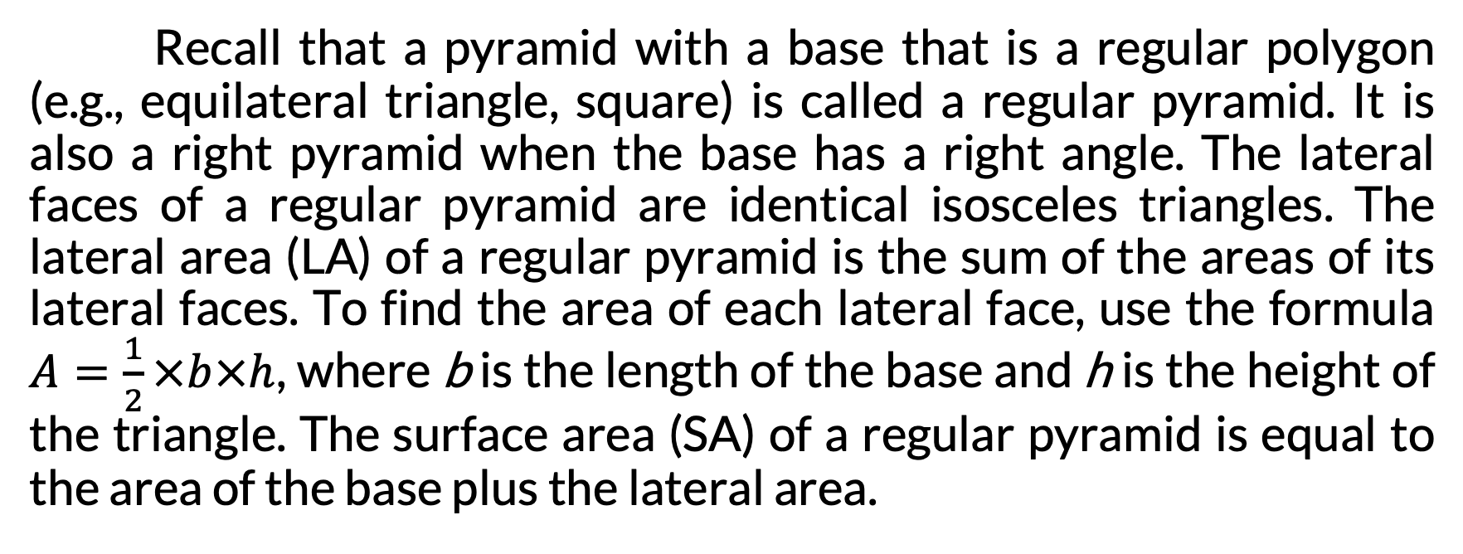
Surface Area of Triangular and Other Pyramids
Recall that a pyramid with a base that is a regular polygon (e.g., equilateral triangle, square) is called a regular pyramid. It is also a right pyramid when the base has a right angle. The lateral faces of a regular pyramid are identical isosceles triangles. The lateral area (LA) of a regular pyramid is the sum of the areas of its lateral faces. To find the area of each lateral face, use the formula $A=\frac{1}{2}×b×h$, where b is the length of the base and h is the height of the triangle. The surface area (SA) of a regular pyramid is equal to the area of the base plus the lateral area.

Slide 5
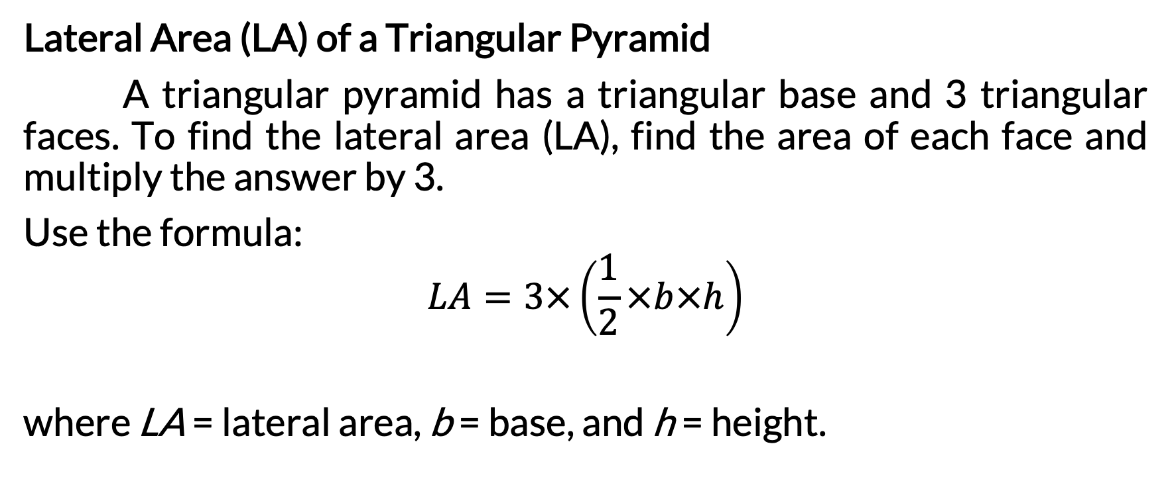
Surface Area of Triangular and Other Pyramids
Lateral Area (LA) of a Triangular Pyramid
A triangular pyramid has a triangular base and 3 triangular faces. To find the lateral area (LA), find the area of each face and multiply the answer by 3.
Use the formula:
$$LA=3×\left(\frac{1}{2}×b×h\right)$$
where LA = lateral area, b = base, and h = height.

Slide 6
Surface Area of Triangular and Other Pyramids
Find the lateral area (LA) and surface area (SA) of the triangular pyramid.
Note: There are 3 identical lateral faces.
Given:
Base Lateral Faces
b = 10 ft b = 10 ft
h = 8.7 ft h = 12 ft

Slide 7
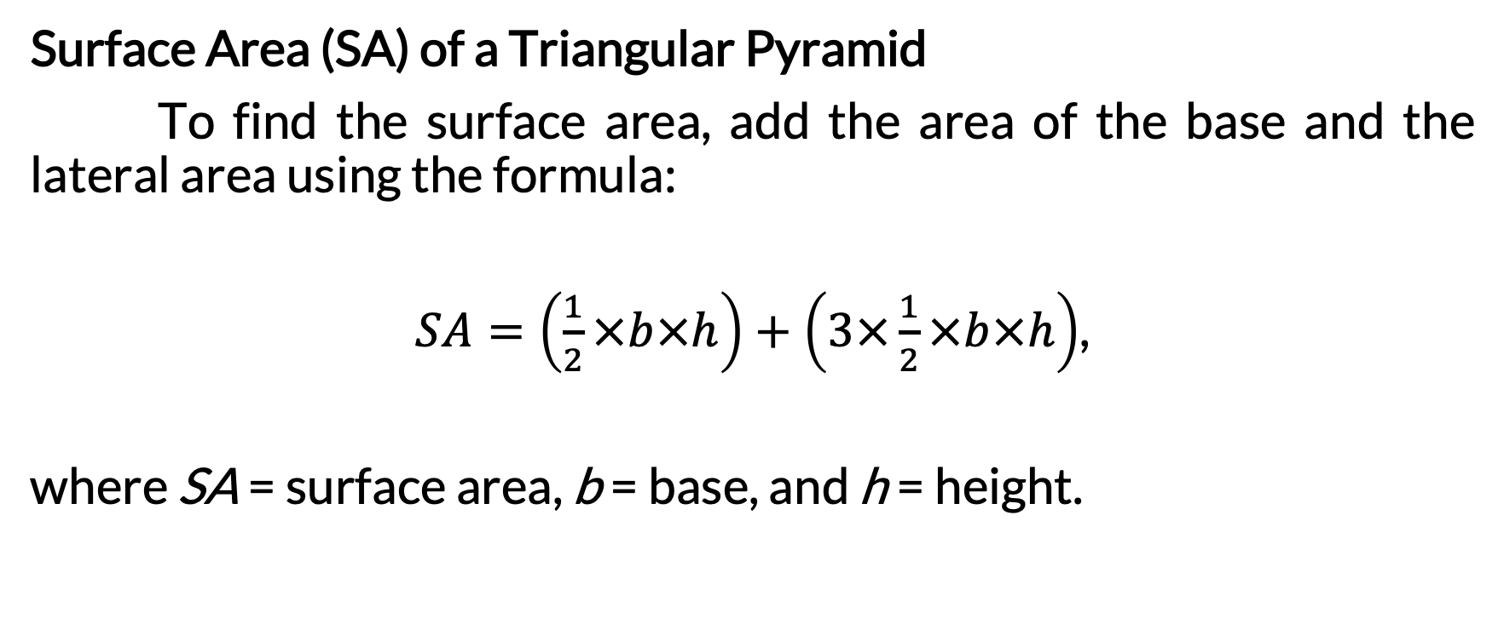
Surface Area of Triangular and Other Pyramids
Surface Area (SA) of a Triangular Pyramid
To find the surface area, add the area of the base and the lateral area using the formula:
$SA=\left(\frac{1}{2}×b×h\right)+\left(3×\frac{1}{2}×b×h\right)$,
where SA = surface area, b = base, and h = height.

Slide 8
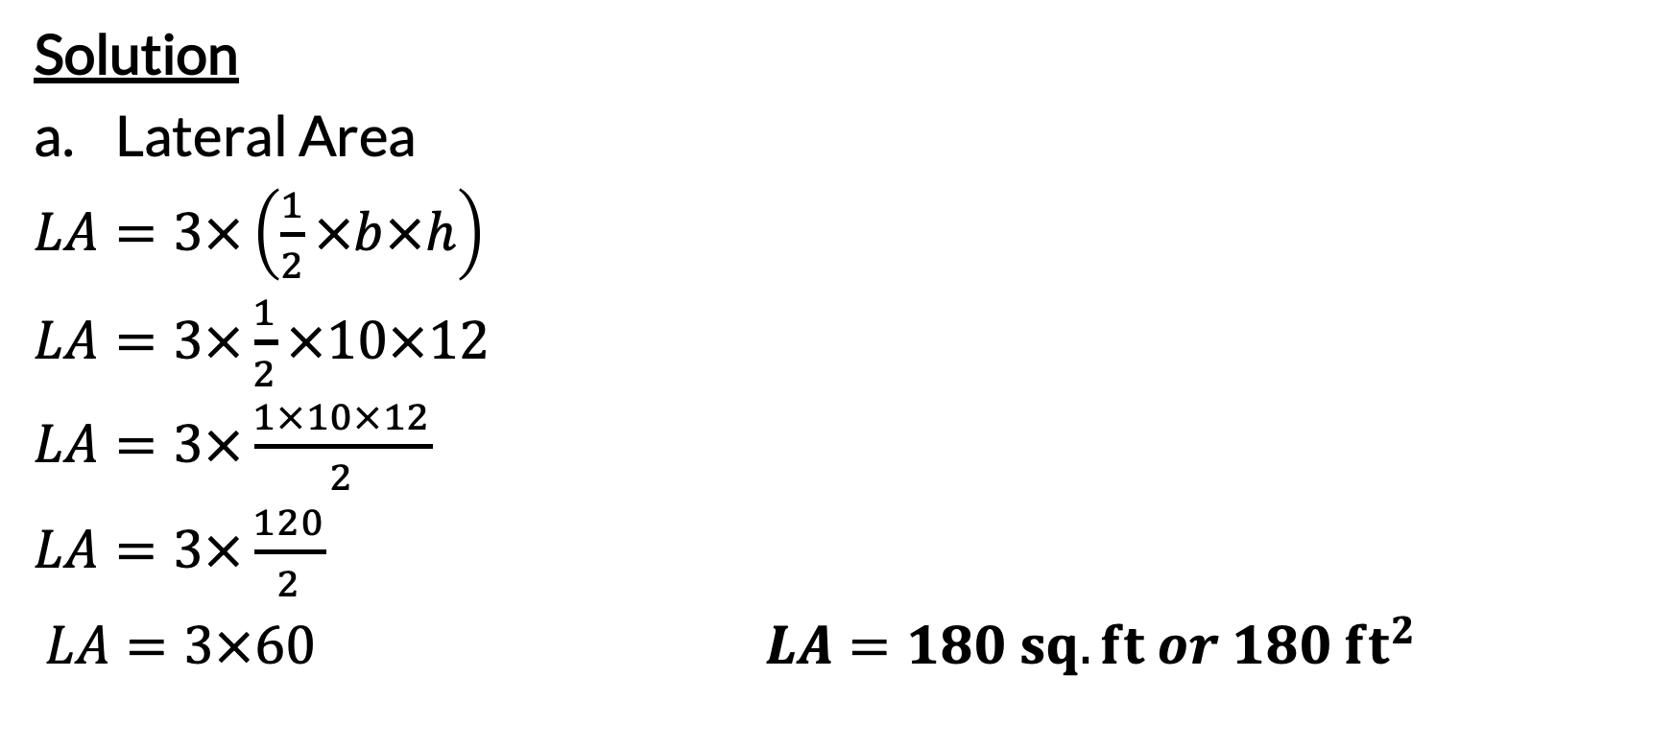
Surface Area of Triangular and Other Pyramids
Solution
Lateral Area
$LA=3×\left(\frac{1}{2}×b×h\right)$
$LA=3×\frac{1}{2}×10×12$
$LA=3×\frac{1×10×12}{2}$
$LA=3×\frac{120}{2}$
$LA=3×60$ $LA=180 sq. ft or 180 {ft}^{2}$

Slide 9
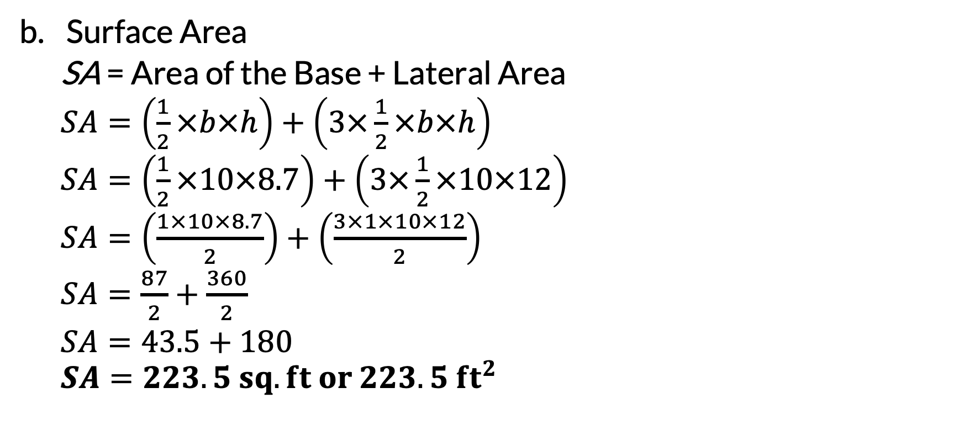
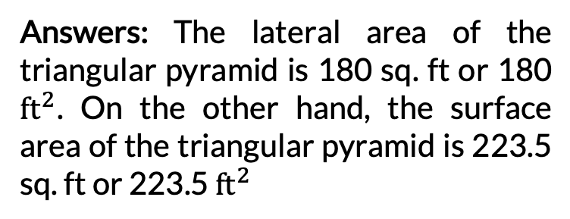
Surface Area of Triangular and Other Pyramids
Surface Area
  SA = Area of the Base + Lateral Area
  $SA=\left(\frac{1}{2}×b×h\right)+\left(3×\frac{1}{2}×b×h\right)$
  $SA=\left(\frac{1}{2}×10×8.7\right)+\left(3×\frac{1}{2}×10×12\right)$
  $SA=\left(\frac{1×10×8.7}{2}\right)+\left(\frac{3×1×10×12}{2}\right)$
  $SA=\frac{87}{2}+\frac{360}{2}$
  $SA=43.5+180$
  $$SA=223.5 sq. ft or 223.5 {ft}^{2}$$
Answers: The lateral area of the triangular pyramid is 180 sq. ft or 180 ${ft}^{2}$. On the other hand, the surface area of the triangular pyramid is 223.5 sq. ft or 223.5 ${ft}^{2}$

Slide 10
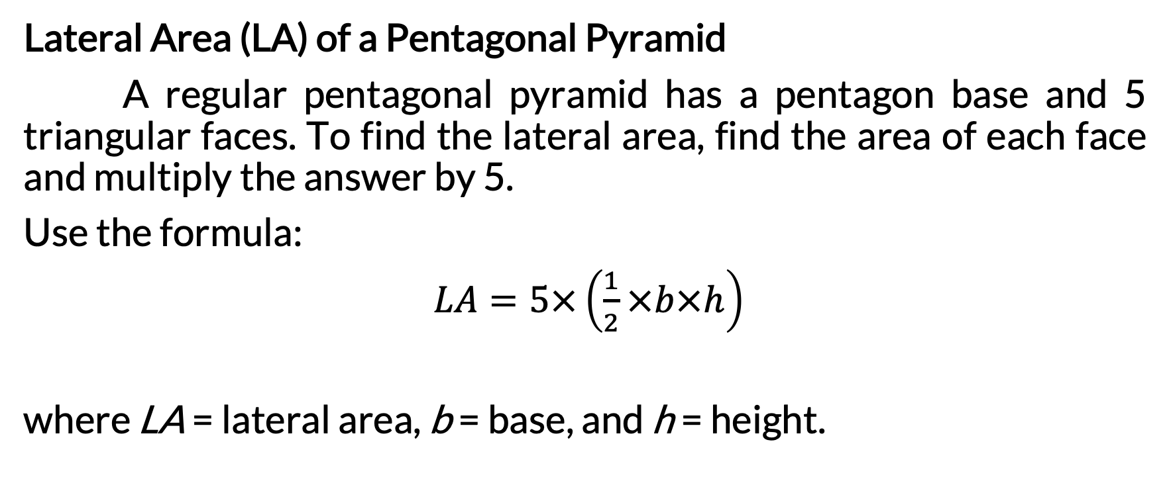
Surface Area of Triangular and Other Pyramids
Lateral Area (LA) of a Pentagonal Pyramid
A regular pentagonal pyramid has a pentagon base and 5 triangular faces. To find the lateral area, find the area of each face and multiply the answer by 5.
Use the formula:
$LA=5×\left(\frac{1}{2}×b×h\right)$
where LA = lateral area, b = base, and h = height.

Slide 11
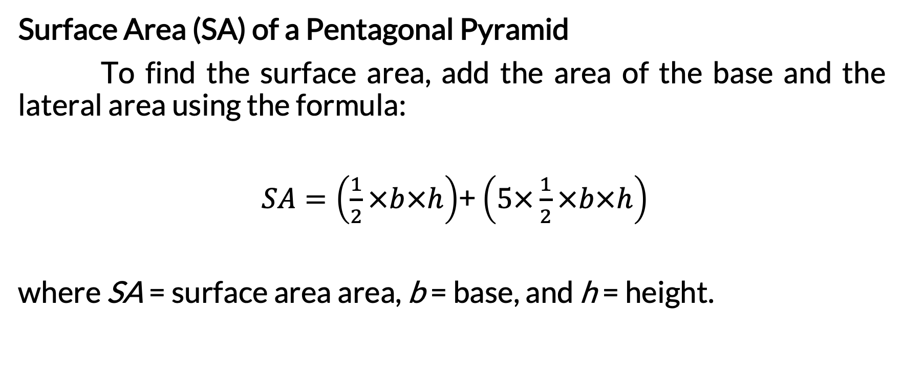
Surface Area of Triangular and Other Pyramids
Surface Area (SA) of a Pentagonal Pyramid
To find the surface area, add the area of the base and the lateral area using the formula:
$SA=\left(\frac{1}{2}×b×h\right)$+ $\left(5×\frac{1}{2}×b×h\right)$
where SA = surface area area, b = base, and h = height.

Slide 12
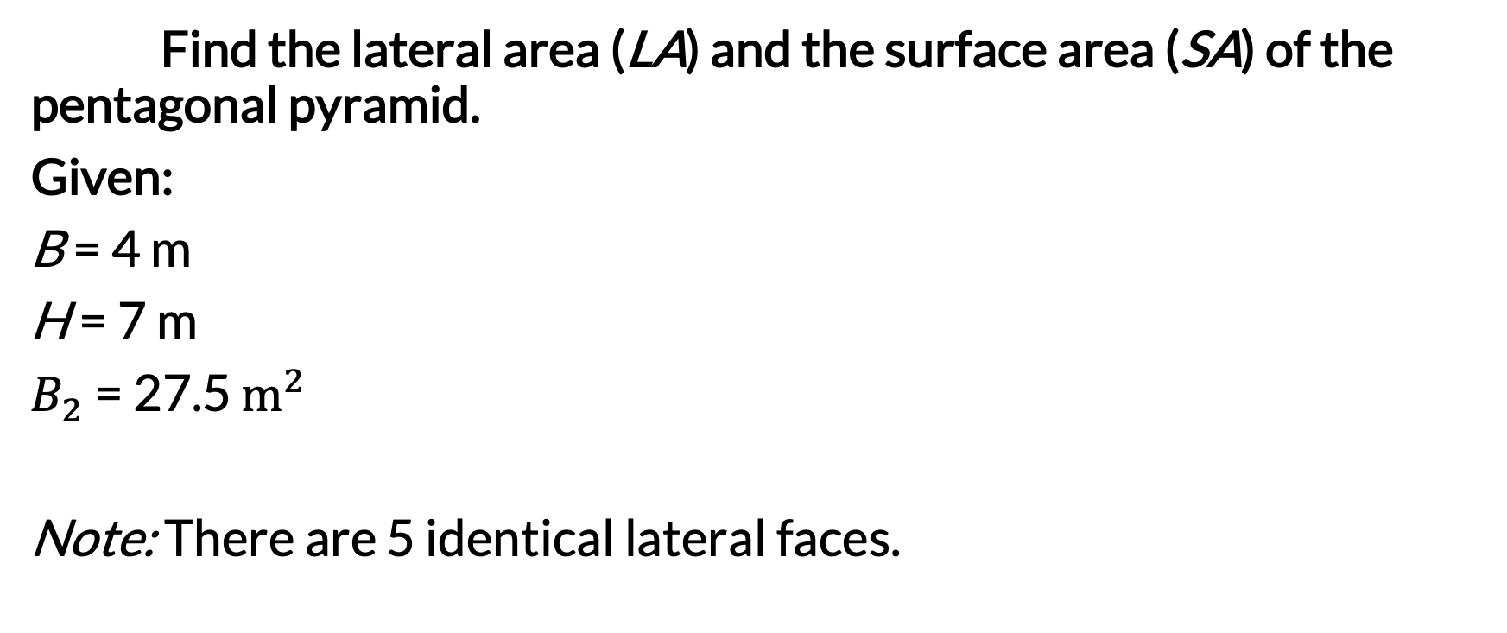
Surface Area of Triangular and Other Pyramids
Find the lateral area (LA) and the surface area (SA) of the pentagonal pyramid.
Given:
B = 4 m
H = 7 m
$B_{2}$ = 27.5 $m^{2}$
Note: There are 5 identical lateral faces.

Slide 13

Surface Area of Triangular and Other Pyramids
Solution
Lateral Area
$LA=5×\frac{1}{2}×b×h$
$LA=5×\frac{1}{2}×4×7$
$LA=\frac{5×1×4×7}{2}$
$LA=\frac{140}{2}$
$$LA=70 sq. m or 70 m^{2}$$

Slide 14
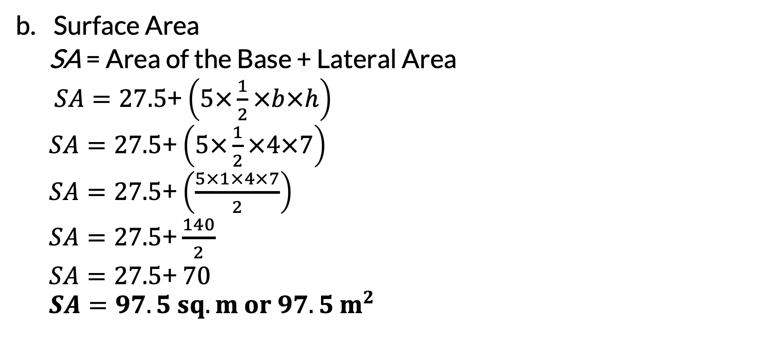
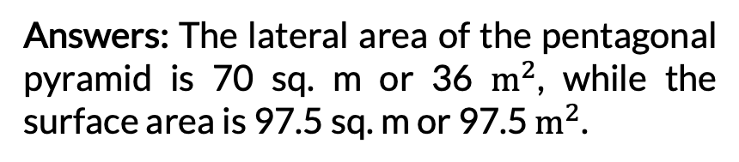
Surface Area of Triangular and Other Pyramids
Surface Area
  SA = Area of the Base + Lateral Area
  $SA=27.5$+ $\left(5×\frac{1}{2}×b×h\right)$
  $SA=27.5$+ $\left(5×\frac{1}{2}×4×7\right)$
  $SA=27.5$+ $\left(\frac{5×1×4×7}{2}\right)$
  $SA=27.5$+ $\frac{140}{2}$
  $SA=27.5$+ $70$
  $$SA=97.5 sq. m or 97.5 m^{2}$$
Answers: The lateral area of the pentagonal pyramid is 70 sq. m or 36 $m^{2}$, while the surface area is 97.5 sq. m or 97.5 $m^{2}$.

