Slide 1
Surface Area of Cones

Slide 2
Surface Area of Cones
A cone is a solid figure that has a circular base and curved surface.
It becomes thinner from its base to a point called the vertex or apex.
If the vertex is directly over the center of the base, it is called a right circular cone.

Slide 3
Surface Area of Cones
The height of the cone is the perpendicular distance from its vertex to its base.
The slant height of a cone is the distance from the vertex of the cone to any point on the circumference of the base.

Slide 4
Surface Area of Cones
The lateral area (LA) of a cone is equal to the area of the curved surface (also known as lateral face). In symbols, LA = π × r × s, where LA = lateral area, r = radius, s = slant height, and π = 3.14. Meanwhile, the surface area (SA) of a cone is the sum of the areas of the circular base and the curved surface.

Slide 5
Surface Area of Cones
In symbols, SA = (π × r × r) + (π × r × s), where SA = surface area, r = radius, s = slant height, and π = 3.14.

Slide 6
Surface Area of Cones
Find the lateral area (LA) of the cone. Use 3.14 for π. Round your final answer to the nearest hundredths.
Given: Note:
  d = 6.4 mm
  s = 5.2 mm
  π = 3.14
  r = d ÷ 2
  r = 6.4 ÷ 2
  r = 3.2 mm
The length of the
radius (r) is half the
length of the diameter (d).

Slide 7
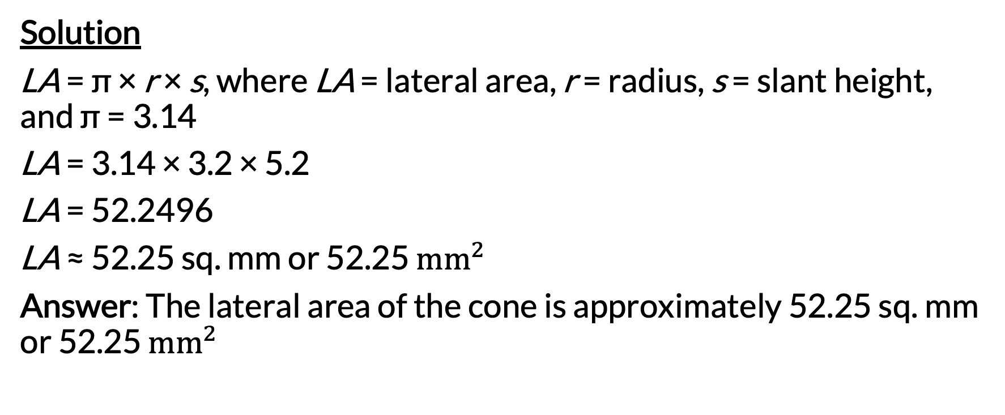
Surface Area of Cones
Solution
LA = π × r × s, where LA = lateral area, r = radius, s = slant height, and π = 3.14
LA = 3.14 × 3.2 × 5.2
LA = 52.2496
LA ≈ 52.25 sq. mm or 52.25 ${mm}^{2}$
Answer: The lateral area of the cone is approximately 52.25 sq. mm or 52.25 ${mm}^{2}$

Slide 8
Surface Area of Cones
Find the surface area (SA) of the cone. Use 3.14 for π.
Given:
  r = 5 cm
  s = 11 cm
  π = 3.14

Slide 9
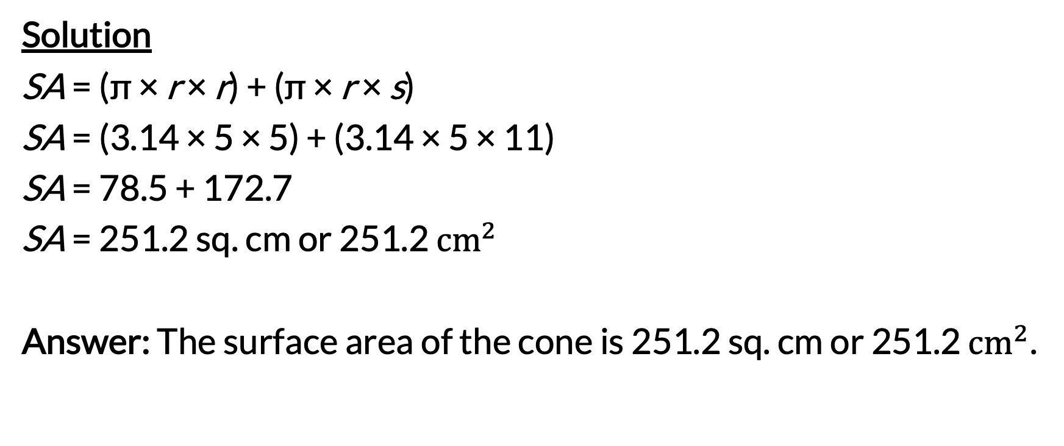
Surface Area of Cones
Solution
SA = (π × r × r) + (π × r × s)
SA = (3.14 × 5 × 5) + (3.14 × 5 × 11)
SA = 78.5 + 172.7
SA = 251.2 sq. cm or 251.2 ${cm}^{2}$
Answer: The surface area of the cone is 251.2 sq. cm or 251.2 ${cm}^{2}$.

