Slide 1


Proving Similarity of Triangles and
Pythagorean Theorem

Slide 2
Proving Similarity of Triangles and Pythagorean Theorem
In the previous lessons, you learned several ways to prove congruent triangles. Can you recall the following statements that were used to prove that triangles are congruent?
1. The SAS Postulate (Side-Angle-Side)
2. The SSS Postulate (Side-Side-Side)
3. The ASA Postulate (Angle-Side-Angle)
The SAS Postulate states that if two sides and the included angle of one triangle are congruent to two sides and the included angle of another triangle, then these two triangles are congruent.
The SSS Postulate states that if three sides of one triangle are congruent to three sides of another triangle, then the two triangles are congruent.
The ASA Postulate states that if two angles and the included side of one triangle are congruent to two angles and the included side of a second triangle, then the triangles are congruent.
These postulates and theorems were used to simplify the writing of proofs for congruent triangles. In the same way as we have postulates and theorems in proving congruency between triangles, we also have postulates and theorems to prove similarity between triangles. We list some of the similarity postulate and theorems between triangles that you will learn in this module.
• AAA Similarity Postulate • SAS Similarity Theorem
• AA Similarity Theorem • SSS Similarity Theorem
The following postulate allows you to conclude that two triangles are similar if you can show that all three corresponding angles of the two triangles are congruent.
Rex Curriculum Resource
WWW.REX.COM.PH

Slide 3
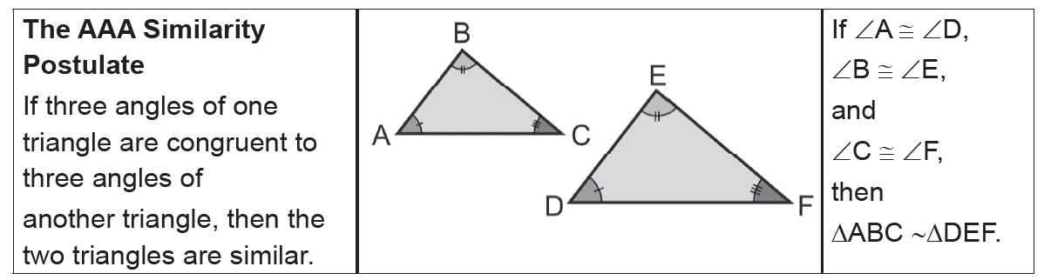
Proving Similarity of Triangles and Pythagorean Theorem
From the AAA Similarity Postulate, we can conclude that congruent triangles are similar triangles.
Rex Curriculum Resource
WWW.REX.COM.PH

Slide 4
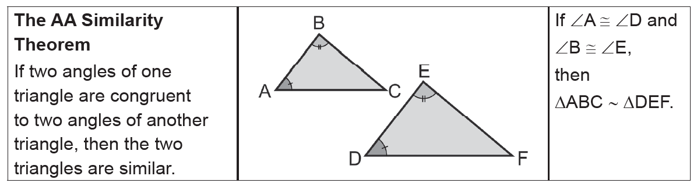
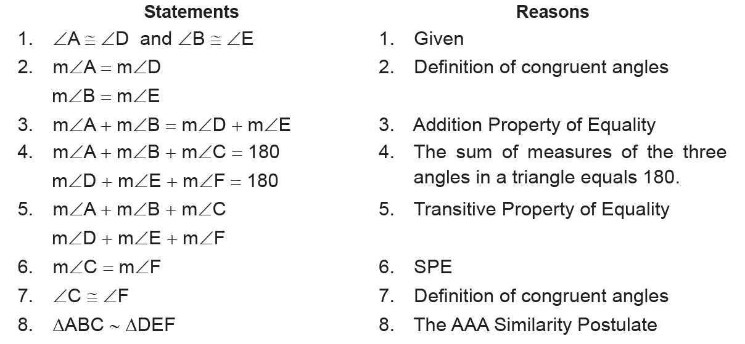
Proving Similarity of Triangles and Pythagorean Theorem
The next theorem now shows that you do not need to check if all three corresponding angles are congruent. It is enough to show that
two of the corresponding angles are congruent. Then, you can already conclude that the two triangles are similar.
To verify the AA Similarity Theorem, consider the following two-column proof.
Rex Curriculum Resource
WWW.REX.COM.PH

Slide 5
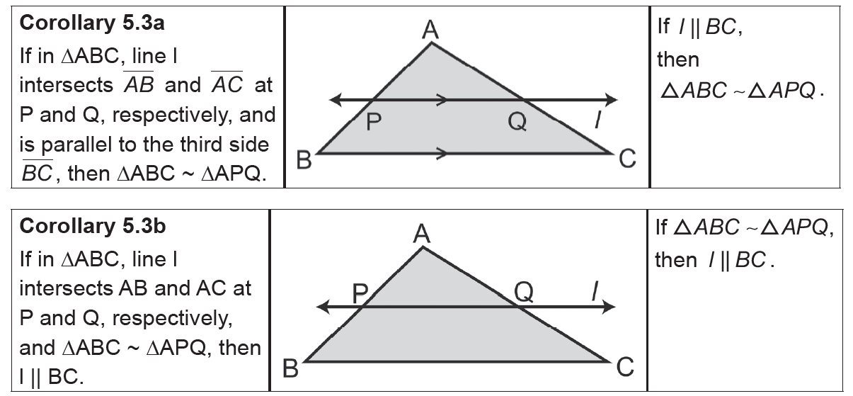
Proving Similarity of Triangles and Pythagorean Theorem
From the first theorem on similarity, we can conclude that if two angles of one triangle are congruent to the corresponding angles of another triangle, then the third pair must also be congruent. Also from this theorem, two more statements can be derived that will allow you to conclude that two triangles are similar.
Rex Curriculum Resource
WWW.REX.COM.PH

Slide 6
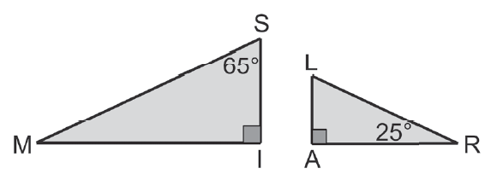
Proving Similarity of Triangles and Pythagorean Theorem
Example 1:
Determine whether the triangles are similar. If so, write a similarity statement.
Explain your answer.
Solution:
If there are two pairs of congruent angles, then the triangles are similar. ∠I ≅ ∠A because any two right angles are congruent. Determine whether ∠M is congruent to ∠R. m∠M = 180 − (90 + 65) and m∠M = 25 because the sum of the measures of the angles of a triangle is 180.
By the AA Similarity Theorem, ΔSIM ~ ΔLAR.
Rex Curriculum Resource
WWW.REX.COM.PH

Slide 7
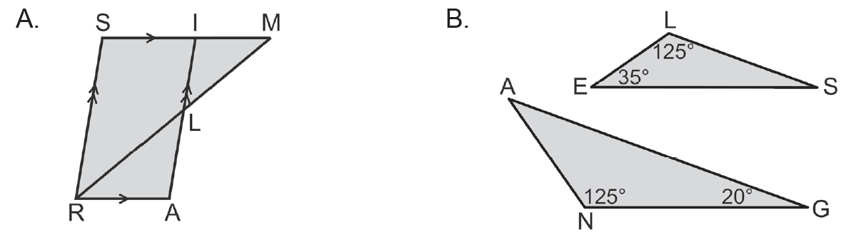
Proving Similarity of Triangles and Pythagorean Theorem
Example 2:
Identify the similar triangles in each figure. Explain your answer.
Solution:
A. ΔRAL ∼ ΔMIL ∼ ΔMSR by AA Similarity Theorem
For ΔRAL ∼ ΔMIL, we have ∠A ≅ ∠MIL because of the PAIC Theorem and ∠ALR ≅ ∠ILM due to VAT.
For ΔMIL ∼ ΔMSR, we have ∠MIL ≅ ∠MSR due to PCAC Theorem and ∠ILM ≅ ∠SRM, which is also due to PCAC Theorem.
B. ΔANG ∼ ΔELS by AA Similarity Theorem
m∠ A = 180 + (125 + 20) = 35 and m S = 180 − (125 + 35) = 20.
Rex Curriculum Resource
WWW.REX.COM.PH

Slide 8
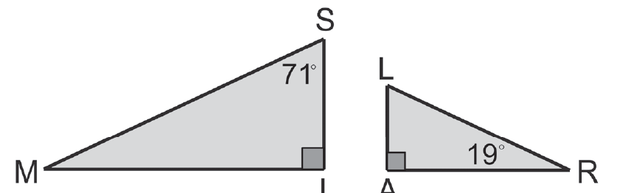
Activity:
CHECKPOINT 1:
Determine whether the triangles are similar. If so, write a similarity statement.
Explain your answer.
Rex Curriculum Resource
WWW.REX.COM.PH

Slide 9
Activity: ANSWER KEY
CHECKPOINT 1:
Determine whether the triangles are similar. If so, write a similarity statement.
Explain your answer.
ANSWER:
Checkpoint 1:
ΔRAL ~ΔMIS by AAA-Similarity Postulate
Rex Curriculum Resource
WWW.REX.COM.PH

Slide 10
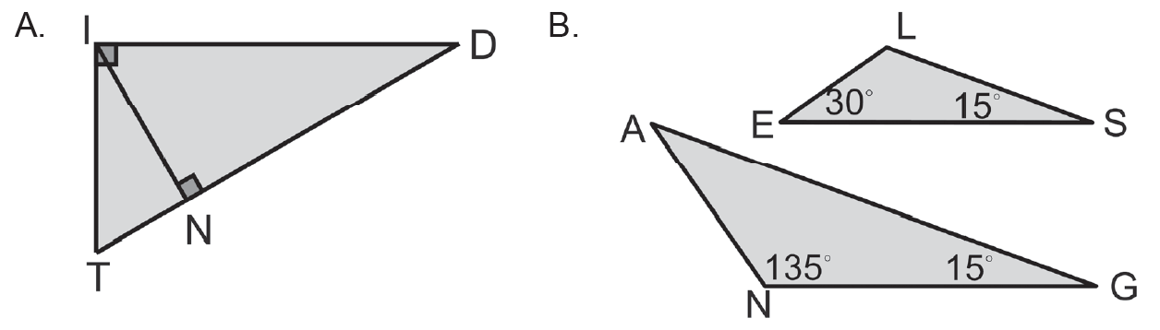
Activity:
CHECKPOINT 2:
Determine whether the triangles are similar. If so, write a similarity statement.
Explain your answer.
Rex Curriculum Resource
WWW.REX.COM.PH

Slide 11
Activity: ANSWER KEY
CHECKPOINT 2:
Determine whether the triangles are similar. If so, write a similarity statement.
Explain your answer.
ANSWER:
Checkpoint 2:
ΔRAL ~ΔMIS by AAA-Similarity Postulate
Rex Curriculum Resource
WWW.REX.COM.PH

Slide 12


Proving Similarity of Triangles and Pythagorean Theorem
Example 3:
Identify the similar triangles in each figure. Explain your answer.
Consider the given fi gure where RI ||NO, RI = 6, RB = 3x + 4,ON = 12, and OB = x +18
RI ||NO, RI = 6, RB = 3x + 4,ON = 12, and OB = x +18 .
Find: a. RB b. OB
Solution:
Since RI ||NO , ∠I ≅ ∠N, and ∠R ≅ ∠O because of PAIC Theorem. By AA Similarity Theorem, ΔRIB ~ ΔONB. By the definition of similar
Polygons, This means that
Solving step by step:
6x + 108 = 36x + 48 Distributive property:
108 = 30x + 48 Subtract 6x from both sides
60 = 30x Subtract 48 from both sides:
X = 2 Divide both sides by 30:
a. RB = 3x + 4 = 3(2) + 4 or 10
b. OB = x + 18 = 2 + 18 or 20
Rex Curriculum Resource
WWW.REX.COM.PH

Slide 13
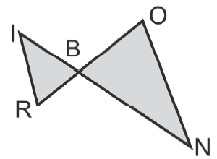
Activity:
CHECKPOINT 3:
Consider the figure on the right where RI ||NO ,
RI = 8, RB = 2x + 1, ON = 24, and OB = 5x + 5.
Rex Curriculum Resource
WWW.REX.COM.PH

Slide 14
Activity: ANSWER KEY
CHECKPOINT 3:
Consider the figure on the right where RI ||NO ,
RI = 8, RB = 2x + 1, ON = 24, and OB = 5x + 5.
ANSWER:
Checkpoint 3:
RB = 5, OB = 15
Rex Curriculum Resource
WWW.REX.COM.PH

Slide 15
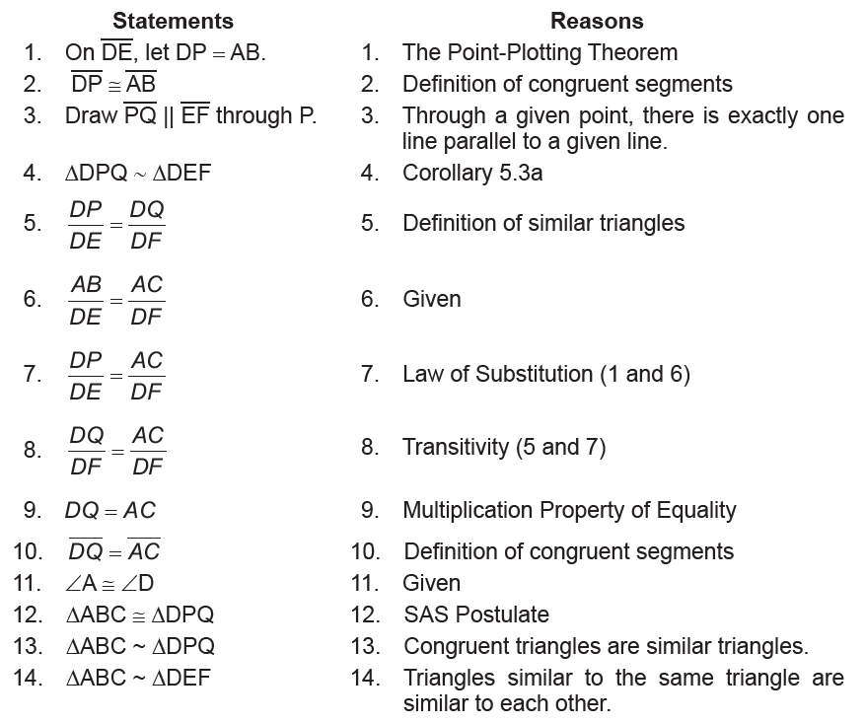
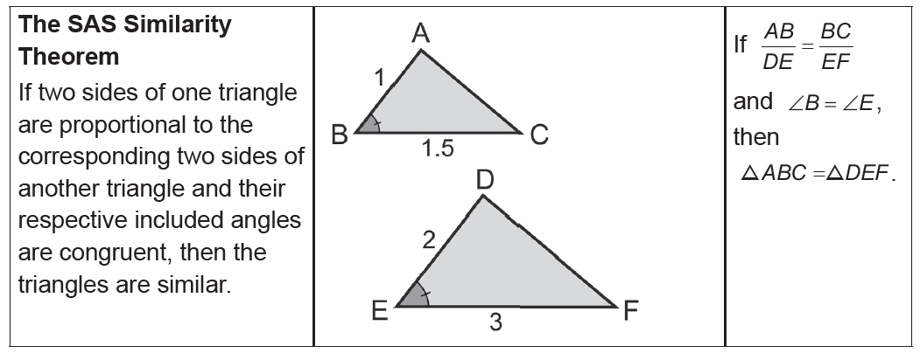
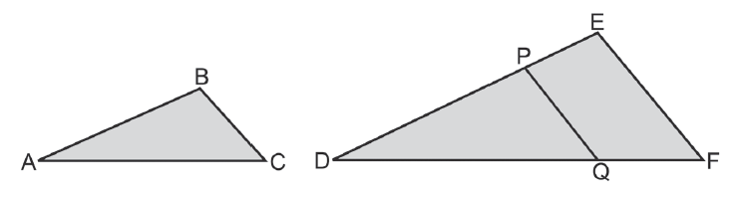
Proving Similarity of Triangles and Pythagorean Theorem
At this point, you should have noticed that the AAA Similarity Postulate and the AA Similarity Theorem were used to prove that two triangles are similar. Other ways of proving similar triangles are given by the SAS Similarity Theorem and SSS Similarity Theorem.
To verify the SAS Similarity Theorem, consider the following two-column proof.
Given:
AB/DE = AC/DF and ∠A ≅ ∠D
Prove: ΔABC ∼ ΔDEF
Rex Curriculum Resource
WWW.REX.COM.PH

Slide 16
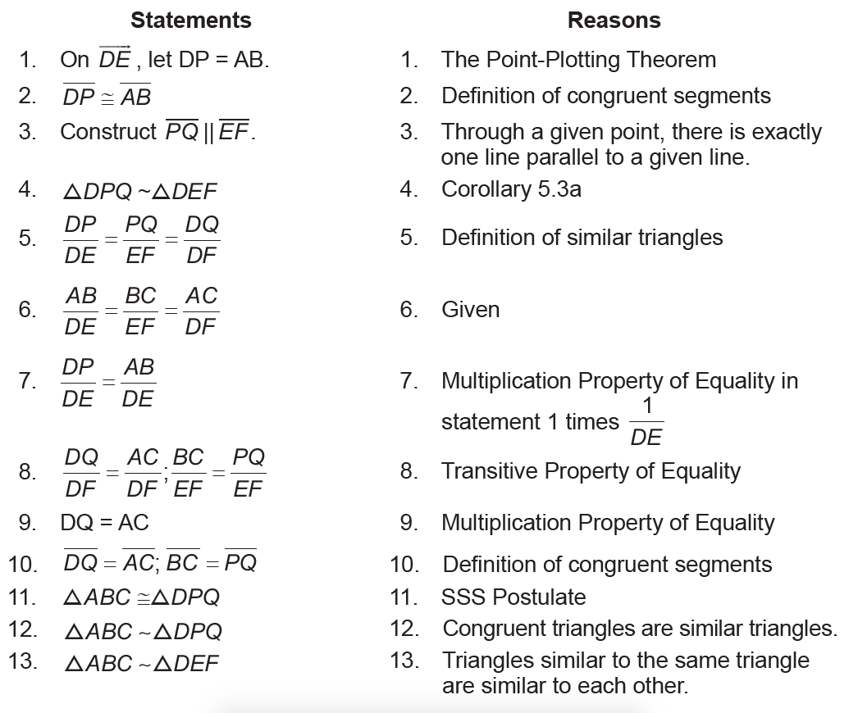
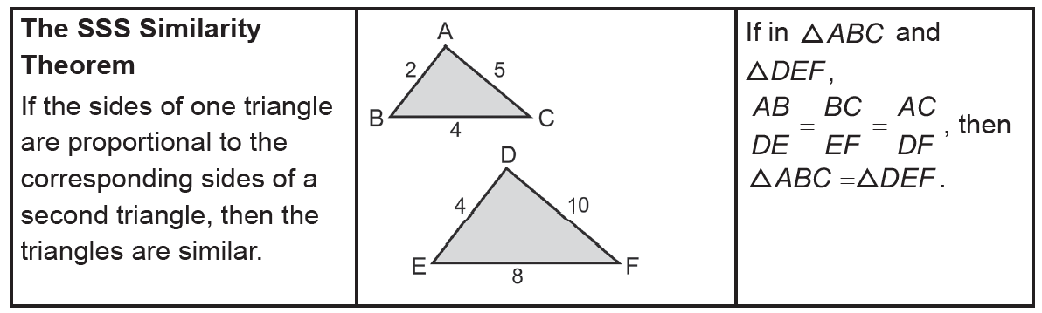
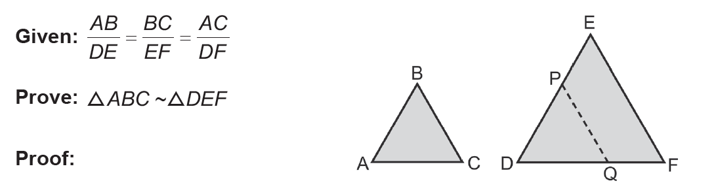
Proving Similarity of Triangles and Pythagorean Theorem
We defined similar triangles as triangles in which corresponding angles are congruent and corresponding sides are proportional. The
first part of the definition, “corresponding angles are congruent,” is sufficient to prove that the two triangles are similar as stated by the AAA Similarity Postulate. The second part, “corresponding sides are proportional,” that will be stated in the SSS Similarity Theorem will
now be proven.
Rex Curriculum Resource
WWW.REX.COM.PH

Slide 17
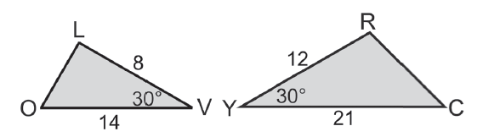
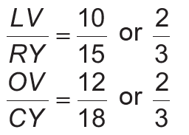

Proving Similarity of Triangles and Pythagorean Theorem
The following examples illustrate how you can use the SAS and SSS Similarity
Theorems to prove that two triangles are similar.
Example 4:
Are the two triangles similar? Justify your answer.
Two pairs of corresponding sides are proportional. Thus, Moreover, m∠V = 30 = m∠Y since the included
angles are congruent. Therefore, ΔLOV ~ ΔRCY by the SAS Similarity Theorem.
Solution:
Rex Curriculum Resource
WWW.REX.COM.PH

Slide 18
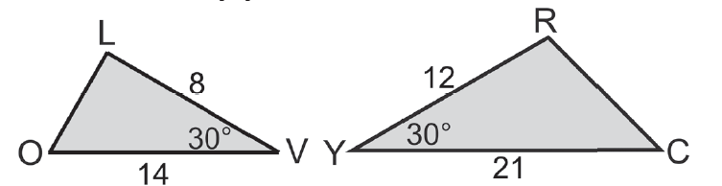
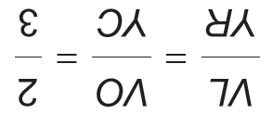
Activity:
CHECKPOINT 4:
Are the two triangles similar? Justify your answer.
Rex Curriculum Resource
WWW.REX.COM.PH

Slide 19
Activity: ANSWER KEY
CHECKPOINT 4:
Are the two triangles similar? Justify your answer.
ANSWER:
Yes. Since
and ∠V ≅ ∠Y . By SAS Similarity Theorem, the triangles are similar.
Rex Curriculum Resource
WWW.REX.COM.PH

Slide 20
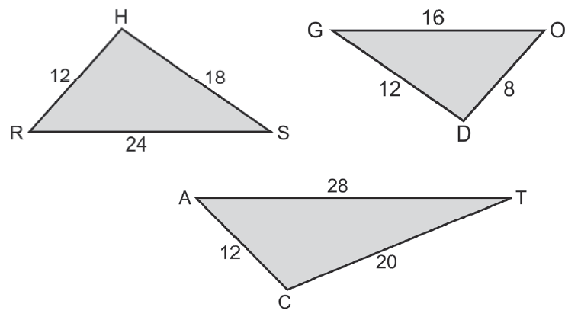
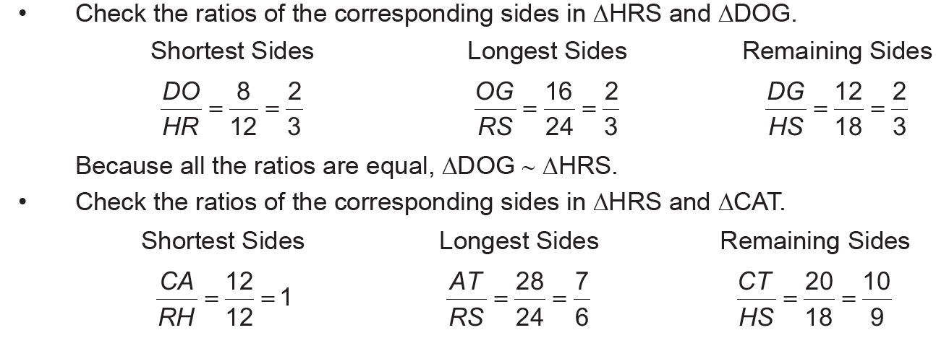
Proving Similarity of Triangles and Pythagorean Theorem
Example 5:
Consider the triangles below. Is ΔDOG or ΔCAT similar to ΔHRS?
Solution:
Since the ratios are not equal, ΔHRS and ΔCAT are not similar.
Rex Curriculum Resource
WWW.REX.COM.PH

Slide 21
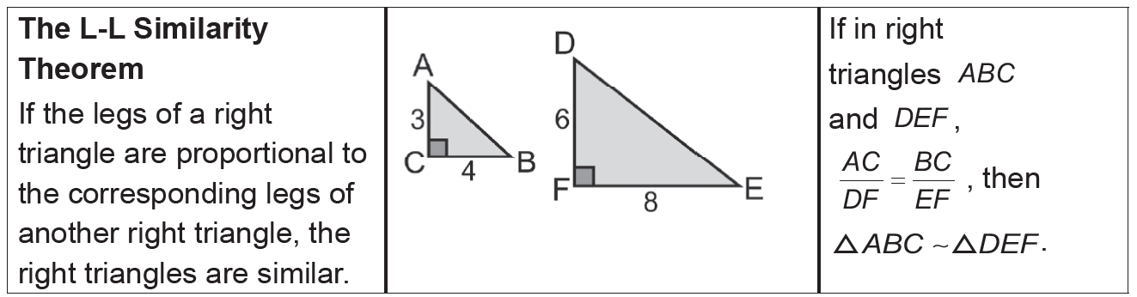
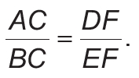
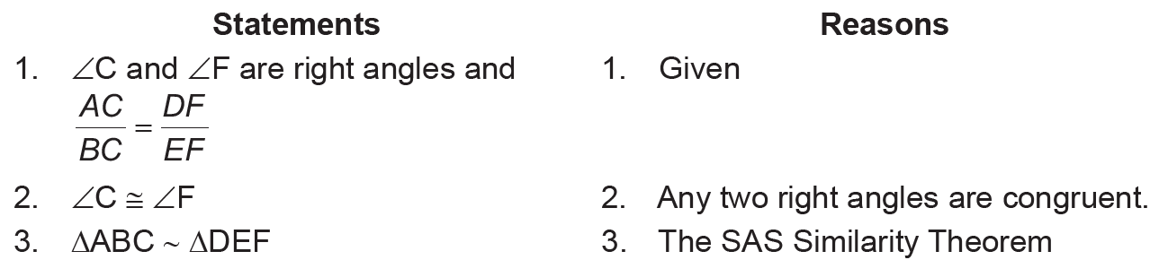
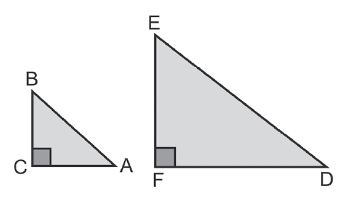
Proving Similarity of Triangles and Pythagorean Theorem
Example 5:
You may have noticed that the AA Similarity Theorem allows you to prove that two triangles are congruent when two of the corresponding angles in the two triangles are congruent. You may have asked yourself: Is there a theorem where you only need to verify two corresponding sides to be congruent to show that the two triangles are similar? The following theorems show that this is only true when the triangles are right triangles.
Proof:
Given: ∠C and ∠F are right angles and
Prove: ΔABC ∼ ΔDEF
Rex Curriculum Resource
WWW.REX.COM.PH

Slide 22
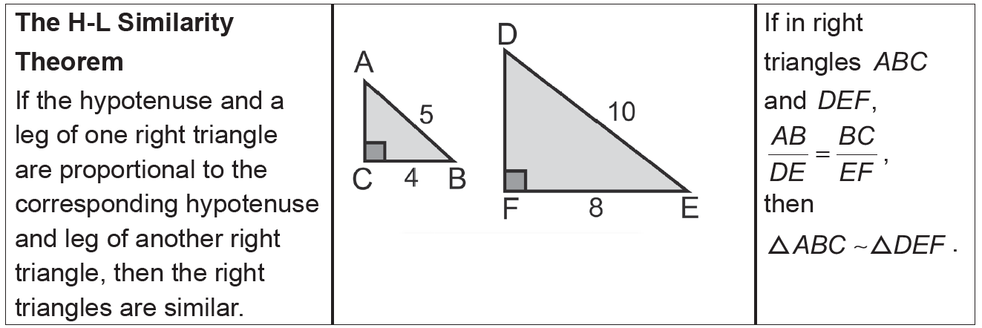
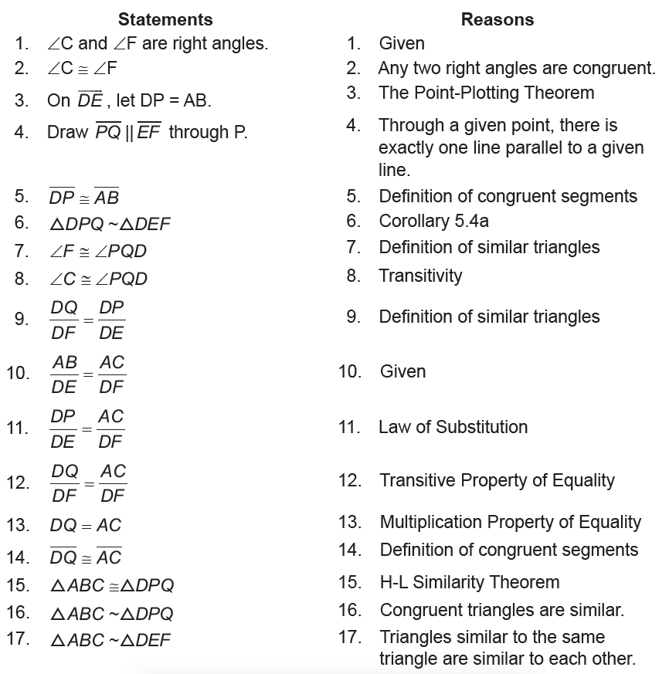

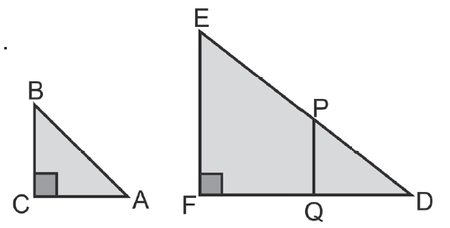
Proving Similarity of Triangles and Pythagorean Theorem
Proof:
Given: ∠C and ∠F are right angles and
Prove: ΔABC ∼ ΔDEF
Rex Curriculum Resource
WWW.REX.COM.PH

Slide 23
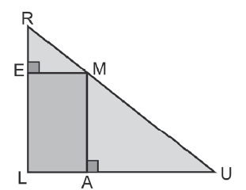
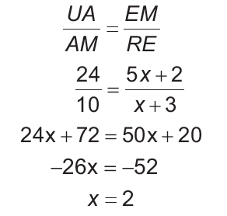
Proving Similarity of Triangles and Pythagorean Theorem
Example 6:
In the figure, UA ⊥ AM,ME ⊥ ER,UA = 24, AM = 10,
EM = 5x + 2, and RE = x + 3. Determine x so that ΔUAM ~ ΔREM.
Solution:
UA ⊥ AM, ME ⊥ ER, ∠UAM, and ∠REM are right angles because of the definition
of perpendicularity. Hence, ΔUAM and ΔREM are right triangles by definition of right
triangles. If the corresponding legs of ΔUAM are proportional to the corresponding
legs of ΔREM, then the triangles are similar.
Rex Curriculum Resource
WWW.REX.COM.PH

Slide 24
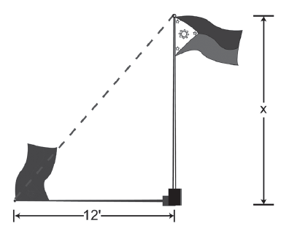
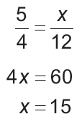
Proving Similarity of Triangles and Pythagorean Theorem
Example 7:
If your classmate is 5-feet tall and casts a shadow of 4 feet at the same time that the flagpole casts a 12-feet shadow, what is the height of the flagpole?
Solution:
Cross-Product Property of Proportion
Divide each side by 4.
This shows that the flagpole is about 15 feet tall.
Rex Curriculum Resource
WWW.REX.COM.PH

Slide 25
Proving Similarity of Triangles and Pythagorean Theorem
Example 6:
In the figure, UA ⊥ AM,ME ⊥ ER,UA = 24, AM = 10,
EM = 5x + 2, and RE = x + 3. Determine x so that ΔUAM ~ ΔREM.
Solution:
UA ⊥ AM, ME ⊥ ER, ∠UAM, and ∠REM are right angles because of the definition
of perpendicularity. Hence, ΔUAM and ΔREM are right triangles by definition of right
triangles. If the corresponding legs of ΔUAM are proportional to the corresponding
legs of ΔREM, then the triangles are similar.
Rex Curriculum Resource
WWW.REX.COM.PH

Slide 26
Activity:
CHECKPOINT 5:
If your classmate is 6 feet tall and casts a shadow of 4 feet at the same time that
the flagpole casts a 20-ft shadow, what is the height of the flagpole?
Rex Curriculum Resource
WWW.REX.COM.PH

Slide 27
Activity: ANSWER KEY
CHECKPOINT 5:
If your classmate is 6 feet tall and casts a shadow of 4 feet at the same time that
the flagpole casts a 20-ft shadow, what is the height of the flagpole?
ANSWER:
The height of the flagpole is 30 ft.
Rex Curriculum Resource
WWW.REX.COM.PH

Slide 28
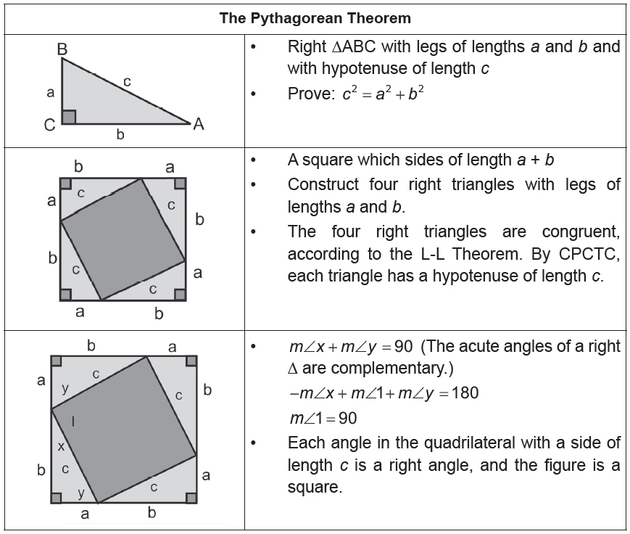
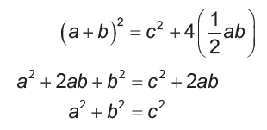
Proving Similarity of Triangles and Pythagorean Theorem
The next theorem states that the sum of the squares of two legs of a right triangle is equal to the square of its hypothenuse. This is the famous Pythagorean theorem.
You might have encountered this idea before. In this lesson, you will see the proof of why this theorem is true as well as it is converse.
Pythagorean theorem:
If triangle ABC is a right Δ, then c² = a² + b².
Pythagorean theorem converse:
If c² = a² + b² , then ΔABC is a right triangle. There are several proofs of the Pythagorean theorem, and one of them is the following:
There are several proofs of the Pythagorean theorem, and one of them is the following:
Proof of Pythagorean Theorem by Area Formula
Area of the larger square = Area of the smaller square + Area of the 4 right Δs
Rex Curriculum Resource
WWW.REX.COM.PH

Slide 29
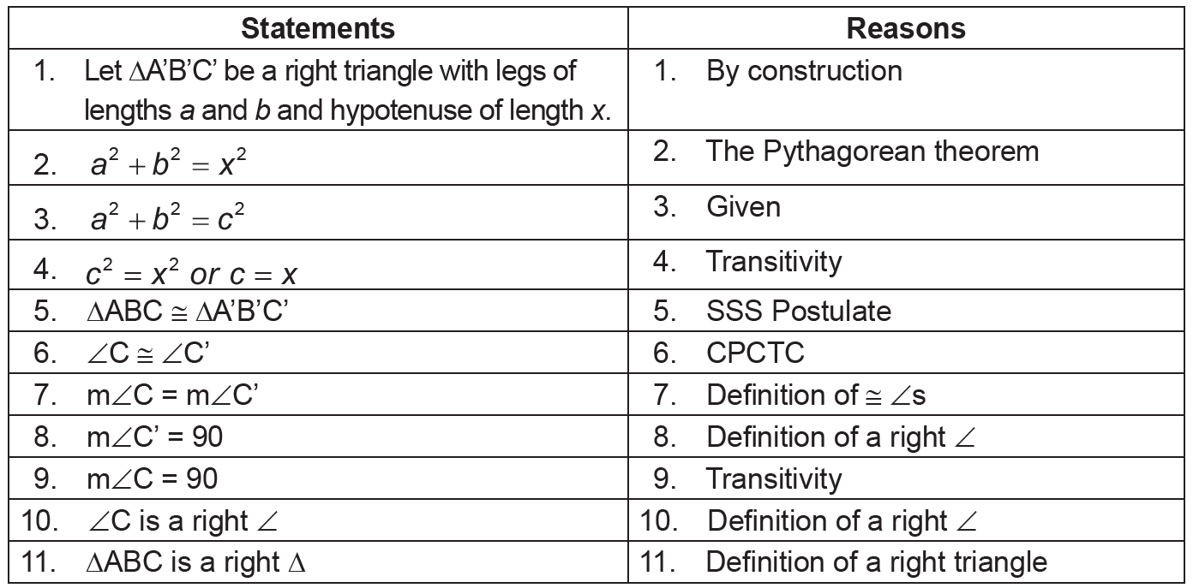
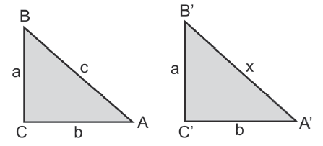
Proving Similarity of Triangles and Pythagorean Theorem
Proof of Pythagorean Theorem Converse
Given: ΔABC with a² + b² = c²
Prove: ΔABC is a right Δ.
Rex Curriculum Resource
WWW.REX.COM.PH

Slide 30
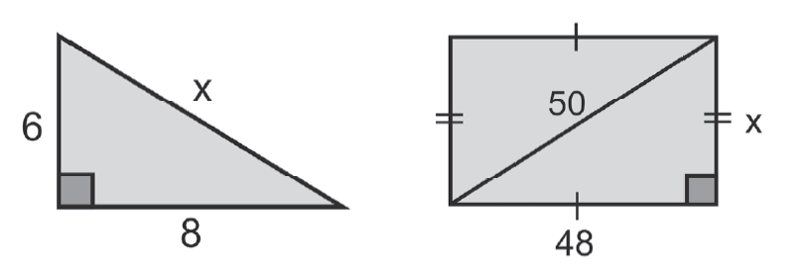
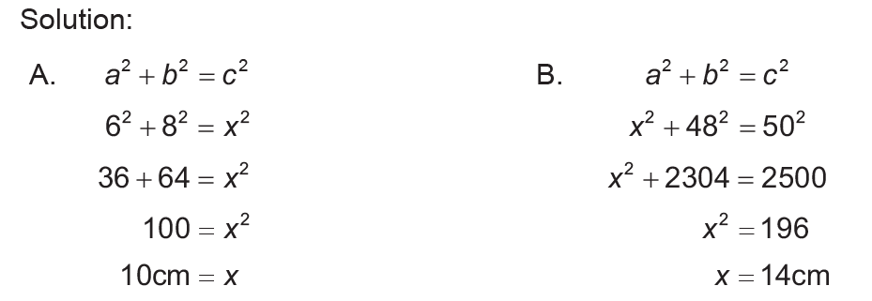
Proving Similarity of Triangles and Pythagorean Theorem
Example 8:
Use the Pythagorean theorem to find each missing length. All measurements are in centimeters.
Rex Curriculum Resource
WWW.REX.COM.PH

Slide 31
Proving Similarity of Triangles and Pythagorean Theorem
Example 9:
Determine if the given measures are the lengths of the sides of a right triangle.
A. 9, 12, 15 B. 12, 35, 36
Solution:
A. Show that
92 +122 = ?152
81+144 = ?225
225 = 225
Because 9² +12² = 15², it follows that the triangle formed is a right triangle.
B. Show that 12² + 35² = ?36²
144 + 1,225 = ? 1, 296
1369 ≠ 1,296
Because 12² + 35² = 36² , it follows that the triangle formed is not a right triangle.
Rex Curriculum Resource
WWW.REX.COM.PH

Slide 32
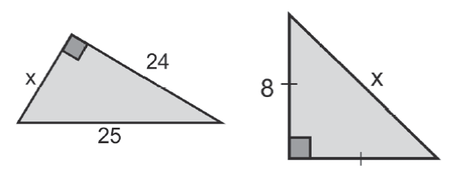
Activity: ANSWER KEY
CHECKPOINT 6:
Use the Pythagorean theorem to find each missing length. All measurements are in centimeters.
ANSWER:
X = 7
x = 8 √2
Rex Curriculum Resource
WWW.REX.COM.PH

Slide 33


