Slide 1
Classifying Materials as Solids, Liquids, Or Gases Based
on Their Observable
Characteristics

Slide 2
Classifying means grouping materials according to their common characteristics or properties.
What is Matt er Made of?
Matter is made up of tiny particles called molecules. A molecule is the smallest particle of a material which has its properties. Molecules can join together to form larger molecules.
Molecules of matter are arranged differently in the different states of matter: solid, liquid, and gas.

Slide 3
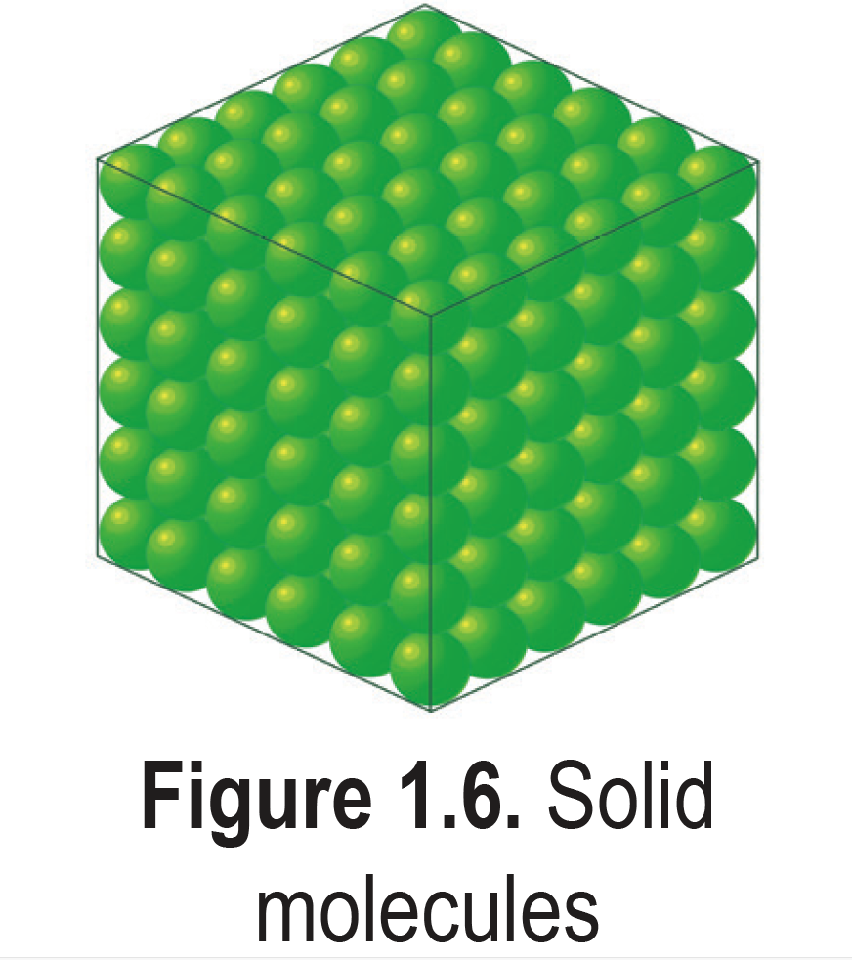
Solids
In solids, the molecules are held firmly by the force of attraction between them. Force of attraction between molecules is referred to as how strong the molecules are held together. The molecules in solids move very slowly because they are very close together. They are compressed so solids can keep their size and shape. Solids have definite shape and volume. Figure shows the arrangement of molecules in a solid state.
Solid Molecules

Slide 4
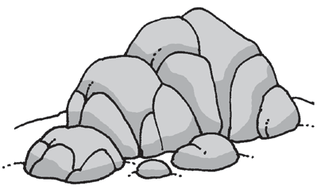
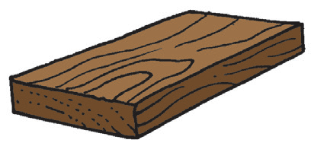
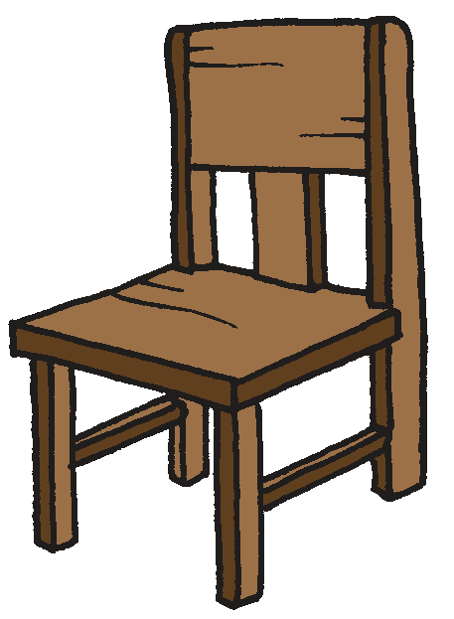


Examples of solids are stone, wood, pencil, scissors, book, chair, and bag.
Examples of solids

Slide 5
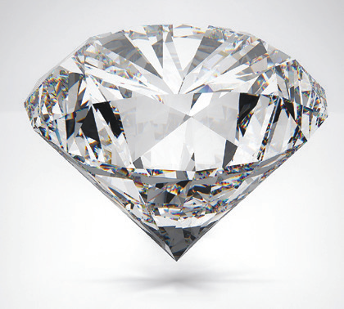
Solids also have special properties:
1. Hardness is the property of solid matter to resist scratching or abrasion. For example, we can use a fingernail to scratch a piece of chalk. If the chalk can be scratched, we describe the chalk as soft and the fingernail that scratched it as hard.
Diamond is the hardest material on Earth. This is the reason why diamond is used to cut other materials such as glass and tiles.
A diamond

Slide 6
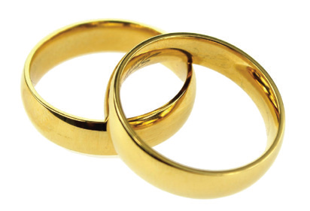
2. Malleability is the ability of materials to be pressed, hammered, or rolled into various shapes and sizes without breaking.
Observe your gold ring or pair of earrings. The gold is molded and hammered into different shapes, yet it is not broken. Gold is malleable.
Gold rings

Slide 7
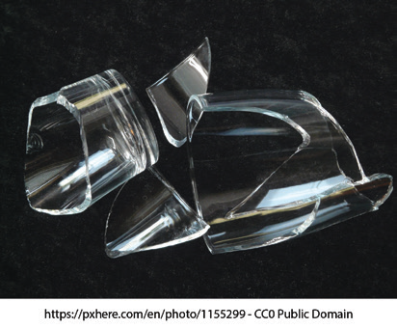
3. Brittleness is the tendency of a material to be easily broken into pieces. What do you think will happen to a glass when you drop it accidentally? The glass will surely break into pieces. The glass
that breaks into pieces exhibits brittleness. Brittleness is the tendency of a material to be easily broken into pieces. Can you name other brittle materials?
A broken glass

Slide 8
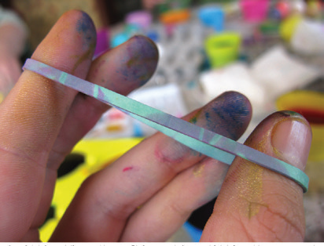
4. Elasticity is the property of solid materials to be stretched when pressure is applied on them. Some solids like rubber bands are elastic. You can stretch a rubber band to twice its length. When the pressure is not too strong, the rubber band will go back to its original length and shape when the tension is removed. A thin wire can stretch a little if you hang a weight on it. If the weight is not too heavy, the wire will return to its original length when the weight is removed.
Stretched rubber band

Slide 9

5. Strength determines how durable the material is. Metals are used to construct buildings, bridges, and roads because they are very strong. Iron and steel are examples of metals used to support buildings and other structures. They are also used for making steel chairs and cabinets. Solids made of strong materials do not wear out easily.
A bridge made of iron and steel.

Slide 10
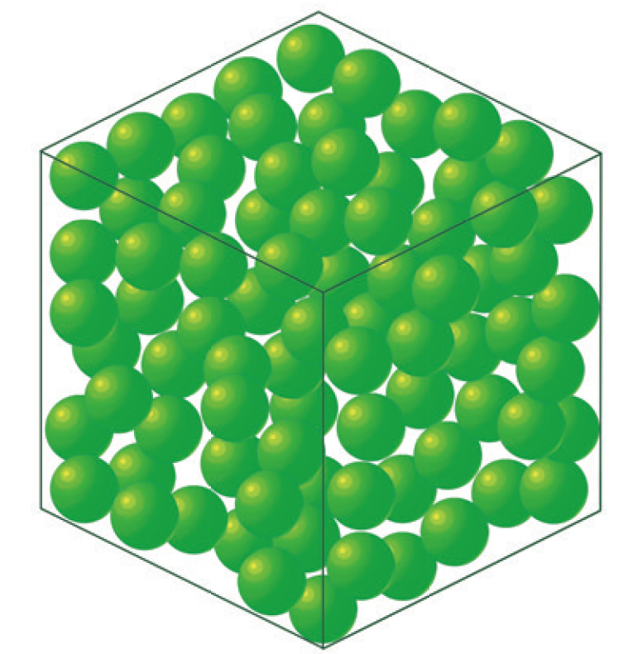
Liquids
Compared to molecules in solids, the molecules in liquids are farther apart from each other. The force of attraction among the molecules is weak. They always move, roll, slide, or bump to each other. This is the reason why liquids can change shape. Liquids take the shape of their container.
Liquid molecules

Slide 11
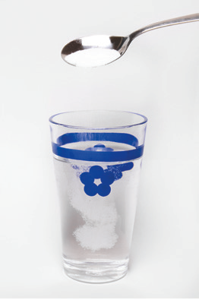
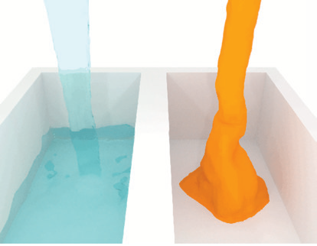
Liquids also have properties:
1. Liquids may dissolve some solids. When sugar is placed in water, it melts or dissolves. Sugar breaks and spreads out.
2. Some liquids, like water, flow easily. Other liquids, like oil, flow very
slowly. Liquids that fl ow very slowly are described as viscous.
Viscosity is the resistance of a liquid to flow. This is because the
molecules in a viscous material are strongly attached to each other.
Which flows easily: evaporated milk or condensed milk?
The condensed milk that does not flow easily is more viscous
than the evaporated milk that flows easily.
How different liquids flow.

Slide 12
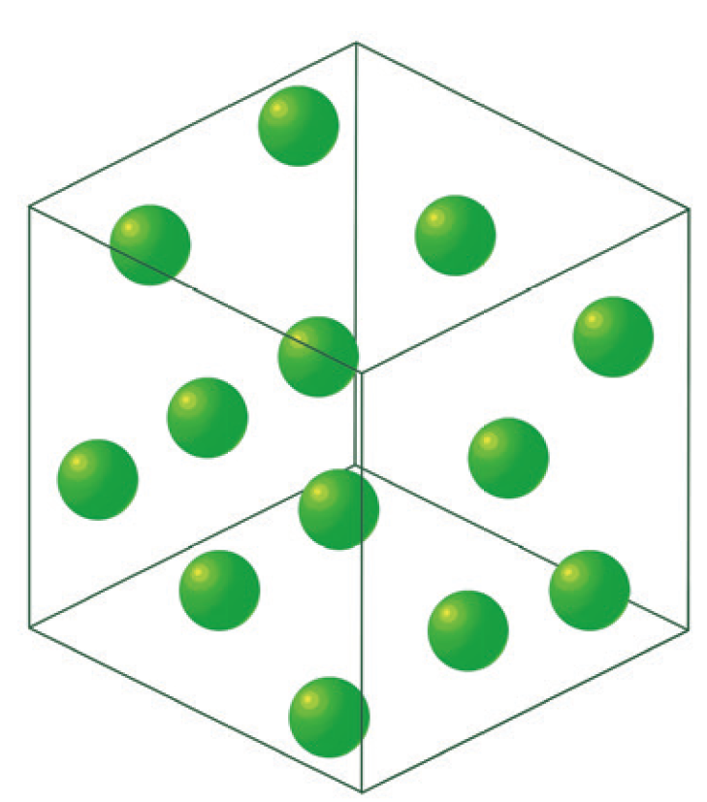
Gases
In gases, the molecules are farther apart compared to those of liquids. The molecules bounce off and move in every direction. The force of attraction between the molecules is too weak to hold them close.
Take a closed, half-filled bottle of perfume. Now, remove the top cover. Can you smell the scent of the perfume? The molecules of the perfume spread out and fill the room, and soon everyone inside the room can smell the scent of the perfume.
The attraction among molecules of any gas is weak, so they can change both their shape and volume.
Gas molecules.

Slide 13

Air is an example of gas. Air is colorless, tasteless, and invisible. Air can be squeezed
or compressed. As you press the balloon, it feels harder as it occupies a smaller space. Air can be pushed from both sides (left and right).
Moreover, air has heaviness. Gas has definite mass and no definite shape and volume. This heaviness is also called weight.
Examples of gases are oxygen, carbon dioxide, and cooking gas.

Slide 14
Comparing the Characteristics/Properties of States of Matter
Below is a table that shows the characteristics of the different states of matter:
State | Mass | Volume | Shape
Solid | Definite mass | Definite volume | Has definite shape
Liquid | Definite mass | Definite volume | Takes the shape of the container
Gas | Definite mass | No definite volume | No definite shape

Slide 15
In addition to solid, liquid, and gas, we also have plasma. Plasma, the “fourth state,”
is characterized by lack of shape, and it cannot be classified as gas, liquid, or solid. Examples of plasma are plasma ball and the contents of a fluorescent bulb.
The fifth state has already been discovered by scientists. It is called Bose-Einstein Condensate (BEC), but in Grade 3, the focus of study is only on the three states of matter: solids, liquids, and gases.

Slide 16
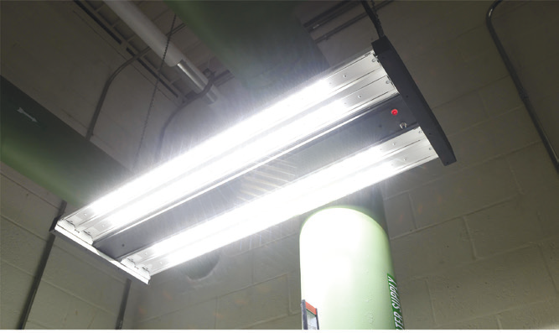
Plasma: The Fourth State of Matter
Plasma is different from the other states of matter. It may be formed from heating or from a gas. You can find plasma in fluorescent light bulbs. Inside the long tube is a gas. Electricity flows through the tube when the light is turned on. The electricity charges up, thus, creating glowing plasma inside the bulb.
Another example of plasma is a neon sign. Neon signs are glass tubes filled with gas. When light is turned on, electricity flows. The electricity charges the gas and creates plasma inside the tube. The plasma glows a special color depending on what kind of gas is inside. Inert gases are usually used in signs to create different colors.
A fluorescent bulb

Slide 17
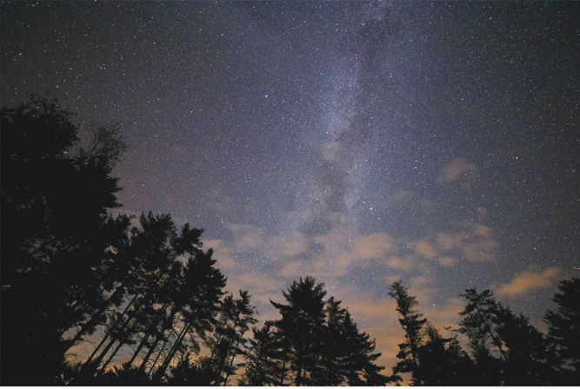
You see plasma when you look at the stars. Stars are big balls of gases at very high temperatures. The high temperature charges up the atoms and creates plasma.
Stars

