Slide 1
Effects of Temperature on Materials

Slide 2
Temperature is the determining factor in the changes in the phases of matter and also in chemical change. In this lesson, you will learn more about the effects of changes in temperature on materials. These changes have good and bad effects on people and environment.
Temperature changes. It affects the motion of molecules. The temperature of water increases when heated. When heat is added, the temperature increases more. Water turns into water vapor. When heat is removed, water is cooled.

Slide 3

Changes in Materials Affected by Temperature
When water is heated, its temperature rises until it reaches the boiling point of 100 degrees centigrade (100oC) or 212 degrees Fahrenheit (212oF). The temperature will stay there until all the water is boiled away. The temperature of the steam or water vapor will be increased.
Likewise, when heat is removed and steam or water
vapor is cooled, its temperature will drop until it reaches the
condensation point. What happens to heat when clouds
condense to rain? Water vapor condenses into tiny droplets
of water to form clouds. When tiny droplets of water grow and
become heavy, they fall as rain.

Slide 4
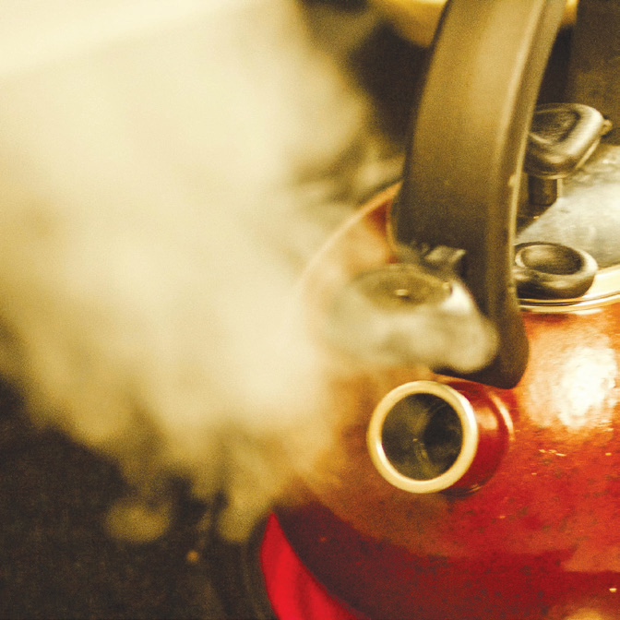
A. When you boil water, you will observe water vapor or steam coming out of the container.
Water vapor or steam is the gaseous state of water. When water evaporates, it turns into water vapor. Evaporation is the process of changing liquid to gas at a constant temperature or just below its
boiling point.
Even if liquid does not boil, it may still evaporate. Sometimes, sunlight alone or wind alone or both help water evaporates without being noticed. Moisture rises up and then condenses as clouds.
Steam coming out of a kettle

Slide 5
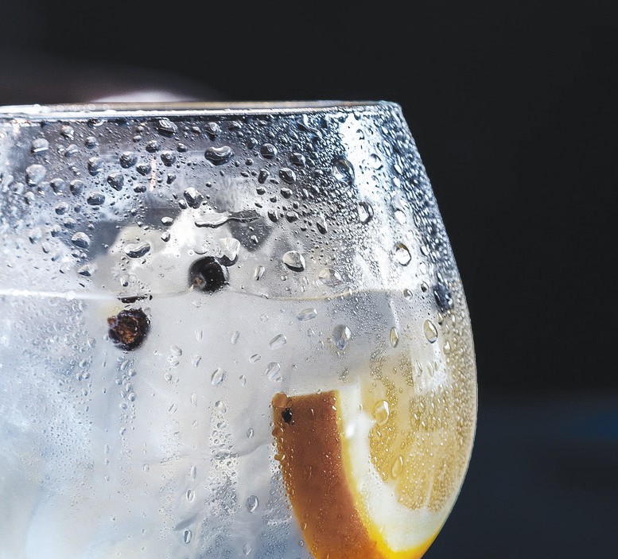
B. When you put some cold water in a drinking glass, droplets of water are formed outside the glass. Why?
When water vapor in the air touches a cooler surface, it turns into liquid. This process of changing gas to liquid is called condensation.
Droplets of water outside of the glass.

Slide 6
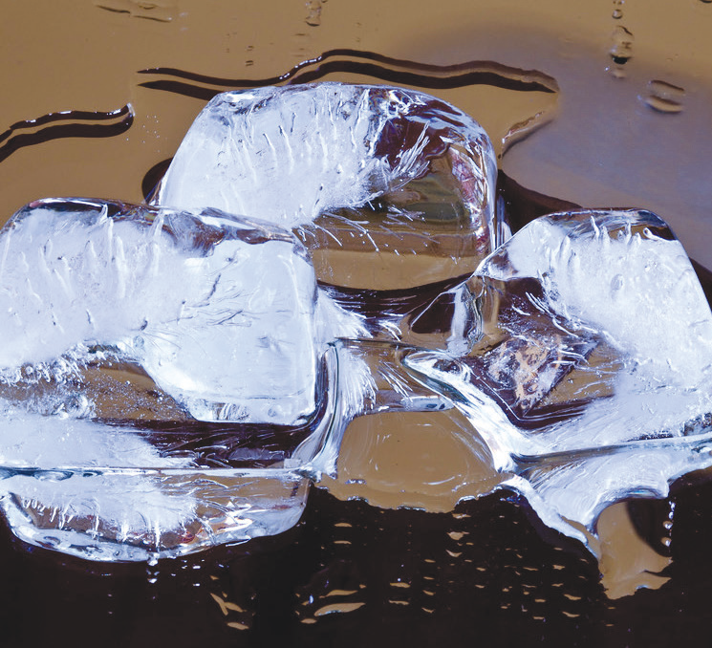
C. Ice water melts and becomes liquid when they are heated. This process of changing solid to liquid is called melting. Melting is a change in phase, from solid to liquid, that happens at constant temperature.
Ice cubes melting.

Slide 7
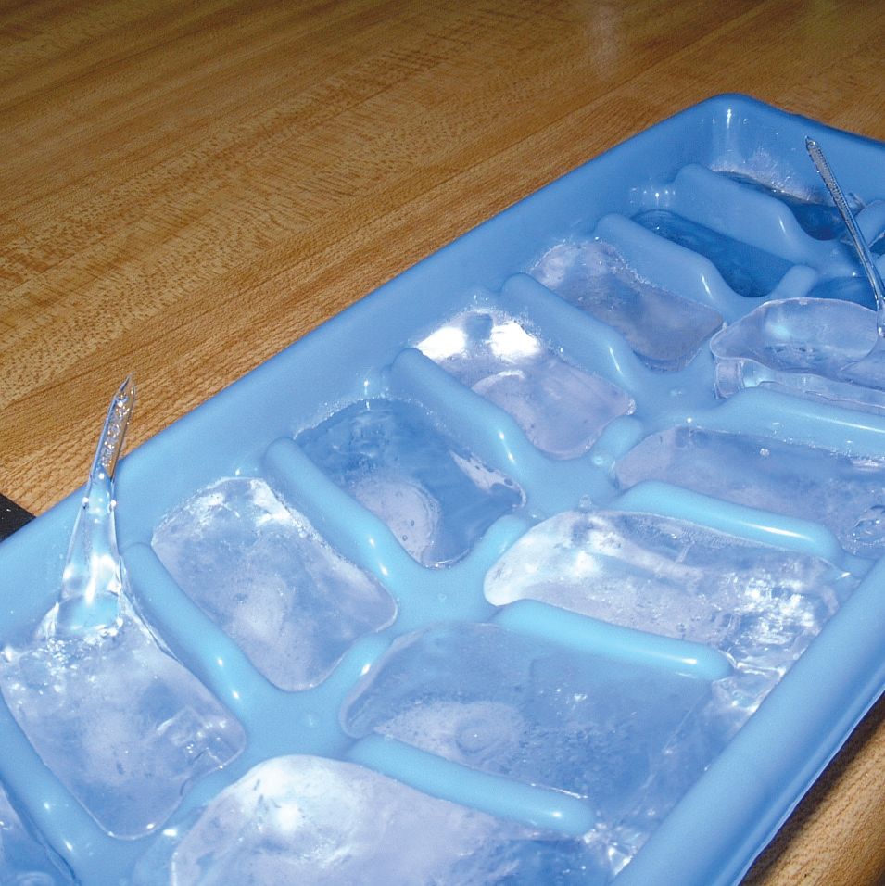
D. When water is placed inside a freezer, it becomes ice. This process is called freezing.
Some liquids like oil and melted butter become hard and turn to solid when cooled.
Freezing and cooling can change liquid to solid. Freezing is a change from liquid to solid at a constant temperature.
Ice cubes in a tray.

Slide 8
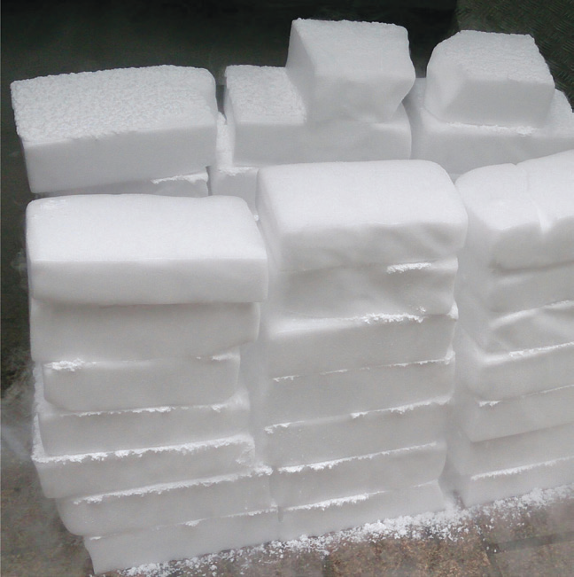
E. “Dry ice,” a solid material which is a frozen carbon dioxide, sublimates or turns into gas at a certain temperature. The fog is a mixture of cold carbon dioxide gas and cold humid air created as the dry ice sublimates. Sublimation is the process of changing matter from solid to gas without passing the liquid state.
Dry ice.

Slide 9
Evaporation and melting require an increase in temperature of the material for phase change to occur.
Condensation and freezing require a decrease in temperature of the material for phase change to occur.
All liquids become solids at a very low temperature. Some liquids solidify even if they are not placed in a freezer. But they do not freeze at the same temperature. Different liquids freeze at different temperatures. For example, gelatin may freeze at 10⁰C, but water will solidify only at 0ºC or lower.

Slide 10
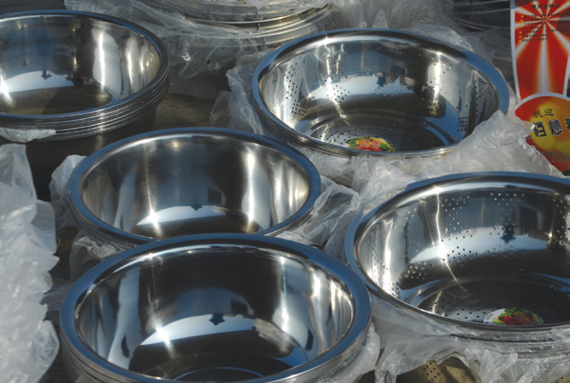
Effects of Temperature Changes Involving Phase Change in the Community
Positive Effects of Phase Changes
How does physical change become useful?
1. Freezing helps store our food without spoiling.
It is used in making ice cream and other frozen
delicacies.
2. Melting is used in making different products.
Metals, plastics, and glasses can be reshaped
by melting.
Metals reshaped through melting

Slide 11
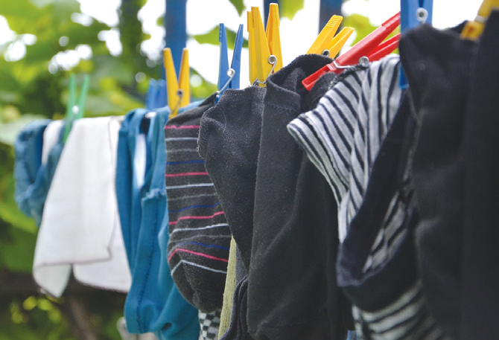
3. Evaporation makes laundry dry. It also dries up
perspiration, your wet hair, and anything that is
wet. Evaporation keeps water from all areas on
Earth to move and turn to water vapor forming
the clouds in the sky.
Drying of clothes

Slide 12
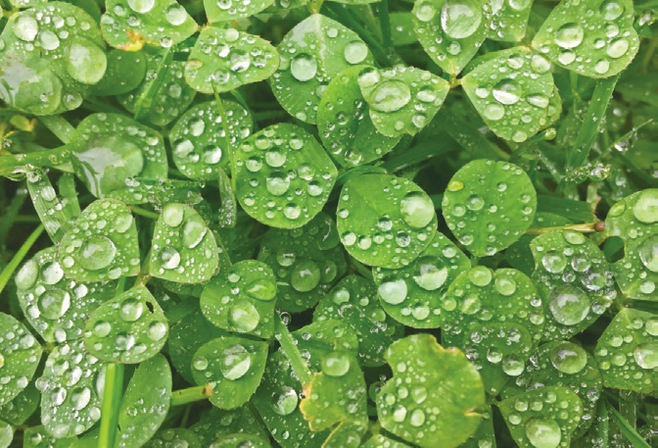
4. Condensation is important because it produces dew on the grass in the morning. It also causes the formation of rain clouds and finally the rain which the farmers need for their crops.
Dew on leaves in the morning

Slide 13
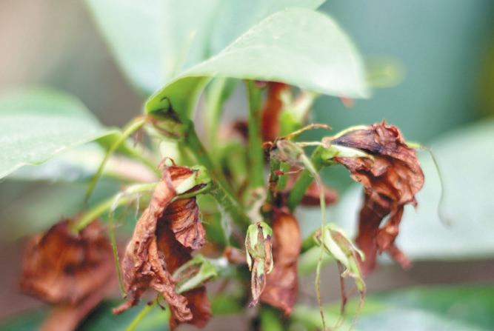
Negative Effects of Phase Changes
A. Evaporation can have bad effects. Too much evaporation can cause dehydration and withering of plants. This can lead to drought. If plants dried up because of drought, many people will have no food to eat.
Withering plants

Slide 14
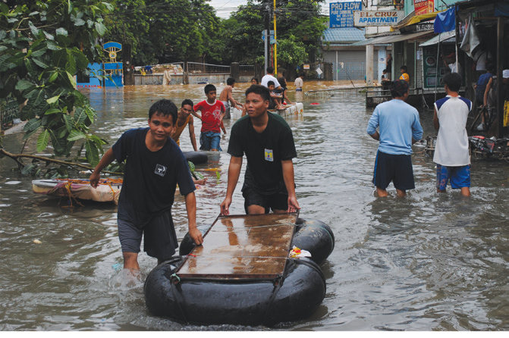
B. Too much condensation followed by precipitation
can cause rain. Too much rain can cause flood.
The changes in temperature are also due to the negative effects of human activities and modern technologies like cutting of trees, construction of buildings and factories, and the improper disposal of garbage and wastes in the bodies of water.
Flooded street

Slide 15
Simple Ways to Help Minimize Negative Effects
of Temperature Changes in the Community
Here are some of the simple ways to help control the change in the earth’s temperature:
1. Just walk or ride a bike when going to near places.
2. Turn off the lights and other appliances when they are not in use.
3. Use a fan instead of an air conditioner.
4. During cold days, take shorter showers to use less hot water.
5. Avoid burning garbage.
6. Dispose of garbage properly.

Slide 16
Effects of Temperature on Chemical Change in Materials
Certain chemical changes do not just take place at room temperature. They occur readily at a high temperature. Heat is required to start the change. For example, fuels like coal and wood start burning at a certain temperature (ignition temperature).
Increasing the temperature will cause chemical change to occur faster. Decreasing the temperature will cause chemical change to occur slower.

Slide 17

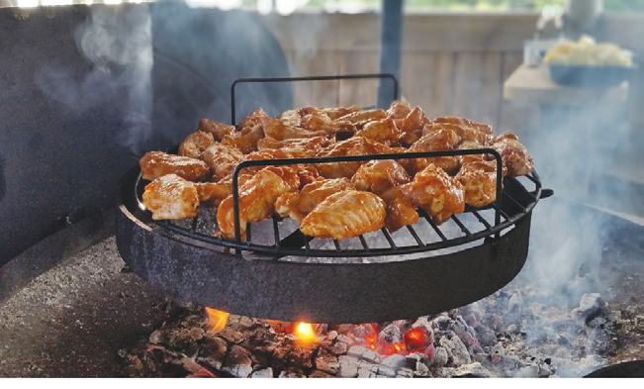
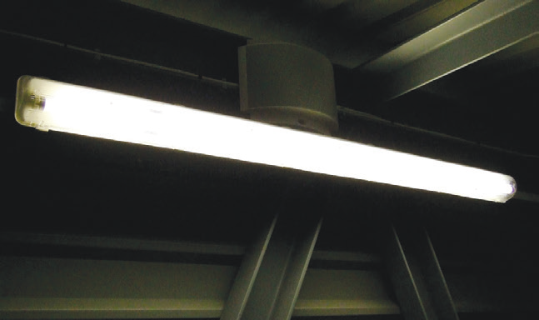
Positive Effects
Burning of wood, coal, gas, and oil are used for different purposes.
Camping, cooking, and light from a fluorescent lamp

Slide 18
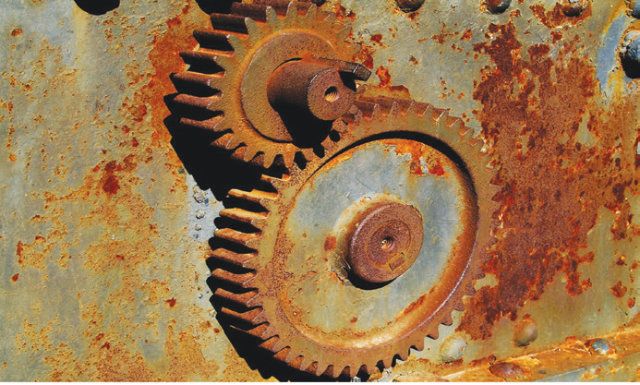
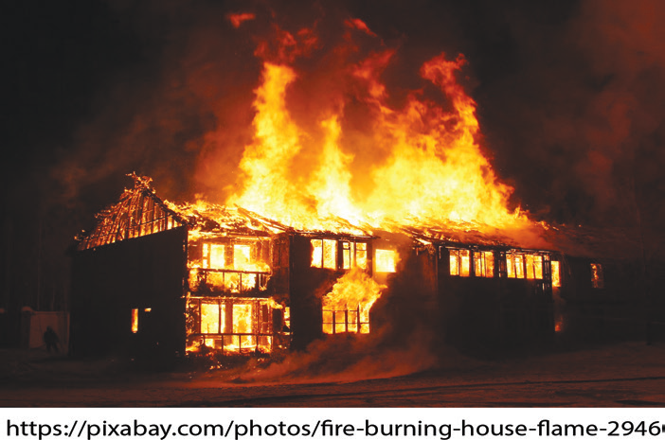
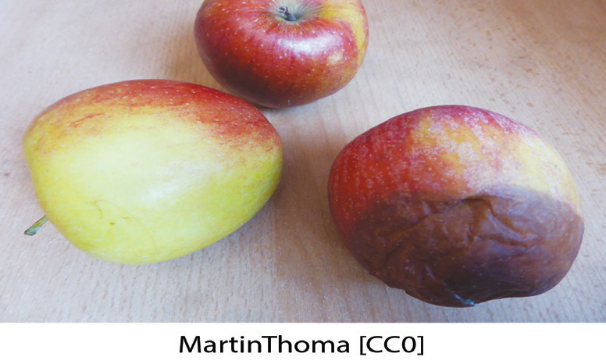
Negative Effects
Some chemical changes have the following bad effects:
Rusting of iron, burning of buildings, and decaying food when left out of refrigeration for a few days

Slide 19
What will you do to prevent iron from rusting? What should we do to prevent food from decaying? Why should rags, papers, and hay be stored properly and with care?
To prevent iron tools from rusting, keep them always dry and apply oil on them before storing. We should keep food in a cold storage to prevent the growth of harmful bacteria that destroy the food. Papers, rags, and hay should not be stored in a place exposed to heat because these materials can burn easily.

