Slide 1
Properties of Useful and Harmful Materials

Slide 2
Properties of Useful and Harmful Materials
A useful material is a material that you can use anytime or anywhere when you need it.
It can save lives rather than cause harm.Useful materials serve a purpose.
Example: curtain
In the living room, a curtain is needed as shade from excessive sunlight during the daytime.

Slide 3
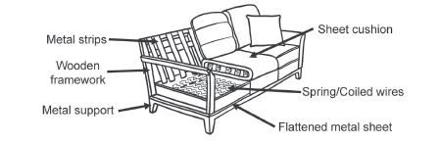
Properties of Useful and Harmful Materials
Study the picture of how a sofa is assembled.

Slide 4
Properties of Useful and Harmful Materials
There are different properties of materials that are illustrated.
• Malleability is the property of a material that allows it to be hammered into thin sheets.
This is shown using metal strips and flattened metal sheets. Metals are malleable.
• Ductility is the property of materials particularly metals that allows them to be drawn into fine wire.
This is shown in the spring or coiled wire.
• Hardness is the property of a material that allows it to overcome pressure
or strength. Durable materials are shown in the metal support and wooden framework.
• Flexibility is the property of a material that allows it to bend or roll without
breaking easily.
• Elasticity/Compressibility is the property of a material that allows it to be stretched (elastic)
or compressed when a force is applied and return to its original size and shape when the
deforming force is removed. This is shown by the metal strips at the back and the cushion.
• Porosity/Capillarity is the property of matter that allows it to absorb water as
shown by the washable cover.

Slide 5
Properties of Useful and Harmful Materials
The physical properties are also shown by some of the materials in the kitchen.
If you accidentally broke a ceramic mug or plate, it would break into pieces.
This property is called brittleness.The spoons are shiny.This property is called luster.
There are useful materials in the bathroom or garage that serve a purpose but are harmful.
These are shown by some icons in the label that indicate how the product should be used properly.
Example:
The acid used in cleaning the toilet bowl indicates, “Do not inhale.” It is useful in cleaning, but it can cause difficulty in breathing.

Slide 6
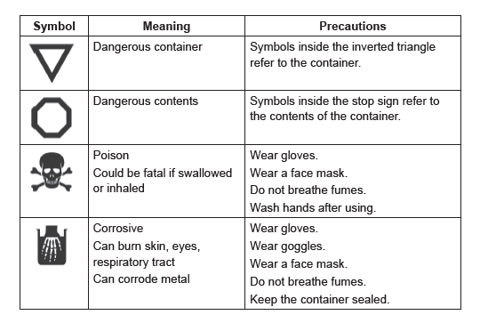
Properties of Useful and Harmful Materials
Aside from precautions, there are symbols indicated in the product that the material is harmful.
Oil is necessary for machine parts but should be disposed of properly.
Given above is a table of the icons or signs that show the meaning and necessary precautions for use.
This means that materials are useful when used for their purpose but will be harmful if used and disposed
of improperly.

Slide 7
Properties of Useful and Harmful Materials
Materials can also be classified as recyclable and non recyclable.
Recyclable materials
- are solid waste materials that are collected, sorted, or processed to become
useful materials again.
Examples:
plastics, metals, and glasses
Most of the time, glasses are sold to junk shops in exchange for an amount.

Slide 8
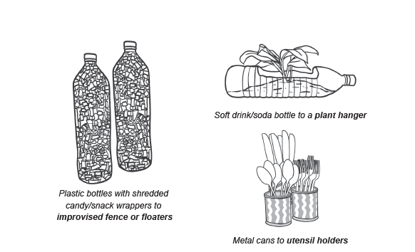
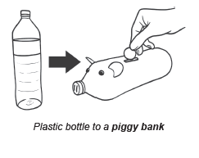
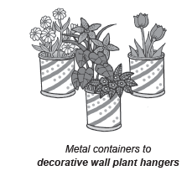
Properties of Useful and Harmful Materials
Below are some pictures of how solid waste materials are recycled.

Slide 9
Properties of Useful and Harmful Materials
Instruction:
Classify the given materials inside the word pool below the table as either USEFUL or HARMFUL.
Write your answer in their proper column.
Useful materials | Harmful materials
Drained batteries Empty plastic bottles Old newspaper Worn out rubber tires Empty glass jars Food cartons Paint thinner Aerosol spray gasoline Empty insecticide container
Wood chopped into pieces
Change its phase

Slide 10
Properties of Useful and Harmful Materials
Answer key:
Useful materials | Harmful materials
Worn-out rubber tires | Drained batteries
Food Cartons | Paint thinner
Old newspaper | Aerosol spray
Empty plastic bottles | gasoline
Empty glass jars | Empty insecticide container

