Slide 1
The Respiratory System

Slide 2
The Respiratory System
Did you know that you never stop breathing even when you are asleep? Cool, right? Why is this so? This is because our respiratory system continuously supplies our body with oxygen through respiration, the overall process by which the body can obtain oxygen and use it during cellular respiration, which refers to the set of chemical reactions taking place in the cell that produce ATP and remove carbon dioxide. On the other hand, breathing refers to exhalation and inhalation. The organs that make up the respiratory system work together and serve as passageways for the air as they enter and exit the body.

Slide 3
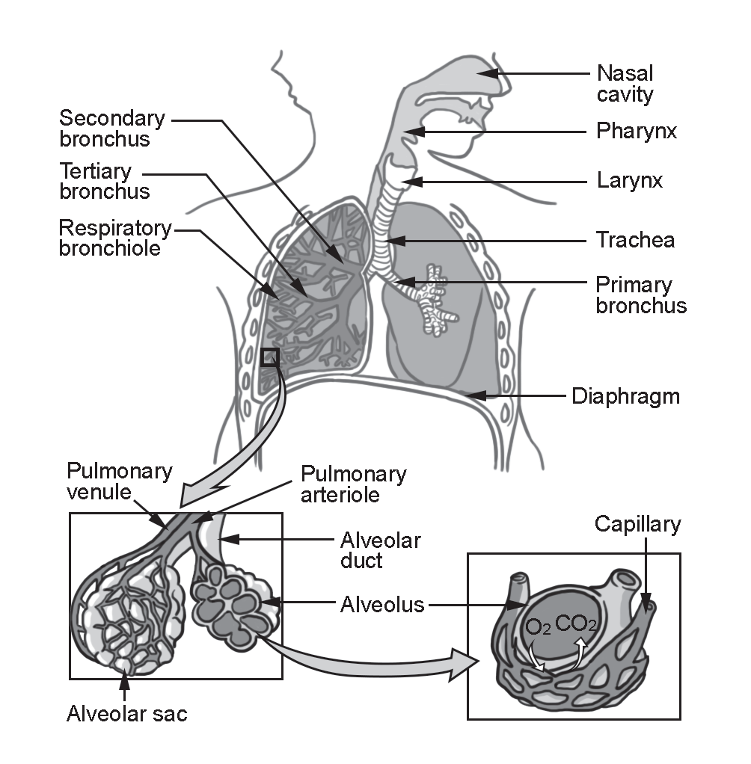
The Respiratory System
Organs of the Respiratory System

Slide 4
The Respiratory System
Pathway of Air along the Respiratory Track
Air enters the nasal cavity through our nostrils. The nasal cavity is lined with tiny hairs called cilia and mucous membranes that secrete sticky fluid. The nasal cavity moistens and warms the air and helps trap dirt and other particles.
Air flows to the pharynx or throat, then to the larynx or voice box, connecting the pharynx and the trachea. The larynx contains the vocal cords that produce sounds when vibrated by air.
Air goes to the trachea, a 5-inch long narrow and cylindrical tube made up of rings of cartilage and is lined with mucous membrane.

Slide 5
The Respiratory System
The Breathing Process
During inhalation:
The diaphragm contracts and is in a flat position.
The intercostal muscles contract, and the rib cage move upward and outward.
The volume of the thoracic cavity increases, causing the lungs to inflate, and air pressure within the lungs is less than the outside atmospheric pressure. In addition, since air flows from a high pressure area to a low-pressure area consequently, the air naturally flows from outside the body into the respiratory passages and the alveoli.
4. Air enters the lungs through the two branches of the trachea, the bronchi (sing.:
Bronchus).
5. Lastly, each bronchus then divides and subdivides into bronchioles. At the distal end of each bronchiole are the air sacs or alveoli (sing.: alveolus), where gases, oxygen, and carbon dioxide are exchanged with the blood.

Slide 6
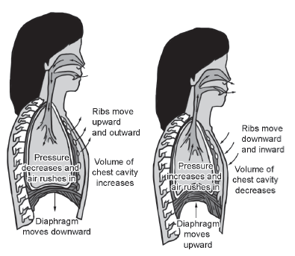
The Respiratory System
4. Air enters the lungs through the two branches of the trachea, the bronchi (sing.:
Bronchus).
5. Lastly, each bronchus then divides and subdivides into bronchioles. At the distal end of each bronchiole are the air sacs or alveoli (sing.: alveolus), where gases, oxygen, and carbon dioxide are exchanged with the blood.

Slide 7
The Respiratory System
During exhalation:
The diaphragm relaxes, resuming its dome-shaped position.
The intercostal muscles relax, and the ribcage moves downward and inward.
The volume of the thoracic cavity decreases, causing the lungs to deflate, and air pressure within the lungs is greater than the outside atmospheric pressure; hence, air flows from the inside of the body to the outside.

Slide 8
The Respiratory System
Coordinated Functions of the Respiratory and Circulatory Systems
Happens during pulmonary circulation
through
External Respiration The exchange of gases (oxygen and carbon dioxide) between the blood in the pulmonic capillaries and the alveoli of the lungs
Circulatory System
transports the oxygen
supplied by the respiratory system to each tissue cell in the body.
Respiratory System
supplies the circulatory
system with sufficient
oxygen.
Happens during systemic circulation
Internal Respiration The exchange of gases (oxygen and carbon dioxide) between the blood in the systemic capillaries and the tissue cells
through
Circulatory System
brings carbon dioxide from the tissue cells
to the lungs for elimination.

Slide 9
The Respiratory System
Pathways of Blood Circulation
During pulmonary circulation, the deoxygenated blood from the heart’s right ventricle flows to the lungs via pulmonary arteries, which branch out into smaller pulmonary arterioles connected to the pulmonary capillaries. External respiration takes place between the lungs’ alveoli and the deoxygenated blood in the pulmonary capillaries. Oxygen from the alveoli moves toward the blood in the pulmonary capillaries, while carbon dioxide from the blood in the pulmonary capillaries moves to the alveoli through diffusion. The now oxygenated blood will flow toward the pulmonary venules next to the pulmonary vein and enter the left atrium of the heart and then to the left ventricle, which pumps the blood toward the aorta.

Slide 10
The Respiratory System
During systemic circulation, the oxygenated blood flows from the aorta toward the arteries, which branch out into smaller vessels called arterioles that, in turn, are connected to the systemic capillaries. Between the oxygenated blood in the systemic capillaries and each tissue cell in the body, internal respiration takes place.
Oxygen in the blood diffuses into the cell, while carbon dioxide from the cell diffuses toward the blood in the systemic capillaries. The deoxygenated blood in the systemic capillaries will then be collected by the venules that are connected to the veins. The deoxygenated blood returns to the right atrium of the heart via the superior and inferior vena cava. The flow continues to the right atrium and to the right ventricle, which pumps the blood toward the lungs via the pulmonary arteries, and the pulmonary circulation will be repeated.

Slide 11
The Respiratory System
Effects of Lifestyle on the Respiratory and Circulatory Systems
Cigarette smoking: Cigarettes contain tar and nicotine that make the gaseous exchange process inefficient, which causes asthma, bronchitis, emphysema, pneumonia, and cancer. This is why you should never engage in this activity, no matter how your friends or peers pressure you to do so.
Sedentary lifestyle: Lifestyle with irregular or no physical activities resulting in weight gain is one of the leading causes of cardiovascular diseases. Hence, you should make sure to carry out even simple exercises at home, especially at this time of the pandemic.

Slide 12
The Respiratory System
Heavy alcohol consumption: Short-term effects of heavy alcohol consumption include slower pulse rate, difficulty breathing, and distortion of senses and perception. Its long-term effects are persistent high BP, cardiac muscle deterioration (cardiomyopathy), anemia, and stroke. Just like smoking, you are not advised to engage in heavy alcohol consumption for the reasons explained here.
Unhealthy Diet: Excessive food consumption high in fats, cholesterol, heavy calories, and salts increases the risk of cardiovascular diseases, such as atherosclerosis, hypertension, heart attack, and even strokes. Thus, you need to be watchful of what you eat and avoid binging on chips, soda, and sweets to maintain a healthy diet.

Slide 13
The Respiratory System
Activity
Directions: Answer the following questions.
1. Explain the main function of the respiratory system.
2. Explain how pressure facilitates the breathing process.

Slide 14
The Respiratory System
Answer Key
1. Explain the main function of the respiratory system.
- The principal function of the respiratory system is to ensure that the body has a sufficient supply of oxygen. It eliminates carbon dioxide through the process of breathing or respiration.
2. Explain how pressure facilitates the breathing process.
- During inhalation and exhalation, the opposing movements of the intercostal muscles of the ribcage and diaphragm create a pressure difference between the chest cavity and the outside of the body. This pressure difference allows airflow between the lungs and the outside environment since air flows from high-pressure areas to low-pressure areas.

