Slide 1
Life Cycle of Different Plants

Slide 2
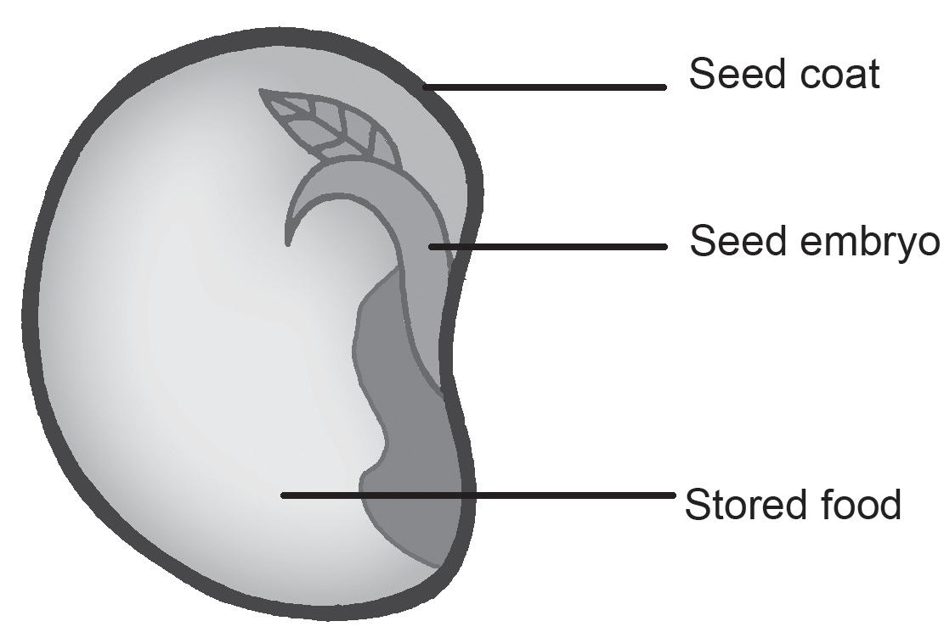
Life Cycle of Different Plants
The entire life span of a plant is called the plant life cycle. This is a cycle that shows how plants develop from seeds and grow into mature plants that are ready to reproduce. The life cycle of a plant starts from the seed stage. Look at the image of a plant seed provided below.
The seed of a plant contains a miniature plant known as the embryo. The embryo is protected by a hard cover known as the seed coat. The embryo of the plant will use its stored food for it to grow.

Slide 3
Life Cycle of Different Plants
Life Cycle of Different Plants
Germination is the process where roots and small leaves pop out and the seed gets ready to sprout
The plant will next reach the seedling stage wherein a small plant has just emerged from the ground. In this stage, the plant is still small and will absorb sunlight and water for it to continuously grow. The plant will then undergo the vegetative stage. In this stage, the plant absorbs sunlight, water, and different nutrients for it to prepare for the flowering stage.

Slide 4
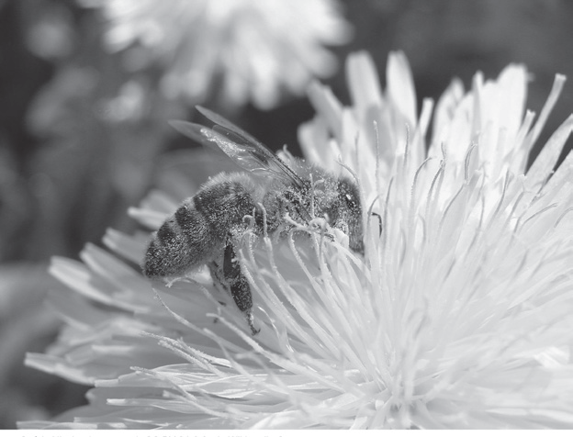
Life Cycle of Different Plants
The flowering stage is where the plant tries to reproduce. Once the flower of the plant is pollinated, it will produce a fruit that contains the seed of the plant. Pollination is the transfer of the pollen grains from the stamen to the pistil of the same flower (self-pollination) or a different flower of the same kind (cross-pollination). Once the new seed falls to the ground, the life cycle of the plant will start again from the seed stage.
Guérin Nicolas (messages), CC BY-SA 3.0, via Wikimedia CommonsBY-SA 3.0, via

Slide 5
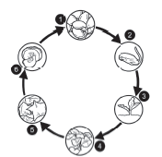
Life Cycle of Different Plants
Example: The Life Cycle Squash or Kalabasa
1.The squash seed is planted.
2. The squash seed begins to sprout.
3. The squash seedling emerges from the soil.
4. The squash plant grows and absorbs sunlight, water, and nutrients necessary for its growth.
5. The squash plant starts blooming flowers for reproduction.
6. The fruit of the squash plant is produced. This fruit contains seeds that are necessary for the next life cycle.

Slide 6
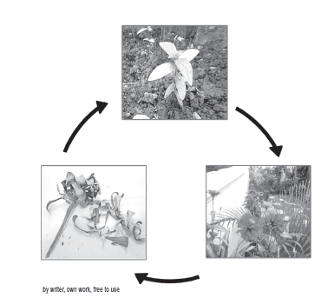
Life Cycle of Different Plants
Some flowering plants do not grow fruits. These plants grow tiny, fertilized seeds.
Example: The Life Cycle of Zinnia Plant
1. Fertilized seed in a withered flower are scattered on the soil.
2. Each seed grows into a seedling with tiny roots and a few leaves.
3. The seedling grows into a young plant with more leaves and stems.
4. The young plant grows a bud at the tip of its stem that develops into a flower.
5. The flower is pollinated, and fertilized seeds are developed in the ovary.
6. The fertilized seeds stay inside the ovary until the flower withers and falls to the ground, scattering the seeds on the soil in the process.

Slide 7
Life Cycle of Different Plants
Environmental Factors That Affect the Life Cycle of Plants
The life cycle of plants is affected by several environmental factors. These environmental factors can be classified as either biotic (living) factors or abiotic (nonliving).
Abiotic Factors
Soil – The soil plays an important role in the life cycle of a plant. A plant will not be able to grow properly if the type of soil is not appropriate. Some plants grow on dry, sandy soil, but some plants
grow in areas where the soil is loamy.
Water– Plants should receive the right amount of water for them to grow. If plants receive too little or too much water, they may not grow properly or eventually die.
Air – Plants will survive in an environment where there is enough
carbon dioxide (CO2).

Slide 8
Life Cycle of Different Plants
Light – Plants need to receive the proper amount of sunlight for them to grow healthy as light is used by plants to produce their own food.
Temperature – As you learned in the previous module, some plants can only grow in certain areas because of their temperature requirement.
Nutrients – Plants need nourishment to grow. These nutrients include nitrogen, phosphorus, potassium, magnesium, sulfur, and Calcium.
Difference between a plant that grows in a healthy environment and the one that does not. If the environmental condition is not favorable, the plant’s growth and development will be negatively affected.

Slide 9
Life Cycle of Different Plants
Activity
Flowering and seed-bearing plants grow from fertilized (1) ___________ that are planted in soil. A seed, which is planted in a proper environment, grows into a (2) ___________. A young plant grows a stem, more leaves, and (3) ___________, the reproductive part of the plant. The formation of seeds in flowers occurs through the process of (4) ___________ and fertilization. A (5) ___________ or ripened ovary contains fertilized seeds that are ready to grow again.
Directions: Fill the missing words in the blanks to complete the statements.

Slide 10
Life Cycle of Different Plants
Answer Key
Flowering and seed-bearing plants grow from fertilized (1) seeds that are planted in soil. A seed, which is planted in a proper environment, grows into a (2) seeding. A young plant grows a stem, more leaves, and (3) flowers, the reproductive part of the plant. The formation of seeds in flowers occurs through the process of (4) pollination and fertilization. A (5) fruit or ripened ovary contains fertilized seeds that are ready to grow again.

