Slide 1


Construction – Creating a Line Parallel to Another Line

Slide 2
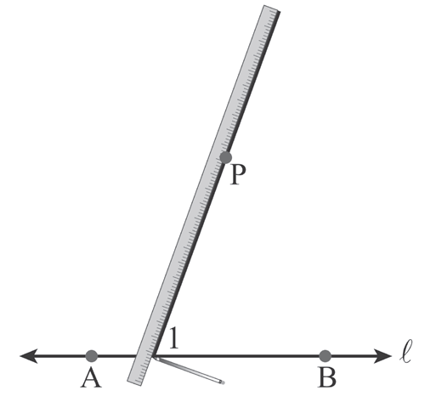
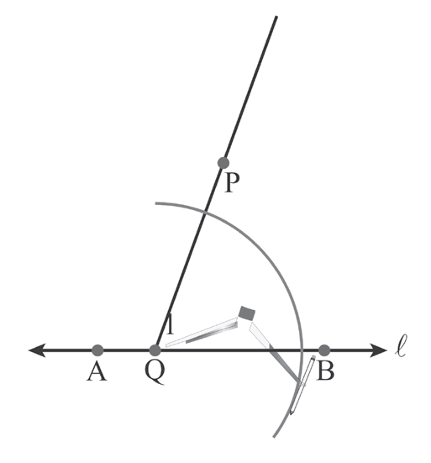
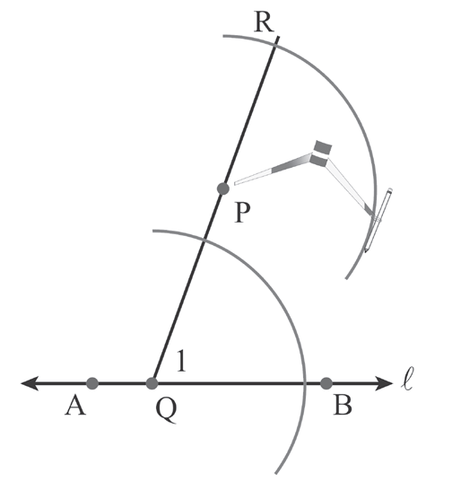
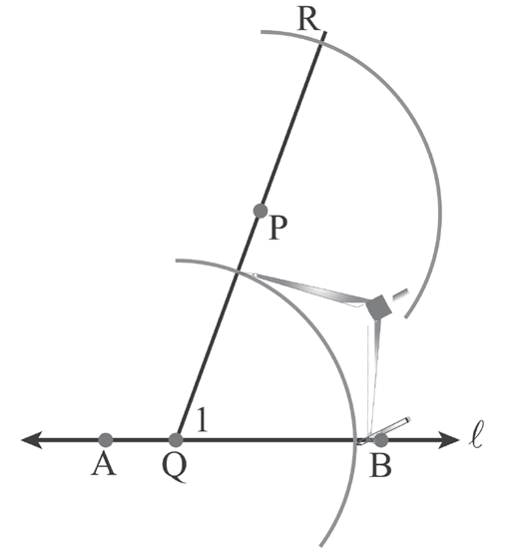
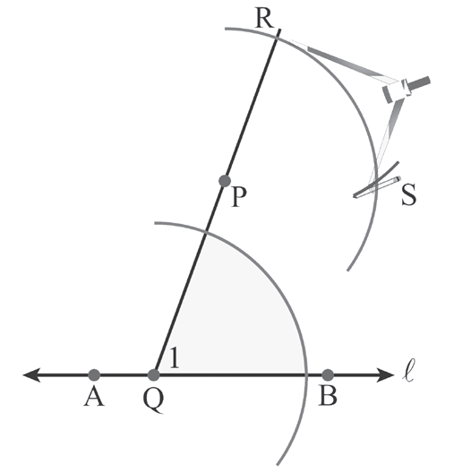
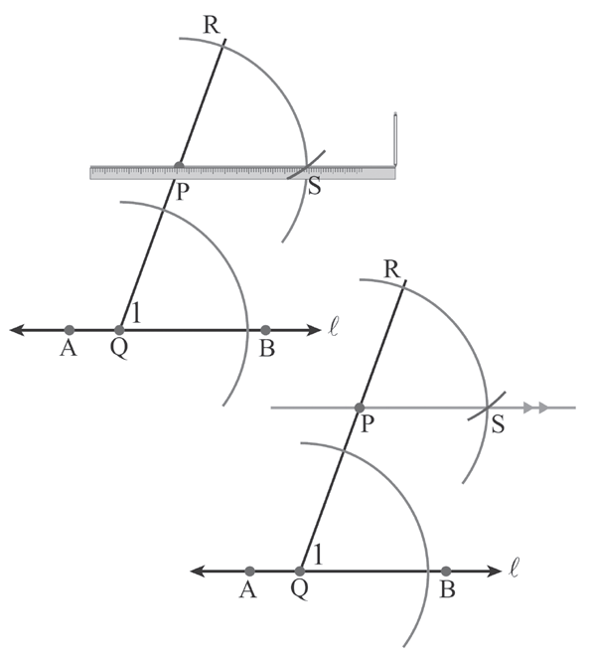
Construction – Creating a Line Parallel to Another Line
Constructing a Line Through a Given Point Parallel to a Given Line
1. Draw a line through P and across AB at Q, creating ∠1. | 2. Place the point of the compass on Q with opening not exceeding the length of PQ. Then draw an arc intersecting both sides of the angle. | 3. Using the same compass opening, repeat the procedure at point P and the arcs intersect PQ at R.
4. Set the compass opening to the lower arc. | 5. Using the same compass opening with the compass point at R, mark off an arc to make point S. | 6. Draw a straight line through P and S. PQ is parallel to AB .
Rex Curriculum Resource
WWW.REX.COM.PH

Slide 3
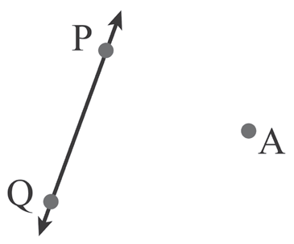
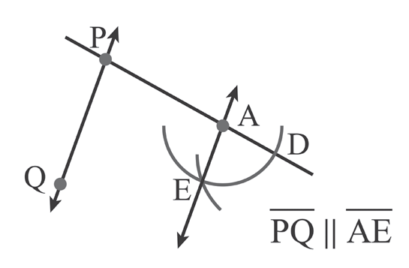
Construction – Creating a Line Parallel to Another Line
Example : Parallel Lines
Solution:
Consider PQ to be AB in the geometric construction presented above. By following the steps in constructing a line through a given point parallel to a given line, the figure below can be accomplished:
Rex Curriculum Resource
WWW.REX.COM.PH

Slide 4
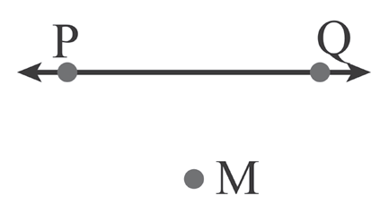
Activity:
Construct a line parallel to PQ through M.
Rex Curriculum Resource
WWW.REX.COM.PH

Slide 5
Activity: ANSWER KEY
Construct a line parallel to PQ through M.
ANSWER KEY:
The student should be able to show correct arc markings, and the line constructed should be parallel to line PQ and passes through point M.
Rex Curriculum Resource
WWW.REX.COM.PH

Slide 6


