Slide 1


Pairs of Angles

Slide 2
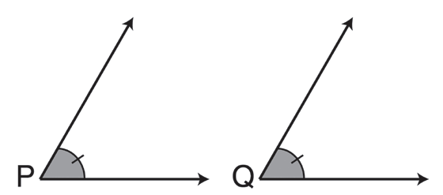
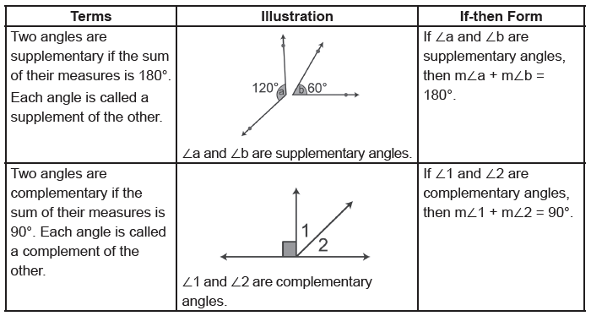
Pairs of Angles
Definition
Two angles are congruent if they have the same measure. ∠P ≅ ∠Q means “Angle P is congruent to angle Q”. Similar markings are used to indicate congruent angles.
∠P is congruent to ∠Q (∠P ≅ ∠Q).
The measure of ∠P is equal to the measure of ∠Q (m∠P = m∠Q).
If-then form: If ∠P ≅ ∠Q, then m∠P = m∠Q.
Rex Curriculum Resource
WWW.REX.COM.PH

Slide 3
Pairs of Angles
Example 1: Complementary and Supplementary Angles
a. What are the complements of the angles 41°, 33°, 8°, and 84°?
b. What are the supplements of 82° and 125°?
Solution:
a. Find the measures of angles that will give a sum of 90° when added to the given angle.
The complements of 41°, 33°, 8°, and 84° are 49°, 57°, 82°, and 6°, respectively.
b. Find the measures of angles that will give a sum of 180° when added to 82° or 125°.
For 82°: For 125°:
82° + x = 180° x = 180° – 125° = 55°
x = 98°
Note: Either of the two methods can be used in determining the supplement of an angle.
41° + x = 90° x = 49° | 33° + x = 90° x = 57° | 8° + x = 90° x = 82° | 84° + x = 90° x = 6°
Rex Curriculum Resource
WWW.REX.COM.PH

Slide 4
Pairs of Angles
Example 2: Complementary and Supplementary Angles
The measure of the supplement of an angle is 30 more than twice the measure of the complement of the angle. Find the measure of the angle.
Solution:
If x represents the measure of the angle, then 90 – x represents the measure of its complement, and 180 – x is the measure of its supplement. If the supplement is 30 more than twice the complement, then:
180 – x = 2(90 – x) + 30
180 – x = 180 – 2x + 30
Use the Distributive Property.
180 – x = 210 – 2x
Combine like terms.
180 + x = 210
Add 2x to both sides.
x = 30
Subtract 180 from both sides.
The measure of the angle is 30°.
Checking:
x = 30
180 - 30 = 2(90-30) + 30
150 = 2(60) + 30
150 = 120 + 30
150 = 150
Rex Curriculum Resource
WWW.REX.COM.PH

Slide 5
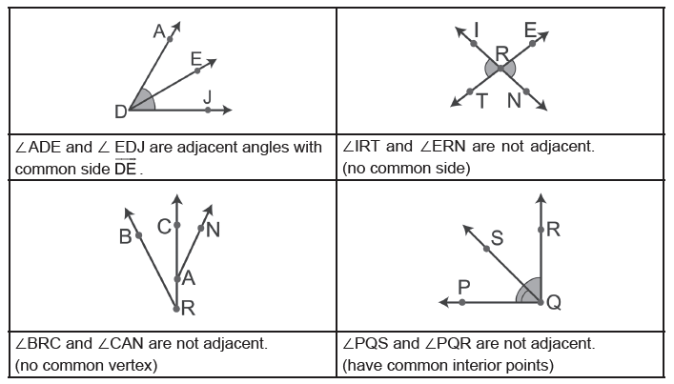
Pairs of Angles
Definition
Adjacent angles are two coplanar angles that have a common side between them but have no interior points in common.
Adjacent angles must have a common side; hence, they must also have a common vertex.
Rex Curriculum Resource
WWW.REX.COM.PH

Slide 6
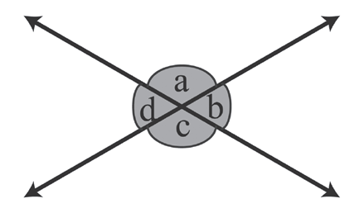
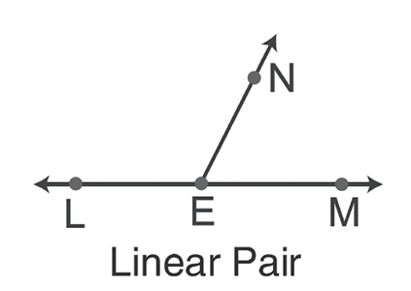
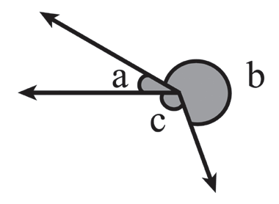
Pairs of Angles
Definition
If two angles are adjacent and supplementary, then they are called a linear pair.
If-then form: If ∠LEN and ∠NEM are adjacent and supplementary, then ∠LEN and ∠NEM form a linear pair.
Other angles related to straight lines are vertical angles and angles at a point as shown below:
∠a and ∠c are vertical angles.
∠b and ∠d are vertical angles.
∠a, ∠b, and ∠c are
angles at a point.
Rex Curriculum Resource
WWW.REX.COM.PH

Slide 7
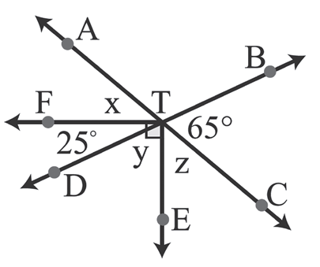
Pairs of Angles
Example 3: Angle Properties
Given: TA and TC are opposite rays.
TB and TD are opposite rays
Find the values of x, y, and z.
Solution:
For x
x + 25 = 65 Vertical angles are equal.
x = 65 − 25
x = 40
Solution:
For y
y + 25 = 90 The angles are complementary angles.
y = 90 − 25
y = 65
Solution:
For z
65 + z + y = 180 The angles are supplementary.
65 + z + 65 = 180
130 + z = 180
z = 180 − 130
z = 50
Rex Curriculum Resource
WWW.REX.COM.PH

Slide 8
Activity:
Determine whether the pair of measures of angles are complementary or supplementary.
1. 25° and 65°
2. 56° and 34°
3. 140° and 40°
4. 82° and 98°
5. 45° and 45°
6. 156° and 24°
7. 88° and 92°
8. 67° and 23°
Rex Curriculum Resource
WWW.REX.COM.PH

Slide 9
Activity: Answer Key
Determine whether the pair of measures of angles are complementary or supplementary.
1. 25° and 65°
2. 56° and 34°
3. 140° and 40°
4. 82° and 98°
5. 45° and 45°
6. 156° and 24°
7. 88° and 92°
8. 67° and 23°
ANSWER KEY
1. Complementary
2. Complementary
3. Supplementary
4. Supplementary
5. Complementary
6. Supplementary
7. Supplementary
8. Complementary
Rex Curriculum Resource
WWW.REX.COM.PH

Slide 10
Activity: ANSWER KEY
Content
Rex Curriculum Resource
WWW.REX.COM.PH

Slide 11


