Slide 1


Parallel and Perpendicular Lines

Slide 2
Parallel Lines

Slide 3
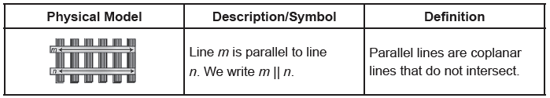
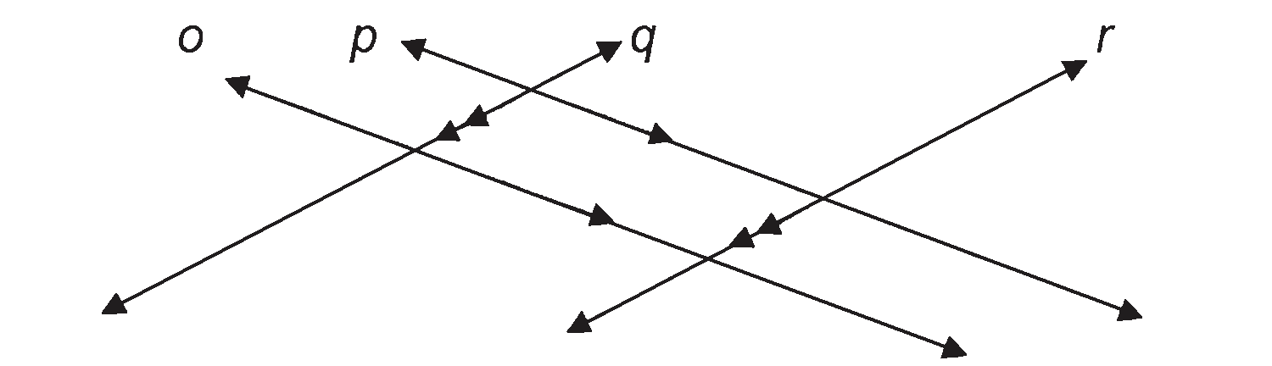
Parallel Lines
Shown on the right is the definition of parallel lines with its physical model and symbol for writing.
Example : Examine the figure below and determine which lines are parallel to each other.
Solution:
Claim: Line o is parallel to line p, and line q is parallel to line r. By simply looking at the figure, we can already assume that they do not intersect. However, what if the lines were extended infinitely? Would they intersect? The answer is no. They will not intersect. Observe the arrowheads in the middle of each line. Those arrowheads indicate that lines with the same number of indicated arrowheads are parallel to each other. Thus, what we claim is true.
Rex Curriculum Resource
WWW.REX.COM.PH

Slide 4
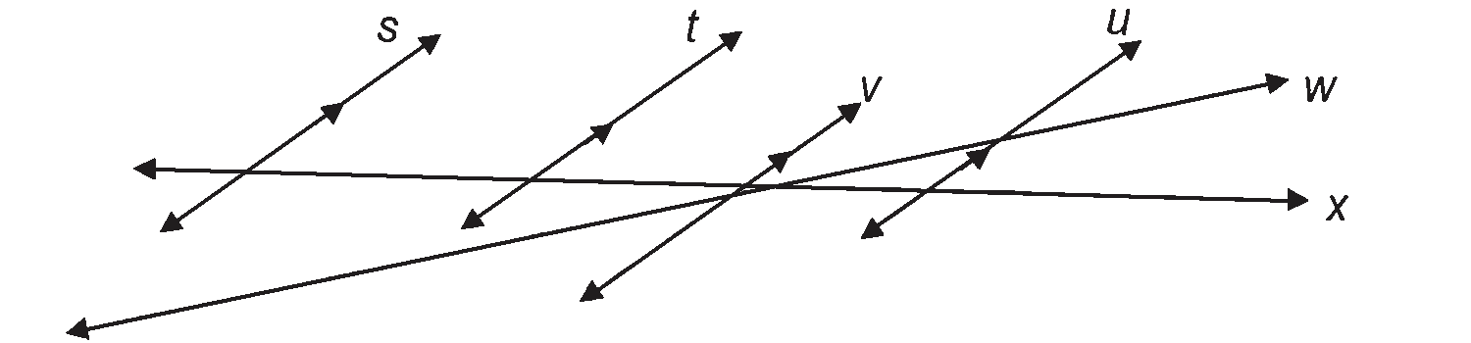
Activity:
Examine the figure below and identify which lines are parallel to line s.
Rex Curriculum Resource
WWW.REX.COM.PH

Slide 5
Activity: ANSWER KEY
ANSWER KEY
The lines parallel to line s are
line t, line v, and line u.
Rex Curriculum Resource
WWW.REX.COM.PH

Slide 6
Perpendicular Lines

Slide 7
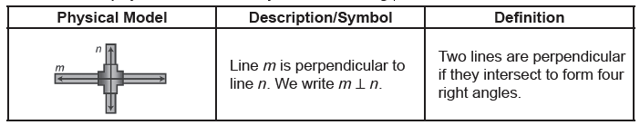
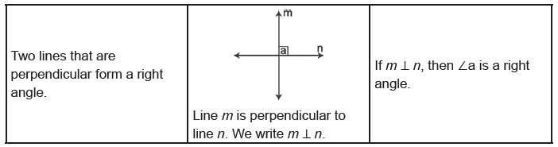
Perpendicular Lines
Another relationship that can be established among lines is their perpendicularity with each other. How do we know if two lines are perpendicular? See the definition below with its physical model and symbol for writing.
For a specific example, we can say that angle a in the illustration below is a right angle which also goes the same with the other angles formed by the two lines, m and n.
Rex Curriculum Resource
WWW.REX.COM.PH

Slide 8
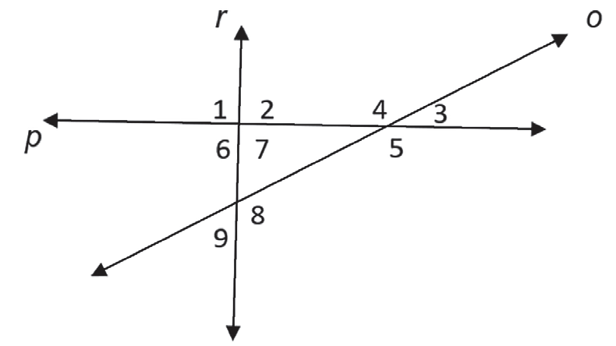
Perpendicular Lines
Example : If lines r and p are perpendicular, which of the following angles are right angles?
Solution:
Claim: The right angles are ∠1, ∠2, ∠6, and ∠7.
Rex Curriculum Resource
WWW.REX.COM.PH

Slide 9
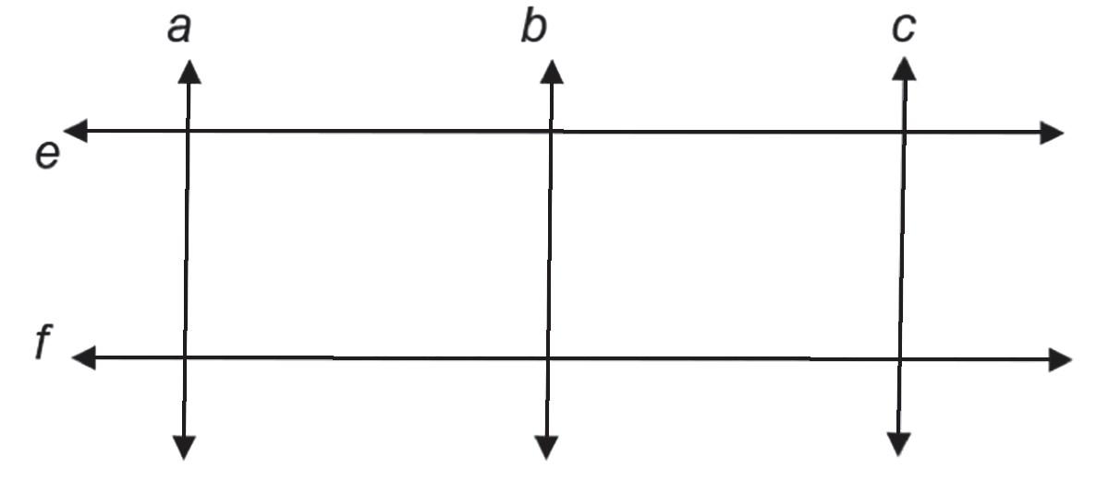
Activity:
Examine the figure below and determine all the pairs of perpendicular lines if all angles formed by every intersecting line are right angles.
Rex Curriculum Resource
WWW.REX.COM.PH

Slide 10
Activity: ANSWER KEY
Examine the figure below and determine all the pairs of perpendicular lines if all angles formed by every intersecting line are right angles.
ANSWER:
Pairs of perpendicular lines:
Line f and line a, line f and line b, line f and line c, line e and line a, line e and line b, line e and line c
Rex Curriculum Resource
WWW.REX.COM.PH

Slide 11


