Slide 1


Angles Formed by Parallel Lines Cut
by a Transversal Line

Slide 2
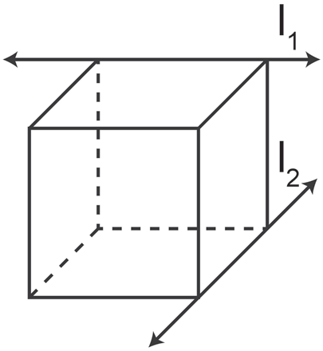
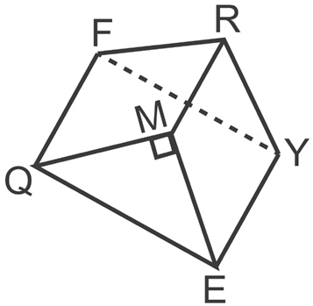
Angles Formed by Parallel Lines Cut by a Transversal Line
In a plane, two lines will either intersect or are parallel. If two coplanar lines do not intersect, they are called parallel lines. However, in a 3-dimensional space, it is possible to have two lines that are not parallel and do not intersect. The lines l1 and l2
(refer to the figure) show how this is possible. Hence, l1 and l2 are called skew lines.
Example 1: Parallel, Skew, and Oblique Lines
A chocolate company is designing a new chocolate box. The shape is half of a cube as shown on the right. Describe each pair of edges as perpendicular, parallel, skew, or oblique.
a. FR and FQ c. FY and QE
b. ME and QE d. QE and MR
Solution:
a. Since the given figure is half of a cube, FRMQ is a square. FR and FQ are
perpendicular since they are sides of a square.
b. ME and QE intersect but do not form a right angle. Thus, they are oblique.
c. FY and QE are coplanar and would never intersect. Thus, they are parallel.
d. QE and MR do not lie on the same plane. Thus, they are skew.
Definition
• Skew lines – lines that are noncoplanar and do not intersect
• Parallel lines – lines that are coplanar and do not intersect
• Oblique lines – lines that intersect but are not perpendicular
Note: Rays and segments are also described as perpendicular, oblique, parallel, or
skew. The term “parallel” and the notation || are used for segments, rays, lines, and planes. The symbol ∦ means that they are not parallel.
Rex Curriculum Resource
WWW.REX.COM.PH

Slide 3
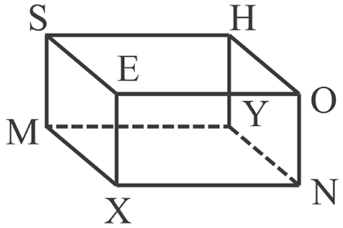
Activity:
A. Name all segments oblique to HO.
B. Name all segments parallel to HY.
C. Name all segments that are skew to SM.
Rex Curriculum Resource
WWW.REX.COM.PH

Slide 4
Activity: ANSWER KEY
A. Name all segments oblique to HO.
B. Name all segments parallel to HY.
C. Name all segments that are skew to SM.
ANSWER KEY
A. SH, EO, YH, NO (in any order)
B. SM, NO (in any order)
C. HO, NO, NY, EO, XN, EO (in any order)
Rex Curriculum Resource
WWW.REX.COM.PH

Slide 5
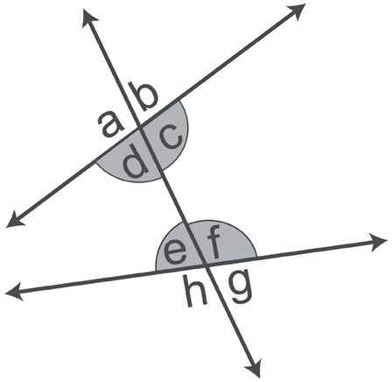
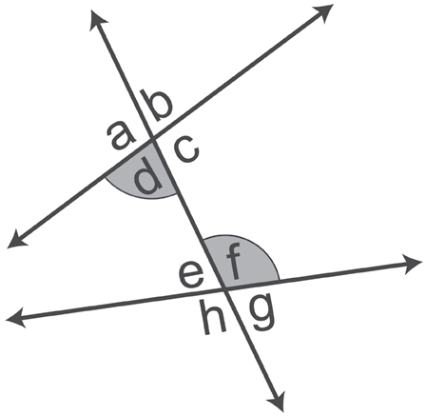
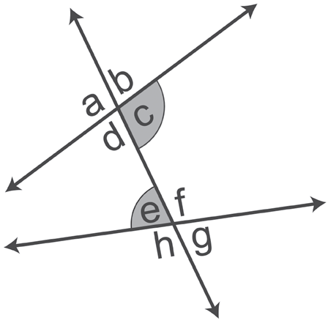
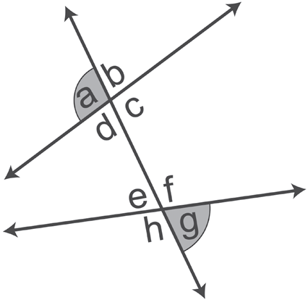
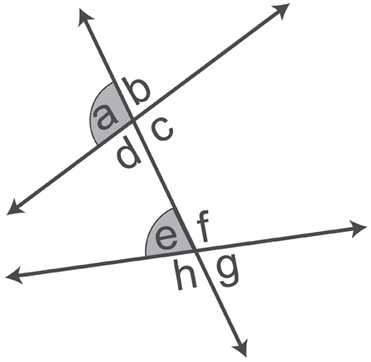
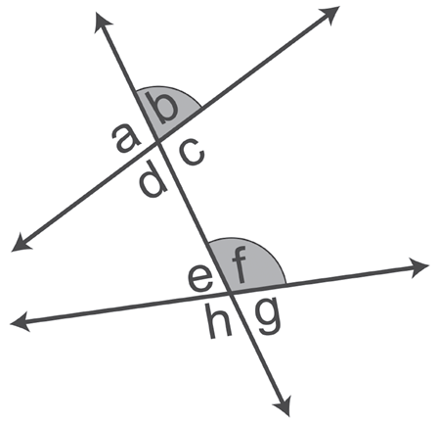
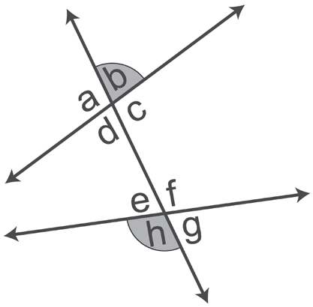
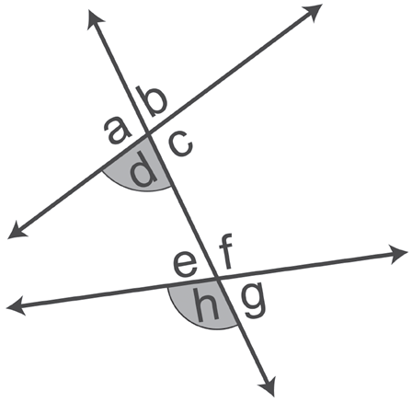
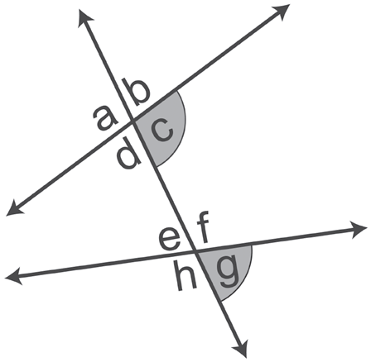
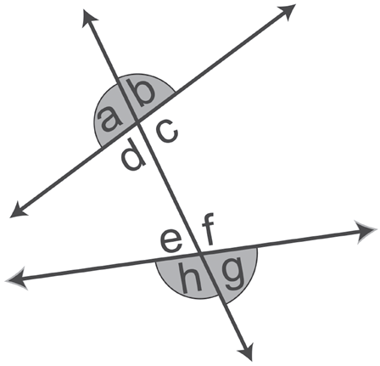
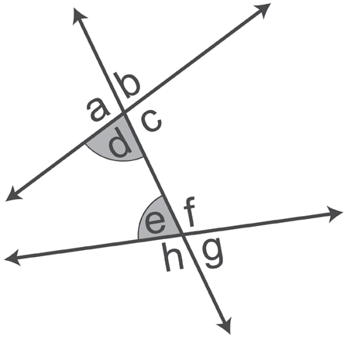
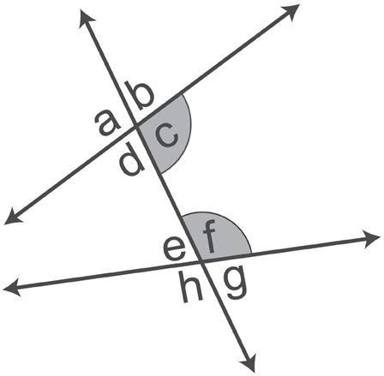
Angles Formed by Parallel Lines Cut by a Transversal Line
The angles formed by two different lines and a transversal have special names.
The angles c, d, e, and f are called interior angles. | The following pairs: ∠d and ∠f, and ∠c and ∠e are alternate interior angles.
The following pairs: ∠a and ∠g, and ∠b and ∠h are alternate exterior angles. | The following pairs: ∠a and ∠e, ∠b and ∠f, ∠h and ∠d, and ∠c and ∠g are corresponding angles.
The angles a, b, g, and h are called exterior angles. | The following pairs: ∠d and ∠e, and ∠c and ∠f are interior angles on the same side of the transversal.
Rex Curriculum Resource
WWW.REX.COM.PH

Slide 6
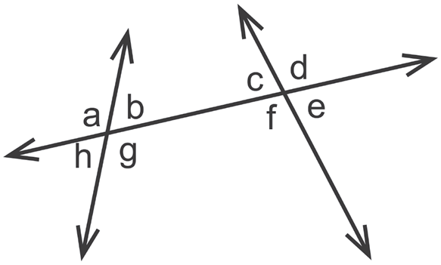
Angles Formed by Parallel Lines Cut by a Transversal Line
Definition:
• Transversal – a line that intersects two coplanar lines at two different points
• Alternate interior angles – a pair of non-adjacent interior angles on opposite sides of a transversal
• Corresponding angles – a pair of non-adjacent interior and exterior angles on the same side of a transversal
• Same-side interior angles – interior angles on the same side of a transversal
• Alternate exterior angles – a pair of non-adjacent exterior angles on opposite sides of a transversal
• Same-side exterior angles – exterior angles on the same side of a transversal
Example 2: Angles Related to Parallel Lines
Identify each pair of angles as alternate interior,
corresponding, alternate exterior, interior angles on the
same side of the transversal, or none of these.
a. ∠a and ∠e c. ∠b and ∠c e. ∠c and ∠a
b. ∠g and ∠c d. ∠b and ∠d f. ∠h and ∠c
Solution:
a. alternate exterior angles
b. alternate interior angles
c. interior angles on the same side of the transversal
d. corresponding angles
e. corresponding angles
f. none of these
Rex Curriculum Resource
WWW.REX.COM.PH

Slide 7
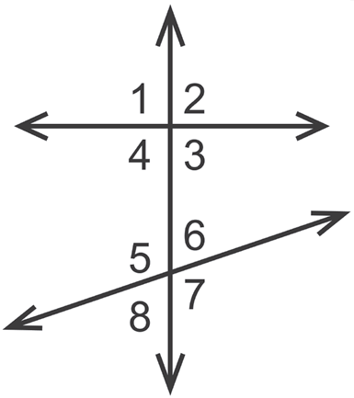
Activity:
Identify each pair of angles as alternate interior,corresponding, alternate exterior, interior angles on the same side of the transversal, or none of these.
A. ∠4 and ∠6
B. ∠2 and ∠6
C. ∠1 and ∠7
D. ∠4 and ∠5
E. ∠5 and ∠7
F. ∠3 and ∠5
Rex Curriculum Resource
WWW.REX.COM.PH

Slide 8
Activity: ANSWER KEY
Identify each pair of angles as alternate interior,corresponding, alternate exterior, interior angles on the same side of the transversal, or none of these.
A. ∠4 and ∠6
B. ∠2 and ∠6
C. ∠1 and ∠7
D. ∠4 and ∠5
E. ∠5 and ∠7
F. ∠3 and ∠5
ANSWER KEY
A. Alternate interior angles
B. Corresponding angles
C. Alternate exterior angles
D. Same-side interior angles
E. None of the special angles formed by parallel lines cut by a transversal (But students may answer vertical
angles.)
F. Alternate interior angles
Rex Curriculum Resource
WWW.REX.COM.PH

Slide 9


