Slide 1


Solving Problems Involving Parallel Lines Cut by a Transversal Line

Slide 2
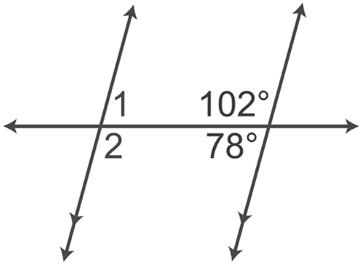
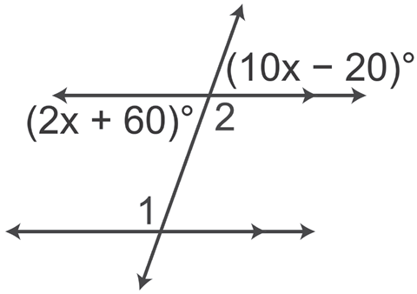
Solving Problems Involving Parallel Lines Cut
by a Transversal Line
Example : Properties of Parallel Lines
Each diagram shows two parallel lines and a transversal. Find the measure of each numbered angle.
a. b.
Solution:
a. m∠1 = 78° and m∠2 = 102°
b. 10x – 20 = 2x + 60 VAT
8x = 80 Subtract 2x and add 20 to both sides of the equation.
x = 10 Divide both sides by 8.
2x + 60 = 2(10) + 60 Substitute 10 in place of x.
m∠2 = 180° – 80° = 100°
Therefore, m∠1 = 100° If two lines are parallel, then alternate interior angles are congruent.
Rex Curriculum Resource
WWW.REX.COM.PH

Slide 3
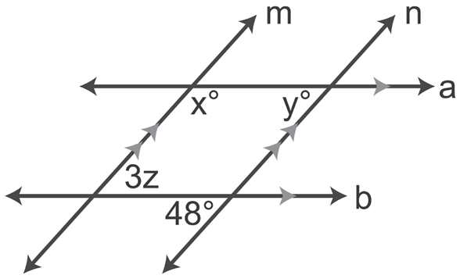
Solving Problems Involving Parallel Lines Cut
by a Transversal Line
Example : Properties of Parallel Lines
Find the value of x, y, and z.
Solution:
Since a || b cut by a transversal n, y = 48° by the property of corresponding
angles formed by parallel lines cut by a transversal.
Since m || n cut by a transversal a, then x + y = 180° by the property of
Same-side interior angles formed by parallel lines cut by a transversal.
If y = 48° and
x + y = 180°, then
x + 48° = 180°
X = 132°
Since m || n cut by a transversal b, 3z = 48° by the property of alternate interior angles formed by parallel lines cut by a transversal.
3z = 48°
z = 16°
Rex Curriculum Resource
WWW.REX.COM.PH

Slide 4
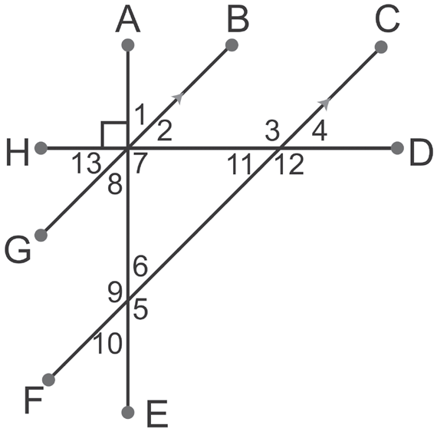
Activity:
Given the figure as marked and m∠1 = 35, find:
A. m∠8
B. m∠2
C. m∠4
D. m∠11
E. m∠13
F. m∠9
Rex Curriculum Resource
WWW.REX.COM.PH

Slide 5
Activity: Answer Key
Given the figure as marked and m∠1 = 35, find:
A. m∠8
B. m∠2
C. m∠4
D. m∠11
E. m∠13
F. m∠9
ANSWER KEY
A. 35
B. 55
C. 55
D. 55
E. 55
F. 145
Rex Curriculum Resource
WWW.REX.COM.PH

Slide 6
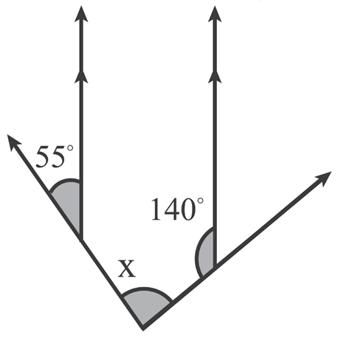
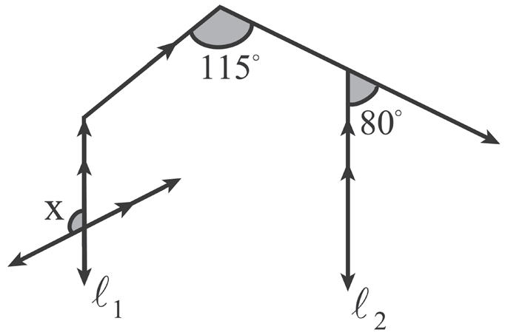
Solving Problems Involving Parallel Lines Cut
by a Transversal Line
Example : Properties of Parallel Lines
Find the value of x in the following figures.
a. b.
Solution:
a. Draw a vertical line l3 parallel to l1 and l2.
∠a = 55° Corresponding angles are congruent
(l1 || l3).
b + 140° = 180° Same-side interior angles are
b = 40° supplementary (l3 || l2).
Because x = a + b
x = 55° + 40°
x = 95°
b. Draw l3 parallel to l1 and l2 and make the necessary marking as shown on the figure b.
b = 80° Corresponding angles are
a + b = 115° congruent (l3 || l2).
a + 80° = 115°
a = 115° – 80°
a = 35°
a = c = 35° Alternate interior angles are congruent (l1 || l3).
c = d = 35° Corresponding angles are congruent (l4 || l5).
Therefore,
x + d = 180° Two angles forming linear pair are supplementary.
x + 35° = 180°
x = 145°
Rex Curriculum Resource
WWW.REX.COM.PH

Slide 7
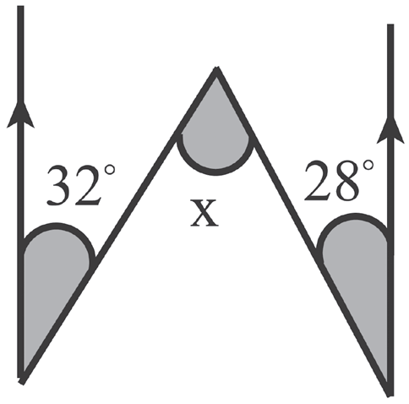
Activity:
Find the value of x in the figure.
Rex Curriculum Resource
WWW.REX.COM.PH

Slide 8
Activity:
Find the value of x in the figure.
ANSWER KEY
x = 60°
Rex Curriculum Resource
WWW.REX.COM.PH

Slide 9


