Slide 1
Properties of Parallel Lines

Slide 2
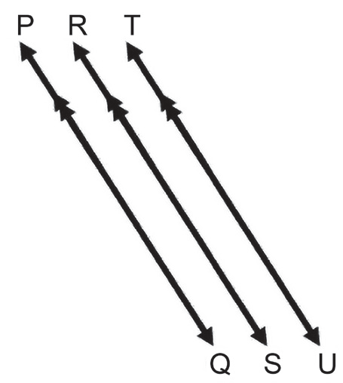
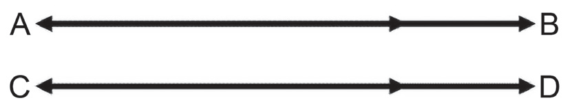
Properties of Parallel Lines
Parallel lines are formed when two or more lines lying on the same plane do not intersect. They are represented by either single or double arrowheads pointing to the same direction. Below are some examples of parallel lines.

Slide 3
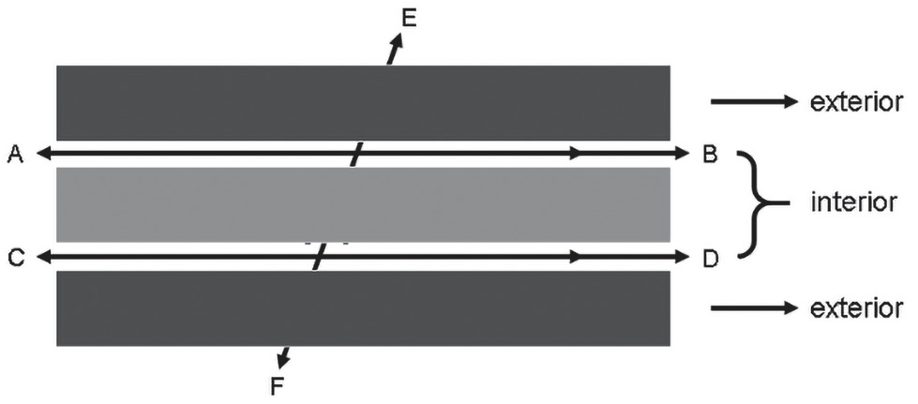
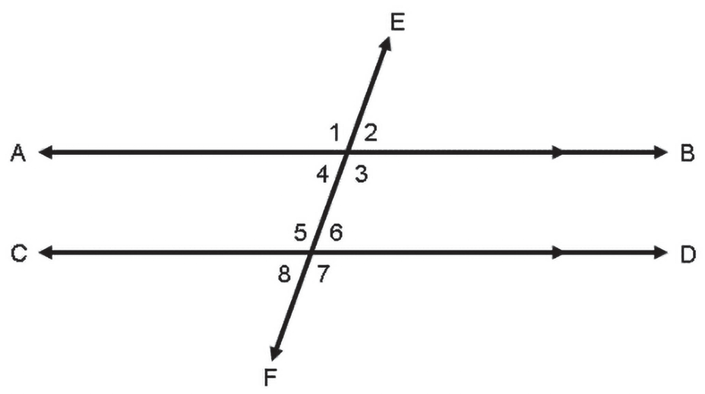
Properties of Parallel Lines
The symbol “||” is used to denote two or more lines that are parallel. AB || CD is read as “line AB is parallel to line CD.” On the other hand, a transversal is a line that cuts two or more lines on the same plane at two or more distinct points. When a transversal cuts a pair of parallel lines, the following angle pairs are formed: corresponding angles; alternate interior angles; alternate exterior angles; same side interior angles; and same side exterior angles. The figures below show how the angles and regions are formed when a pair of parallel lines is cut by a transversal.

Slide 4
Properties of Parallel Lines
In the given figures above, AB || CD. AB and CD are cut by a transversal line, EF, thereby forming eight angles. ∠3, ∠4, ∠5, and ∠6 are located in the area bounded by the parallel lines; thus, they are considered as interior angles. While ∠1, ∠2, ∠7, and ∠8 are located in the area outside the area bounded by the parallel lines; thus, they are called exterior angles.
Let us now differentiate the angle pairs formed when a pair of parallel lines is cut by a transversal. Do the following tasks. Use the figures above where AB || CD is cut by a transversal line EF. Use a protractor to measure the angles and use the angle measurement to describe the relationship of the angle pair. Fill in the information in the third column based on the measurements you have got. In the fourth column, provide another example of the given angle pair. First one is done for you.

Slide 5
Properties of Parallel Lines
Angle Pairs | Examples | Relationships | Other Examples
1. Alternate Interior Angles – interior angles are located on the opposite sides of the transversal – do not form a linear pair | ∠4 and ∠6 | m∠4 = 70° m∠6 = 70° Alternate interior angles have equal angle measurements. Hence, they are congruent. | ∠3 and ∠5
2. Alternate Exterior Angles – exterior angles are located on the opposite sides of the transversal – do not form a linear pair | ∠1 and ∠7 | m∠1 = ______ m∠7 = ______ Alternate exterior angles have ______ angle measurements. Hence, they are ______. | ______

Slide 6
Properties of Parallel Lines
3. Same Side Interior Angles – interior angles are located on the same side of the transversal | ∠3 and ∠6 | m∠3 = ______ m∠6 = ______ m∠3 + m∠6 = ______ _____________________ _____________________. | ______
4. Same Side Exterior Angles – exterior angles are located on the same side of the transversal | ∠1 and ∠8 | m∠1 = ______ m∠8 = ______ m∠1 + m∠8 = ______ _____________________ _____________________. | ______
5. Corresponding Angles – two angles that lie on the same side of the transversal – one angle lies in the exterior region and the other angle lies in the interior region – do not form a linear pair | ∠1 and ∠5 | m∠1 = ______ m∠5 = ______ m∠1 + m∠5 = ______ _____________________ _____________________. | ______

Slide 7
Properties of Parallel Lines
The activity above teaches you the definition and measurement of the angle pairs formed when a pair of parallel lines is cut by a transversal. Using this information, answer the questions below about the postulate and theorems involving parallel lines.
1. What can you say about the measurement of the corresponding angles in the given activity?
_______________________________________________________
2. Are corresponding angles congruent or supplementary? ____________________
3. Complete the following sentence:
Corresponding Angle Postulate
If a pair of parallel lines is cut by a transversal, then the corresponding angles are __________.
4. What can you say about the measurement of the alternate interior/exterior angles in the given activity? ____________________________________________
5. Are alternate angles congruent or supplementary? ________________________

Slide 8
Properties of Parallel Lines
6. Complete the following sentence:
Alternate Angle Theorem
If a pair of parallel lines is cut by a transversal, then the alternate angles are __________.
7. What can you say about the measurement of the same side interior/exterior angles in
the given activity? ____________________________________________
8. Are the same side angles congruent or supplementary? _______________________
9. Complete the following sentence:
Same Side Angle Theorem
If a pair of parallel lines is cut by a transversal, then the same side angles are __________.

Slide 9
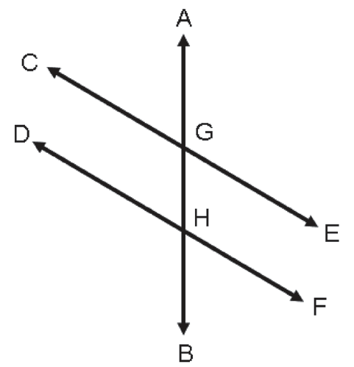
Properties of Parallel Lines
Let us now solve the missing angles of parallel lines cut by a transversal in Figure 1. Suppose CE || DF.
Example 1: If m∠AGE = 135°, what is the measure of ∠FHA?
Solution:
Notice that ∠AGE and ∠FHA are corresponding angles and
corresponding angles have equal measurements. Thus, m∠FHA = 135°.
Example 2: If m∠BHD = (2x + 3)° and m∠CGA = (3x + 7)°, what is the value of x?
Solution: ∠BHD and ∠CGA both exterior angles and they are located on the same side of the transversal; therefore, ∠BHD and ∠CGA are same side exterior angles. Note that the sum of the measures of same side exterior angles is 180°. With this information, you can now solve for the value of x.

Slide 10
Properties of Parallel Lines
m∠BHD + m∠CGA = 180
(2x + 3) + (3x + 7) = 180
5x + 10 = 180
5x + 10 − 10 = 180 − 10
5X = 170
x = 34
Thus, the value of x is 34.
5x
170
=
5
5

Slide 11
Properties of Parallel Lines
Example 3: If m∠DHA = (6x + 15)° and m∠BGE = (4x + 33)°, what is m∠DHA?
Solution:
∠DHA and ∠BGE are not interior angles and they are located on the opposite sides of the transversal; they do not form a linear pair. Thus, they are alternate interior angles. Note that alternate interior angles have equal angle measurements.
Solving for the value of x, Substitute the value of x to solve for m∠DHA.
m∠DHA = m∠BGE
6x + 15 = 4x + 33
6x − 4x + 15 − 15 = 4x − 4x + 33 − 15
2x = 18
x = 9
m∠DHA = (6x + 15)°
= [6(9) + 15]°
= (54 + 15)°
= 69°
Hence, m∠DHA = 69°.
2x
18
=
2
2

