Slide 1
Proving Parallel Lines

Slide 2
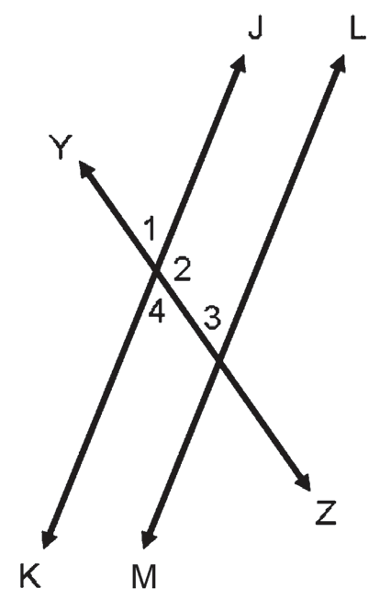
Proving Parallel Lines
In this lesson, you are going to learn how to prove that two lines are parallel using the converses of the following: corresponding angle postulate; alternate angle theorem; and same side angle theorem.
Converse of Corresponding Angle Postulate
If two lines and a transversal form corresponding angles that are congruent, then the two lines are parallel.
Example 1: Given that ∠4≅∠3, prove that JK || LM.
Proof:
Statements | Reasons
1. ∠4 ≅ ∠3 | 1. Given
2. ∠4 and ∠1 are vertical angles. | 2. Definition of vertical angles
3. ∠4 ≅ ∠1 | 3. Vertical angles are congruent.
4. ∠3 ≅ ∠1 | 4. Transitive property of equality
5. JK || LM | 5. Converse of corresponding angle postulate

Slide 3

Proving Parallel Lines
Converse of Alternate Angle Theorem
If two lines and a transversal form alternate interior or exterior angles that are congruent, then the two lines are parallel.
Example 2: Given that ∠2 and ∠3 are supplementary, prove that JK || LM by using the converse of alternate angle theorem.
Proof:
Statements | Reasons
1. m∠2 + m∠3 = 180° | 1. Given
2. ∠2 and ∠4 form a linear pair. | 2. Definition of a linear pair
3. m∠2 + m∠4 = 180° | 3. Linear pairs are supplementary.
4. m∠2 + m∠3 = m∠2 + m∠4 = | 4. Transitive property of equality
5. m∠3 = m∠4 | 5. Addition property of equality (added −m∠2 to both the sides of the equation)
6. ∠3 ≅ ∠4 | 6. Definition of congruent angles
7. JK || LM | 7. Converse of alternate angle theorem

Slide 4
Proving Parallel Lines
Converse of Same Side Angle Theorem
If two lines and a transversal form a pair of same side interior or exterior angles that are supplementary, then the two lines are parallel.
Example 3: Given that ∠4 ≅∠3 prove that JK || LM by using the converse of same side angle
theorem.
Proof:
Statements] | Reasons
1. ∠4 ≅∠3 | 1. Given
2. m∠4 = m∠3 | 2. Definition of congruent angles
3. ∠4 and ∠2 form a linear pair. | 3. Definition of a linear pair
4. m∠4 + m∠2 = 180° | 4. Linear pairs are supplementary
5. m∠3 + m∠2 = 180° | 5. Substitution
6. ∠3 and ∠2 are same side interior angles | 6. Definition of same side interior angles
7. JK || LM | 7. Converse of same side angle theorem

Slide 5
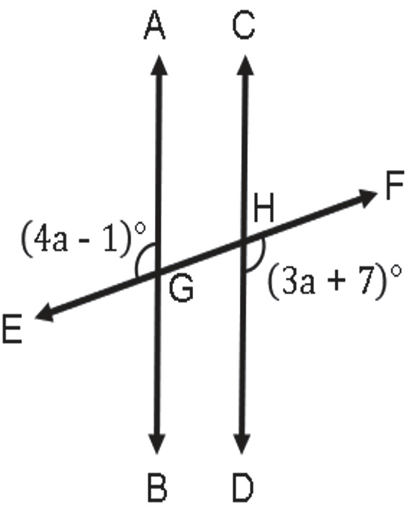
Proving Parallel Lines
Example 4:
Find the value of a that will make AB || CD given that m∠EGA = (4a − 1)° and m∠DHF = (3a + 7)°.
Solution:
In this example, you need to find the value of the variable that
will make AB || CD. In the figure, you can notice that ∠EGA and ∠DHF
are alternate exterior angles. The converse of alternate angle theorem
states that if these angles are congruent, then AB || CD. Solving for a,
m∠EGA = m∠DHF
4a − 1 = 3a + 7
4a − 3a − 1 + 1 = 3a − 3a + 7 + 1
a = 8
The value of a that will make AB || CD is 8.

