Slide 1
Proving Perpendicular Lines

Slide 2
Proving Perpendicular Lines
Perpendicular lines are formed when two lines meet at exactly one point, forming four right angles. Perpendicular lines are represented by the symbol “⊥.” AB⊥CD is read as “AB is perpendicular to CD.”
If EF and GH are the two lines intersecting each other at 90°, then they are perpendicular to each other and are written as EF⊥GH. Recall that the point of intersection of perpendicular lines is called the foot of the perpendicular.
You already know the properties of perpendicular lines from the past lessons, but how will you prove that the two given lines are perpendicular to each other? In this lesson, you will learn about the converse of the properties of perpendicular lines and use them to prove that the given lines are perpendicular.

Slide 3
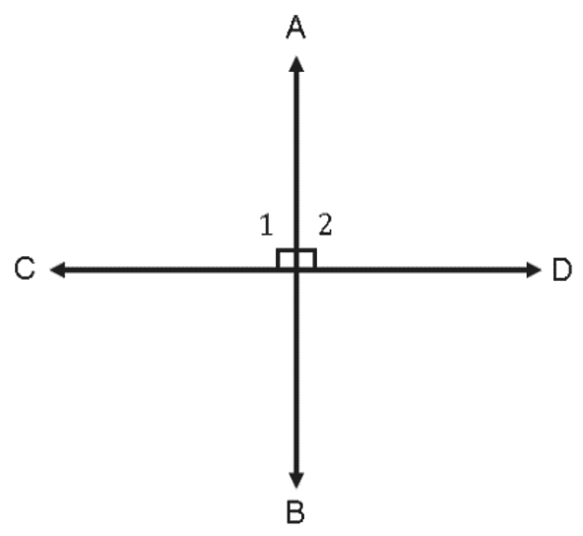
Proving Perpendicular Lines
Linear Pair Perpendicular Theorem
If two straight lines intersect at a point and form a linear pair of equal angles, then the lines are perpendicular.
Given: ∠1≅∠2
Prove: AB⊥CD
Proof:
Statement | Reasons
1. ∠1 ≅ ∠2 | 1. Given
2. m∠1 = m∠2 | 2. Definition of congruent angles
3. ∠1 and ∠2 form a linear pair. | 3. Definition of a linear pair
4. m∠1 + m∠2 = 180° | 4. Linear pairs are supplementary.
5. m∠1 + m∠1 = 180° | 5. Substitution
6. 2(m∠1) = 180° | 6. Simplification
7. m∠1 = 90° | 7. Multiplication property of equality
8. m∠2 = 90° | 8. Definition of congruent angles
9. ∠1 and ∠2 are right angles | 9. Definition of a right angle
10. AB⊥CD | 10. Definition of perpendicular lines

Slide 4
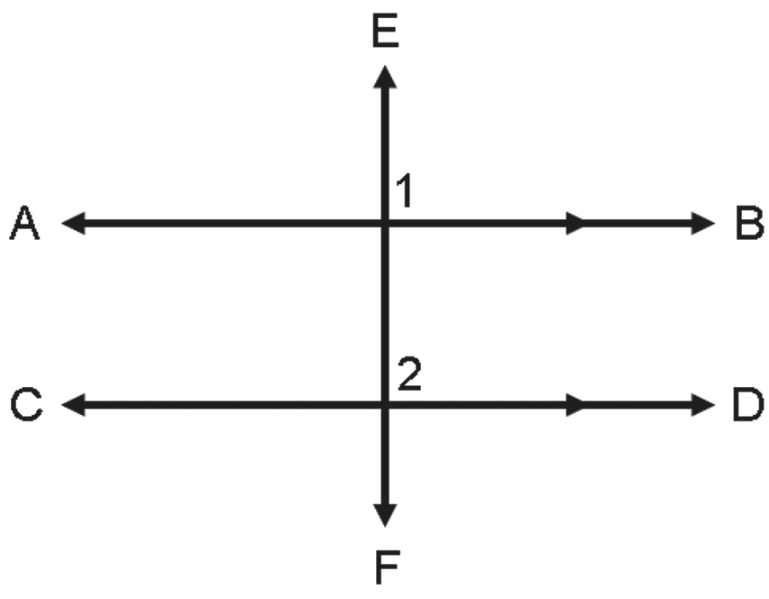
Proving Perpendicular Lines
Perpendicular Transversal Theorem
If a transversal is perpendicular to one of the two parallel lines, then it is perpendicular to the second parallel line.
Given: AB || CD, AB⊥EF
Prove: CD⊥EF
Proof:
Statements | Reasons
1. AB || CD, AB⊥EF | 1. Given
2. ∠1 is a right angle | 2. Definition of perpendicular lines
3. m∠1 = 90° | 3. Definition of a right angle
4. ∠1≅∠2 | 4. Corresponding angle postulate
5. m∠1=m∠2 | 5. Definition of congruent angles
6. m∠2=90° | 6. Transitive property
7. ∠2 is a right angle | 7. Definition of a right angle
8. CD⊥EF | 8. Definition of perpendicular lines

Slide 5
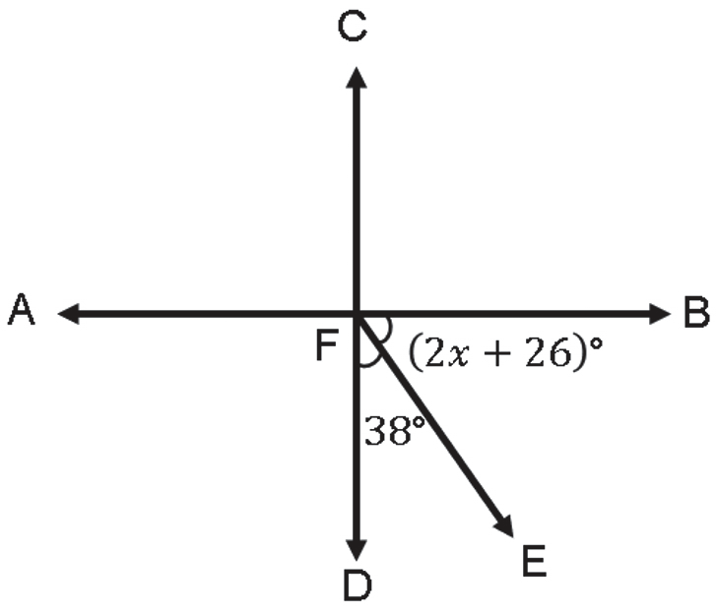
Proving Perpendicular Lines
Example: Find the value of x that will make AB ⊥ CD, given that m∠BFE = (2x + 26)° and m∠DFE = 38°.
Solution:
In this example, you need to find the value of x that will
make AB ⊥ CD. By the definition of perpendicular lines, you can
say that m∠BFD = 90°. Thus, by the angle addition postulate,
m∠BFE + m∠DFE = 90°. Solving for the value of x,
m∠BFE + m∠DFE = 90
2x + 26 + 38 = 90
2x + 64 = 90
2x + 64 − 64 = 90 − 64
2x = 26
x = 13
Therefore, the value of x that will make AB⊥CD is 13.

