Slide 1
Relations and Functions

Slide 2
Relations and Functions
A relation is a set of ordered pairs. The domain of a relation is the set of first coordinates. The range is the set of second coordinates.
A function is a relation in which each element of the domain corresponds to exactly one element of the range.
The members of the domain can be called inputs and the members of the range can be called outputs when a function is compared to a number-processing machine.

Slide 3
Relations and Functions
For each input (value of x), the number-processing machine yields an output (value of y). For example, when the input values are x = 50, 100, and 150, the output values are y = 35, 70, and 105. Because you input an x-value to represent the marked price, x is called the independent variable. Since the selling price depends on the marked price, y is called the dependent variable.

Slide 4
Relations and Functions
Arrows can also be used to describe correspondence in the function.
Domain Range
₱50 ₱35 ₱100 ₱70 ₱150 ₱105 ₱200 ₱140 ₱250 ₱175 ₱300 ₱210 ₱350 ₱245

Slide 5
Relations and Functions
This relation is a function since each element in the domain {₱50, ₱100, ₱150, ₱200, ₱250, ₱300, ₱350} is assigned one element in the range {₱35, ₱70, ₱105, ₱140, ₱175, ₱210, ₱245}.

Slide 6
Relations and Functions
Determine whether the following relations are functions or not.
{(1, 4), (2, 4), (3, 6), 4, 7)} 2. {(1, 2), (2, 5), (2, 0), 3, 7)}

Slide 7
Relations and Functions
Solutions:
Each element in the domain, {1, 2, 3, 4} is assigned to no more one value in the range. 1 is assigned only to 4, 2 is assigned only to 5, 3 is assigned only to 6, and 4 is assigned only to 7. Therefore, it is a function.
Since the domain element 2 is assigned to two different values in the range, 5 and 0, it is not a function.

Slide 8
Relations and Functions
Tell whether or not each table of values represents a function. Give the domain and range of each relation.
1. 2.
Input | Output
1 | 2
2 | 4
3 | 8
Input | Output
2 | 1
0 | 3
2 | 5

Slide 9
Relations and Functions
Solutions:
To be a function, each input must have exactly one output. It is helpful to use arrows to show the correspondence between the input values and output values.
a.
b.
Each input value matches with only one output value. So, this relation is a function. The domain is {1, 2, 3} and the range is {2, 4, 8}.
The input value 2 has two output values, 1 and 5. This relation is not a function because one input value has more than one output value. The domain is {0, 2} and the range is {1, 3, 5}.

Slide 10
Relations and Functions
Characteristics of a Function
Each element in domain x must be matched with exactly one element in range y.
Some elements in y may not be matched with any element in x.
Two or more elements in x may be matched with the same element in y. A function can be represented in different ways, namely:
      a. a table of values c. a graph
      b. ordered pairs d. an equation

Slide 11
Relations and Functions
Table of Values:
Ordered Pairs:
{(50, 35), (100, 70), (150, 105), (200, 140), (250, 175), (300, 210), (350, 245)}
Marked Price (₱x) | 50 | 100 | 150 | 200 | 250 | 300 | 350
Selling Price (₱y) | 35 | 70 | 105 | 140 | 175 | 210 | 245

Slide 12
Relations and Functions
Table of Values:
Equation: y = – 0.3x or y = 0.7x
The selling price is computed by multiplying the discount (30%) to the marked price (x) and subtracting this amount from the marked price which is given by y = x - 0.3x. Likewise, the selling price can also be computed by getting 70% of the marked price which can be written as y = 0.7x.

Slide 13
Relations and Functions
Let the domain be {9, -45, 8.28, x}. Represent the rule “add three to each x-coordinate to get the y-coordinate” with a table of values, a set of ordered pairs, a graph, and an equation.
Solutions:
Table of Values
Ordered Pairs: {(9, 12), (–45, –42), (8.28, 11.28), (x, x + 3}
Input (x) | 9 | –45 | 8.28 | x
Output (y) | 12 | –42 | 11.28 | X + 3

Slide 14
Relations and Functions
Graph: d. Equation:
    y = x + 3

Slide 15
Relations and Functions
The age, height, and weight of 10 people are shown in the table below.
Name | Age | Height (inches) | Weight (pounds)
Arnold | 15 | 64 | 128
Bert | 79 | 54 | 93
Cora | 23 | 60 | 103
Donna | 17 | 60 | 103
Elaine | 24 | 67 | 178
Fred | 2 | 26 | 28
Gina | 12 | 60 | 198
Anton | 49 | 55 | 76
Jasmine | 15 | 70 | 118
Kevin | 52 | 67 | 193

Slide 16
Relations and Functions
Make three different graphs to show the ordered pairs: (age, height), (age, weight), and (height, weight). On each graph, label the points A, B, C, …, K to represent Arnold, Bert, Cora, …, Kevin, respectively.
Use the set of ordered pairs for (age, height) to answer the following:
  Who among the people have the same age?
  Who among the people have the same height?
  Which point represents the oldest person?
  Who is the youngest person?

Slide 17
Relations and Functions
  Who is the tallest person?
  Are there people that have the same age but different height?
  Is this group of ordered pairs a function? Explain why.
Use the set of ordered pairs for (age, weight) to answer the following:
  Find the point for the youngest, oldest, heaviest, and lightest person.
  Is this group of ordered pairs a function? Why or why not?
Tell whether the set of ordered pairs (height, weight) is a function or not. Explain why or why not.

Slide 18
Relations and Functions
Solutions:
LETTER A
For ordered pairs (age, height):
A(15, 64), B(79, 54), C(23, 60), D(17, 60), E(24, 67), F(2, 26), G(12, 60), I(49, 55), J(15, 70), K(52, 67)

Slide 19
Relations and Functions
Solutions:
For ordered pairs (age, weight):
A(15, 128), B(79, 93), C(23, 103), D(17, 103), E(24, 178), F(2, 28), G(12, 198), I(49, 76), J(15, 118), K(52, 193)

Slide 20
Relations and Functions
Solutions:
For ordered pairs (height, weight):
A(64, 128), B(54, 93), C(60, 103), D(60, 103), E(67, 178), F(26, 28), G(60, 198), I(55, 76), J(70, 118), K(67, 193)

Slide 21
Relations and Functions
Solutions: LETTER B
Arnold and Jasmine have the same age (15 years old).
Cora, Donna, and Gina have the same height (60 in); Elaine and Kevin have the same height (67 in).
Point B represents the oldest person (70 years old).
Fred is the youngest person (2 years old).
Jasmine is the tallest person (70 in).
Yes, Arnold and Jasmine have the same age (15 years old) but different heights (64 in and 70 in respectively).
The relation (age, height) is not a function because the domain element 15 is assigned to two different values in the range, 64 and 70.

Slide 22
Relations and Functions
Solutions:
LETTER C
Point F represents the youngest person. Point B represents the oldest person. Point G represents the heaviest person. Point F represents the lightest person.
The group of ordered pairs is not a function because the domain element 15 is assigned to two different values in the range, 128 and 118.

Slide 23

Relations and Functions
Solutions:
LETTER D
The ordered pairs are not a function because the domain element 60 is assigned to two different values in the range, 103 and 108. Also, the domain element 67 is assigned to two different values in the range, 178 and 193.
$$x^{2}+y−4=0$$

Slide 24
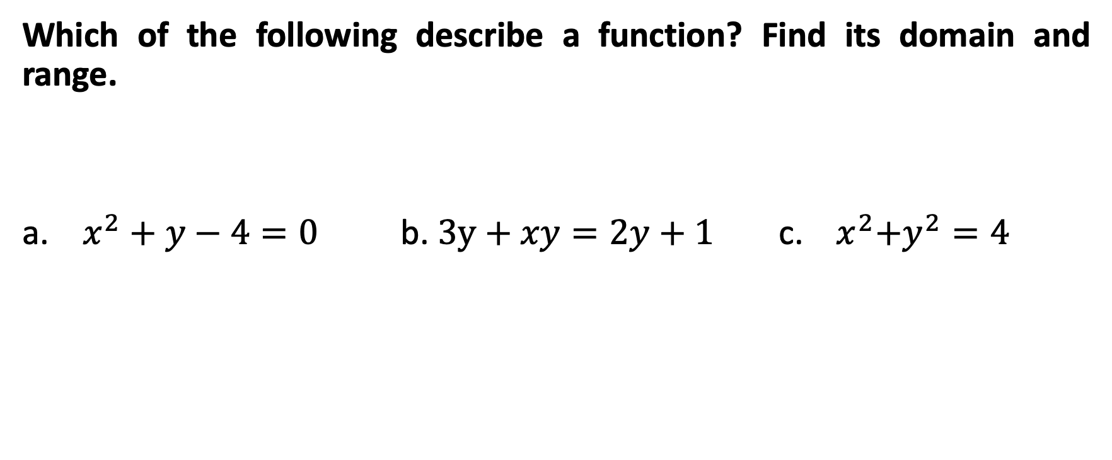
Relations and Functions
Which of the following describe a function? Find its domain and range.
a. $x^{2}+y−4=0$ b. $3y+xy=2y+1$ c. ${ x}^{2}+y^{2}=4$

Slide 25
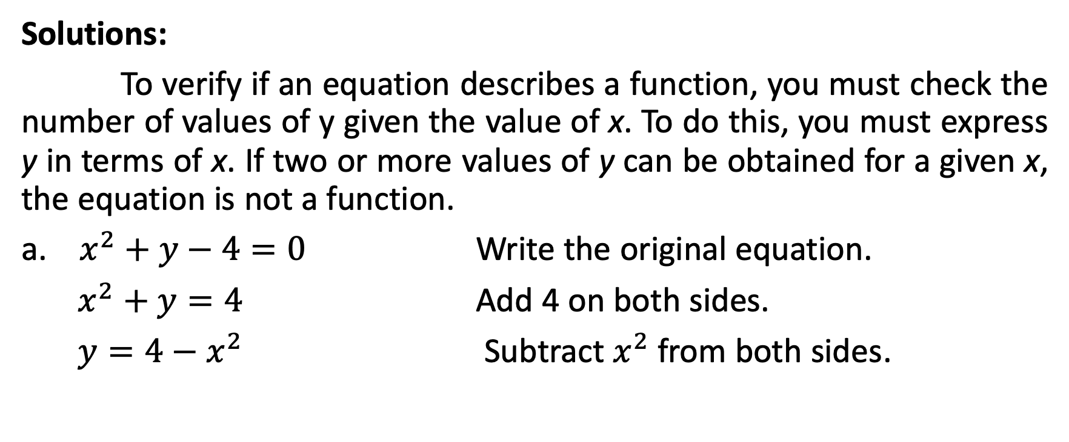
Relations and Functions
Solutions:
To verify if an equation describes a function, you must check the number of values of y given the value of x. To do this, you must express y in terms of x. If two or more values of y can be obtained for a given x, the equation is not a function.
a. $x^{2}+y−4=0$ Write the original equation.
$x^{2}+y=4$ Add 4 on both sides.
$y=4−$ $x^{2}$ Subtract $x^{2}$ from both sides.

Slide 26
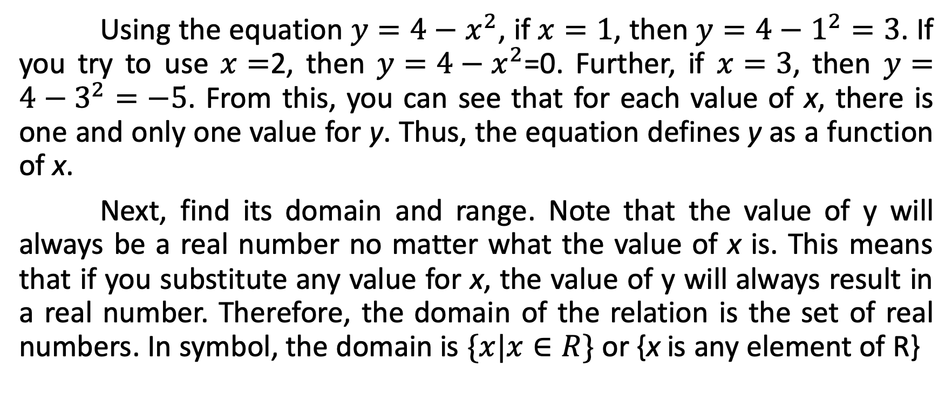
Relations and Functions
Using the equation $y=4−$ $x^{2}$, if $x=1$, then $y=4−$ $1^{2}=3$. If you try to use $x=$2, then $y=4−x^{2}$=0. Further, if $x=3$, then $y=4−3^{2}=−5$. From this, you can see that for each value of x, there is one and only one value for y. Thus, the equation defines y as a function of x.
Next, find its domain and range. Note that the value of y will always be a real number no matter what the value of x is. This means that if you substitute any value for x, the value of y will always result in a real number. Therefore, the domain of the relation is the set of real numbers. In symbol, the domain is $\{x|x∈R\}$ or {x is any element of R}

Slide 27
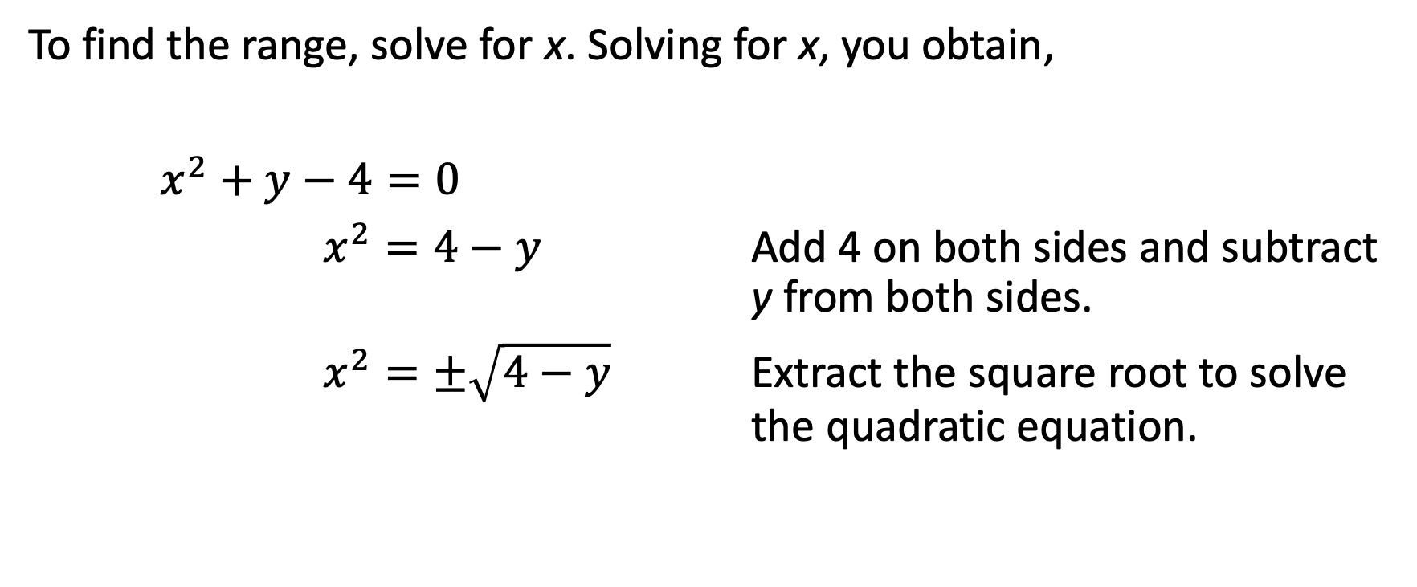
Relations and Functions
To find the range, solve for x. Solving for x, you obtain,
$x^{2}+y−4=0$
$x^{2}=4−y$ Add 4 on both sides and subtract y from both sides.
$x^{2}=±\sqrt{4−y}$ Extract the square root to solve the quadratic equation.

Slide 28
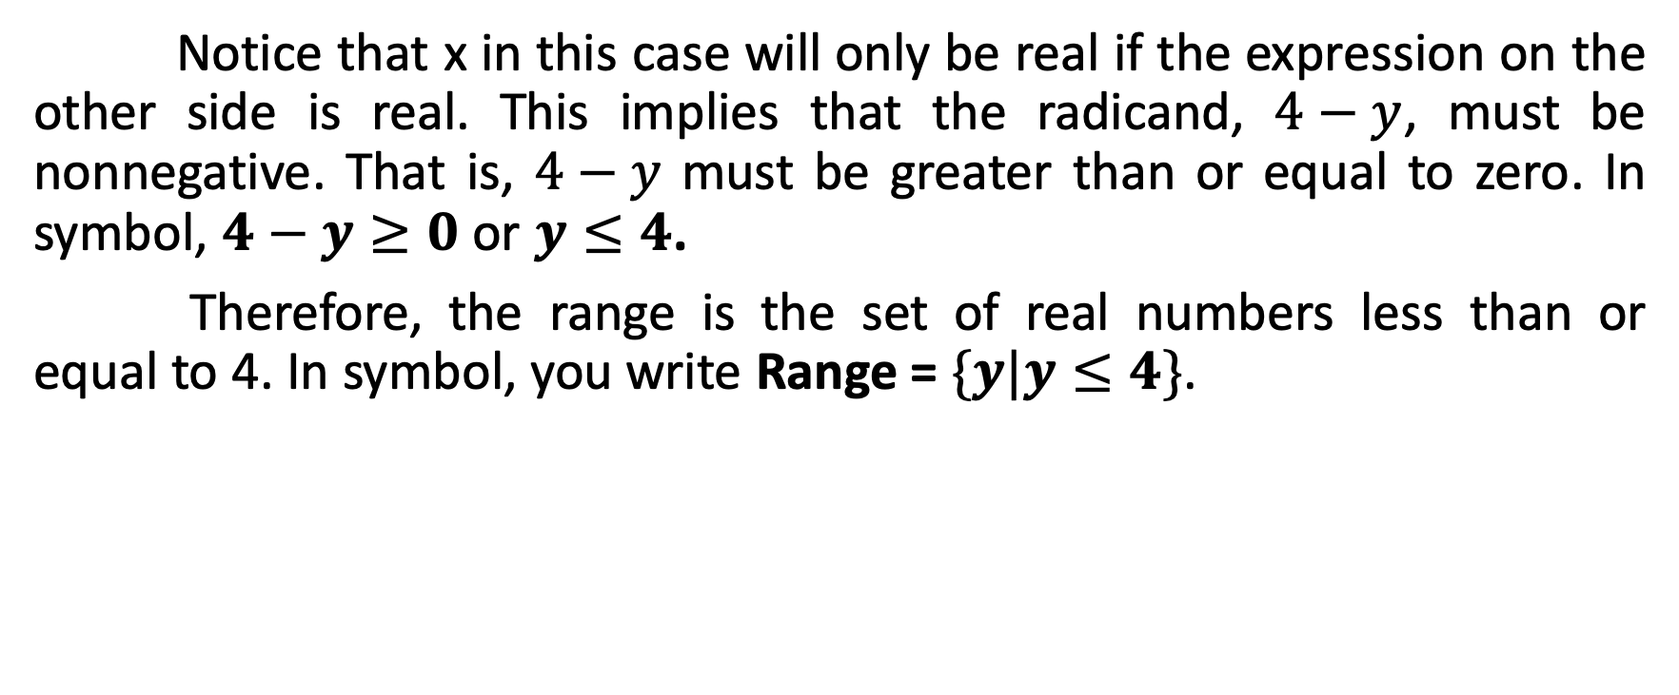
Relations and Functions
Notice that x in this case will only be real if the expression on the other side is real. This implies that the radicand, $4−y$, must be nonnegative. That is, $4−y$ must be greater than or equal to zero. In symbol, $4−y≥0$ or $y≤4$.
Therefore, the range is the set of real numbers less than or equal to 4. In symbol, you write Range = $\{y|y≤4\}$.

Slide 29
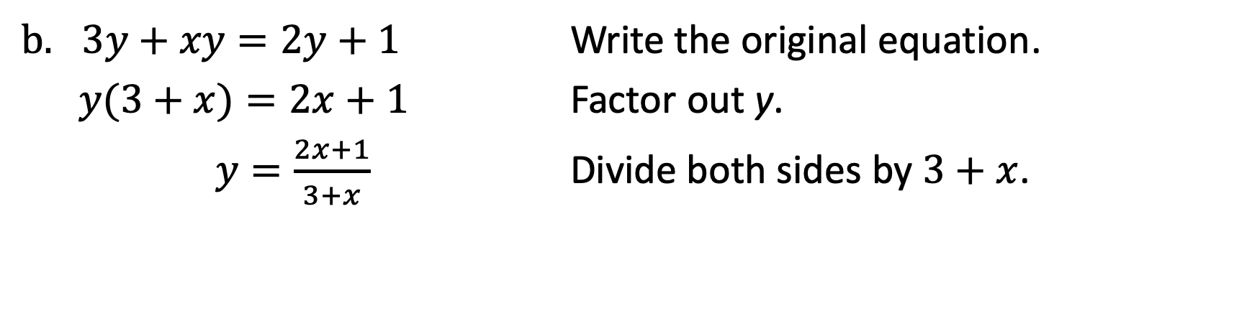
Relations and Functions
$3y+xy=2y+1$ Write the original equation.
$y(3+x)=2x+1$ Factor out y.
$y=\frac{2x+1}{3+x}$ Divide both sides by $3+x$.

Slide 30
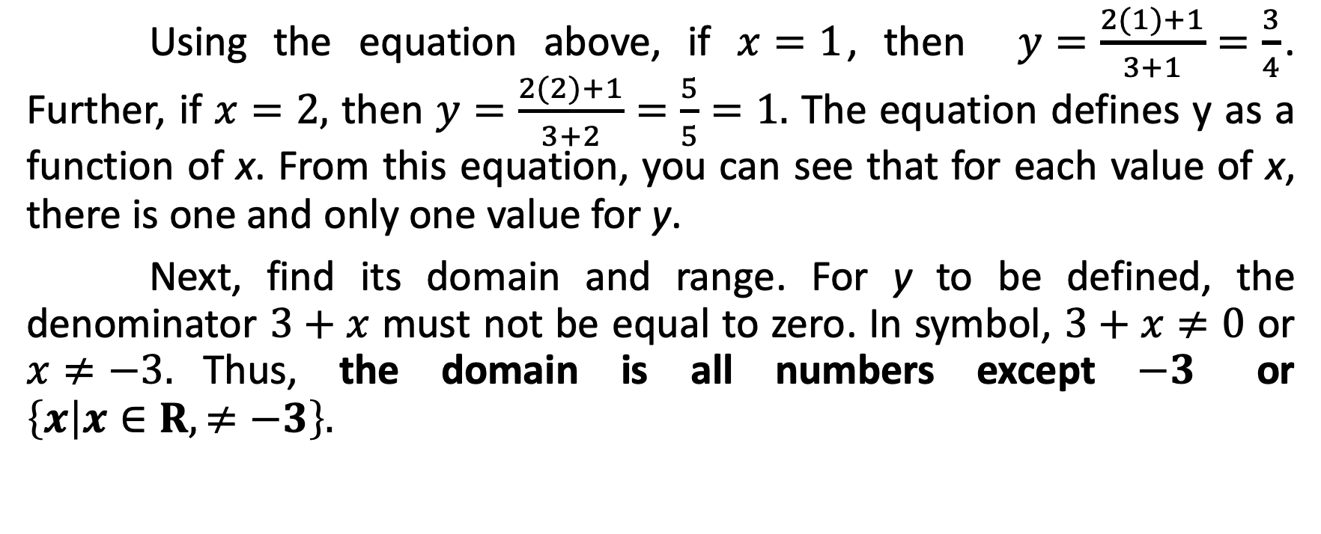
Relations and Functions
Using the equation above, if $x=1$, then $y=\frac{2(1)+1}{3+1}=\frac{3}{4}$. Further, if $x=2,$ then $y=\frac{2(2)+1}{3+2}=\frac{5}{5}=1.$ The equation defines y as a function of x. From this equation, you can see that for each value of x, there is one and only one value for y.
Next, find its domain and range. For y to be defined, the denominator $3+x$ must not be equal to zero. In symbol, $3+x≠0$ or $x≠−3.$Thus, the domain is all numbers except $−3$ or $\left\{x | x∈R,≠−3\right\}.$

Slide 31
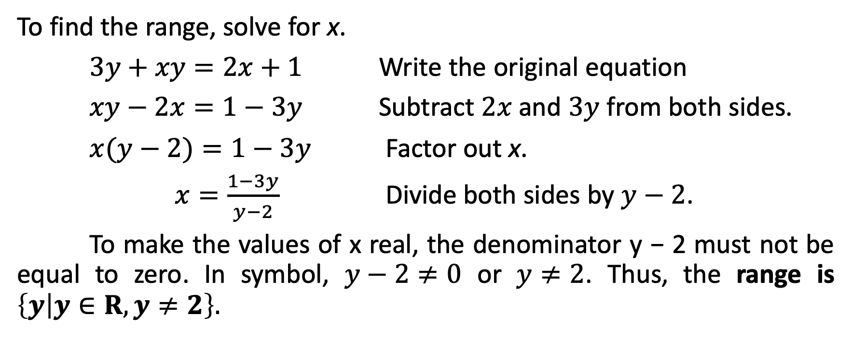
Relations and Functions
To find the range, solve for x.
$3y+xy=2x+1$ Write the original equation
$xy−2x=1−3y$ Subtract $2x$and $3y$ from both sides.
$x(y−2)=1−3y$ Factor out x.
$x=\frac{1−3y}{y−2}$ Divide both sides by $y−2$.
To make the values of x real, the denominator y − 2 must not be equal to zero. In symbol, $y−2≠0$ or $y≠2$. Thus, the range is $\left\{y | y∈R, y≠2\right\}.$
s

Slide 32
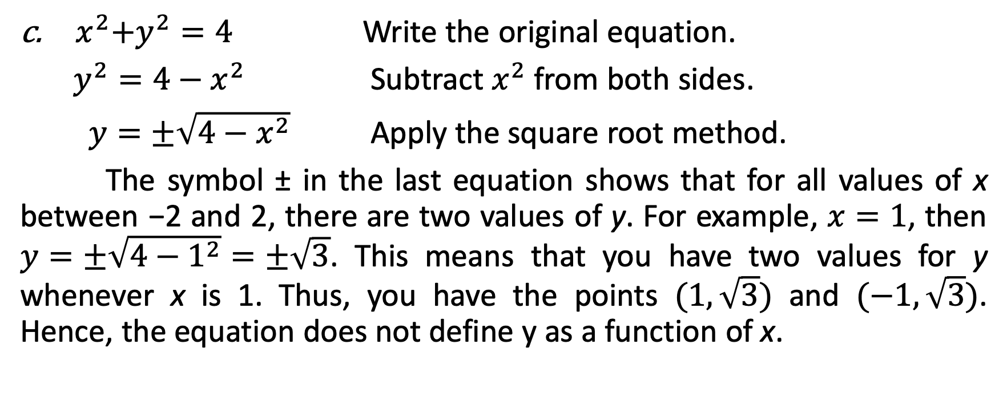
Relations and Functions
${ x}^{2}+y^{2}=4$ Write the original equation.
$y^{2}=4−x^{2}$ Subtract $x^{2}$ from both sides.
$y=±\sqrt{4−x^{2}}$ Apply the square root method.
The symbol ± in the last equation shows that for all values of x between −2 and 2, there are two values of y. For example, $x=1$, then $y=±\sqrt{4−1^{2}}=±\sqrt{3}$. This means that you have two values for y whenever x is 1. Thus, you have the points $(1,\sqrt{3})$ and $(−1,\sqrt{3})$. Hence, the equation does not define y as a function of x.

Slide 33
Relations and Functions
Restrictions to consider when finding the domain and range of some functions that involve the following:
Radicals with even indices: Radicands must be nonnegative (i.e., radicand is greater than or equal to zero).
Fractions: Denominator must not be equal to zero.
Not every graph in the xy-plane represents a function. The vertical line test is the simplest way of determining whether or not a graph represents a function.
Vertical Line Test - A graph represents a function if and only if no vertical line intersects the graph at more than one point.

Slide 34
Relations and Functions
Use the vertical line test to identify graphs in which y is a function of x.
Solutions:
Use the vertical line test to determine which graph represents y as a function of x. A graph represents a function if no vertical line intersects the graph at more than one point.
Graph A | Graph B | Graph C | Graph D

Slide 35
Relations and Functions
Graph A | Graph B | Graph C | Graph D
y is a function of x. | y is not a function of x. Two values of y correspond to an x-value. | y is not a function of x. Two values of y correspond to an x-value. | y is a function of x.

Slide 36
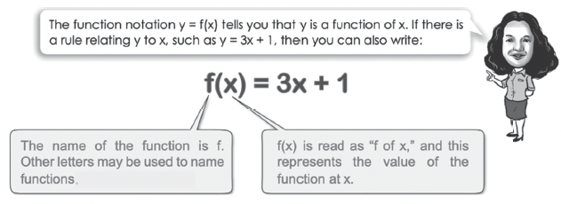
Relations and Functions

Slide 37
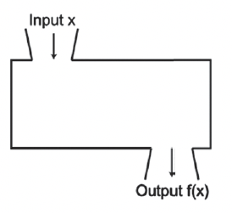
Relations and Functions
The domain of a function f is the set of values of x for which f is defined. The range of a function f is the set of all values of f(x), where x is an element of the domain of f. Think of the domain as the set of the function’s input values and the range as the set of the function’s output values as shown in the figure below. The input is represented by x and the output is represented by f(x). The special notation, f(x), represents the value of the function at the number x.

Slide 38
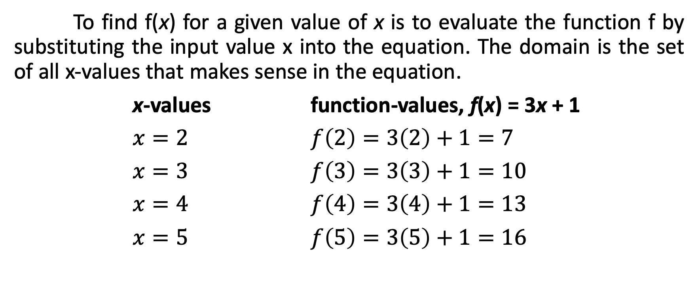
Relations and Functions
To find f(x) for a given value of x is to evaluate the function f by substituting the input value x into the equation. The domain is the set of all x-values that makes sense in the equation.
x-values function-values, f(x) = 3x + 1
$x=2$ $f\left(2\right)=3\left(2\right)+1=7$
$x=3$ $f\left(3\right)=3\left(3\right)+1=10$
$x=4$ $f\left(4\right)=3\left(4\right)+1=13$
$x=5$ $f\left(5\right)=3\left(5\right)+1=16$

Slide 39
Relations and Functions
Remember that:
f(x) means “the value of the function at x.” It does not mean “f times x.”
Letters other than f such as g and h can also be used.
The function notation f(x) = 3x + 1 has a certain advantage over the notation y = 3x + 1 as far as evaluation is concerned. That is, if we use y = 3x + 1, then we would have to write, when x = 2, then y = 3(2) + 1 = 7. However, if we use f(x) = 3x + 1, we would only write,

Slide 40
Relations and Functions
The formula f(a) = 172 – 0.8a where f(a) is the number of beats per minute and a is the age, can be used to find the maximum heartbeat s per minute based on a person’s age.
Use the function to find the maximum number of beats per minute for ages 10, 20, 30, 40, and 50.
Using the data in (a), graph the ordered pairs (age, number of beats per minute). Is this a function? Why or why not?

Slide 41
Relations and Functions
Plot the ordered pairs (10, 164), (20, 156), (30, 148), (40, 140), and (50, 132).
The relation (age, number of beats per minute) is a function because the graph is a line.

Slide 42
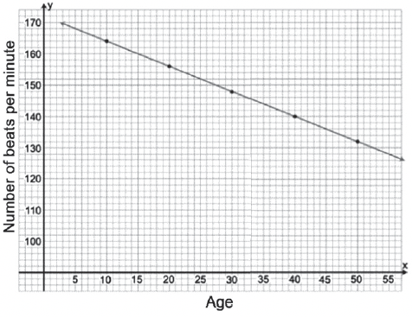
Relations and Functions
Solutions:
Substitute 10, 20, 30, 40, and 50 in the function f(a) = 172 – 0.8a to find f(a).
For 10: f(a) = 172 – 0.8(10) = 172 – 8 = 164
For 20: f(a) = 172 – 0.8(20) = 172 – 16 = 156
For 30: f(a) = 172 – 0.8(30) = 172 – 24 = 148
For 40: f(a) = 172 – 0.8(40) = 172 – 32 = 140
For 50: f(a) = 172 – 0.8(50) = 172 – 40 = 132

