Slide 1
Linear Functions

Slide 2
Relations and Functions
A linear function is a function whose equation can be written in the form f(x) = mx + b, where a and b are real numbers.
The activity in the previous lesson suggests the following about a linear equation in two variables.
The graph is a straight line.
a. Every solution of the equation is represented by a point on the graph.
b. Every point on the graph represents a solution of the equation.

Slide 3
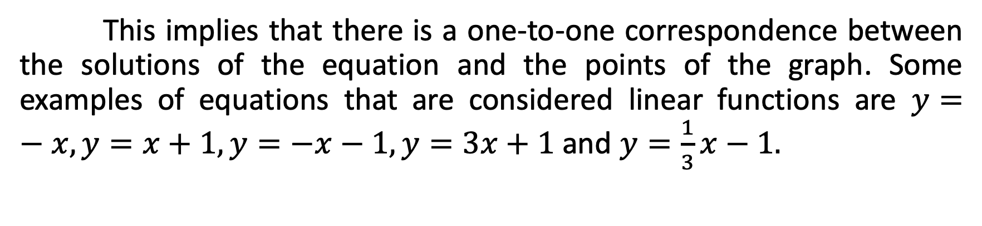
Relations and Functions
This implies that there is a one-to-one correspondence between the solutions of the equation and the points of the graph. Some examples of equations that are considered linear functions are $y=−x, y=x+1, y=−x−1, y=3x+1$ and $y=\frac{1}{3}x−1.$

Slide 4

Relations and Functions
State whether or not each function is a linear function.
$f\left(x\right)=4x+5$
$g\left(x\right)=x^{2}−1$
$h\left(x\right)=9−5x$

Slide 5
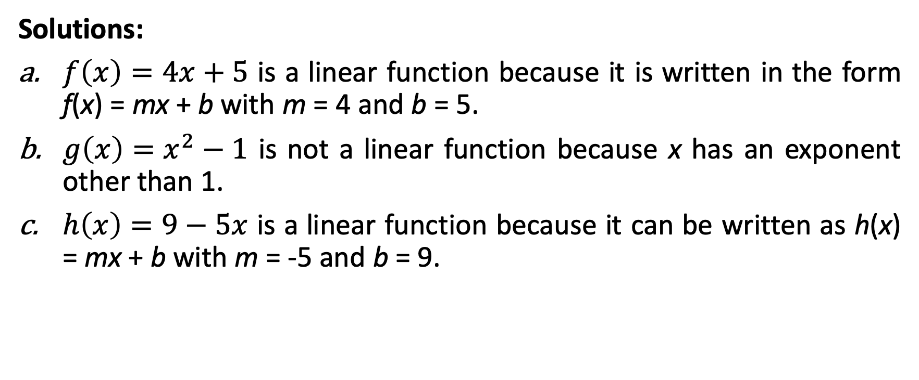
Relations and Functions
Solutions:
$f\left(x\right)=4x+5$ is a linear function because it is written in the form f(x) = mx + b with m = 4 and b = 5.
$g\left(x\right)=x^{2}−1$ is not a linear function because x has an exponent other than 1.
$h\left(x\right)=9−5x$ is a linear function because it can be written as h(x) = mx + b with m = -5 and b = 9.

Slide 6
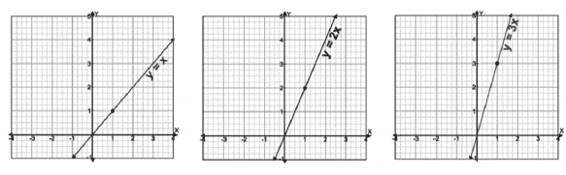
Relations and Functions
Observe the graphs on the below.

Slide 7
Relations and Functions
The graph of the linear function f(x) = mx + b is exactly the same as the graph of the linear equation y = mx + b. If m = 0, then we get f(x) = b, which is called a constant function. If m = 1 and = 0, then we get the function f(x) = x, which is called the identity function. When you graph a function given in function notation, you usually label the vertical axis as f(x) rather than y.

Slide 8
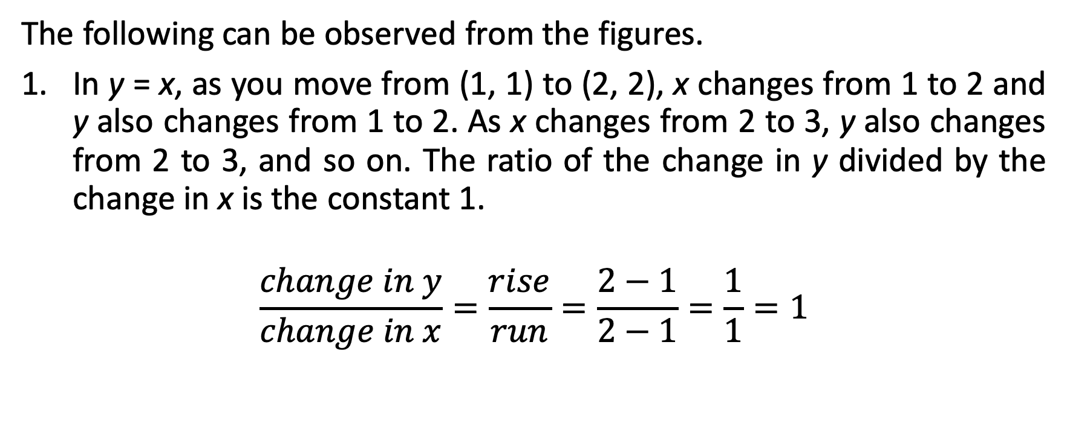
Relations and Functions
The following can be observed from the figures.
In y = x, as you move from (1, 1) to (2, 2), x changes from 1 to 2 and y also changes from 1 to 2. As x changes from 2 to 3, y also changes from 2 to 3, and so on. The ratio of the change in y divided by the change in x is the constant 1.
$$\frac{change in y}{change in x}=\frac{rise}{run}=\frac{2−1}{2−1}=\frac{1}{1}=1$$

Slide 9
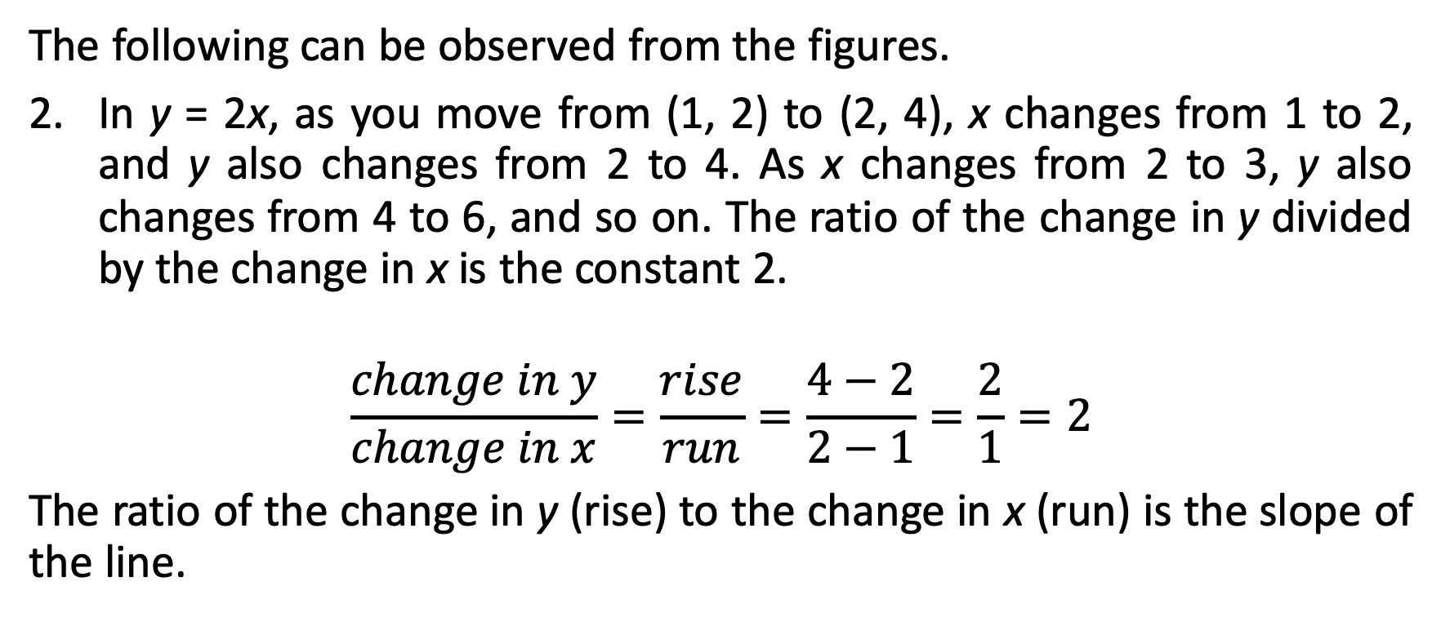
Relations and Functions
The following can be observed from the figures.
In y = 2x, as you move from (1, 2) to (2, 4), x changes from 1 to 2, and y also changes from 2 to 4. As x changes from 2 to 3, y also changes from 4 to 6, and so on. The ratio of the change in y divided by the change in x is the constant 2.
$$\frac{change in y}{change in x}=\frac{rise}{run}=\frac{4−2}{2−1}=\frac{2}{1}=2$$
The ratio of the change in y (rise) to the change in x (run) is the slope of the line.

Slide 10
Relations and Functions
Recall
The slope m of a line is the ratio of the change in the y-coordinates to the corresponding change in the x-coordinates.
Determine the slope of each line.
Graph A | Graph B | Graph C | Graph D

Slide 11
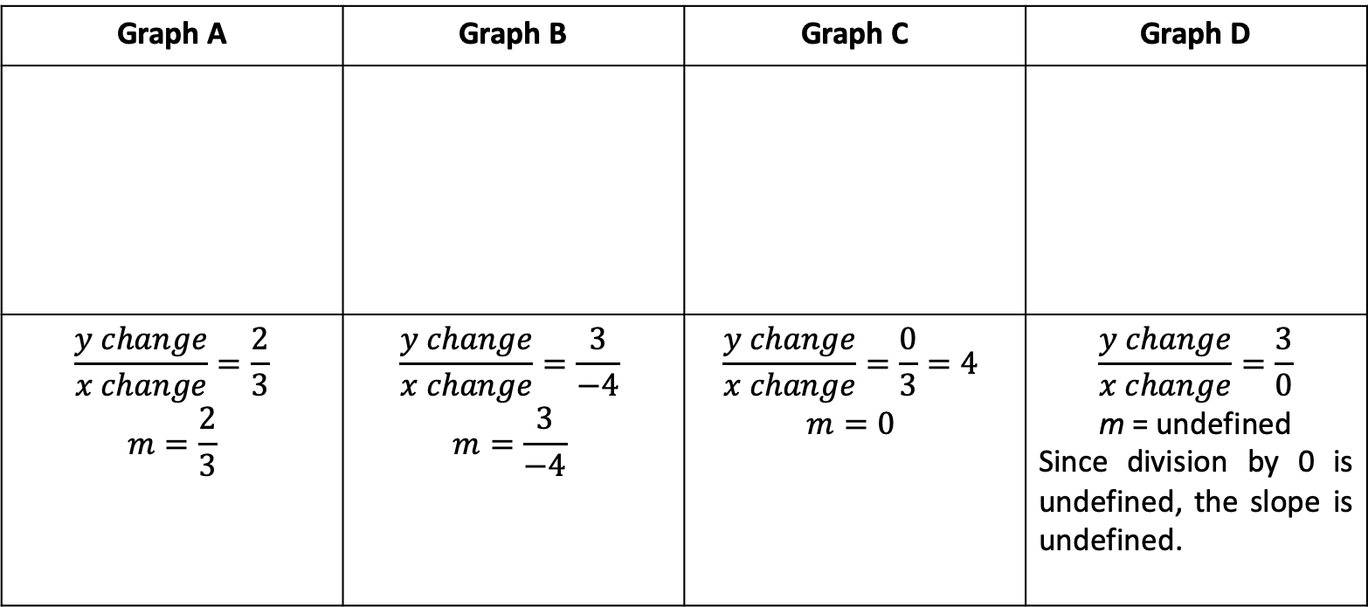
Relations and Functions
Solutions:
Graph A | Graph B | Graph C | Graph D
$$\frac{y change}{x change}=\frac{2}{3}$$ $$m=\frac{2}{3}$$ | $$\frac{y change}{x change}=\frac{3}{−4}$$ $$m=\frac{3}{−4}$$ | $$\frac{y change}{x change}=\frac{0}{3}=4$$ $$m=0$$ | $$\frac{y change}{x change}=\frac{3}{0}$$ m = undefined Since division by 0 is undefined, the slope is undefined.

Slide 12
Relations and Functions
Take note of the following:
Graph A has a positive slope which means that the line moves upward from left to right.
Graph B has a negative slope which means that the line moves downward from left to right.
The graph in c is a horizontal line and has a slope of 0.
The graph in d is a vertical line and its slope is undefined.
  The observations above are true for all lines that have the same characteristic.
This means that if a line moves upward from left to right, then it has a positive slope. Further, if a line moves downward from left to right, then it has a negative slope. The table below summarizes the four possibilities for the slope of a line.

Slide 13
Relations and Functions
Positive Slope | Negative Slope | Zero Slope | Undefined Slope
Line rises from left to right. | Line rises from right to left. | Line is horizontal. | Line is vertical.

Slide 14
Relations and Functions
Before you proceed to graph, you have to identify two points that are usually convenient to use in graphing linear equations are the points at which the line intersects the x-axis and the y-axis.
Intercepts of a Line
The x-intercept is the x-coordinate of a point where the graph intersects the x-axis. To find the x-intercept, let y = 0 and solve for the value of x.
The y-intercept is the y-coordinate of a point where the graph intersects the y-axis. To find the y-intercept, let x = 0 and solve for the value of y.
Note: The y-coordinate of any x-intercept will always be 0. The x-coordinate of any y-intercept will always be 0.

Slide 15
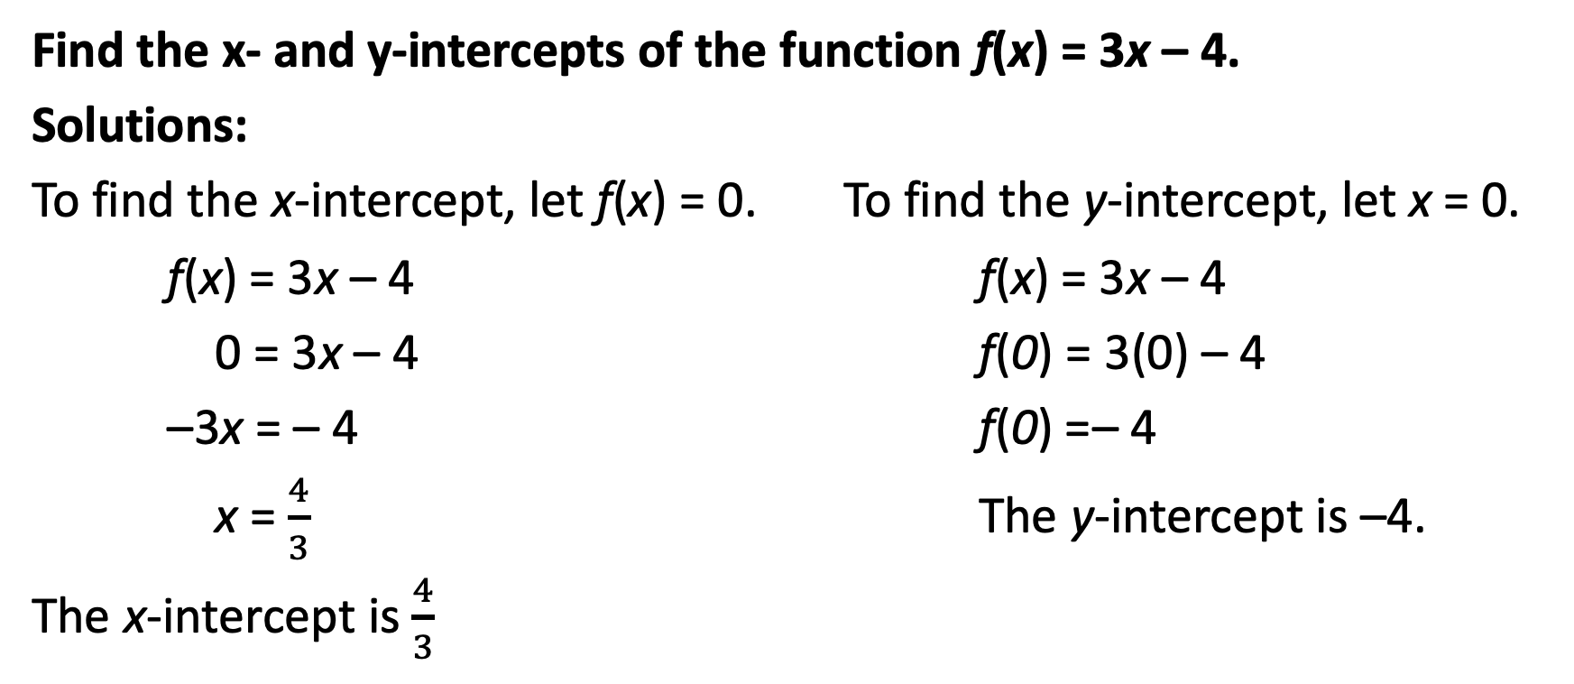
Relations and Functions
Find the x- and y-intercepts of the function f(x) = 3x – 4.
Solutions:
To find the x-intercept, let f(x) = 0. To find the y-intercept, let x = 0.
f(x) = 3x – 4 f(x) = 3x – 4
0 = 3x – 4 f(0) = 3(0) – 4
–3x = – 4 f(0) =– 4
x = $\frac{4}{3}$ The y-intercept is –4.
The x-intercept is $\frac{4}{3}$

Slide 16
Relations and Functions
Recall
In some cases that the function is written in the form of f(x) = mx + b, where m and b are real numbers, m represents the slope, and b represents the y-intercept of the line. This form is called the slope-intercept form.

Slide 17
Relations and Functions
Find the slope and the x- and y-intercepts of the function f(x) = 2x + 4.
Solutions:
Since the function is written in slope-intercept form, the slope is given by the numerical coefficient of x which is 2 and the y-intercept is 4. Hence, m = 2 and b = 4.
To find the x-intercept, let f(x) = 0, then solve for the value of x. Thus, we have the following solutions:
f(x) = 2x + 4
0 = 2x + 4
–2x = 4
x = –2
The x-intercept is –2

Slide 18
Relations and Functions
Graph the function f(x) = 2x + 4 using its intercepts and one more point.
Solutions:
Based on the solutions in Example 4, the intercepts of the linear function are (-2, 0) and (0, 4). To identify one more point, we can choose any number for x.

Slide 19
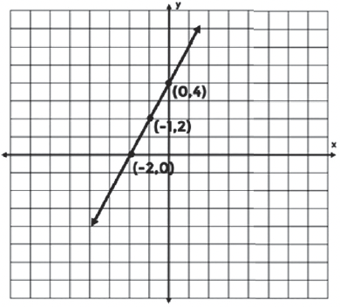
Relations and Functions
Third Point: If x = –1, then So we have the following point
f(– 1) = 2(– 1) + 4
f(– 1) = – 2 + 4
f(– 1) = 2
Thus, we have the point (–1, 2).
 | x | y
x-intercept | – 2 | 0
y-intercept | 0 | 4
Third point | –1 | 2

Slide 20
Relations and Functions
Procedure
Graphing Linear Functions Using the Point-Plotting Method
Choose at least two input values of x-values.
Substitute these x-values in the function to solve for the corresponding y-values.
Plot the points in the coordinate plane.
Connect the points to form a straight line.

Slide 21
Relations and Functions
Graph The function f(x) = –3x + 12 on the coordinate plane.
Solutions:
Choose at least two x-values and substitute it in the function.
x | –3x + 12 | f(x) | Ordered Pair
0 | -3(0) 12 | 12 | (0, 12)
1 | -3(1) + 12 | 9 | (1, 4)
4 | -3(4) + 12 | 0 | (4, 0)

Slide 22
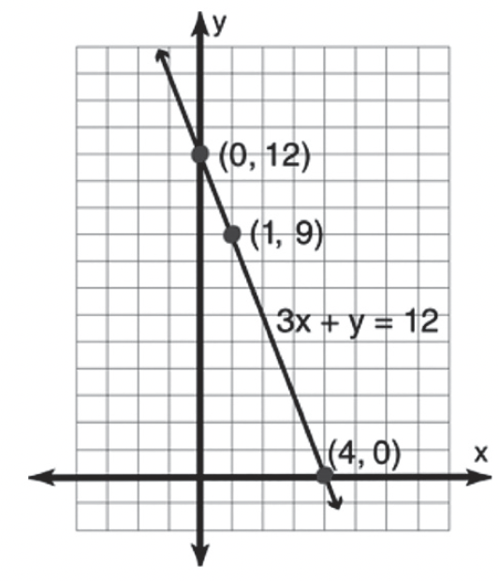
Relations and Functions
Plot each point in the coordinate plane, then connect the points to form a straight line.

