Slide 1
Problems Involving Linear Functions

Slide 2
Problems Involving Linear Functions
Now that you know the concepts related to relations and functions such as dependent and independent variables, and domain and range as well as linear functions, you will now apply these concepts in solving the following word problems.

Slide 3
Problems Involving Linear Functions
Suppose a banana dealer has a total cost function C(x) = 10x + 2,500, where x is the number of kilograms of bananas and a profit function of P(x) = 18x - 2,500.
Find the cost of 300 kilograms of bananas.
How much is the profit on selling 500 kilograms of bananas?

Slide 4
Problems Involving Linear Functions
Solutions:
a. To solve for the cost, use the cost function C(x) = 10x + 2,500.
Evaluate the function.
C(300) = 10(300) + 2,500
C(300) = 5,500
Thus, the cost is ₱5,500
b. To solve for the profit, use the profit function P(x) = 18x - 2,500. Evaluate the function.
P(500) = 18(500) - 2,500
P(500) = 6,500
Thus, the profit is ₱6,500.

Slide 5
Problems Involving Linear Functions
For any sedan car, a car rental company charges a flat rate rental fee of ₱1,500 per day plus ₱40 per kilometer traveled.
If x represents the total kilometer traveled, write a function f(x) that represents the daily cost by the number of kilometers traveled.
Graph the linear function.
If a total of 100 kilometers was traveled in one day, how much is the total amount to be collected by the rental company?

Slide 6
Problems Involving Linear Functions
Solutions:
a. If x represents the total kilometer traveled, the function f(x) that will represent the given situation is f(x) = 40x + 1,500.
b. The points listed in the table of values below are plotted and connected on the coordinate plane.
x | 0 | 10 | 20
y | 1,500 | 1,900 | 2,300

Slide 7
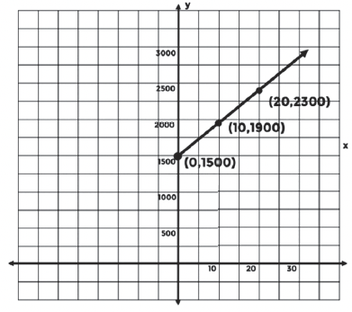
Problems Involving Linear Functions
c. If a total of 100 km was traveled in one day, the total amount to be collected by the rental company is ₱5,500.

