Slide 1


Theorems on Parallelograms

Slide 2
Theorems on Parallelograms
A parallelogram is a quadrilateral that has two sets of parallel sides and two sets of congruent angles. Moreover, it has the following properties: its opposite sides are congruent, its opposite angles are congruent, its consecutive angles are supplementary, its diagonals bisect each other, and its diagonals form two congruent triangles.
We also have parallelograms that aside from these properties possess other properties that make them special, such as having equal angles, having equal sides, and having both equal sides and angles, which are the description of rectangle, rhombus, and square, respectively.
Now, let us now deepen your understanding of rectangle, rhombus, and square. Let us begin with the discussion of rectangle.
Definition:
A rectangle is a parallelogram with four congruent angles.
Since rectangle is a parallelogram, it inherits all the properties of the parallelogram as well.
In addition, the theorem presented below is also a property of rectangle.
Rex Curriculum Resource
WWW.REX.COM.PH

Slide 3
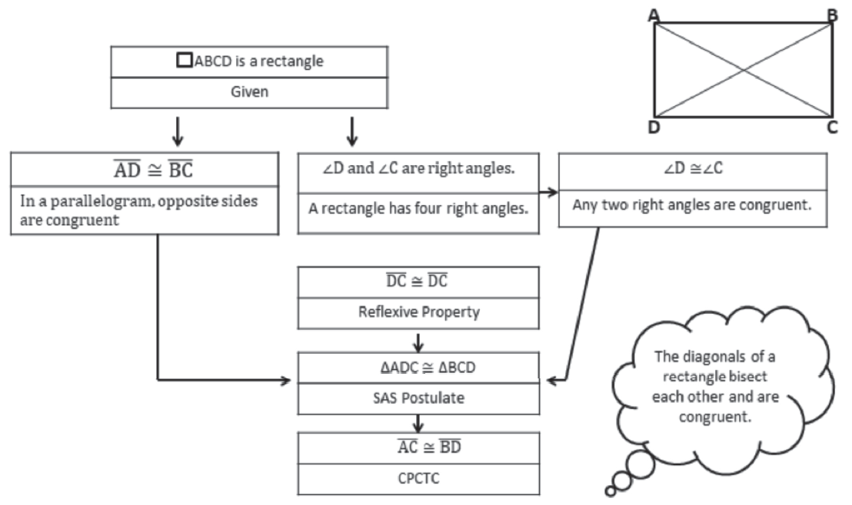
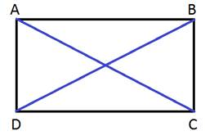
Theorems on Parallelograms
Theorem
Proof
The diagonals of a rectangle are congruent. |  | If □ ABCD is a rectangle, then AC ≅ BD.
Let us check the proof of this theorem.
Given: □ ABCD is a rectangle with diagonals AC and BD .
Prove: 􀀁AC ≅ BD
Rex Curriculum Resource
WWW.REX.COM.PH

Slide 4
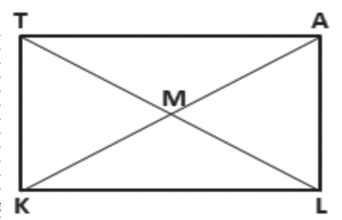
Theorems on Parallelograms
Example 1:
Quadrilateral TALK is a rectangle. Find the value of x if TL = 5x – 14 and KM = 2x + 3.
Solution:
Since the diagonals of a rectangle are congruent, TL = AK,
where
AK = 2 KM.
Hence, TL = 2 KM.
5x – 14 = 2 (2x + 3)
5x – 14 = 4x + 6
x = 20
Rex Curriculum Resource
WWW.REX.COM.PH

Slide 5
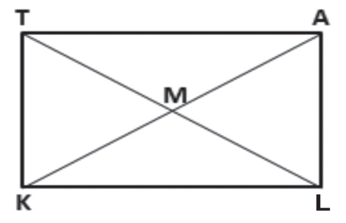
Activity:
Try It 1
Quadrilateral TALK is a rectangle.
Find the value of x when:
TL = 7x – 16 and KM = 3x + 4.
Rex Curriculum Resource
WWW.REX.COM.PH

Slide 6
Activity:
Try It 1
Quadrilateral TALK is a rectangle.
Find the value of x when:
TL = 7x – 16 and KM = 3x + 4.
ANSWER
Since the diagonals of a rectangle are congruent, TL = AK, where AK = 2 KM.
Hence, TL = 2 KM.
7x – 16 = 2 (3x + 4)
7x – 16 = 6x + 8
x = 24
Rex Curriculum Resource
WWW.REX.COM.PH

Slide 7
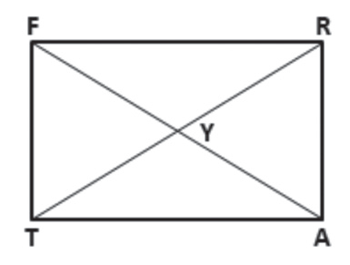
Theorems on Parallelograms
Activity:
Example 2:
Use rectangle FRAT and the given information to answer each of the following.
a. m∠FRT = 65. Find m∠TRA, m∠ATR, and m∠RTF
b. m∠FYT = 110. Find m∠YTF, m∠YFT, and m∠YFR
Solution:
a. Since □ FRAT is a rectangle, m∠FRA = 90°.
m∠FRT + m∠TRA = m∠FRA AAP
65° + m∠TRA = 90° Replace m∠FRT with 65° and m∠FRA with 90°.
m∠TRA = 25° Subtract 65° from both sides.
∠FRT and ∠ATR are congruent because □ FRAT is also a parallelogram; thus, m∠ATR = m∠FRT = 65°. Similarly, m∠TRA = m∠RTF = 25°.
b. Since diagonals of a rectangle are congruent and bisect each other, FY ≅ TY; thus, YFT YTF by the isosceles triangle theorem.
Let x represents the measure of ∠YTF. Then,
m∠YFT + m∠YTF + m∠FYT = 180
x + x + 110 = 180
2x = 70
x = 35
Thus, m∠YTF = m∠YFT = 35°
m∠YFR = 90 – 35 or 55°
Rex Curriculum Resource
WWW.REX.COM.PH

Slide 8
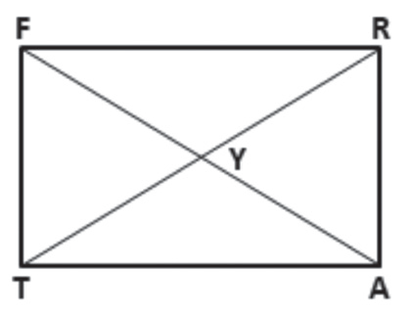
Activity:
Try It 2
Use rectangle FRAT and the given information to answer each of the following.
a. m∠FRT = 70°. Find m∠TRA, m∠ATR, and m∠RTF.
b. m∠FYT = 105°. Find m∠YTF, m∠YFT, and m∠YFR.
Rex Curriculum Resource
WWW.REX.COM.PH

Slide 9
Activity:
Try It 2
Use rectangle FRAT and the given information to answer each of the following.
a. m∠FRT = 70°. Find m∠TRA, m∠ATR, and m∠RTF.
b. m∠FYT = 105°. Find m∠YTF, m∠YFT, and m∠YFR.
ANSWER
Since the diagonals of a rectangle are congruent, TL = AK, where AK = 2 KM.
Hence, TL = 2 KM.
7x – 16 = 2 (3x + 4)
7x – 16 = 6x + 8
x = 24
Rex Curriculum Resource
WWW.REX.COM.PH

Slide 10
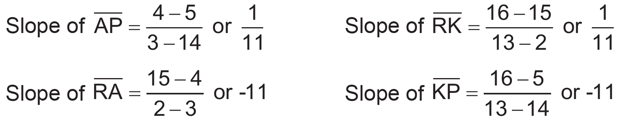
Theorems on Parallelograms
Activity:
Example 3:
Determine whether parallelogram PARK is a rectangle, given that
P (14, 5), A (3, 4), R (2, 15), K (13, 16) are the vertices of the parallelogram.
Solution:
Thus, AP ‖ RK and RA ‖ KP(slopes are the same). In addition AP ⊥ RA , RA ⊥ RK , RK ⊥ KP, and KP ⊥ AP(slopes are negative reciprocals), creating four right angles; thus, □ PARK is a rectangle.
Rex Curriculum Resource
WWW.REX.COM.PH

Slide 11
Activity:
Try It 3
Determine whether parallelogram PARK is a rectangle, given that P (12, 3),
A (1, 2), R (0, 13), K (11, 14).
Rex Curriculum Resource
WWW.REX.COM.PH

Slide 12
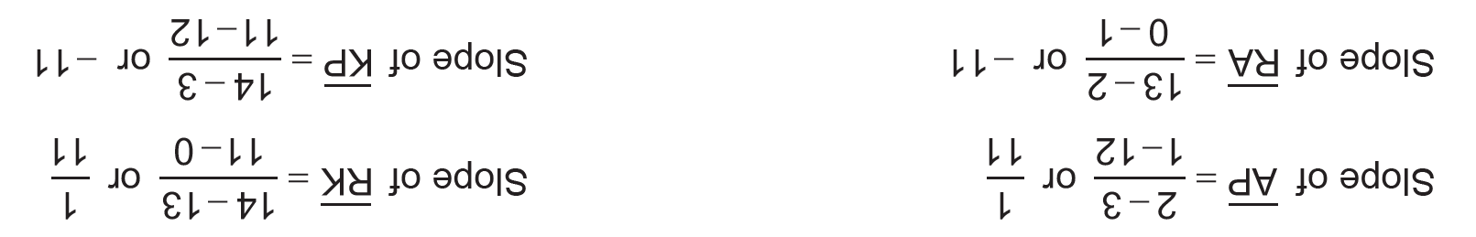
Activity:
Try It 3
Determine whether parallelogram PARK is a rectangle, given that P (12, 3),
A (1, 2), R (0, 13), K (11, 14).
ANSWER
Thus, AP  RK and RA  KP (slopes are the same). In addition AP ⊥ RA, RA ⊥ RK, RK ⊥ KP, and KP ⊥ AP
(slopes are negative reciprocals), creating four right angles thus, □PARK is a rectangle.
Rex Curriculum Resource
WWW.REX.COM.PH

Slide 13
Theorems on Parallelograms
Activity:
Summary of the Properties of Rectangle:
• All four angles are congruent and are all right angles.
• Opposite sides are parallel and congruent.
• Diagonals bisect each other.
• Diagonals are congruent.
• Consecutive angles are supplementary.
Rex Curriculum Resource
WWW.REX.COM.PH

Slide 14
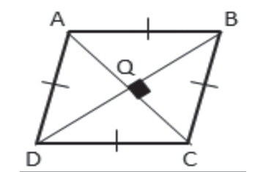
Theorems on Parallelograms
You have now a deeper understanding of the rectangle, its properties, and the theorems related to it. Let us now have the discussion of rhombus.
Definition:
A rhombus is a parallelogram with four congruent sides.
Since rhombus is a parallelogram, it inherits all the properties of the parallelogram
as well. In addition, the two theorems presented below are also properties of rhombus.
Theorem
The diagonals of a rhombus are perpendicular. |  | If □ ABCD is a rhombus, then AC ⊥ BD .
Rex Curriculum Resource
WWW.REX.COM.PH

Slide 15
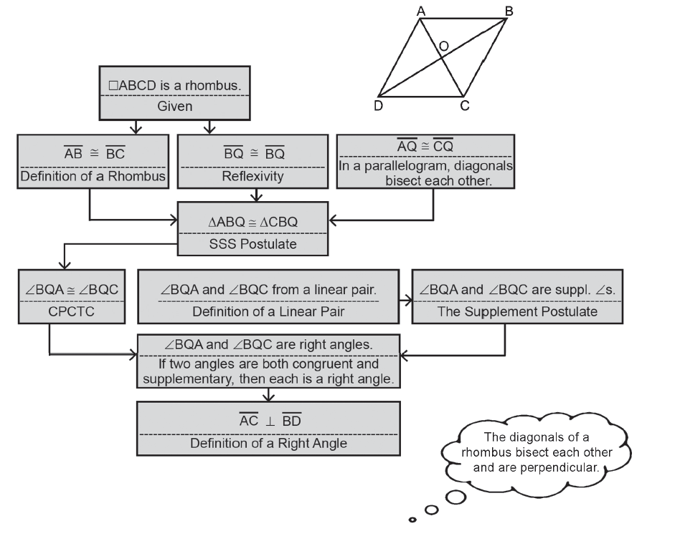
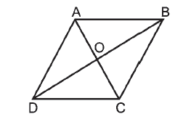
Theorems on Parallelograms
Theorem
The proof of the first part of the theorem is given below.
Given: □ ABCD is a rhombus.
Prove: AC ⊥ BD
Proof:
The diagonals of a rhombus are perpendicular. |  | If □ ABCD is a rhombus, then AC ⊥ BD .
Rex Curriculum Resource
WWW.REX.COM.PH

Slide 16
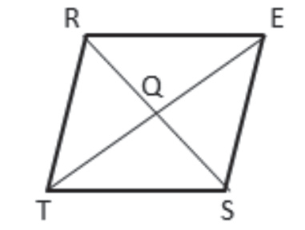
Theorems on Parallelograms
Example 4:
□REST is a rhombus. Find each missing value using the given information.
a. If TE = 40 cm, find TQ.
b. If m∠RQE = x² + 26, find x.
Solution:
a. Because a rhombus is a parallelogram, its diagonals bisect each other. Thus, if TE = 40, TQ = ½ (40 cm).
Thus, TQ = 20 cm.
b. The diagonals of a rhombus are perpendicular; thus, ∠RQE is a right angle.
If m∠RQE = 90°, then
x² +26 = 90°
x² = 64° Subtract 26° from each side.
x = 8° Take the square root of both sides.
Rex Curriculum Resource
WWW.REX.COM.PH

Slide 17
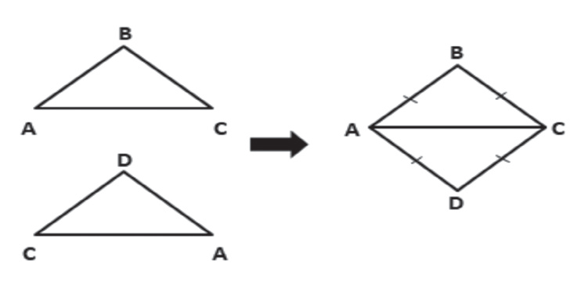
Activity:
Try It 4
□REST is a rhombus. Find each missing value using the given information.
a. If RQ = 15 cm, find RS.
b. If m∠RQT = x2 + 65, find x.
If two congruent isosceles triangles BAC and DAC are drawn in a way that
their bases coincide as shown on the right, a rhombus ABCD is formed.
In rhombus ABCD, ∠BAC, ∠DAC, ∠BCA, and ∠DCA are all congruent.
This suggests the next theorem.
Rex Curriculum Resource
WWW.REX.COM.PH

Slide 18
Activity:
Try It 4
□REST is a rhombus. Find each missing value using the given information.
a. If RQ = 15 cm, find RS.
b. If m∠RQT = x2 + 65, find x.
If two congruent isosceles triangles BAC and DAC are drawn in a way that
their bases coincide as shown on the right, a rhombus ABCD is formed.
In rhombus ABCD, ∠BAC, ∠DAC, ∠BCA, and ∠DCA are all congruent.
This suggests the next theorem.
ANSWER
a. Because a rhombus is a parallelogram, its diagonals bisect each other. Thus, RS = 2 RQ 40. By substitution, RS = 2 (15 cm). RS = 30 cm.
b. The diagonals of a rhombus are perpendicular; thus, ∠RQT is a right angle. If m∠RQT = 90°, then
x² + 65 = 90⁰
x² = 25⁰
x = 50⁰
Rex Curriculum Resource
WWW.REX.COM.PH

Slide 19
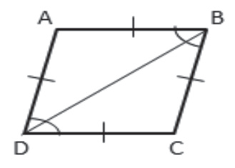
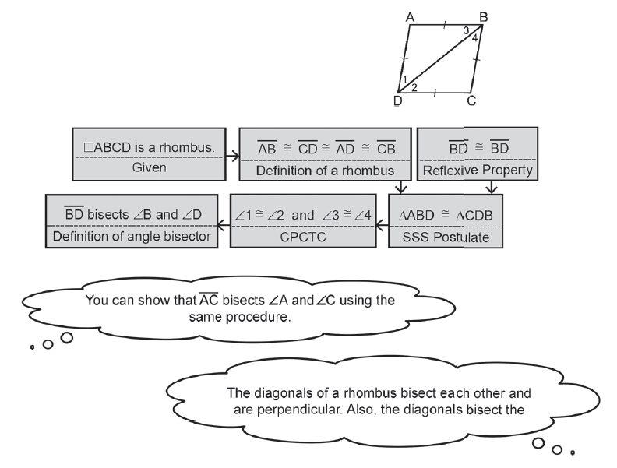
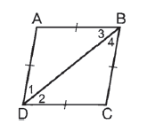
Theorems on Parallelograms
Theorem
Let us prove this theorem.
Given: □ ABCD is a rhombus.
Prove: BD bisects ∠B and ∠D.
Proof:
Each diagonal of a rhombus bisects two angles of the rhombus. |  | If □ ABCD is a rhombus, with diagonal BD, then BD bisects ∠B and ∠D.
Rex Curriculum Resource
WWW.REX.COM.PH

Slide 20
Theorems on Parallelograms
Summary of the Properties of Rhombus:
• All sides are congruent.
• Opposite sides are parallel and congruent.
• Opposite angles are congruent.
• Diagonals bisect each other.
• Diagonals are perpendicular.
• Diagonals bisect vertices.
• Consecutive angles are supplementary.
• Each of the diagonal divides the rhombus into two congruent triangles.
Rex Curriculum Resource
WWW.REX.COM.PH

Slide 21
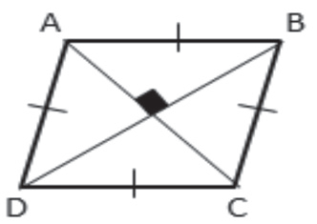
Theorems on Parallelograms
Let us now have the discussion of square.
Definition:
A square is a parallelogram with four congruent sides and four congruent angles.
Since square is a parallelogram, it inherits all the properties of the parallelogram.
In addition, the theorem presented below is also a property of square.
Theorem
The diagonals of a square are congruent and perpendicular. |  | If □ ABCD is a rectangle, then AC ≅ BD and AC ⊥ BD
Rex Curriculum Resource
WWW.REX.COM.PH

Slide 22
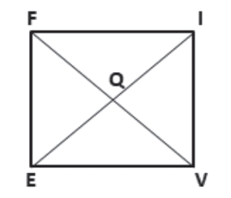
Theorems on Parallelograms
Example 5:
□ FIVE is a square. If QI = x + 5 and FV = x + 25, find EI.
Solution:
EI = FV and EI = 2QI Diagonals of a square are congruent.
EI = 2QI
x + 25 = 2 (x + 5) Law of Substitution
x + 25 = 2x +10 Distributive Property
25 = x + 10 Subtract x from each side.
15 = x Subtract 10 from each side.
EI = 2 (x + 5) = 2 (15 + 5) = 40
Rex Curriculum Resource
WWW.REX.COM.PH

Slide 23
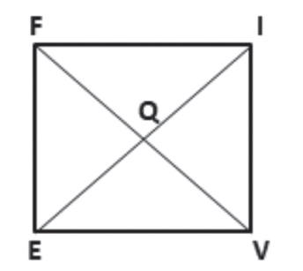
Activity:
Try It 5
□ FIVE is a square. Find each missing value using the given information.
a. If FQ = x + 3 and EI = x + 18, find FV.
b. If m∠VQE = 4x + 10, find the value of x.
Rex Curriculum Resource
WWW.REX.COM.PH

Slide 24
Activity:
Try It 5
□ FIVE is a square. Find each missing value using the given information.
a. If FQ = x + 3 and EI = x + 18, find FV.
b. If m∠VQE = 4x + 10, find the value of x.
ANSWER
Try It 5
a. El = FV and EI = 2FQ Diagonals of a square are congruent.
EI = 2FQ
x + 18 = 2 (x + 3) Law of Substitution
x + 18 = 2x + 6 Distributive Property
18 = x + 6 Subtract x from each side.
12 = x Subtract 6 from each side.
FV = 2 (x + 3) = 2 (12 + 3) = 30
b. Since diagonals of square are perpendicular to each other, ∠VQE is a right triangle. Thus,
m∠VQE = 4x + 10 = 90°
4x + 10 = 90
4x = 90 – 10
4x = 80
x = 20°
Rex Curriculum Resource
WWW.REX.COM.PH

Slide 25
Theorems on Parallelograms
Summary of the Properties of Square:
• All four sides are congruent.
• All four angles are congruent and are all right angles.
• Diagonals bisect each other.
• Diagonals are perpendicular.
• Diagonals bisect vertices.
• Diagonals are congruent.
• Consecutive angles are supplementary.
Rex Curriculum Resource
WWW.REX.COM.PH

Slide 26
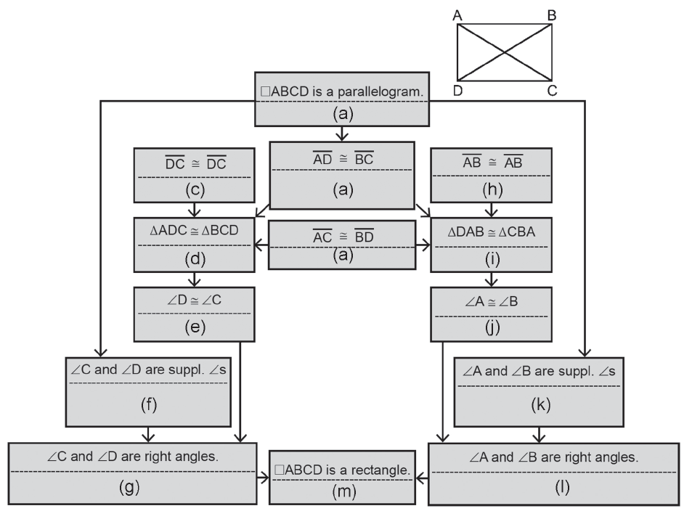
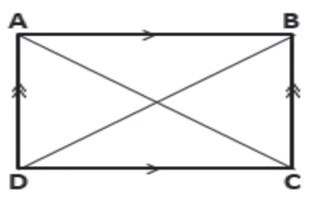
Theorems on Parallelograms
The following theorems are converses of the four previous theorems on rectangle, rhombus, and square. Also, the following theorems will help you conclude if a parallelogram is either a rectangle, a rhombus, or a square.
Proof:
Theorem
If the diagonals of a parallelogram are congruent, then the parallelogram is a rectangle. |  | If □ ABCD is a parallelogram and AC ≅ BD, then □ ABCD is a rectangle.
Given: □ ABCD is a parallelogram with AC ≅ BD.
Prove: □ ABCD is a rectangle.
Rex Curriculum Resource
WWW.REX.COM.PH

Slide 27
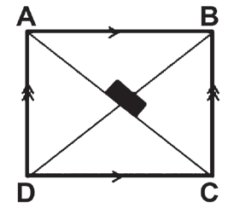
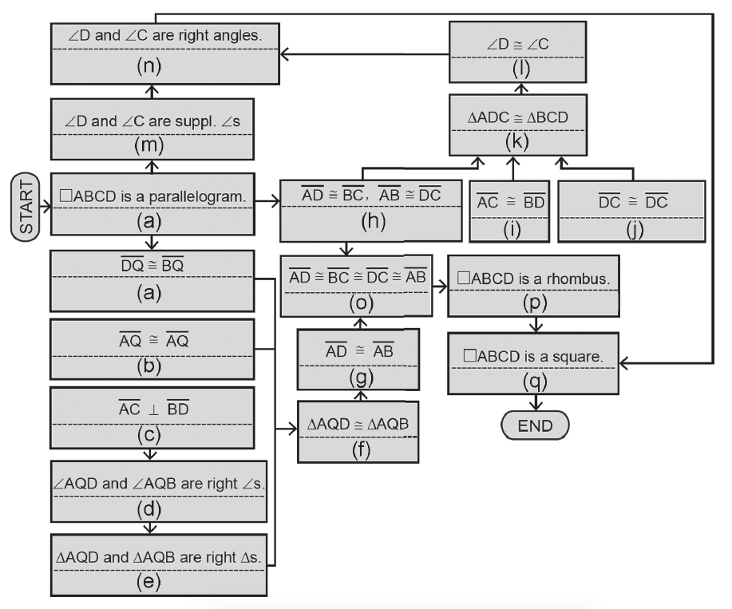
Theorems on Parallelograms
Theorem
Proof:
If the diagonals of a parallelogram are congruent and perpendicular, then the parallelogram is a square. |  | If □ ABCD is a parallelogram with AC ≅ BD, and AC ⊥ BD, then □ ABCD is a square.
Given: □ ABCD is a parallelogram with AC ≅ BD and AC ⊥ BD.
Prove: □ ABCD is a square..
Rex Curriculum Resource
WWW.REX.COM.PH

Slide 28
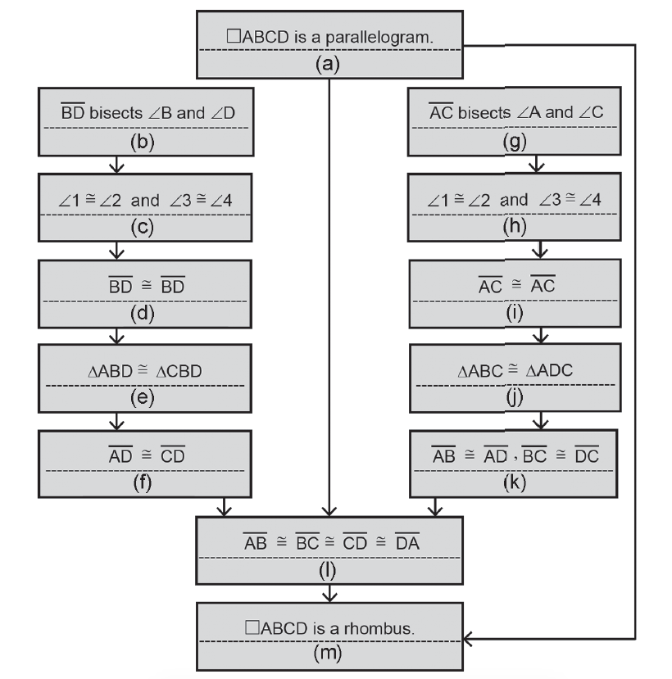
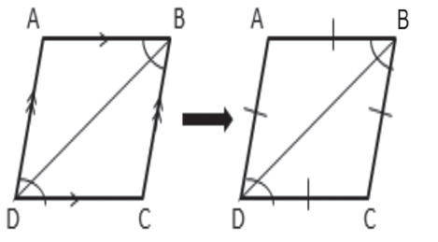
Theorems on Parallelograms
Theorem
Proof:
If one diagonal of a parallelogram bisects two angles of the parallelogram, then the parallelogram is a rhombus. |  | If □ ABCD is a parallelogram with BD, bisecting ∠B and ∠D, then □ ABCD is a rhombus.
Given: □ ABCD is a parallelogram, BD bisects ∠B and ∠D.
Prove: □ ABCD is a rhombus.
Rex Curriculum Resource
WWW.REX.COM.PH

Slide 29
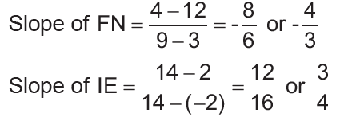
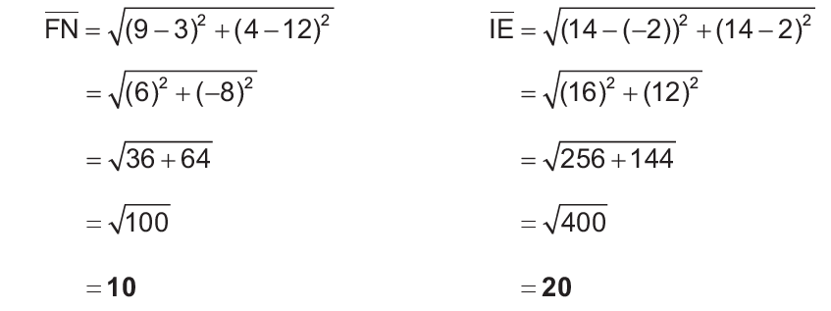
Theorems on Parallelograms
Example 6:
Determine whether parallelogram FINE is a rhombus, rectangle, or
square given F(3, 12), I(-2, 2), N(9, 4), E(14, 14).
Solution:
Use the diagonals to determine whether parallelogram FINE is a rhombus, rectangle, or square. If FN ⊥ IE, then □ FINE is a rhombus; if FN ≅ IE, then □ FINE is a rectangle; and if it is both a rhombus and a rectangle, □ FINE is a square.
The slope FN is the negative reciprocal of the slope of IE. Therefore, the diagonals are perpendicular, and parallelogram FINE is a rhombus. Also,
Because diagonals of □ FINE are not congruent, it is not a rectangle nor a square; thus, □ FINE a rhombus.
Rex Curriculum Resource
WWW.REX.COM.PH

Slide 30
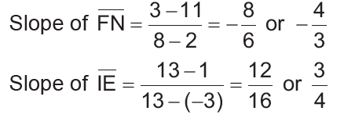
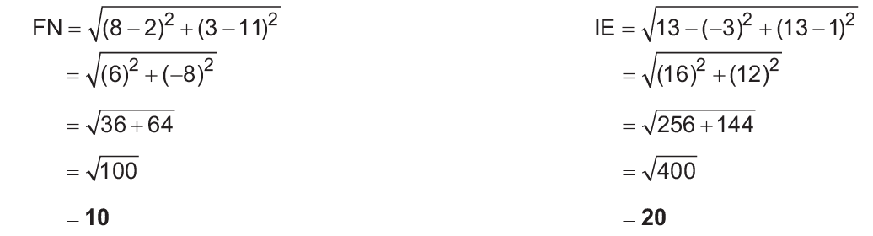
Activity:
Try It 6
Determine whether parallelogram FINE is a rhombus, rectangle, or square
given F(2, 11), I(-3, 1), N(8, 3), E(13, 13).
ANSWER
Try It 6
Use the diagonals to determine whether parallelogram FINE is a rhombus, rectangle, or square. If FN ⊥ IE , then □ FINE is a rhombus; if FN ≅ IE , then □ FINE is a rectangle; and if it is both a rhombus and a rectangle, □ FINE is a square.
The slope FN is the negative reciprocal of the slope of IE . Therefore, the diagonals are perpendicular, and parallelogram FINE is a rhombus. Also,
Because diagonals of □ FINE are not congruent, it is not a rectangle nor a square; thus, □ FINE a rhombus.
Rex Curriculum Resource
WWW.REX.COM.PH

Slide 31


