Slide 1


Quadrilaterals and Parallelograms

Slide 2
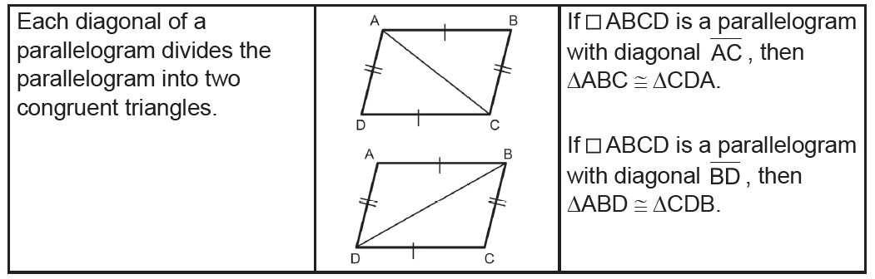
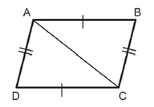
Quadrilaterals and Parallelograms
By definition, a quadrilateral is a parallelogram if it has two pairs of parallel sides. Also, quadrilateral is parallelogram if its diagonals bisect each other, if both pairs of opposite angles are congruent, and if one angle is supplementary to both of its consecutive angles.
The following are properties of a parallelogram
Theorem
Given: If ABCD is a parallelogram, AC is a diagonal.
Prove: ΔABC ≅ ΔCDA.
Proof:
Statements Reasons
1. ABCD is a parallelogram. 1. Given
2. AB DC,DA  CB 2. Definition of a parallelogram
3. ∠BAC ≅ ∠DCA 3. The PAIC Theorem
∠BCA ≅ ∠DAC
4. AC ≅ AC 4. Reflexive Property
5. ΔABC ≅ ΔCDA 5. ASA Postulate
To show that BD divides parallelogram ABCD into congruent triangles, use the same procedure as shown above.
The other characteristics of a parallelogram can be derived from the fact that corresponding parts of congruent triangles are congruent.
Rex Curriculum Resource
WWW.REX.COM.PH

Slide 3
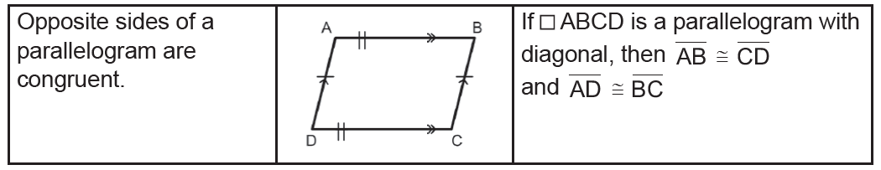
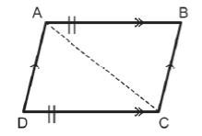
Quadrilaterals and Parallelograms
Theorem
Given: If □ABCD is a parallelogram
Prove: AB ≅ CD and AD ≅ BC
Proof:
Statements Reasons
1. □ABCD is a parallelogram. 1. Given
2. AB II DC, DA II CB 2. Definition
3. ∠BAC ≅ ∠DCA 3. The PAIC Theorem
∠BCA ≅ ∠DAC
4. AC ≅ AC 4. Reflexive Property
5. ΔABC ≅ ΔCDA 5. ASA Postulate
6. AB ≅ CD 6. CPCTC
AD ≅ BC
Rex Curriculum Resource
WWW.REX.COM.PH

Slide 4
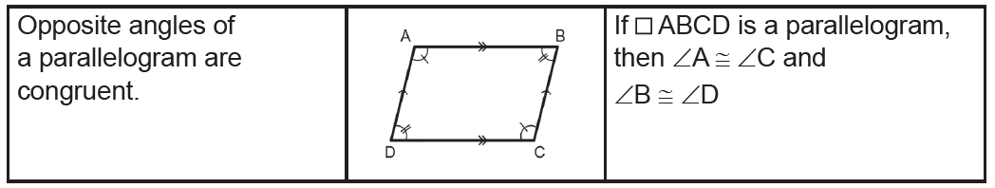
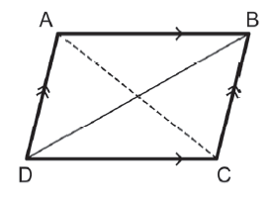
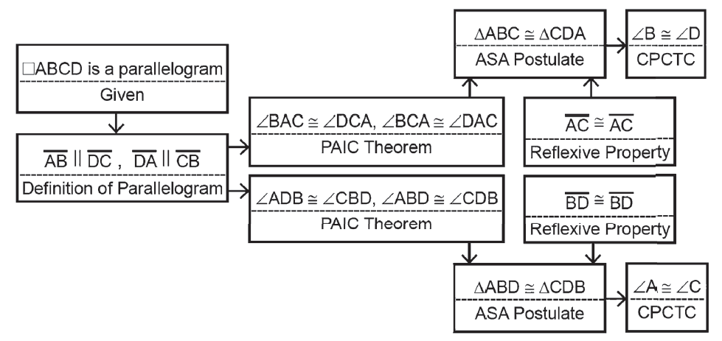
Quadrilaterals and Parallelograms
Theorem
Given: □ABCD is a parallelogram.
AC and BD are diagonals.
Prove: ∠B ≅ ∠D
∠A ≅ ∠C
Proof:
Rex Curriculum Resource
WWW.REX.COM.PH

Slide 5
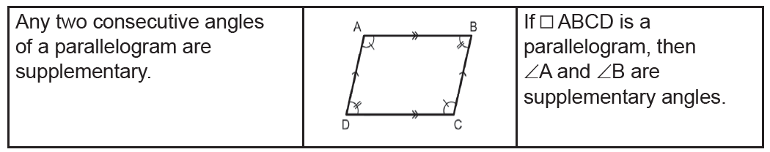
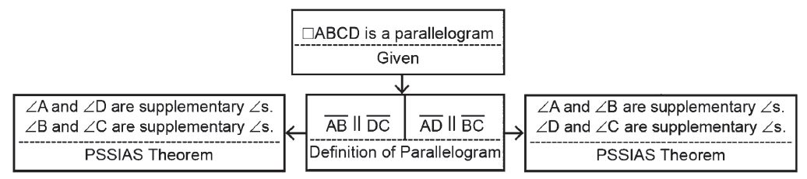
Quadrilaterals and Parallelograms
Theorem
Given: □ABCD is a parallelogram.
Prove: ∠A and ∠B are supplementary angles.
∠D and ∠C are supplementary angles.
∠A and ∠D are supplementary angles.
∠B and ∠C are supplementary angles.
Proof:
Rex Curriculum Resource
WWW.REX.COM.PH

Slide 6
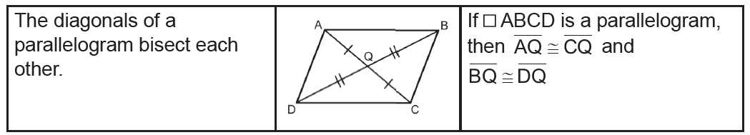
Quadrilaterals and Parallelograms
Theorem
Given: ABCD is a parallelogram.
AC and BD are the diagonals.
Prove: AQ ≅ CQ
BQ ≅ DQ
Proof:
Statements Reasons
1. □ABCD is a parallelogram. 1. Given
2. AB II CD 2. Definition of a parallelogram
3. ∠1 ≅ ∠2, ∠3 ≅ ∠4 3. The PAIC Theorem
4. AB ≅ CD 4. Opposite sides of a parallelogram are congruent.
5. ΔABQ ≅ ΔCDQ 5. ASA Postulate
6. AQ ≅ CQ, BQ ≅ DQ 6. CPCTC
Rex Curriculum Resource
WWW.REX.COM.PH

Slide 7
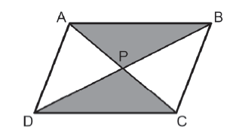
Quadrilaterals and Parallelograms
To summarize, the following are the properties of a parallelogram.
Given that □ABCD is a parallelogram:
1. Opposite sides are congruent.
AB ≅ CD and AD ≅ CB
2. Opposite angles are congruent.
∠A ≅ ∠B, ∠C ≅ ∠D
3. Any two consecutive angles are supplementary.
∠ A ≅ ∠B are supplementary angles;
∠ D ≅ ∠C are supplementary angles;
∠ A ≅ ∠D are supplementary angles; and
∠ B ≅ ∠C are supplementary angles.
4. Diagonals bisect each other.
AP ≅ CP and BP ≅ DP
5. Each diagonal divides the parallelogram into two congruent triangles.
ΔABD ≅ ΔCDB, ΔADC ≅ ΔCBA.
The following conditions guarantee that quadrilaterals are parallelograms.
Rex Curriculum Resource
WWW.REX.COM.PH

Slide 8
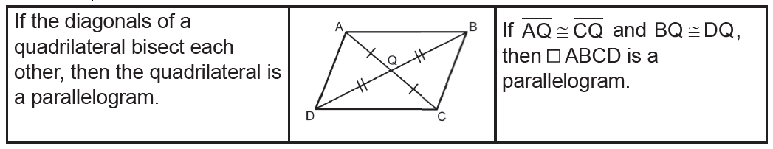
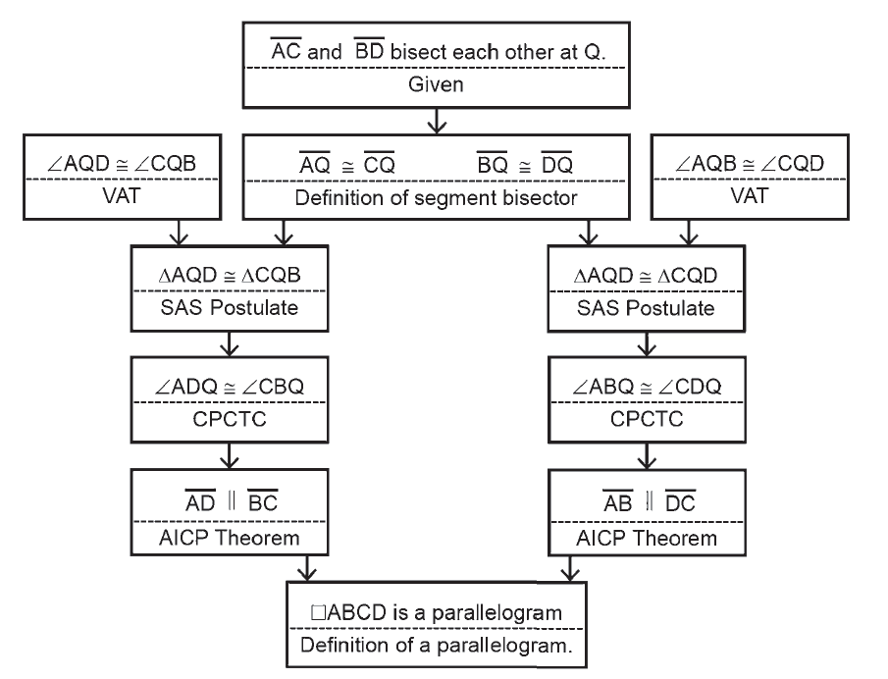
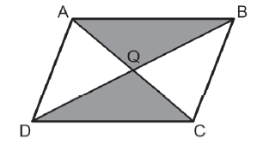
Quadrilaterals and Parallelograms
Theorem
Given: AC and BD
Prove: □ABCD is a parallelogram.
Proof:
Rex Curriculum Resource
WWW.REX.COM.PH

Slide 9
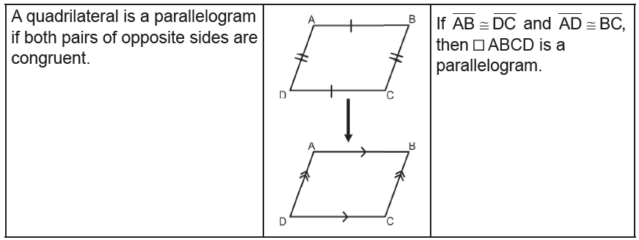
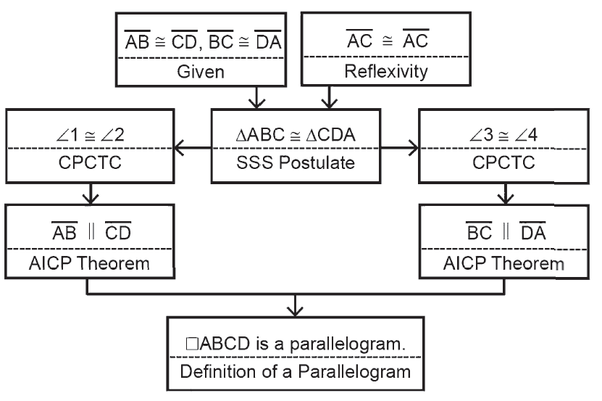
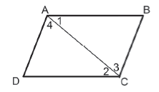
Quadrilaterals and Parallelograms
Theorem
Given: ABCD with AB ≅ DC and BC ≅ DA
Prove: ABCD is a parallelogram.
Proof:
Rex Curriculum Resource
WWW.REX.COM.PH

Slide 10
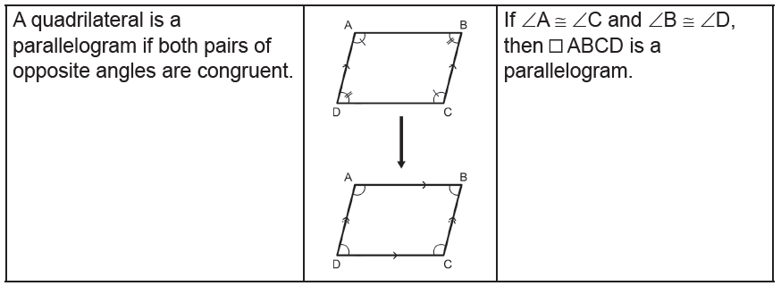
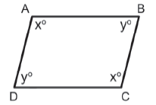
Quadrilaterals and Parallelograms
Theorem
Given: m∠A = m∠C = x and m∠B = m∠D = y
Prove: ABCD is a parallelogram.
Proof:
Statements Reasons
1. m∠A = m∠C = x 1. Given
m ∠B = m ∠D = y
2. 2x + 2y = 360° 2. The sum of the measures of the angles of a quadrilateral is 360°/
Definition of a convex quadrilateral.
3. x + y = 180° 3. MPE/DPE
4. AB II DC and AD II BC 4. SSIAS Theorem
5. □ABCD is a parallelogram. 5. Definition of a parallelogram
Rex Curriculum Resource
WWW.REX.COM.PH

Slide 11
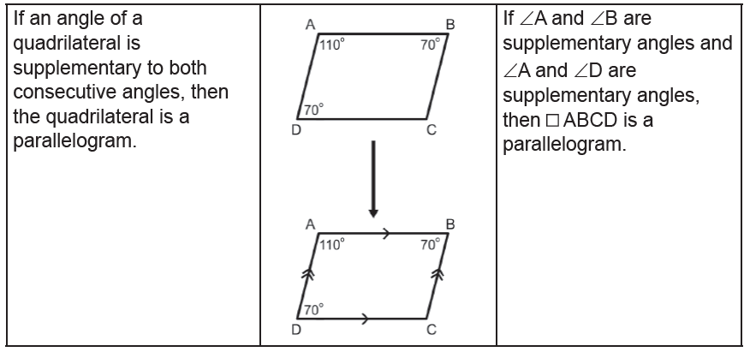
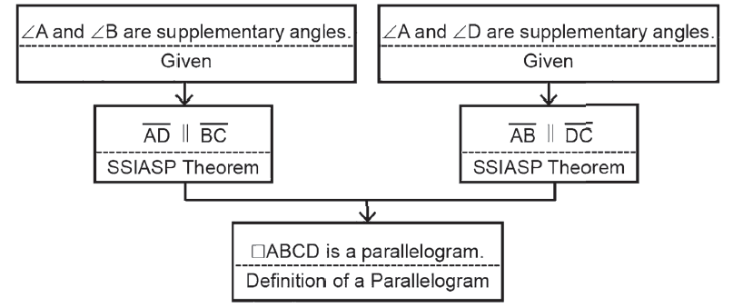
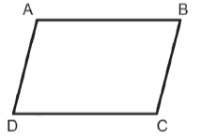
Quadrilaterals and Parallelograms
Theorem
Given: ∠A and ∠B are supplementary angles.
∠A and ∠D are supplementary angles.
Prove: □ABCD is a parallelogram.
Proof:
Rex Curriculum Resource
WWW.REX.COM.PH

Slide 12
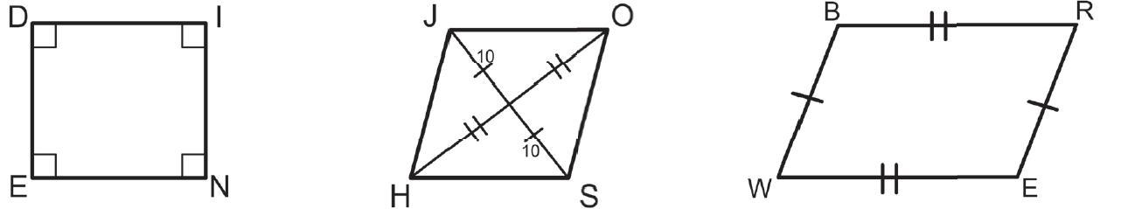
Quadrilaterals and Parallelograms
Example 1:
Determine whether each quadrilateral is a parallelogram or not. Justify your answer.
a. b. c.
Solution:
a. Yes, both pairs of opposite angles are congruent.
b. Yes, the diagonals bisect each other.
c. Yes, the pair of opposite sides are both parallel and congruent.
Rex Curriculum Resource
WWW.REX.COM.PH

Slide 13
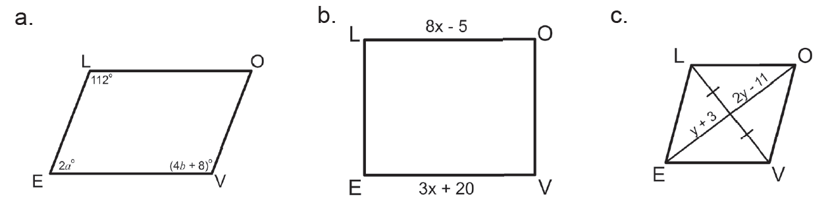
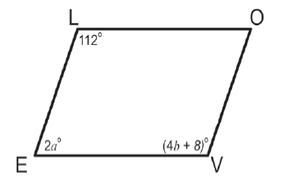
Quadrilaterals and Parallelograms
Example 2:
Find the values of a, b, x, and y in the parallelograms □LOVE.
Solution:
a. For a quadrilateral to be a parallelogram, both pairs of opposite angles must be congruent.
4b + 8 = 112
4b = 112 − 8
4b = 104
4b/4 = 104/4
b = 26
For a quadrilateral to be a parallelogram, its angle must be supplementary to
both consecutive angles. So,
2a + 112 = 180
2a = 180 − 112
2a = 68
2a/2 = 68/2
a = 34
and
2a + 4b + 8 = 180
2a + 4(26) + 8 = 180
2a + 104 + 8 = 180
2a + 112 = 180
2a = 180 − 112
2a = 68
a = 34
Rex Curriculum Resource
WWW.REX.COM.PH

Slide 14
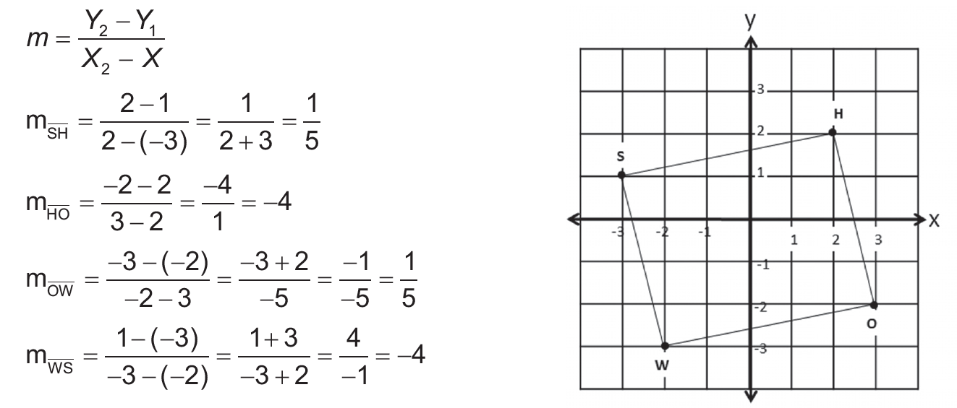
Quadrilaterals and Parallelograms
Example 3:
Consider the quadrilateral □SHOW, with S(-3, 1), H(2, 2), O(3, -2),
and W(-2, -3). Is □SHOW a parallelogram?
Solution:
Lines or line segments are parallel if their slopes are equal.
The slopes of SH and OW are equal, so SH II OW .
The slopes of HO and WS are equal, so HO II WS.
Both pairs of opposite sides are parallel, so □SHOW is a parallelogram.
Rex Curriculum Resource
WWW.REX.COM.PH

Slide 15
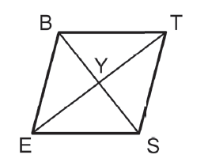
Activity:
Consider that □BEST is a parallelogram. Based on the figure, answer the following questions.
a. Identify the opposite sides that are congruent.
b. Identify the opposite angles that are congruent.
c. What are the consecutive angles that are supplementary?
d. If the diagonals bisect each other, then ___________.
e. What are the congruent triangles that were divided by the diagonals BS and ET?
Rex Curriculum Resource
WWW.REX.COM.PH

Slide 16
Activity:
Consider that □BEST is a parallelogram. Based on the figure, answer the following questions.
a. Identify the opposite sides that are congruent.
b. Identify the opposite angles that are congruent.
c. What are the consecutive angles that are supplementary?
d. If the diagonals bisect each other, then ___________.
e. What are the congruent triangles that were divided by the diagonals BS and ET?
ANSWERS
a. BE ≅ TS, BT ≅ ES
b. ∠B ≅ ∠S, ∠E ≅ ∠T
c. ∠B and ∠E, ∠E and ∠S, ∠S and ∠T, ∠T and ∠B
d. EY ≅ YT, BY ≅ YS
e. ΔBST ≅ ΔSBT, ΔEST ≅ ΔTBE
Rex Curriculum Resource
WWW.REX.COM.PH

Slide 17


