Slide 1




Undefined Terms in Geometry

Slide 2

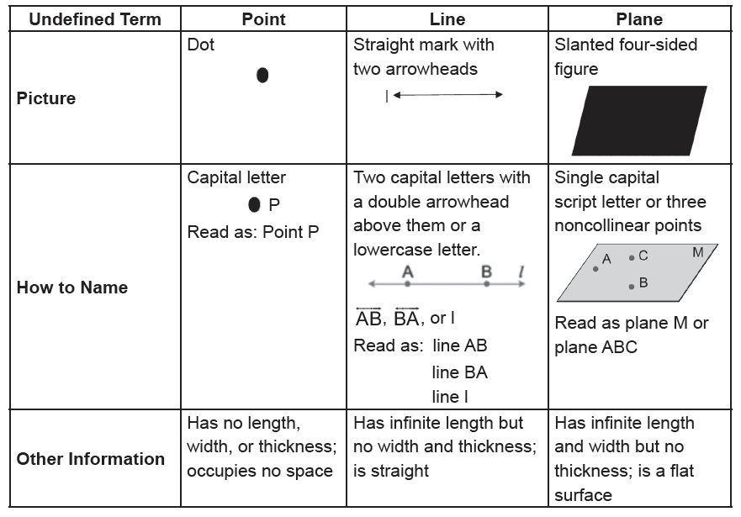
Undefined Terms in Geometry
Early mathematicians were frustrated with trying to define a point, line, and plane. To define a point, line, and plane, you must use words or phrases. However, those also need definition or further explanation. Hence, to understand their meaning, we offer general descriptions about them as given in the table.
Rex Curriculum Resource
WWW.REX.COM.PH

Slide 3
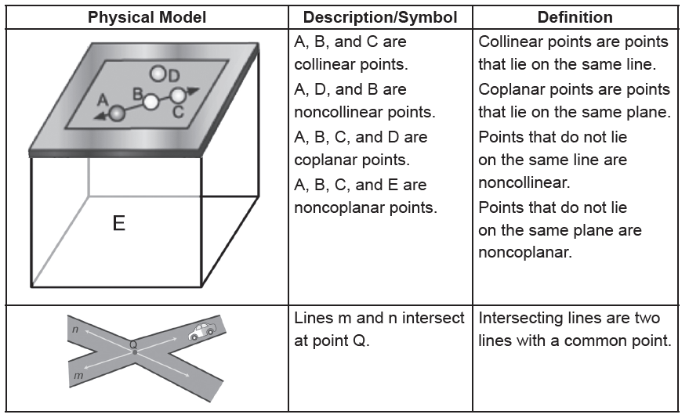
Undefined Terms in Geometry
Definition
A definition is a statement that clarifies or explains the meaning of a word or phrase.
Undefined terms such as point, line, and plane can be used to define many new geometric figures and terms. Many definitions may pertain to point, lines, and plane, but we should take note of the definitions used in Geometry. Keep a definition list (or glossary) in your notebook, and each time you encounter a new term, add it to your list. Illustrate your definition with a simple sketch and read the definition list daily.
The following is your first set of definitions. Begin your list.
• A space is the set of all points.
• A figure is any set of points.
Here are other concepts about points, lines, and planes.
Rex Curriculum Resource
WWW.REX.COM.PH

Slide 4
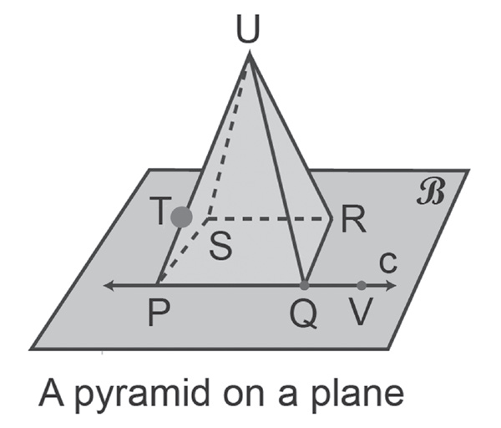
Undefined Terms in Geometry
Example 1: Points, Lines, and Planes
Use the figure on the right to answer each question.
a. Name all the planes in the figure.
b. Are points P, Q, and V collinear?
c. Name other collinear points.
d. Are points P, Q, R, and T coplanar?
Solution:
a. There are five planes: plane QRU, plane RSU, plane PSU, plane PQU, and plane β. Plane β can also be named using any three of the four points: P, Q, R, and S.
b. Because P, Q, and V lie on line PV, then they are collinear.
c. Points P, T, and U are collinear points.
d. Points P, Q, and R lie on plane β, but point T does not. Hence, the four points are not coplanar.
Rex Curriculum Resource
WWW.REX.COM.PH

Slide 5
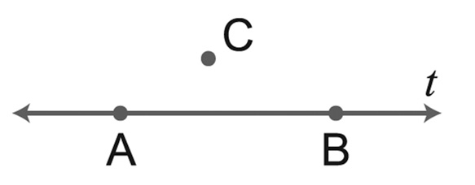
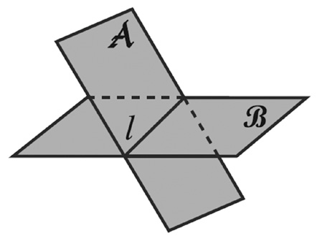
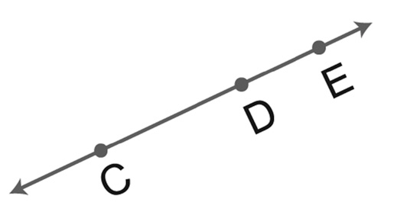
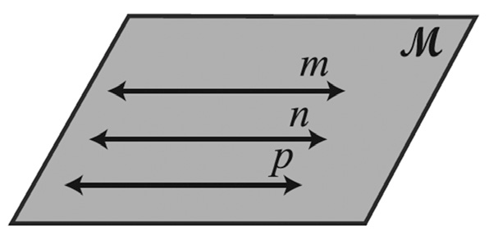
Undefined Terms in Geometry
Solution:
b.
c.
d.
Example 2: Collinear and Coplanar Points
Draw and label a figure for each condition.
a. Point E lies on CD.
b. Line t contains A and B but does not contain C.
c. Planes A and B intersect in l.
d. Lines m, n, and p are coplanar but do not intersect.
Solution:
a.
Rex Curriculum Resource
WWW.REX.COM.PH

Slide 6
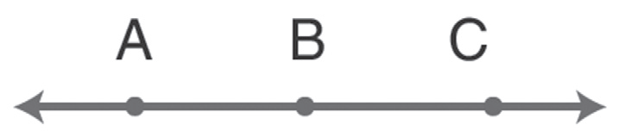
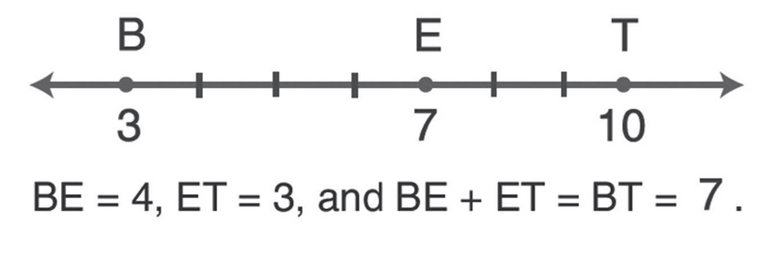
Undefined Terms in Geometry
Definition
Point B is between A and C if (a) A, B, and C are collinear and (b) AB + BC = AC.
In the figure on the right, point E with coordinate 7 is between points B and T. When you graph the points associated to 3 and 10, and all points having coordinates between 3 and 10, the resulting graph is a segment. The points associated with 3 and 10 are also the endpoints of the segment.
Rex Curriculum Resource
WWW.REX.COM.PH

Slide 7
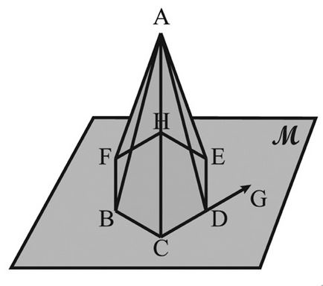
Activity:
A. Use the figure on the right to answer each question.
a. Name all planes in the figure.
b. Are points B, E, and F coplanar?
c. Name the collinear points.
Rex Curriculum Resource
WWW.REX.COM.PH

Slide 8
Activity: ANSWER KEY
A. Use the figure on the right to answer each question.
a. Name all planes in the figure.
b. Are points B, E, and F coplanar?
c. Name the collinear points.
ANSWERS
a. There are 7 planes: plane M, plane ADE, plane ACD, plane ABC, plane ABF, plane AFH, and plane AEH. Plane M can also be named using any three of the six points: B, C, D, E H, and F.
b. Yes, because they are on the same plane M.
c. CDG is an example of collinear points.
Rex Curriculum Resource
WWW.REX.COM.PH

Slide 9


