Slide 1


Construction – Bisecting a Line Segment

Slide 2

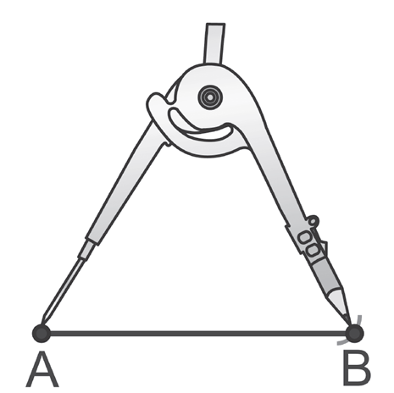
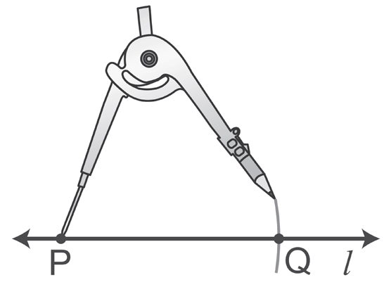

Construction – Bisecting a Line Segment
A Segment Congruent to a Given Segment
This is how to construct a segment congruent to segment AB.
1. Construct a line l and a point P on line l.
2. Place the point of the compass at A and the compass pencil at B.
3. Without changing the opening, place the point of the compass at P and draw an arc that intersects line l at Q.
(AB≅ PQ)
Rex Curriculum Resource
WWW.REX.COM.PH

Slide 3
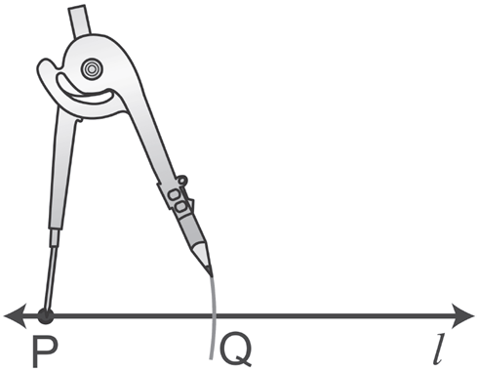

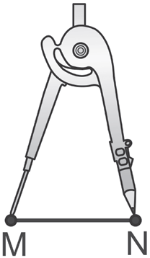
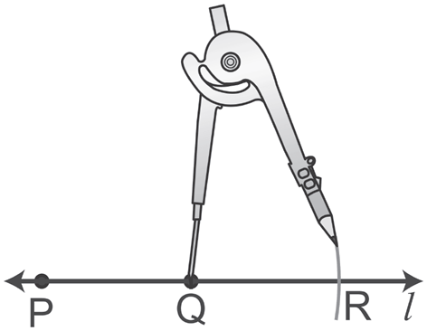

Construction – Bisecting a Line Segment
Example 1: Congruent Segments
Construct a segment whose length is twice the length of MN.
Solution:
Draw a line l and point P on line l.
Set the compass to the length of MN.
With the same opening of the compass, place the compass point at P and draw an arc that intersects line l at Q.
Then place the compass point at Q
and draw an arc that intersects line l at R.
Notice that PQ is a duplicate of MN and hence PQ = MN. Furthermore, QR is a duplicate of MN and hence QR = MN.
Thus, the length of segment PR is the sum of PQ and QR, which is MN + MN or 2MN.
Rex Curriculum Resource
WWW.REX.COM.PH

Slide 4
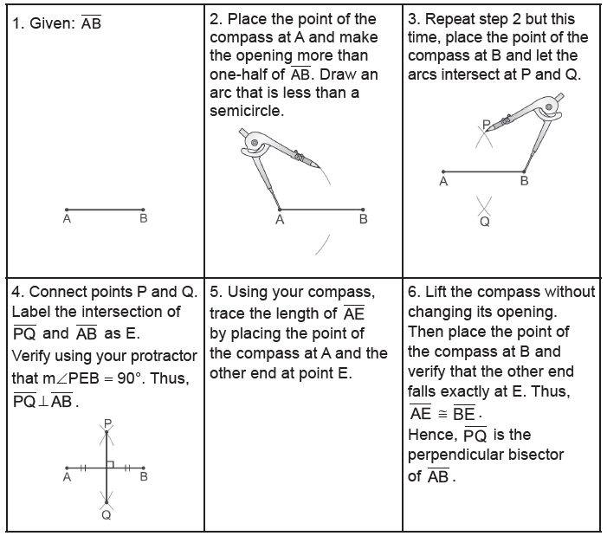
Construction – Bisecting a Line Segment
The Perpendicular Bisector of a Segment
Rex Curriculum Resource
WWW.REX.COM.PH

Slide 5
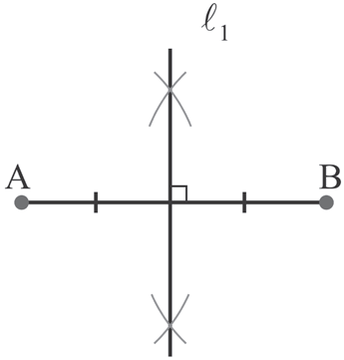


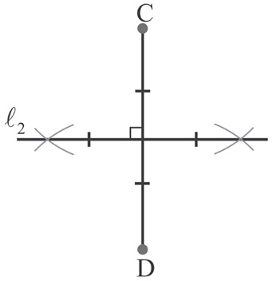
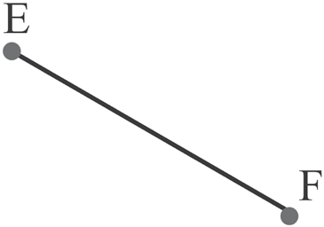
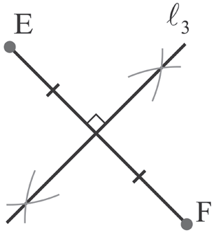
Construction – Bisecting a Line Segment
Example : Perpendicular Bisector
Construct the perpendicular bisectors of the following segments:
a.
b.
c.
Solution:
a. Bisect AB.
b. Bisect CD.
c. Bisect EF.
Rex Curriculum Resource
WWW.REX.COM.PH

Slide 6

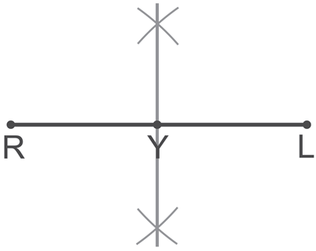
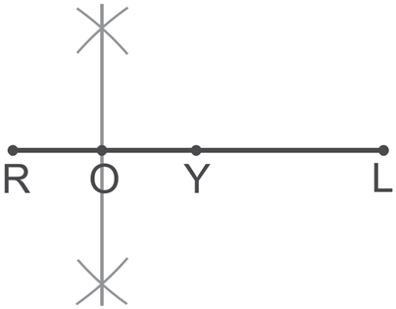
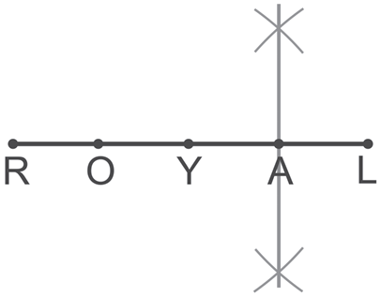
Construction – Bisecting a Line Segment
Example : Dividing into Four
Divide RL into four segments of equal lengths.
Solution:
To divide RL into four congruent segments, we have to divide it first into two congruent segments. After it, we will divide each of the congruent segments into another pair of congruent segments as shown below.
Bisect RL. Bisect RY Bisect YL
Rex Curriculum Resource
WWW.REX.COM.PH

Slide 7
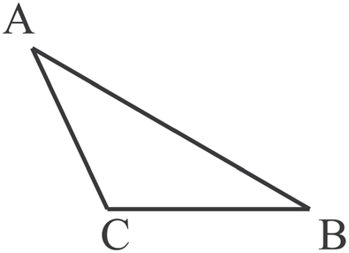
Activity:
A.. Construct the perpendicular bisector of the sides of triangle ABC.
B. Divide AB of triangle ABC into four congruent segments
Rex Curriculum Resource
WWW.REX.COM.PH

Slide 8
Activity: ANSWER KEY
A.. Construct the perpendicular bisector of the sides of triangle ABC.
B. Divide AB of triangle ABC into four congruent segments
ANSWER KEY:
a. The three perpendicular bisectors should be concurrent (intersecting at one point).
b. The student should be able to show correct arc markings in constructing three lines that divide segment AB into four congruent segments.
Rex Curriculum Resource
WWW.REX.COM.PH

Slide 9


