Slide 1


Construction – Angle Bisector

Slide 2
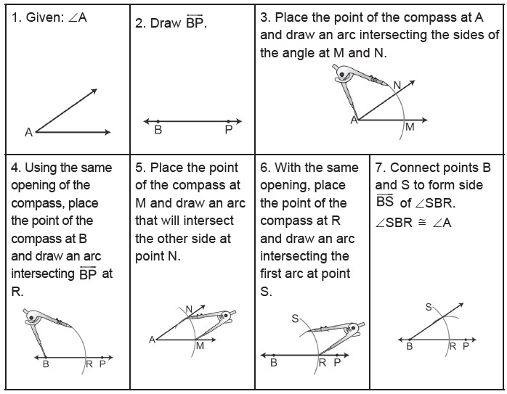
Construction – Angle Bisector
An Angle Congruent to Another Angle (To Copy an Angle)
Rex Curriculum Resource
WWW.REX.COM.PH

Slide 3
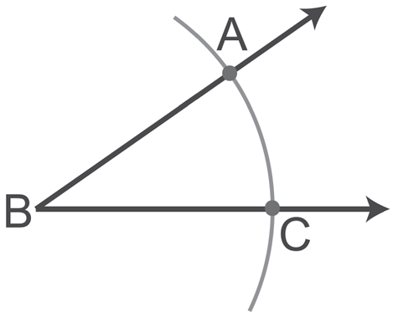
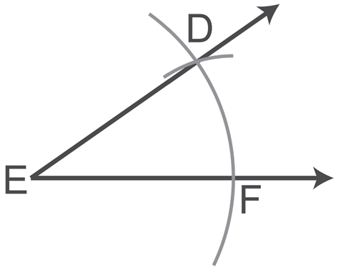
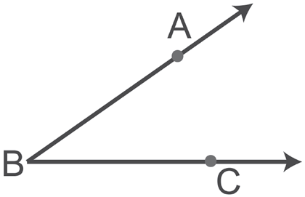
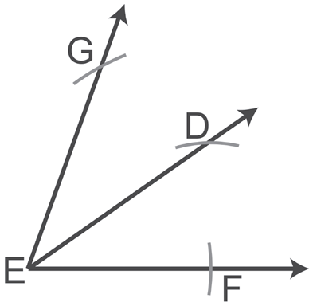
Construction – Angle Bisector
Solution:
Copy ∠ABC by following the steps in copying an angle.
Now, consider ray ED to be the leg for constructing another angle with the same angle measure of ∠ABC.
m∠GEF = 2m∠ABC
Example : Congruent Angles
Construct an angle whose measure is twice the measure of ∠ABC.
Rex Curriculum Resource
WWW.REX.COM.PH

Slide 4
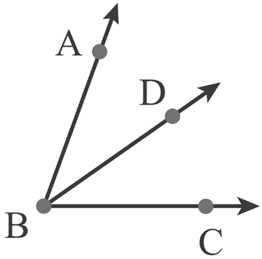
Construction – Angle Bisector
Definition
Bisector of an angle:
If D is in the interior of ∠ABC and ∠ABD ≅ ∠DBC, then BD is an angle bisector of ∠ABC.
Note: If BD is an angle bisector of ∠ABC, then
• ∠ABC ≅ ∠DBC.
• m∠ABC = 2m∠ABD or m∠ABC = 2m∠DBC.
• m∠ABD = ½ m∠ABC or m∠DBC = ½ m∠ABC.
Rex Curriculum Resource
WWW.REX.COM.PH

Slide 5
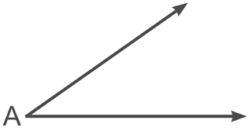
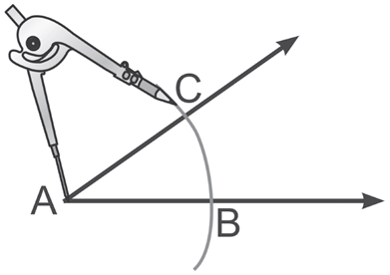
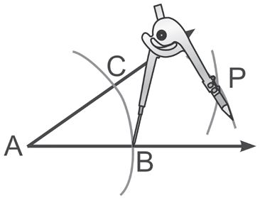
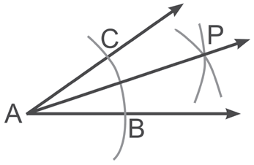
Construction – Angle Bisector
Bisector of an Angle
1. Given: ∠A | 2. Place the point of the compass at A and draw an arc intersecting its sides at B and C. | 3. Without changing the opening of the compass from Step 2, place the point of the compass at B and draw an arc. After that, place the point of the compass at C and draw an arc which intersects the other arc. Label the intersection of the arcs as P. | 4. Using your compass, we can verify that the distance between C and P is equal to the distance of B to P by tracing their lengths. Connect points A and P. AP bisects angle A.
Rex Curriculum Resource
WWW.REX.COM.PH

Slide 6
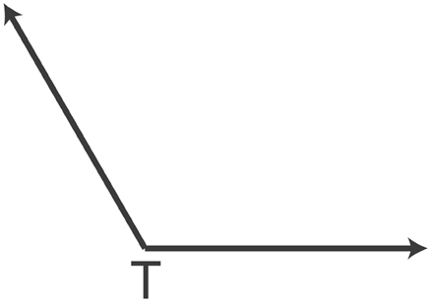
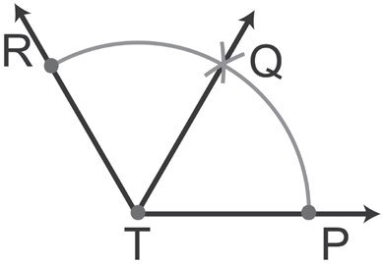
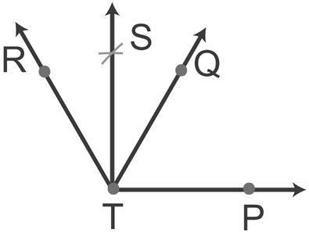
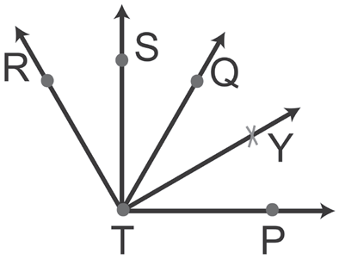
Construction – Angle Bisector
Example : Dividing into Four
Divide ∠T with four angles of equal measure.
Solution:
To divide ∠T into four congruent angles, first, divide ∠T into two congruent angles. Then, divide each of the two congruent angles into two other congruent angles as shown below.
Bisect ∠T Bisect ∠RTQ Bisect ∠QTP
m∠RTS = m∠STQ = m∠QTY = m∠YTP
Rex Curriculum Resource
WWW.REX.COM.PH

Slide 7
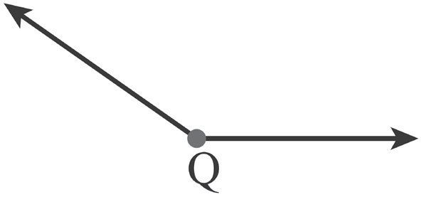
Activity:
Divide ∠Q into eight congruent angles. Name your congruent angles as ∠AQB, ∠BQC, ∠CQD, ∠DQE, ∠EQF, ∠GQH, and ∠HQS.
Rex Curriculum Resource
WWW.REX.COM.PH

Slide 8
Activity: ANSWER KEY
Divide ∠Q into eight congruent angles. Name your congruent angles as ∠AQB, ∠BQC, ∠CQD, ∠DQE, ∠EQF, ∠GQH, and ∠HQS.
ANSWER KEY
The student should be able to show correct arc markings used to construct seven lines in the interior of angle Q, which divide it into eight congruent angles
Rex Curriculum Resource
WWW.REX.COM.PH

Slide 9


