Slide 1


Congruent Triangles

Slide 2
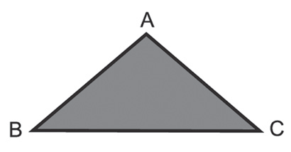
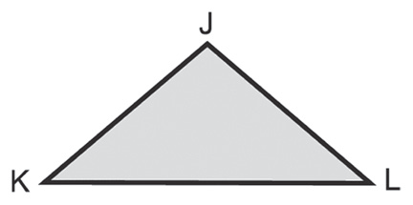
Congruent Triangles
If ΔABC slides over to the right to fi t in ΔJKL, then they will fi t exactly. However, they will fi t exactly only if a proper pairing of the vertices is made. In this case, the proper pairing will have to be:
A to J or A ↔ J reads as “A corresponds to J.”
B to K or B ↔ K reads as “B corresponds to K.”
C to L or C ↔ L reads as “C corresponds to L.”
When the vertices are matched this way, ∠A and ∠J are corresponding angles and AC and JL are corresponding sides.
Corresponding angles and corresponding sides are examples of corresponding parts. Figures are congruent if all pairs of corresponding sides and angles are congruent.
If ΔABC is congruent to ΔJKL (that is, ΔABC ≅ ΔJKL), then the vertices of the two triangles correspond in the same order as the letters naming the triangles.
A ↔ J
B ↔ K
C ↔ L
Rex Curriculum Resource
WWW.REX.COM.PH

Slide 3
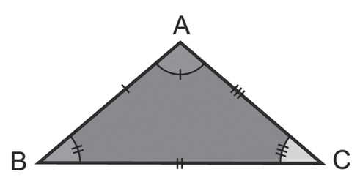
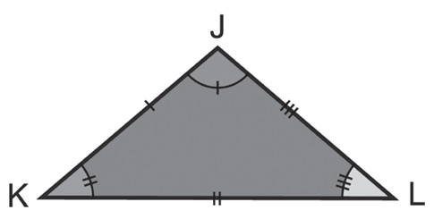
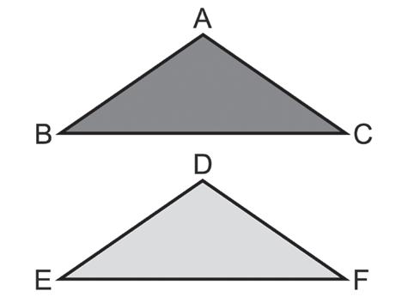
Congruent Triangles
The correspondence among vertices can be used to name the corresponding congruent sides and angles of the two triangles.
∠A ≅ ∠J AB ≅ JK
∠B ≅ ∠K BC ≅ KL
∠C ≅ ∠L AC ≅ JL
The corresponding sides and angles can be determined from any congruence statement by following the order of the letters.
For example, ΔABC ≅ ΔDEF indicates the following congruences:
∠A ≅ ∠D, ∠B ≅ ∠E, and ∠C ≅ ∠F.
Also, AB ≅ DE, BC ≅ EF, AC ≅ DF.
This means that if two triangles are congruent, then their corresponding parts are also congruent (Corresponding Parts of Congruent Triangles are Congruent).
This is actually a restatement of the definition of congruent triangles. Since this will often be used as a reason in proofs, it is convenient to use the abbreviation, CPCTC.
Two polygons are congruent if and only if their vertices can be matched up so that their corresponding parts are congruent.
Rex Curriculum Resource
WWW.REX.COM.PH

Slide 4
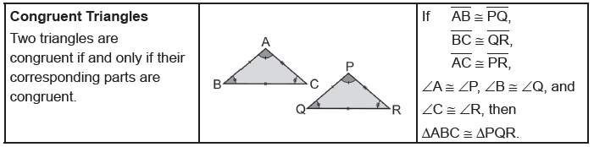
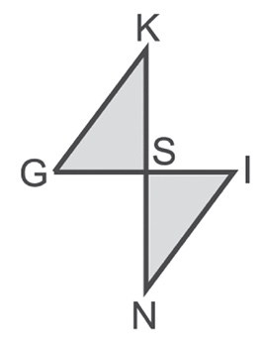
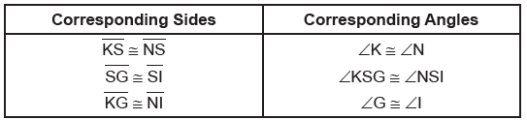
Congruent Triangles
In general, two figures are said to be congruent if they have the same shape and size. Hence, congruent figures can fit each other exactly.
It is important to list the letters of the vertices in the correct order whenever you write a congruence statement.
Example 1:
Given that ΔKSG ≅ ΔNSI, name all the corresponding parts.
Solution:
The correspondence of the vertices can be used to name the congruent
sides and angles of the two triangles.
Rex Curriculum Resource
WWW.REX.COM.PH

Slide 5
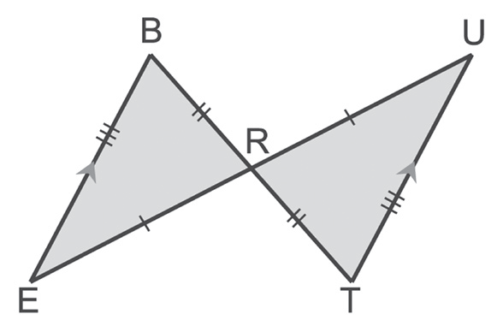
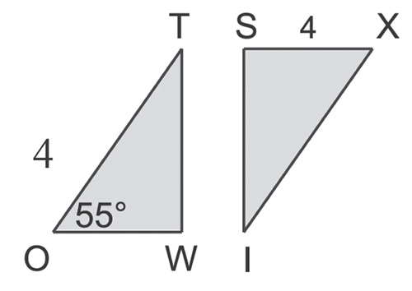
Congruent Triangles
Example :
Given: ΔTWO ≅ ΔISX, m∠O = 55, and SX = 4.
Find: a. m∠K b. WO
Solution:
a. Because ∠X ≅ O, you know that m∠X = m∠O = 55.
b. Because WO ≅ SX, you know that WO = SX = 4.
Example :
Given the marked figure, determine whether the triangles are congruent. If they are, write a congruence statement.
Solution:
The congruent sides are marked on the figure, so:
BR ≅ TR, ER ≅ UR, and BE ≅ TU.
We have the following congruent angles.
∠BRE ≅ ∠TRU The Vertical Angle Theorem
∠B ≅ ∠T The PAIC Theorem
∠E ≅ ∠U The PAIC Theorem
Since all corresponding parts are congruent, ΔBRE ≅ ΔTRU.
Rex Curriculum Resource
WWW.REX.COM.PH

Slide 6
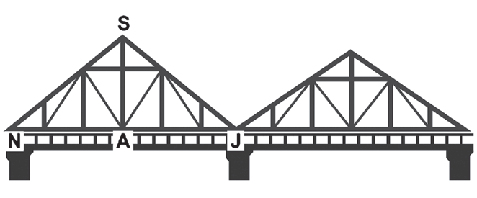
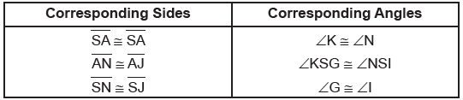
Congruent Triangles
Example :
The bridge at the right uses a triangular truss
design. Some vertices are labeled and ΔSAN ≅ ΔSAJ.
List the congruent sides and angles.
Solution:
Since ΔSAN ≅ ΔSAJ, the following corresponding parts are congruent.
Rex Curriculum Resource
WWW.REX.COM.PH

Slide 7
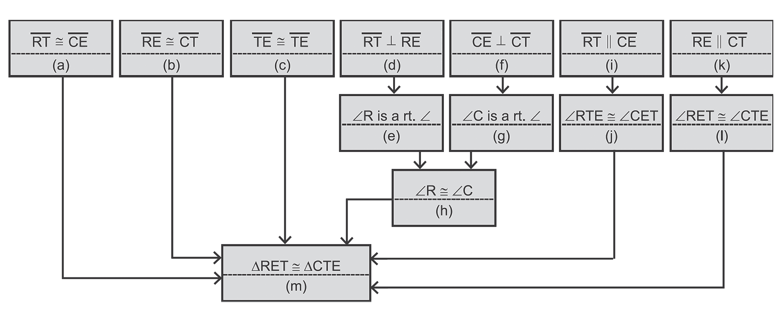
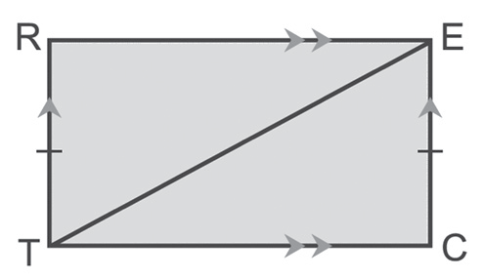
Congruent Triangles
Example :
Provide a reason for each statement.
Given: RT ≅ CE, RE ≅ CT, RT ┴ RE, CE ┴ CT,
RT || CE, RE || CT
Prove: ΔRET ≅ ΔCTE
Solution:
a. Given h. Any two right angles are ≅.
b. Given i. Given
c. Reflexive Property j. The PAIC
d. Given k. Given
e. Definition of Perpendicularity l. The PAIC
f. Given m. Definition of Congruent Triangles
g. Definition of Perpendicularity
Rex Curriculum Resource
WWW.REX.COM.PH

Slide 8
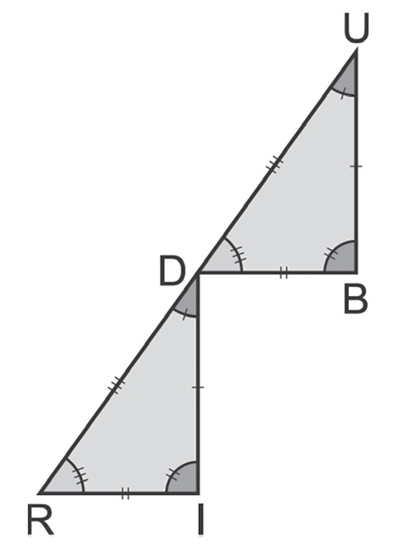
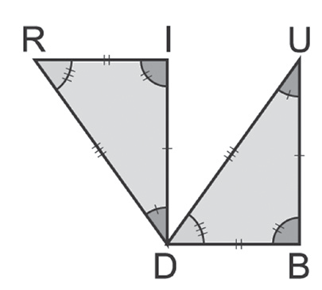
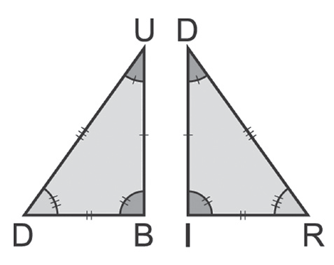
Congruent Triangles
Example :
Given: ΔUBD ≅ ΔDIR, UB = 28, BD = 36, UD = 43, and DR = 2x + 3
a. Draw the congruent triangles and label the congruent parts.
b. Find the value of x.
Solution:
a. Some of the congruent triangles:
Are there other triangles that can be drawn?
b. Since ΔUBD ≅ ΔDIR, then UD ≅ DR. Hence, UD = DR by the definition of congruent segments.
UD = DR
43 = 2x + 3 Replace UD by 43 and DR by 2x + 3.
40 = 2x Subtract 3 from each side.
20 = x Divide each side by 2.
Rex Curriculum Resource
WWW.REX.COM.PH

Slide 9
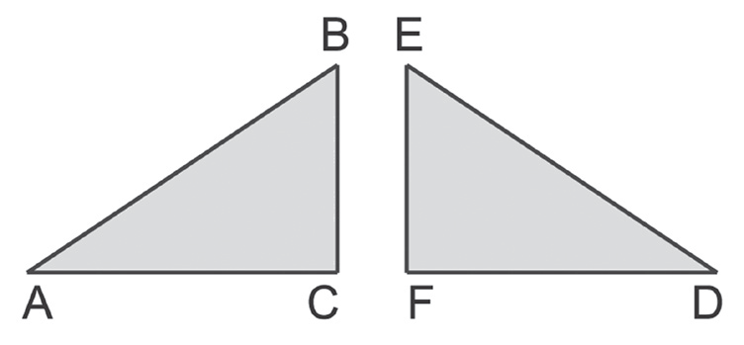
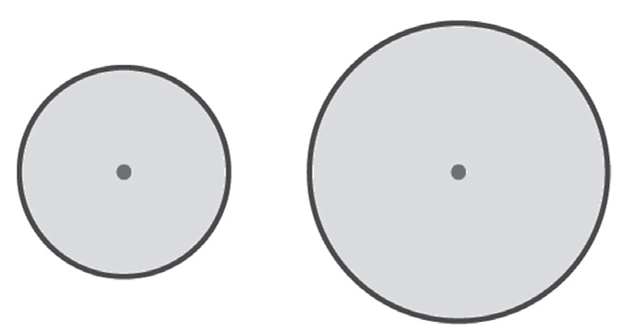
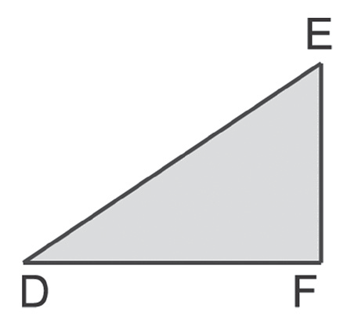
Congruent Triangles
Example :
Determine whether each of the following pairs of figures is congruent. Explain why or why not.
a. b.
Solution:
a. If ΔDEF is drawn on a sheet of transparency and is flipped over, the figure will be the same as the figure on the left of it. The triangle on the transparency fits ΔABC exactly.
Thus, ΔABC ≅ ΔDEF.
b. The radii of the two circles are different. Thus, the two circles are not congruent.
Rex Curriculum Resource
WWW.REX.COM.PH

Slide 10
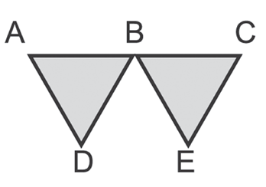

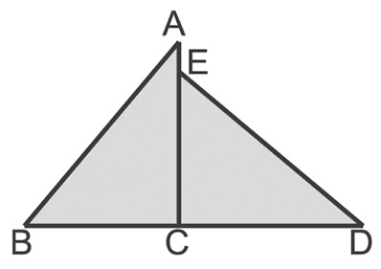
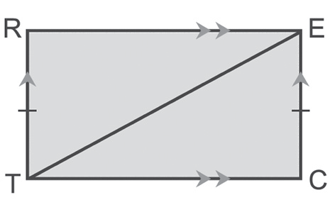
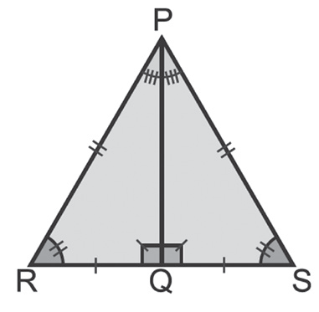
Activity:
1. Given that ΔABD ≅ ΔCBE, name all the corresponding parts.
2. Given that ΔABC ≅ ΔDEC, m∠B = 50, and EC = 3.
Find:
a. m∠DEC
b. BC
3. Given the marked figure, determine whether the triangles
are congruent. If they are, write a congruence statement.
4. The bridge below uses a triangular truss design. Some vertices are labeled and ΔCTL ≅ ΔATL. List the congruent sides and angles.
5. Provide a reason for each statement.
Given: RT ≅ CE, RE ≅ CT, RT ┴ RE,
CE ┴ CT, RT || CE, RE || CT
Prove: ΔRET ≅ ΔCTE using a two-column proof
Rex Curriculum Resource
WWW.REX.COM.PH

Slide 11
Activity: Answer Key
1. ∠A and ∠C
∠ABB and ∠CBE (could not be made with a single variable since B is shared)
∠D and ∠E
AB and CB
BD and BE
AD and CE
2. a. m∠DEC = 50
b. BC = 3
3. ΔPQR ≅ ΔPQS
4. CT ≅ AT
TL ≅ TL
CL ≅ AL
∠ CTL ≅ ∠ATL
∠ CLT ≅ ∠ALT
∠ TCL ≅ ∠TAL
5. Statements Reasons
1. RT ≅ CE 1. Given
2. RE ≅ CT 2. Given
3. ET ≅ ET 3. Reflexive Property
4. RE ┴ RE, CE ┴ CT 4. Given
5. ∠R and ∠E are right angle 5. Definition of perpendicularity
6. ∠R ≅ ∠E 6. Any two right angles are congruent
7. RT || CE, RE || CT 7. Given
8. ∠RTE ≅ ∠CET 8. The PAIC Theorem
9. ∠RET ≅ ∠CTE 9. The PAIC Theorem
10. ΔRET ≅ ΔCTE 10. Definition of congruent triangles
Rex Curriculum Resource
WWW.REX.COM.PH

Slide 12


