Slide 1


Proving Triangle Congruence

Slide 2
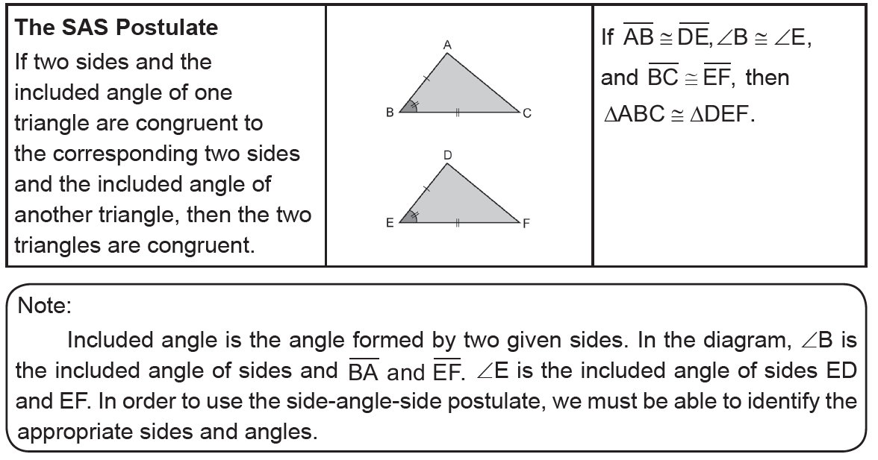
Proving Triangle Congruence
The SAS Postulate
Rex Curriculum Resource
WWW.REX.COM.PH

Slide 3
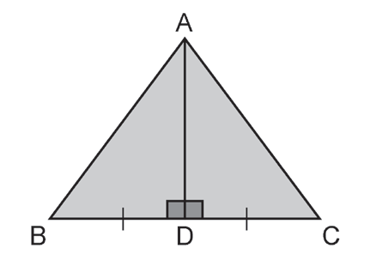
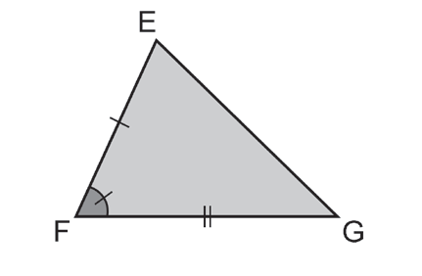
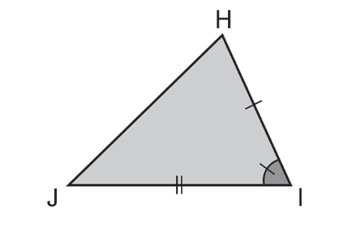
Proving Triangle Congruence
Example 1:
Determine if the SAS Postulate can be used to prove that the triangles
are congruent. If it is not possible, explain.
a. b.
Solution:
a. From the diagram, you know that BD ≅ CD and AD ≅ AD. The angle included between BD and AD is ∠BDA. The angle included between CD and AD is ∠CDA. Because any two right angles are congruent, ΔBDA ≅ ΔCDA. You can use the SAS Postulate to conclude that ADB ≅ ADC.
b. You are given that EF ≅ HI and FG ≅ IJ . You know that F ≅ I, and they are included angles between the congruent sides. You can use the SAS Postulate to conclude that ΔEFG ≅ ΔHIJ.
Rex Curriculum Resource
WWW.REX.COM.PH

Slide 4
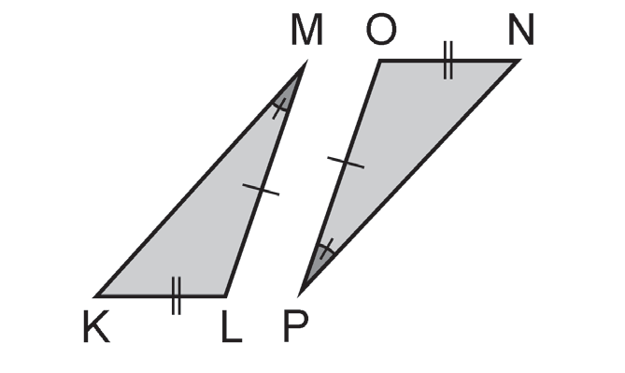
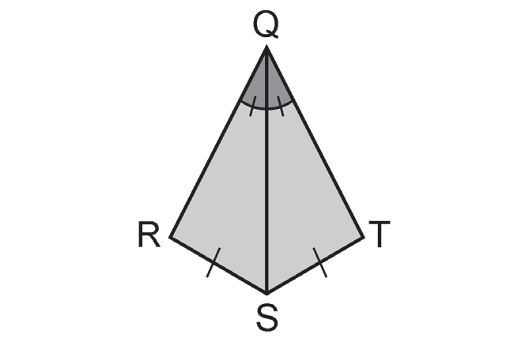
Activity:
CHECKPOINT 1:
Determine if the SAS Postulate can be used to prove that the triangles are
congruent. If it is not possible, explain.
a. b.
Rex Curriculum Resource
WWW.REX.COM.PH

Slide 5
Activity:
CHECKPOINT 1:
Determine if the SAS Postulate can be used to prove that the triangles are
congruent. If it is not possible, explain.
a. b.
Solution:
a. Not Possible
b. Not Possible
Rex Curriculum Resource
WWW.REX.COM.PH

Slide 6
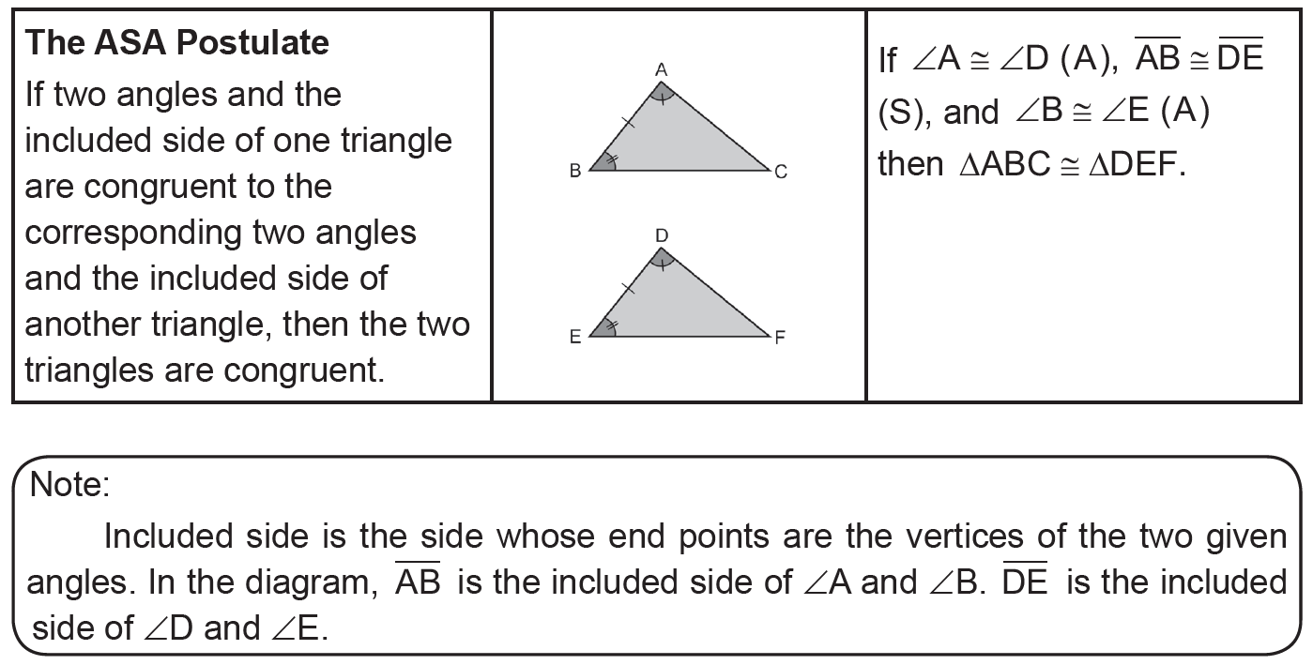
Proving Triangle Congruence
The ASA Postulate
Rex Curriculum Resource
WWW.REX.COM.PH

Slide 7
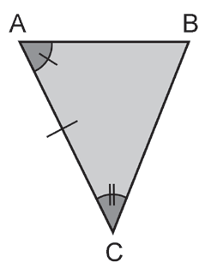
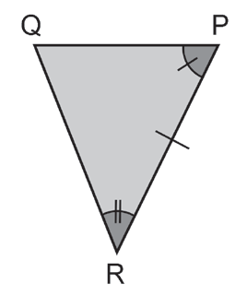
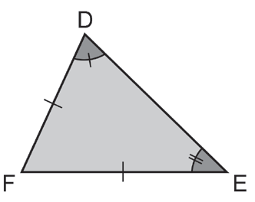
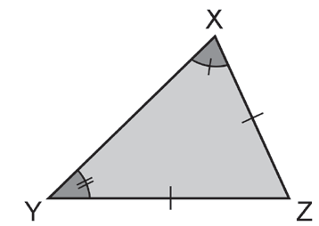
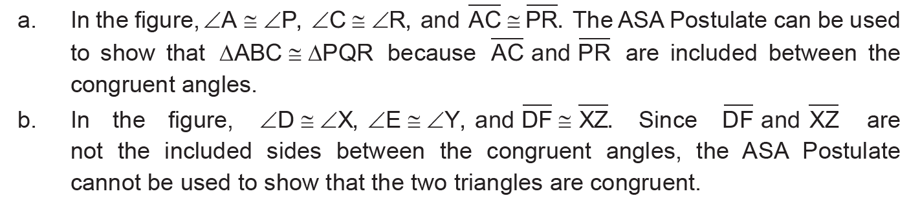
Proving Triangle Congruence
Example 2:
Using the marked figures, can the ASA Postulate be used to show that the
triangles are congruent? Explain.
a. b.
Solution:
Rex Curriculum Resource
WWW.REX.COM.PH

Slide 8
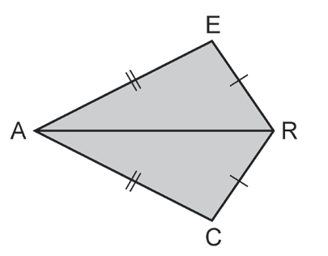
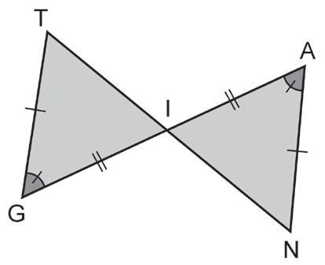
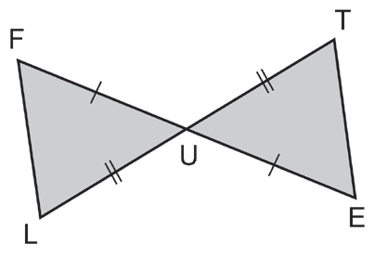
Proving Triangle Congruence
Example 3:
Use the given information to complete each statement. If the triangles
cannot be proven congruent from the given information, write “not congruent.”
a. b. c.
Solution:
a. ETU; SAS b. ARC; SSS c. AIN; ASA
Rex Curriculum Resource
WWW.REX.COM.PH

Slide 9
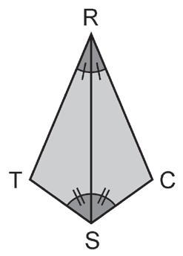
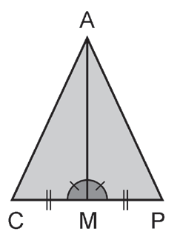
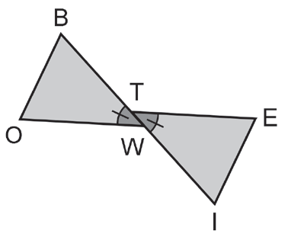
Activity:
CHECKPOINT 2:
Determine if the SAS Postulate can be used to prove that the triangles are
congruent. If it is not possible, explain.
a. b. c.
Rex Curriculum Resource
WWW.REX.COM.PH

Slide 10
Activity:
CHECKPOINT 2:
Determine if the SAS Postulate can be used to prove that the triangles are
congruent. If it is not possible, explain.
a. b. c.
Solution:
a. ΔPAM b. ΔSRC, ASA Postulate c. ΔIET
Rex Curriculum Resource
WWW.REX.COM.PH

Slide 11
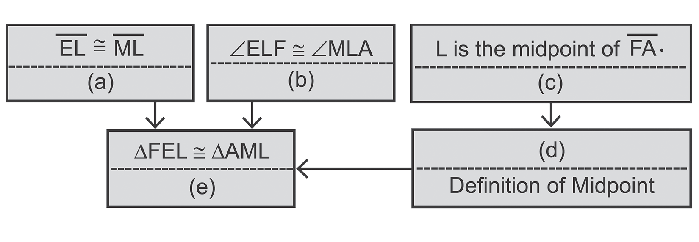
Proving Triangle Congruence
Example 4:
Fill in the missing statements and reasons.
Given: EL ≅ ML and
L is the midpoint of FA .
Prove: ΔFEL ≅ ΔAML
Proof:
Solution:
a. Given
b. VAT
c. Given
d. FL ≅ AL
e. SAS Postulate
Rex Curriculum Resource
WWW.REX.COM.PH

Slide 12
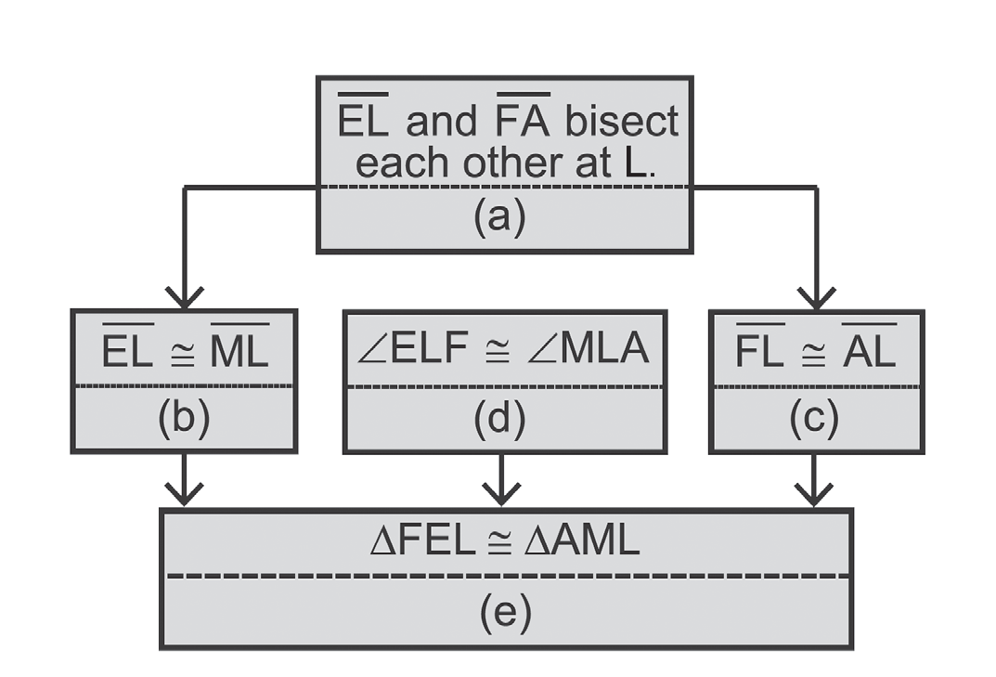
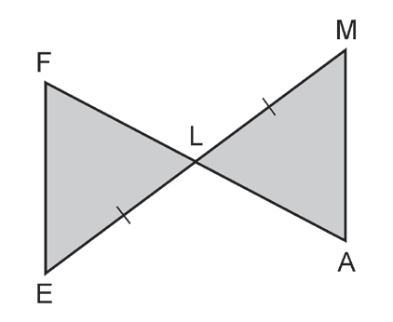
Activity:
CHECKPOINT 3:
Fill in the missing statements and reasons.
Given: EM and FA bisect each other at L.
Prove: FEL ≅ AML Proof:
a.
Rex Curriculum Resource
WWW.REX.COM.PH

Slide 13
Activity:
CHECKPOINT 3:
Fill in the missing statements and reasons.
Given: EM and FA bisect each other at L.
Prove: FEL ≅ AML Proof:
ANSWER KEY:
a. Given
b. Definition of segment bisector
c. Definition of segment bisector
d. VAT
e. SAS Postulate
Rex Curriculum Resource
WWW.REX.COM.PH

Slide 14
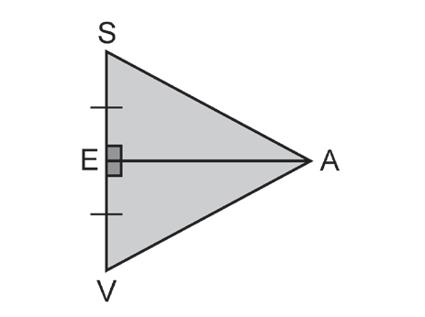
Proving Triangle Congruence
Example 5:
Given: ES ≅ EV
AE ⊥ SV
Prove: ΔSEA = ΔVEA
Solution:
Proof:
Proof:
Statements
1. ES ≅ EV
2. AE ⊥ SV
3. ∠AES and ∠AEV are right angles
4. AES AEV
5. AE ≅ AE
6. SEA VEA
Reasons
1. Given
2. Given
3. Definition of Perpendicularity
4. Any two right angles are congruent.
5. Reflexive Property
6. SAS Postulate
Rex Curriculum Resource
WWW.REX.COM.PH

Slide 15
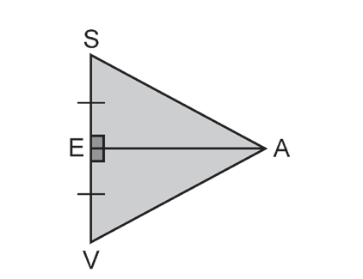
Activity:
CHECKPOINT 4:
Given: AE is a perpendicular bisector of SV.
Prove: ΔSEA ≅ ΔVEA
Rex Curriculum Resource
WWW.REX.COM.PH

Slide 16
Activity:
CHECKPOINT 4:
Given: AE is a perpendicular bisector of SV.
Prove: ΔSEA ≅ ΔVEA
ANSWER KEY:
Proof:
Statements Reasons
1. AE is a perpendicular bisector of SV 1. Given
2. ES EV 2. Definition of Perpendicular Bisector ∠SEA and ∠VEA are right angles
3. ∠SEA ≅ ∠VEA 3. Any two right angles are congruent
4. AE ≅ AE 4. Reflexive Property
5. ΔSEA ≅ ΔVEA 5. SAS Postulate
Rex Curriculum Resource
WWW.REX.COM.PH

Slide 17
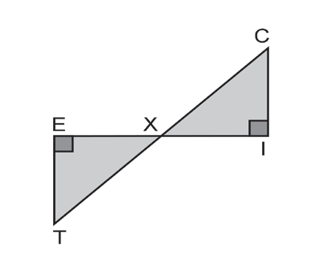
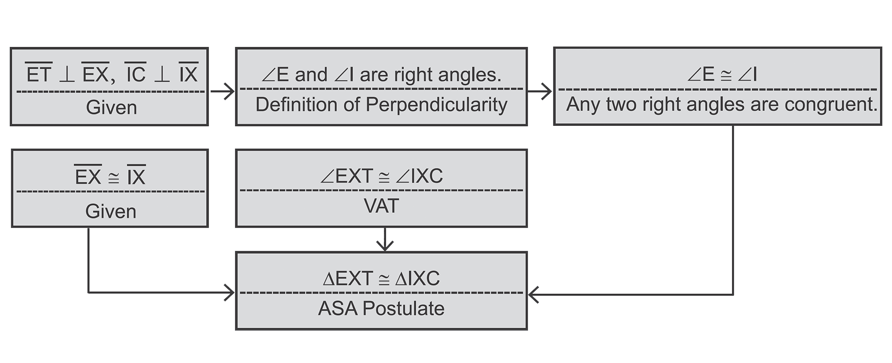
Proving Triangle Congruence
Example 6:
Given: ET ⊥ EX, IC ⊥ IX, EX ≅ IX
Prove: EXT ≅ IXC
Method 2: Flow Proof
Solution:
Method 1: Two-column Proof
Statements Reasons
1. ET ⊥ EX 1. Given
IC ⊥ IX
2. ∠E and ∠I are right angles. 2. Definition of Perpendicularity
(From statement 1)
3. E ≅ I 3. Any two right angles are congruent.
(From statement 2)
4. EX ≅ IX 4. Given
5. ∠EXT ≅ ∠IX 5. VAT (From the figure)
6. EXT ≅ IXC 6. ASA Postulate
(From statements 3, 4, and 5)
Rex Curriculum Resource
WWW.REX.COM.PH

Slide 18
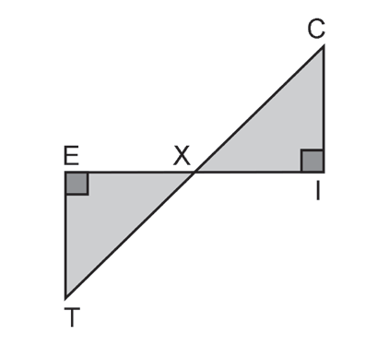
Activity:
CHECKPOINT 5:
Given: ∠E and ∠I are right angles
X is the midpoint of EI.
Prove: ΔEXT ≅ ΔIXC
Rex Curriculum Resource
WWW.REX.COM.PH

Slide 19
Activity:
CHECKPOINT 5 :
Given: ∠E and ∠I are right angles
X is the midpoint of EI.
Prove: ΔEXT ≅ ΔIXC
ANSWER KEY :
Proof:
Statements Reasons
1. ∠E and ∠I are right angles 1. Given
2. E ≅ I 2. Any two right angles are congruent
3. X is the midpoint of EI 3. Given
4. EX ≅ IX 4. Definition of midpoint
5. EXT ≅ IXT 5 . VAT
6. EXT ≅ IXC 6. ASA Postulate
Rex Curriculum Resource
WWW.REX.COM.PH

Slide 20
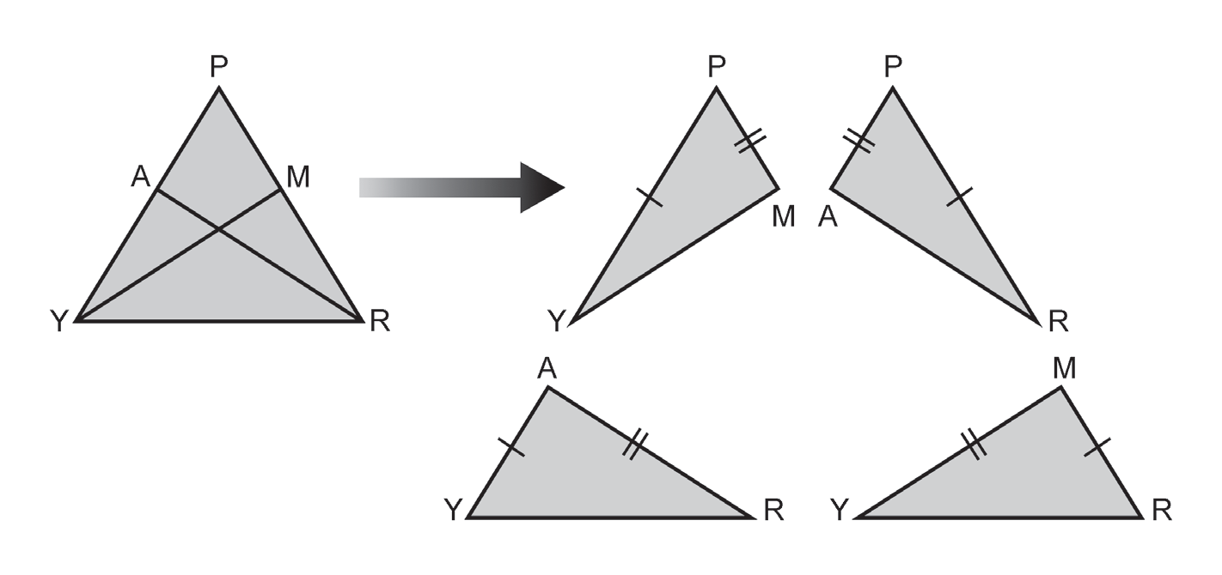
Proving Triangle Congruence
Example 7: Assume that in the following figures, PY ≅ PR and PA ≅ PM.
Prove that:
a. ΔPMY ≅ ΔPAR b. ΔAYR ≅ ΔMRY
Solution:
Sketch the triangles separately on the right figure.
Proof:
Statements Reasons
1. PY ≅ PR 1. Given
2. PA ≅ PM 2. Given
3. P ≅ P 3. Reflexive Property
4. EX ≅ IX 4. SAS Postulate
Rex Curriculum Resource
WWW.REX.COM.PH

Slide 21
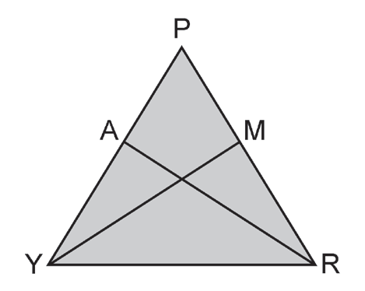
Activity:
CHECKPOINT 6:
In the figure, PY ≅ PR, AY ≅ MR,
AR ≅ MY, PA ≅ PM
Prove that: ΔAYR ≅ ΔMRY
ANSWER KEY :
Proof:
Statements Reasons
1. ∠E and ∠I are right angles 1. Given
2. E ≅ I 2. Any two right angles are congruent
3. X is the midpoint of EI 3. Given
4. EX ≅ IX 4. Definition of midpoint
5. EXT ≅ IXT 5 . VAT
6. EXT ≅ IXC 6. ASA Postulate
Rex Curriculum Resource
WWW.REX.COM.PH

Slide 22
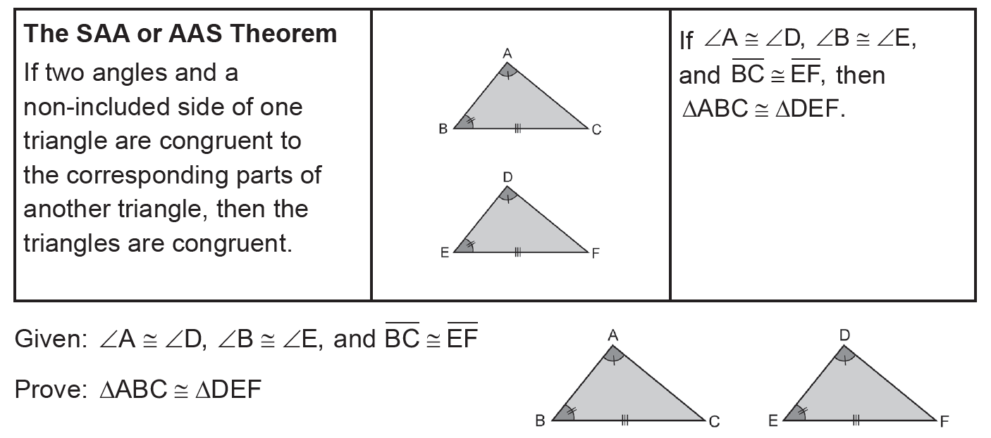
Proving Triangle Congruence
The other method of proving congruent triangles using three pairs of corresponding
parts is given below.
Plan for Proof:
We can prove that triangles are congruent if we can apply the SSS, SAS, or ASA Postulate. Here, we can use the ASA Postulate by first showing that ∠C ≅ ∠F. To do this, we can have ∠C ≅ ∠F by using the fact that if two angles of one
triangle are congruent to the two corresponding angles of another triangle, then their third angles are congruent.
Rex Curriculum Resource
WWW.REX.COM.PH

Slide 23
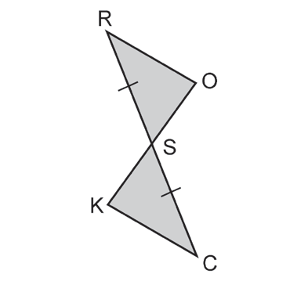
Proving Triangle Congruence
Example 8: Fill in the missing statements and reasons.
Given: SR ≅ SC, RO ll CK
Prove: ROS ≅ CKS
Proof:
Statements Reasons
1. SR ≅ SC 1. ________________________
2. _____________ 2. Given
3. ∠R ≅ ∠C 3. ________________________
4. _____________ 4. VAT
5. ΔROS ≅ ΔCKS 5. ________________________
Solution:
1. Given
2. RO ll CK
3. PAIC Theorem
4. ∠OSR ≅ ∠KSC
5. ASA Postulates
Rex Curriculum Resource
WWW.REX.COM.PH

Slide 24
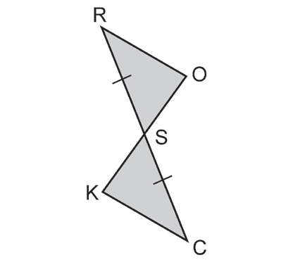
Activity:
CHECKPOINT 7:
Fill in the missing statements and reasons.
Given: SR ≅ SC, RO II CK
Prove: ΔROS ≅ ΔCKS
Proof:
Statements
1. _______________
2. RO || CK
3. O K
4. OSR KSC
5. ROS CKS
Reasons
1. Given
2. ________________
3. ________________
4. ________________
5. ________________
Rex Curriculum Resource
WWW.REX.COM.PH

Slide 25
Activity:
CHECKPOINT 7:
Fill in the missing statements and reasons.
Given: SR ≅ SC, RO II CK
Prove: ΔROS ≅ ΔCKS
Proof:
Statements
1. _______________
2. RO||CK
3. ∠O ≅ ∠K
4. ∠OSR ≅ ∠KSC
5. ΔROS ≅ ΔCKS
Reasons
1. Given
2. ________________
3. ________________
4. ________________
5. ________________
ANSWER KEY:
1. SR ≅ SC
2. Given
3. PAIC Theorem
4. VAT
5. SAA Theorem
Rex Curriculum Resource
WWW.REX.COM.PH

Slide 26


