Slide 1


Solving Corresponding Parts of
Congruent Triangles

Slide 2
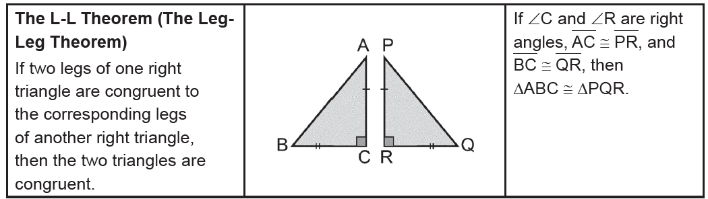
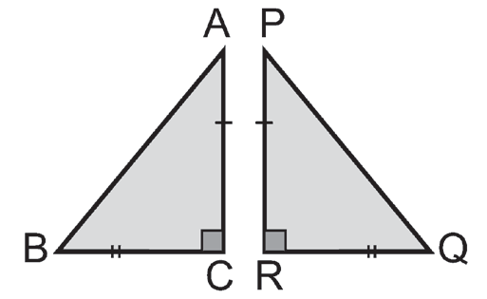
Solving Corresponding Parts of Congruent Triangles
The L-L Theorem (The Leg- Leg Theorem)
Given: ∠C and ∠R are right angles.
AC ≅ PR
BC ≅ QR
Prove: ΔABC ≅ ΔPQR
Proof:
Statements Reasons
1. ∠C and ∠R are right angles. 1. Given
2. ∠C ≅ ∠R 2. Any two right ∠s are congruent.
3. AC ≅ PR 3. Given
BC ≅ QR
4. ΔABC ≅ ΔPQR 4. SAS Postulate
Rex Curriculum Resource
WWW.REX.COM.PH

Slide 3
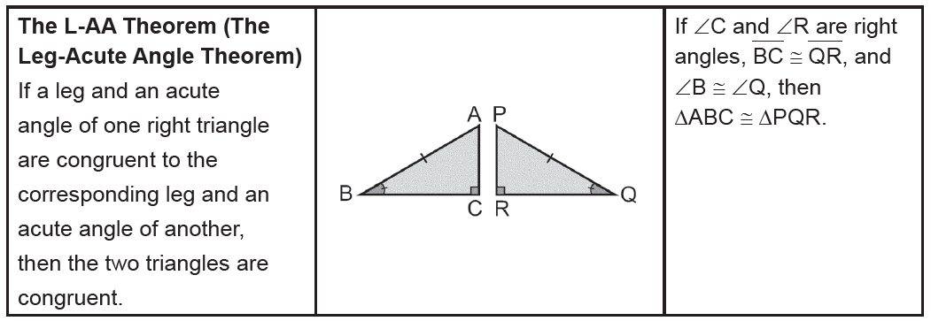
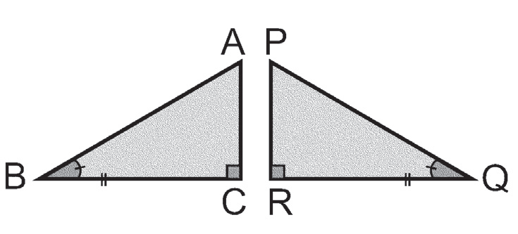
Solving Corresponding Parts of Congruent Triangles
The L-AA Theorem (The Leg-Acute Angle Theorem)
Given: ∠C and ∠R are right angles.
BC ≅ QR
∠B ≅ ∠Q
Prove: ΔABC ≅ ΔPQR
Proof:
Statements Reasons
1. ∠C and ∠R are right angles. 1. Given
2. ∠C ≅ ∠R 2. Any two right ∠s are congruent.
3. BC ≅ QR, ∠B ≅ ∠Q 3. Given
4. ΔABC ≅ ΔPQR 4. ASA Postulate
Rex Curriculum Resource
WWW.REX.COM.PH

Slide 4
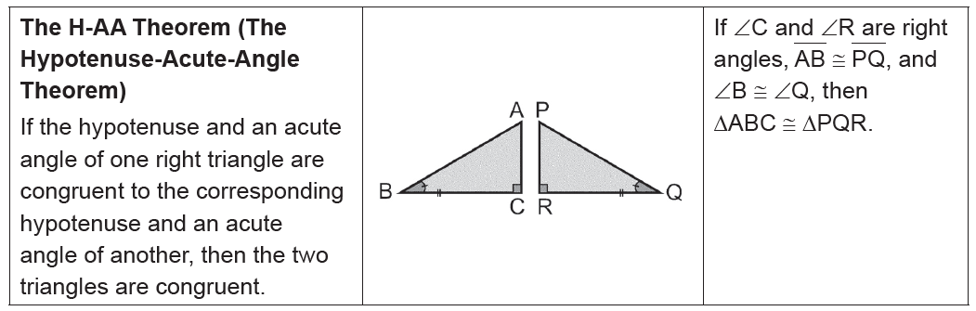
Solving Corresponding Parts of Congruent Triangles
The H-AA Theorem (The Hypotenuse-Acute-Angle Theorem)
Given: ∠C and ∠R are right angles.
AB ≅ PQ
∠B ≅ ∠Q
Prove: ΔABC ≅ ΔPQR
Proof:
Statements Reasons
1. ∠C and ∠R are right angles. 1. Given
2. ∠C ≅ ∠R 2. Any two right ∠s are congruent.
3. AB ≅ PQ, ∠B ≅ ∠Q 3. Given
4. ΔABC ≅ ΔPQR 4. SAA Theorem
Rex Curriculum Resource
WWW.REX.COM.PH

Slide 5
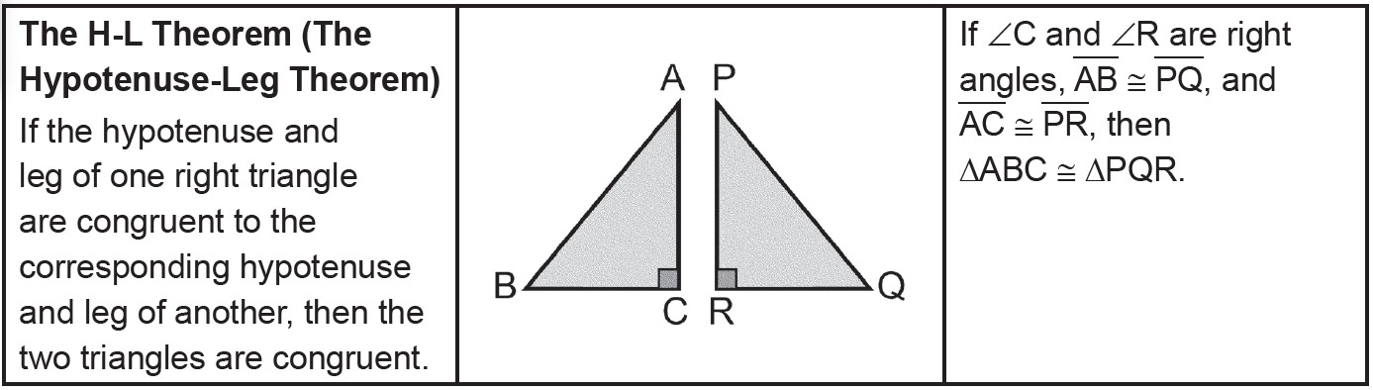
Solving Corresponding Parts of Congruent Triangles
The H-L Theorem (The Hypotenuse-Leg Theorem)
Rex Curriculum Resource
WWW.REX.COM.PH

Slide 6
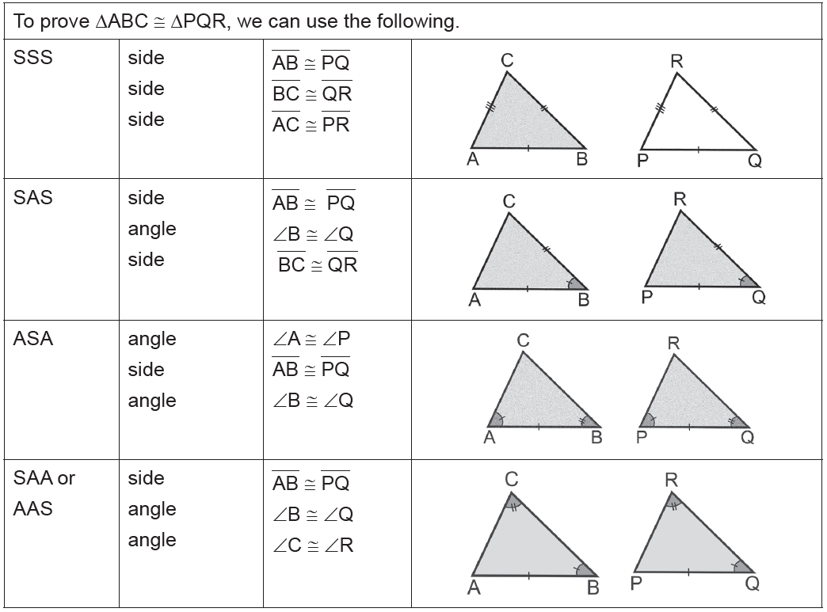
Solving Corresponding Parts of Congruent Triangles
We can now summarize the theorems and postulates that can be used to prove that two triangles are congruent.
Rex Curriculum Resource
WWW.REX.COM.PH

Slide 7
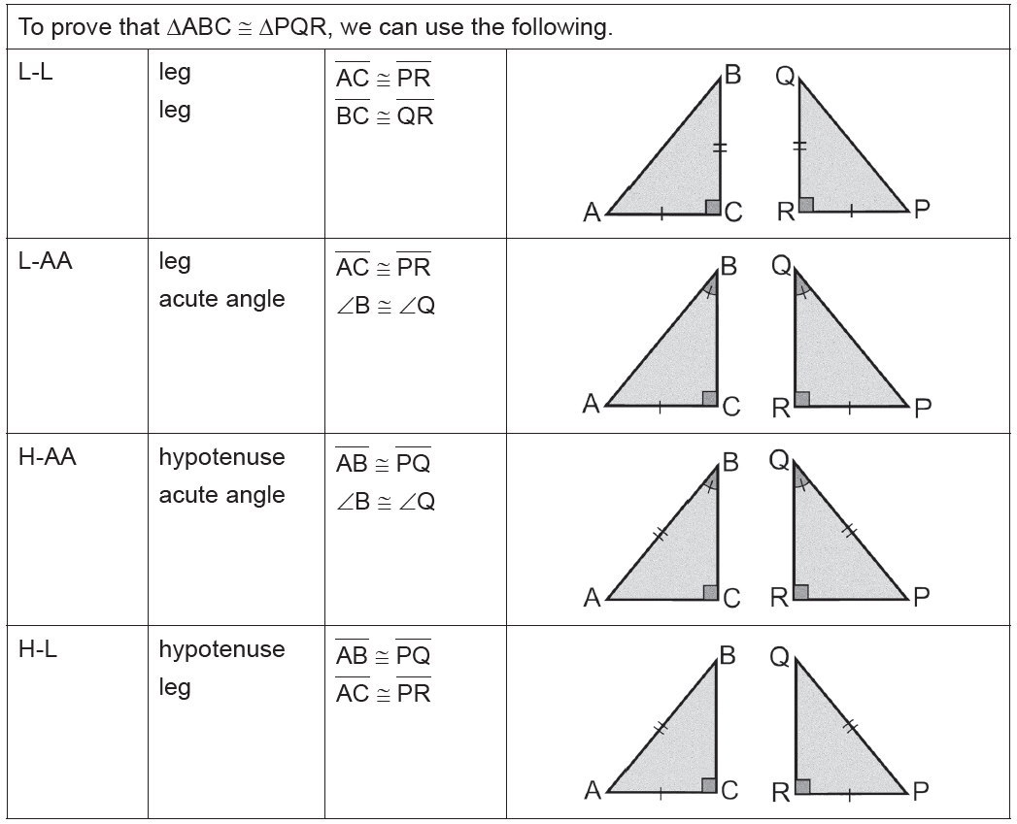
Solving Corresponding Parts of Congruent Triangles
We can now summarize the theorems and postulates that can be used to prove that two triangles are congruent.
Rex Curriculum Resource
WWW.REX.COM.PH

Slide 8
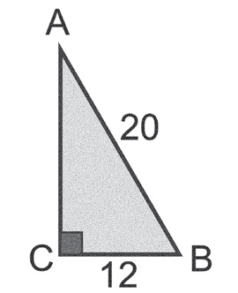
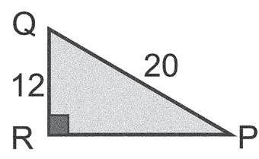
Solving Corresponding Parts of Congruent Triangles
Example 1:
Explain why the two triangles, shown below, are congruent.
Solution:
You are given that ∠C and ∠R are right angles. ΔABC and ΔPQR are right triangles. The hypotenuses of the triangles are AB and PQ. You are given that AB ≅ PQ.
The legs BC and QR are also congruent. Thus, ΔABC ≅ ΔPQR by the H-L Theorem.
Rex Curriculum Resource
WWW.REX.COM.PH

Slide 9
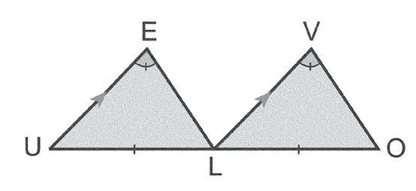
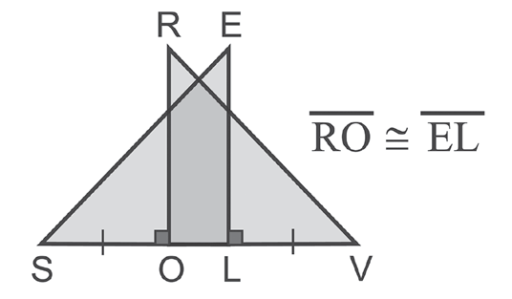
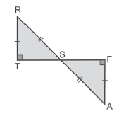
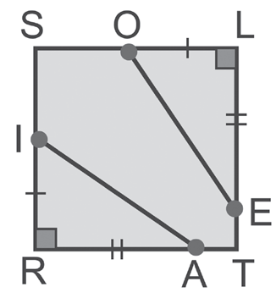
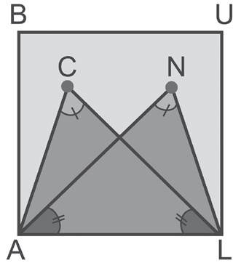
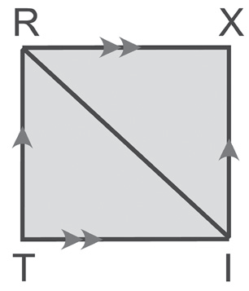
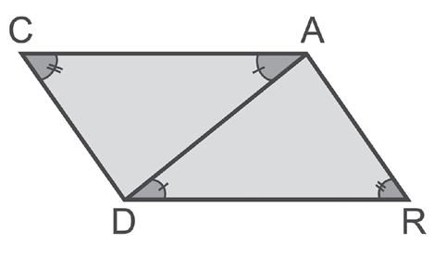
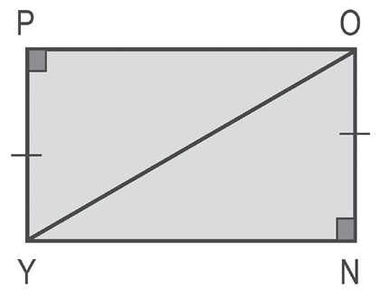
Solving Corresponding Parts of Congruent Triangles
Example 2:
State which congruence theorems or postulates can be used to prove
that the given triangles are congruent. If no method applies, say none.
a. ΔELU and ΔVOL d. ΔSEL and ΔVRO g. ΔRIT and ΔIRX
b. ΔOLE and ΔIRA e. ΔCAL and ΔNLA h. ΔRTS and ΔAFS
c. ΔCAD and ΔRDA f. ΔPOY and ΔNYO
0
Rex Curriculum Resource
WWW.REX.COM.PH

Slide 10
Solving Corresponding Parts of Congruent Triangles
Example 2:
State which congruence theorems or postulates can be used to prove
that the given triangles are congruent. If no method applies, say none.
a. ΔELU and ΔVOL d. ΔSEL and ΔVRO g. ΔRIT and ΔIRX
b. ΔOLE and ΔIRA e. ΔCAL and ΔNLA h. ΔRTS and ΔAFS
c. ΔCAD and ΔRDA f. ΔPOY and ΔNYO
0
Rex Curriculum Resource
WWW.REX.COM.PH

Slide 11
Solving Corresponding Parts of Congruent Triangles
Example 2:
State which congruence theorems or postulates can be used to prove
that the given triangles are congruent. If no method applies, say none.
Solution:
a. ∠E ≅ ∠V Given
UL ≅ LO Given
∠E ≅ ∠V PAIC Theorem
Use the SAA Congruence Theorem to conclude that ΔELU ≅ ΔVOL.
b. OL ≅ IR Given
LE ≅ RA Given
∠L and ∠R are right angles and are congruent.
Use the SAS Congruent Postulate or the L-L Congruence Theorem to conclude that ΔOLE ≅ ΔIRA.
c. ∠C ≅ ∠R Given
∠CAD ≅ ∠RDA Given
AD ≅ AD Reflexive Property
Use the SAA Congruence Theorem to conclude that ΔCAD ≅ ΔRDA.
d. EL ≅ RO Given
SL ≅ VO Given and Definition of Betweenness
∠SLE ≅ ∠VOR ST
Use the SAS Congruent Postulate or the L-L Congruence Theorem to conclude that ΔSEL ≅ ΔVRO.
e. ∠C ≅ ∠N Given
∠ALC ≅ ∠LAN Given
AL ≅ AL Reflexive Property
Use the SAA Congruence Theorem to conclude that ΔCAL ≅ ΔNLA.
f. PY ≅ NO Given
∠P and ∠N are right angles.
OY ≅ OY Reflexive Property
Use the H-L Congruence Theorem to conclude that ΔPOY ≅ ΔNYO.
g. RI ≅ RI Reflexive Property
∠TRI ≅ ∠XIR PAIC Theorem
∠TIR ≅ ∠XRI PAIC Theorem
Use the ASA Congruence Postulate to conclude that ΔRIT ≅ ΔIRX.
h. RT ≅ AF Given
RS ≅ AS Given
∠T and ∠F are right angles.
Use the H-L Congruence Theorem to conclude that ΔRTS ≅ ΔAFS.
Rex Curriculum Resource
WWW.REX.COM.PH

Slide 12
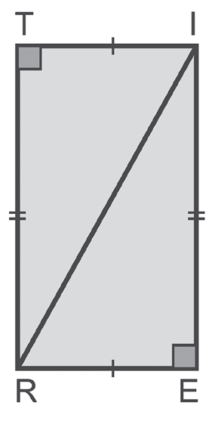
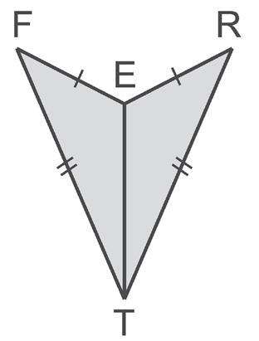
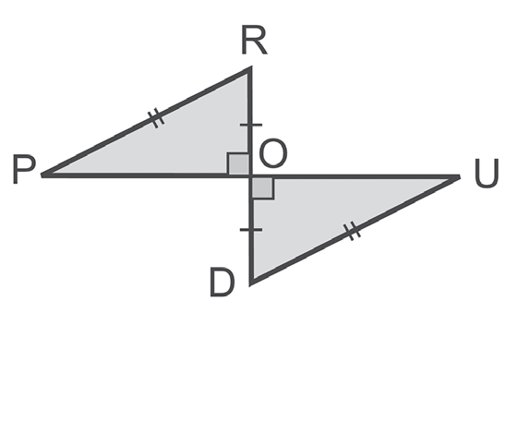
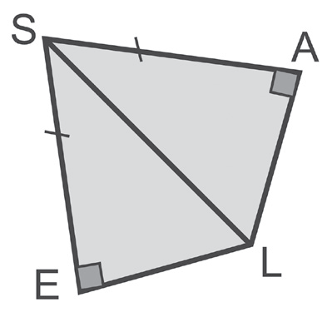
Activity:
CHECKPOINT 1:
State which congruence method(s) can be used to prove that the given triangles
are congruent. If no method applies, say none.
a. ΔITR and ΔREI b. ΔFET and ΔRET c. ΔROP and ΔDOU d.ΔSAL and ΔSEL
Rex Curriculum Resource
WWW.REX.COM.PH

Slide 13
Activity:
CHECKPOINT 1:
State which congruence method(s) can be used to prove that the given triangles
are congruent. If no method applies, say none.
a. ΔITR and ΔREI b. ΔFET and ΔRET c. ΔROP and ΔDOU d.ΔSAL and ΔSEL
ANSWER KEY
a. L-L Theorem
b. SSS Postulate
c. H-L Theorem
d. H-L Theorem
Rex Curriculum Resource
WWW.REX.COM.PH

Slide 14
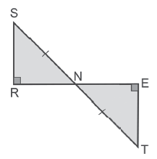
Solving Corresponding Parts of Congruent Triangles
Example 3:
Fill in the missing statements and reasons.
Given: SN ≅ TN Prove: ΔSRN ≅ ΔTEN
SR ┴ RE
TE ┴ RE
Proof:
Statements Reasons
1. ________________________ 1. Given
2. SR ┴ RE 2. ________________________
3. ________________________ 3. Given
4. ∠R and ∠E are right angles. 4. ________________________
5. ∠R ≅ ∠E 5. ________________________
6. ________________________ 6. VAT
7. ΔSRN ≅ ΔTEN 7. ________________________
Solution:
1. SN ≅ TN
2. Given
3. TE ┴ RE
4. Definition of perpendicularity
5. Any two right angles are congruent.
6. ∠SNR ≅ ∠TNE
7. HAA Congruence Theorem
Rex Curriculum Resource
WWW.REX.COM.PH

Slide 15
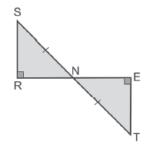
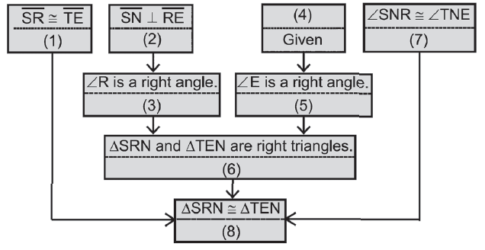
Activity:
CHECKPOINT 2:
Fill in the missing statements and reasons.
Given: SN ≅ TN
SR ┴ RE
TE ┴ RE
Prove: ΔSRN ≅ ΔTEN
Rex Curriculum Resource
WWW.REX.COM.PH

Slide 16
Activity:
CHECKPOINT 2:
Fill in the missing statements and reasons.
Given: SN ≅ TN
SR ┴ RE
TE ┴ RE
Prove: ΔSRN ≅ ΔTEN
ANSWER KEY
1. Given
2. Given
3. Definition of perpendicularity
4. TE ┴ RE
5. Definition of perpendicularity
6. Definition of right triangle
7. VAT
8. H-AA Theorem
Rex Curriculum Resource
WWW.REX.COM.PH

Slide 17
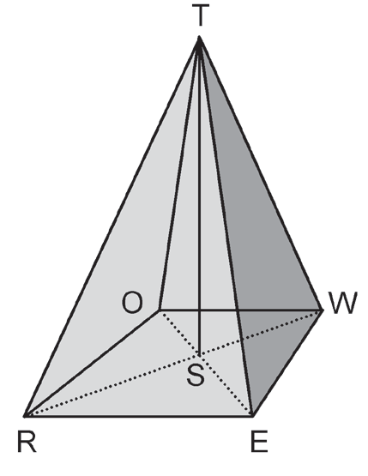
Solving Corresponding Parts of Congruent Triangles
Example 4:
A tower is supported by four cables, all of the same
length. Show that the tower, the support cables, and the ground
determine four congruent triangles.
Solution:
The tower is perpendicular to the ground. Therefore, ΔTSR, ΔTSE, ΔTSW, and ΔTSO are right triangles with a common leg, TS. The four support cables TR, TE, TW, and TO are the hypotenuses of the right triangles. They are all congruent. By the H-L Theorem, ΔTSR ≅ ΔTSE ≅ ΔTSW ≅ ΔTSO.
Rex Curriculum Resource
WWW.REX.COM.PH

Slide 18
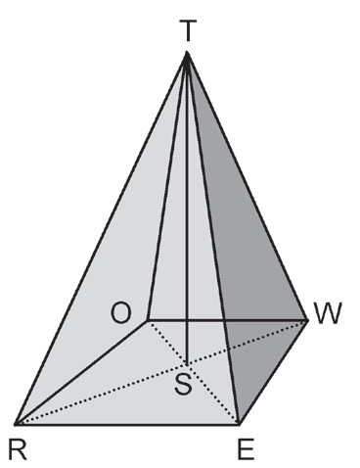
Activity:
CHECKPOINT 3:
A tower is supported by four cables, all of the same length. Show that
ΔTSR ≅ ΔTSW ≅ ΔEST ≅ ΔOST.
Rex Curriculum Resource
WWW.REX.COM.PH

Slide 19
Activity:
CHECKPOINT 3:
A tower is supported by four cables, all of the same length. Show that
ΔTSR ≅ ΔTSW ≅ ΔEST ≅ ΔOST.
ANSWER
The triangle can be proven congruent using the H-L Theorem.
Rex Curriculum Resource
WWW.REX.COM.PH

Slide 20
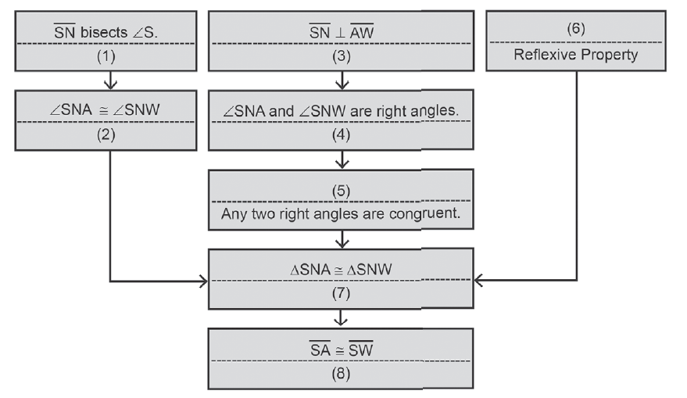
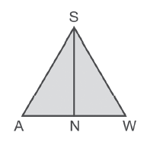
Solving Corresponding Parts of Congruent Triangles
By definition, if two triangles are congruent, then their corresponding parts are also congruent. It follows that the corresponding parts of congruent triangles are congruent (CPCTC). Thus, when writing proof that involve congruent triangles, we just need to identify the corresponding parts and show that the corresponding sides and corresponding angles of the corresponding triangles are congruent. CPCTC can also be used to find the measures of angles and show that lines or segments are parallel or perpendicular.
Example 5:
Fill in the missing statements and reasons.
Given: SN bisects ∠S and SN ┴ AW
Prove: SA ≅ SW
Proof:
Solution:
1. Given 5. ∠SNA ≅ ∠SNW
2. Definition of angle bisector 6. SN ≅ SN
3. Given 7. ASA Postulate
4. Definition of perpendicularity 8. CPCTC
Rex Curriculum Resource
WWW.REX.COM.PH

Slide 21
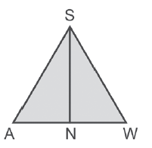
Activity:
CHECKPOINT 4:
Fill in the missing statements and reasons.
Given: SN bisects ∠S and SN ┴ AW
Prove: SA ≅ SW
Statements Reasons
1. ________________ 1. ________________
2. ________________ 2. Definition of angle bisector
3. ________________ 3. Given
4. ∠SNA and ∠SNW are right angles. 4. ________________
5 ΔSNA and ΔSNW are right angles. 5. ________________
6. SN ≅ SN 6. ________________
7. ΔSNA ≅ ΔSNW 7. ________________
8. ________________ 8. CPCTC
Rex Curriculum Resource
WWW.REX.COM.PH

Slide 22
Activity:
CHECKPOINT 4:
Fill in the missing statements and reasons.
Given: SN bisects ∠S and SN ┴ AW
Prove: SA ≅ SW
Statements Reasons
1. ________________ 1. ________________
2. ________________ 2. Definition of angle bisector
3. ________________ 3. Given
4. ∠SNA and ∠SNW are right angles. 4. ________________
5 ΔSNA and ΔSNW are right angles. 5. ________________
6. SN ≅ SN 6. ________________
7. ΔSNA ≅ ΔSNW 7. ________________
8. ________________ 8. CPCTC
ANSWER
1. SN bisects ∠S
2. ∠ASN ≅ ∠WSN
3. SN ┴ AW
4. Definition of perpendicularity
5. Definition of right triangle
6. Reflexive Property
7. H-L Theorem
8. SA ≅ SW
Rex Curriculum Resource
WWW.REX.COM.PH

Slide 23


