Slide 1


Proving Isosceles Triangles Congruence

Slide 2
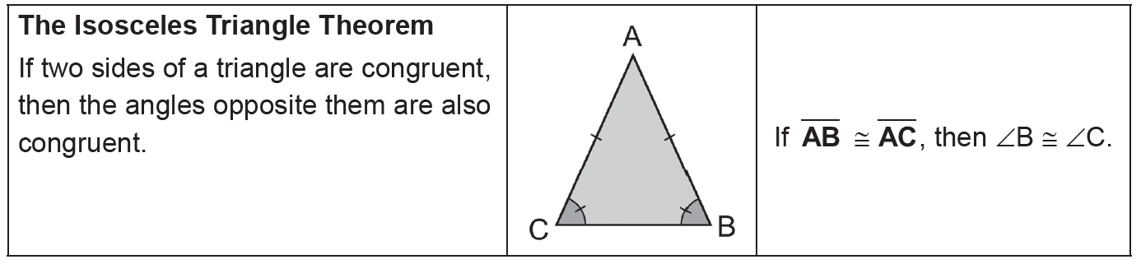
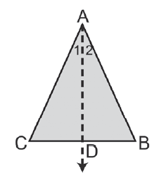
Proving Isosceles Triangles Congruence
The Isosceles Triangle Theorem
Now, let us see the proof for this theorem.
Draw an auxiliary line to form two triangles that can be proven congruent.
Given: ΔABC with AB ≅ AC
Prove: ∠B ≅ ∠C
Proof:
Statements Reasons
1. AB ≅ AC 1. Given
2. Draw AD as angle bisector of 2. Every angle has exactly one bisector.
∠A intersecting BC at D.
3. ∠1 ≅ ∠2 3. Definition of an angle bisector
4. AD ≅ AD 4. Reflexive Property
5. ΔABD ≅ ΔACD 5. SAS Postulate
6. ∴∠B ≅ ∠C 6. CPCTC
Since isosceles triangles are triangles with at least two equal sides, the equilateral triangle, which has three equal sides, is a special case of an isosceles triangle. From this, we have the following corollary.
Corollary:
• An equilateral triangle is also equiangular.
• An equilateral triangle has three 60° angles.
Prove the two corollaries.
Now, let us look at the converse of the Isosceles Triangle Theorem. Again, when we say converse, we are interchanging the hypothesis and conclusion of the statement.
Rex Curriculum Resource
WWW.REX.COM.PH

Slide 3
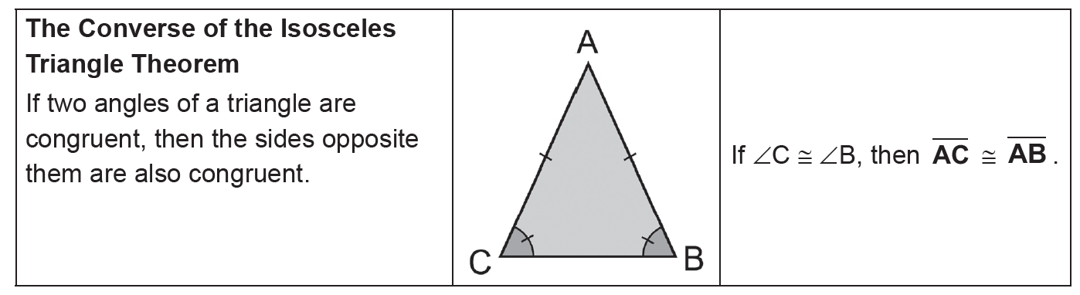
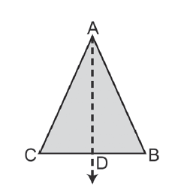
Proving Isosceles Triangles Congruence
The Converse of the Isosceles Triangle Theorem
Let us now find out the proof of this theorem.
Given: ∠B ≅ ∠C
Prove: AB ≅ AC
Proof:
Statements Reasons
1. Let AD be a bisector of ∠BAC. 1. Every angle has a bisector.
2. ∠BAD ≅ ∠CAD 2. Definition of an angle bisector
3. ∠B ≅ ∠C 3. Given
4. AD ≅ AD 4. Reflexive Property
5. ΔADB ≅ ΔADC 5. SAA Theorem
6. AB ≅ AC 6. CPCTC
From this theorem, we can derive the corollary below.
The proof of the corollary is left for you to do.
Corollary:
An equiangular triangle is also equilateral.
Rex Curriculum Resource
WWW.REX.COM.PH

Slide 4
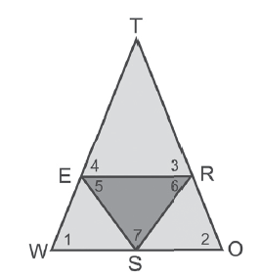
Proving Isosceles Triangles Congruence
Let us now have examples.
Example 1:
Refer to the figure above
a. If ∠5 ≅ ∠6, name two congruent segments.
b. If TE ≅ TR , name two congruent angles.
c. If ∠1 ≅ ∠2, name two congruent segments.
Solution:
a. SE ≅ SR b. ∠4 ≅ ∠3 c. TW ≅ TO
Rex Curriculum Resource
WWW.REX.COM.PH

Slide 5
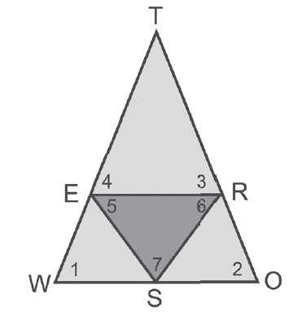
Activity:
CHECKPOINT 1:
Refer to the figure above:
a. If ∠3 ≅ ∠4, name two congruent segments.
b. If ES ≅ RS, name two congruent angles.
c. If TW ≅ TO, name two congruent segments.
Rex Curriculum Resource
WWW.REX.COM.PH

Slide 6
Proving Isosceles Triangles Congruence
Activity: ANSWER KEY
CHECKPOINT 1:
Refer to the figure above:
a. If ∠3 ≅ ∠4, name two congruent segments.
b. If ES ≅ RS, name two congruent angles.
c. If TW ≅ TO, name two congruent segments.
ANSWERS:
Checkpoint 1
a. TE ≅ TR
b. ∠5 ≅ ∠6
c. ∠1 ≅ ∠2
Rex Curriculum Resource
WWW.REX.COM.PH

Slide 7
Proving Isosceles Triangles Congruence
Example 2:
In isosceles ΔPRO with base RO, m∠R = 4x – 15, and m∠O = 2x + 25, find the measures of the base angles.
Solution:
m∠R = m∠O The Isosceles Triangle Theorem
4x – 15 = 2x + 25 Substitute the value of m∠R and m∠O.
2x = 40
x = 20
Substituting the value of x, we have,
m∠R = 4x – 15 m∠O = 2x + 25
= 4(20) – 15 or 65 = 2(20) + 25 or 65
It is now your turn to answer a similar problem to the example above.
Rex Curriculum Resource
WWW.REX.COM.PH

Slide 8
Activity:
CHECKPOINT 2:
In isosceles ΔPRO with base RO, m∠R = 4x – 15, and m∠O = 2x + 25, find the measures of the vertex angle.
Rex Curriculum Resource
WWW.REX.COM.PH

Slide 9
Activity: ANSWER KEY
CHECKPOINT 2:
In isosceles ΔPRO with base RO, m∠R = 4x – 15, and m∠O = 2x + 25, find the measures of the vertex angle.
ANSWER:
Checkpoint 2
Measures of the vertex angle. = 50°
Rex Curriculum Resource
WWW.REX.COM.PH

Slide 10
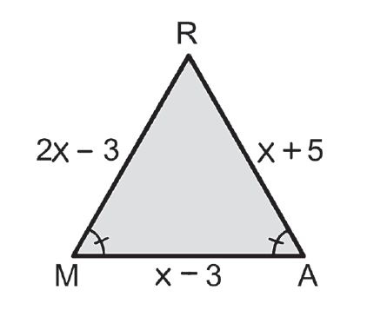
Proving Isosceles Triangles Congruence
Example 3:
Find the length of each side of ΔRAM.
Solution:
Because ∠M ≅ ∠A, then by the converse of the Isosceles Triangle Theorem, RM ≅ RA . Then, RM = RA.
2x − 3 = x + 5
x = 8
Substituting the value of x for each sides, we have,
RM = 2x − 3 RA = x + 5 MA = x − 3
= 2(8) − 3 = 8 + 5 = 8 − 3
= 13 = 13 = 5
Rex Curriculum Resource
WWW.REX.COM.PH

Slide 11
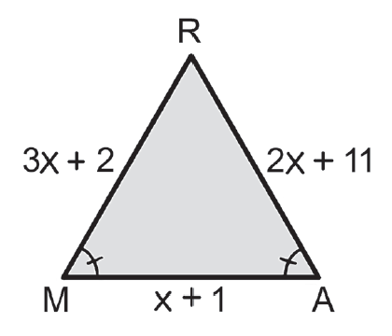
Activity:
CHECKPOINT 3:
Find the length of each side of ΔRAM.
Rex Curriculum Resource
WWW.REX.COM.PH

Slide 12
Activity: ANSWER KEY
CHECKPOINT 3:
Find the length of each side of ΔRAM.
ANSWER
Checkpoint 3
MR = 29
RA = 29
MA = 10
Rex Curriculum Resource
WWW.REX.COM.PH

Slide 13
Proving Isosceles Triangles Congruence
Example 4:
In ΔREX, ER ≅ EX, m∠R is 8 less than twice a number, and m∠X is 15 more than the same number. Find m∠E.
Solution:
Since ER ≅ EX, ∠R ≅ ∠X because of the Isosceles Triangle Theorem. Thus, m∠R = m∠X. Then, substituting the value of m∠R and m∠X, we have,
2x − 8 = x + 15
x = 23
Substituting the value of x, we have,
m∠R = 2x − 8 m∠X = x + 15
= 2(23) − 8 = 23 + 15
= 38 = 38
Solving for m∠E,
m∠R + m∠E + m∠X = 180 The sum of the measures of the angles of a triangle is 180.
38 + m∠E + 38 = 180 Replace m∠R with 38 and m∠X with 38.
m∠E + 76 = 180
m∠E = 104
Rex Curriculum Resource
WWW.REX.COM.PH

Slide 14
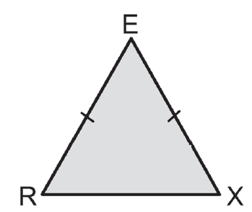
Activity:
CHECKPOINT 4:
In ΔREX, m∠R = x + 70 and m∠X = 2x + 15.
What is the measure of ∠E?
Rex Curriculum Resource
WWW.REX.COM.PH

Slide 15
Activity: ANSWER KEY
CHECKPOINT 4:
In ΔREX, m∠R = x + 70 and m∠X = 2x + 15.
What is the measure of ∠E?
ANSWER
Checkpoint 4
m∠E = 47
Rex Curriculum Resource
WWW.REX.COM.PH

Slide 16
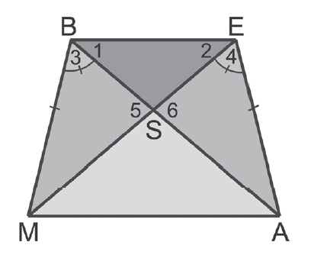
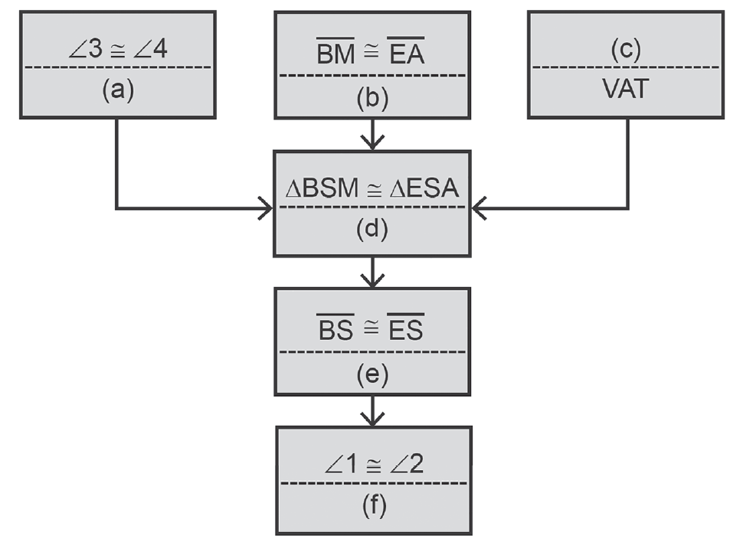
Proving Isosceles Triangles Congruence
Example 5:
Complete the proof.
Given: ∠3 ≅ ∠4 and BM ≅ EA
Prove: ∠1 ≅ ∠2
Proof:
Solution:
a. Given
b. Given
c. ∠5 ≅ ∠6
d. SAA Theorem
e. CPCTC
f. The Isosceles Triangle Theorem
Rex Curriculum Resource
WWW.REX.COM.PH

Slide 17
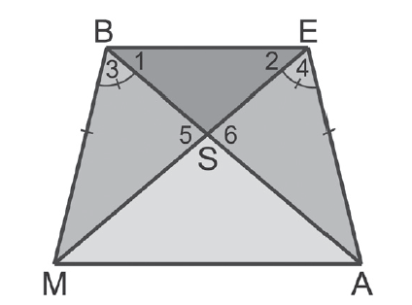
Activity:
CHECKPOINT 5:
Complete the proof.
Given: ∠3 ≅ ∠4 and BM ≅ EA
Prove: ∠1 ≅ ∠2
Statements Reasons
1. BM ≅ EA 1. Given
2. ____________ 2. Given
3. ∠5 ≅ ∠6 3. ____________
4. ΔMBS ≅ ΔAES 4. ____________
5. ____________ 5. CPCTC
6. ____________ 6. ____________
Rex Curriculum Resource
WWW.REX.COM.PH

Slide 18
Activity: ANSWER KEY
CHECKPOINT 5:
Complete the proof.
Given: ∠3 ≅ ∠4 and BM ≅ EA
Prove: ∠1 ≅ ∠2
Statements Reasons
1. BM ≅ EA 1. Given
2. ____________ 2. Given
3. ∠5 ≅ ∠6 3. ____________
4. ΔMBS ≅ ΔAES 4. ____________
5. ____________ 5. CPCTC
6. ____________ 6. ____________
ANSWER:
Checkpoint 5
2. ∠3 ≅ ∠4
3. VAT
4. SAA Theorem
5. BS ≅ ES
6. ∠1 ≅ ∠2; The Isosceles Triangle Theorem
Rex Curriculum Resource
WWW.REX.COM.PH

Slide 19


