Slide 1


Midline Theorem and Theorems
on Trapezoids and Kites

Slide 2
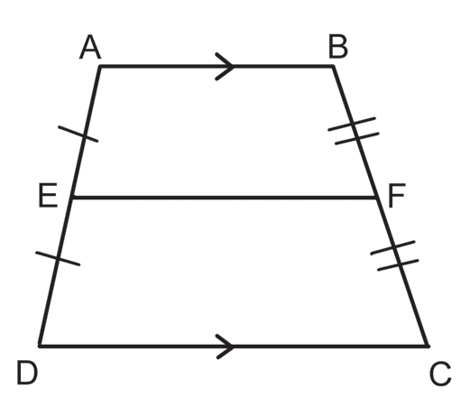
Midline Theorem and Theorems on Trapezoids and Kites
We define a trapezoid as a convex quadrilateral with exactly one pair of parallel sides. These parallel sides are called the bases of the trapezoid. In trapezoid. ABCD, AB, and DC are the bases, and AD and BC are the legs. In trapezoid ABCD, E and F are the midpoints of AD and BC , respectively. The segment EF, which joins the midpoints of the nonparallel sides of a trapezoid is called the midline or median of the trapezoid.
Rex Curriculum Resource
WWW.REX.COM.PH

Slide 3
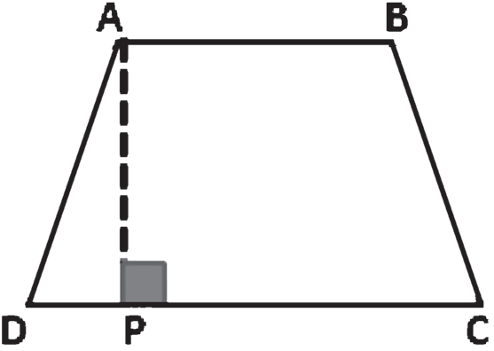
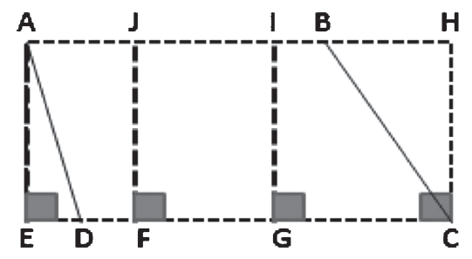
Midline Theorem and Theorems on Trapezoids and Kites
Definition
A trapezoid is a convex quadrilateral with exactly one pair of parallel sides. The bases of a trapezoid are two parallel sides. The legs of a trapezoid are two nonparallel sides. An isosceles trapezoid is a trapezoid with congruent legs. The median of a trapezoid is the segment that joins the midpoints of the legs.
Definition
An altitude of a trapezoid is any segment from a point on one base perpendicular to the line containing the other base. |  | In trapezoid ABCD, AP is an altitude.
A triangle has exactly three altitudes. However, a trapezoid can have many. AE , JF , IG, and HC are altitudes of trapezoid ABCD.
Rex Curriculum Resource
WWW.REX.COM.PH

Slide 4
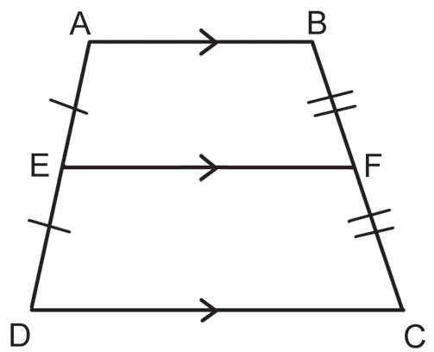
Midline Theorem and Theorems on Trapezoids and Kites
Theorem 1
The median of a trapezoid is parallel to its bases, and its length is half the sum of the lengths of its bases. |  | If EF is a median of trapezoid ABCD, then, EF II AB II DC and EF = 1/2 (AB + DC).
Rex Curriculum Resource
WWW.REX.COM.PH

Slide 5
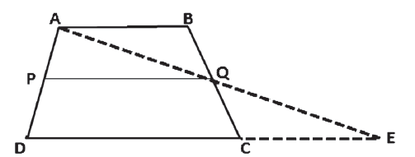
Midline Theorem and Theorems on Trapezoids and Kites
Theorem 1
Given: Trapezoid ABCD with median PQ.
Prove: PQ II AB II DC and PQ = ½ (AB + DC)
Proof:
Statements | Reasons
1. Trapezoid ABCD with median PQ | 1. Given
2. Let AQ and DC be extended and meet at E. | 2. The line postulate at E
3. AB II DC | 3. Definition of a trapezoid
4. BQ II CQ | 4. Definition of median of a trapezoid
5. ABQ ≅ ECQ | 5. PAIC theorem
6. ∠BQA ≅ ∠CQE | 6. VAT
7. ΔABQ ≅ ΔECQ | 7. ASA Postulate
8. AB ≅ EC AQ ≅ EQ | 8. CPCTC
9. PQ II DE and PQ = 1/2 DE | 9. The median of a triangle is parallel to the third side and is half as long.
10. PQ II AB | 10. A line parallel to one of two parallel lines is parallel to the other line.
11. DE = DC + EC | 11. Definition of betweenness
12. AB + EC | 12. Definition of congruent segments
13. DE = DC + AB | 13. Law of Substitution
14. PQ = 1/2 (AB + DC) | 14. Law of Substitution
Rex Curriculum Resource
WWW.REX.COM.PH

Slide 6
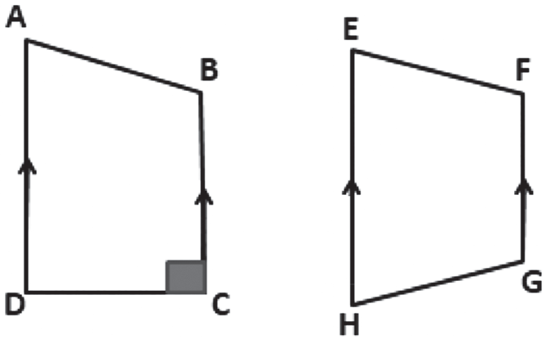
Midline Theorem and Theorems on Trapezoids and Kites
Example 1:
Use the trapezoids below to answer the following.
a. Which sides are the bases?
b. Which sides are the legs?
c. Which sides/s is/are the altitudes/s?
Solution:
a. The bases are the parallel sides. So, AD and BC and EH, and FG are the bases.
b. The legs are the nonparallel sides. So, AB and DC, and EF and HG are the legs.
c. CD is an altitude.
Rex Curriculum Resource
WWW.REX.COM.PH

Slide 7
Midline Theorem and Theorems on Trapezoids and Kites
Example 2:
Given: □TONE is a trapezoid with median RS .
a. If TO = 18 EN = 24, find RS.
b. If TO = 2x – 5, RS = 10, and EN = 3x + 10, find x.
Solution:
a. By Theorem 1, RS is equal to half the sum of TO and EN.
RS TO EN = ½ (TO + EN)
= ½ (18 + 24) Replace TO by 18 and EN by 24.
= ½
= 21 Simplify.
b. By Theorem 1, RS = ½ (TO + EN)
RS = ½ (TO + EN)
10 = ½ (2x -5 +3x +10) Substitute 10 for RS, 2x − 5 for TO and 3x + 10 for EN.
20 = (5x + 5) Multiply each side by 2 and simplify.
15 = 5x Subtract 5 from each side.
3 = x Divide both by 5.
Rex Curriculum Resource
WWW.REX.COM.PH

Slide 8
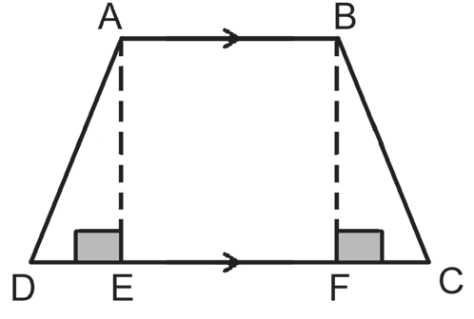
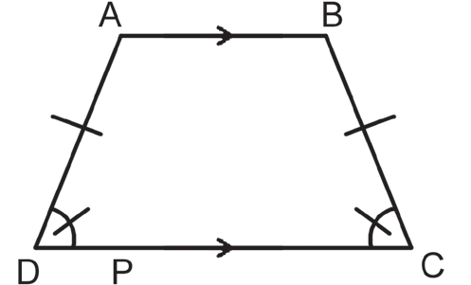
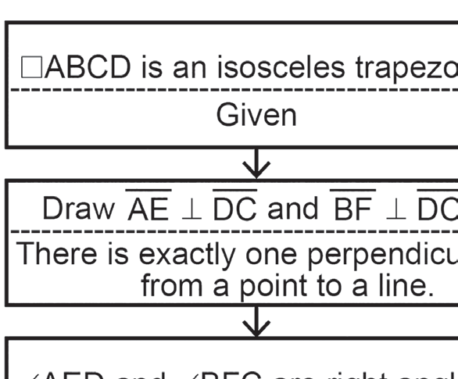
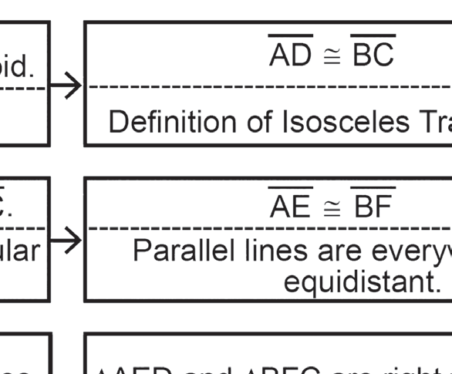
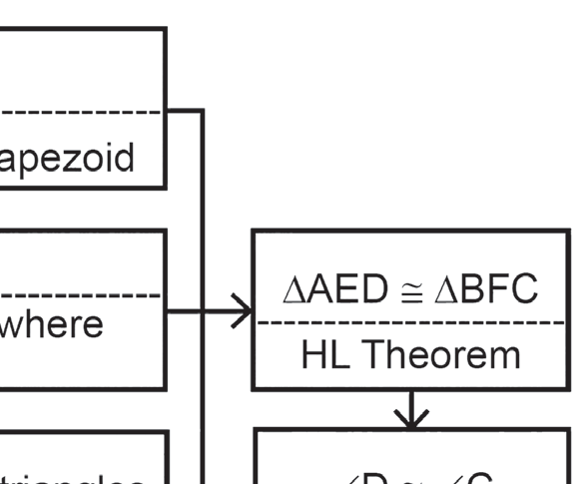
Midline Theorem and Theorems on Trapezoids and Kites
Theorem 2
Given: ABCD is an isosceles trapezoid.
Prove: ∠D ≅ ∠C
Proof:
The base angles of an isosceles trapezoid are congruent. |  | If □ABCD is an isosceles trapezoid, then ∠D ≅ ∠C.
Proof:
Rex Curriculum Resource
WWW.REX.COM.PH

Slide 9
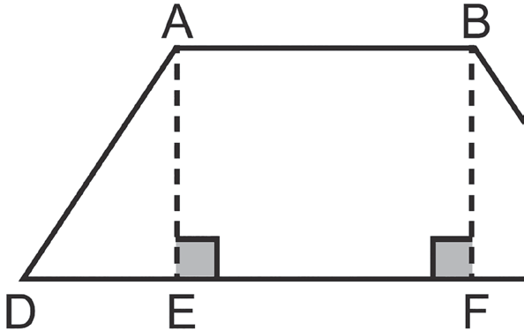
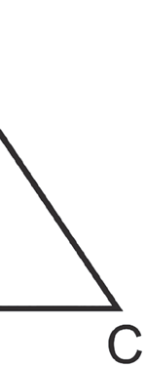
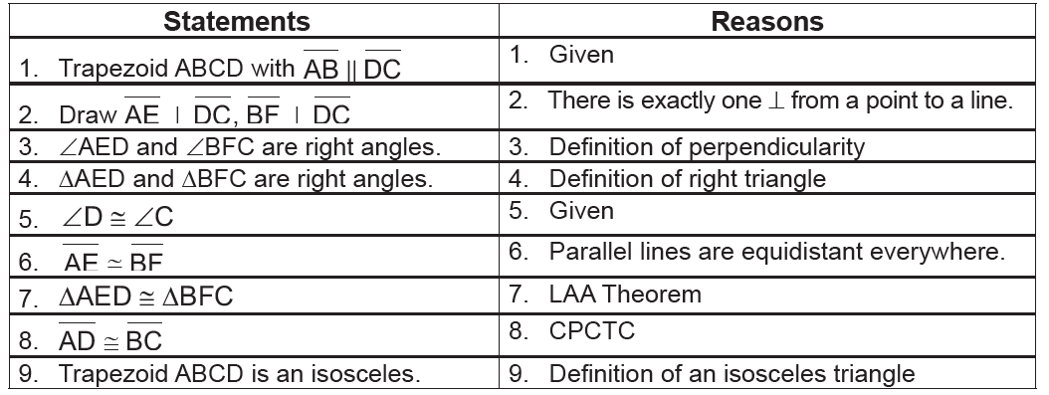
Midline Theorem and Theorems on Trapezoids and Kites
Theorem 3
Given: Trapezoid ABCD with AB II DC and ∠D ≅ ∠C.
Prove: Trapezoid ABCD is isosceles.
If the base angles of a trapezoid are congruent, then the trapezoid is an isosceles. |  | If ∠D ≅ ∠C in trapezoid □ABCD, then ABCD is an isosceles trapezoid.
Proof:
Rex Curriculum Resource
WWW.REX.COM.PH

Slide 10
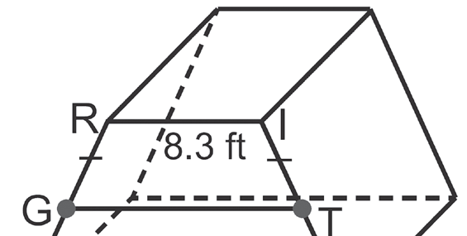
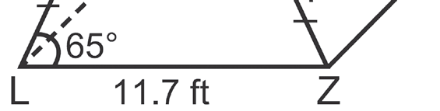
Midline Theorem and Theorems on Trapezoids and Kites
Example 3:
The four lateral faces of the monument base are isosceles trapezoids. Find the measures of ∠IZL, ∠IRL,
and GT.
Solution:
a. By Theorem 2, ∠IZL ≅ ∠RLZ. So,
m∠IZL = m∠RLZ = 65°.
Since RIZL is a trapezoid with RI  LZ, ∠RLZ and ∠IRL are supplementary. So,
m∠IRL + m∠RLZ = 180
m∠IRL + 65 = 180
m∠IRL = 180 − 65
m∠IRL = 115
b. By Theorem 1, GT = 1/2 (RI+LZ)
GT = ½ (8.3+11.7)
GT = 10 ft.
Rex Curriculum Resource
WWW.REX.COM.PH

Slide 11
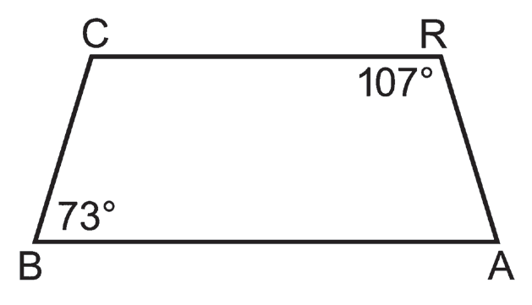
Midline Theorem and Theorems on Trapezoids and Kites
Example 4:
In trapezoid CRAB, CR II BA. If m∠R = 107and m∠B = 73. Is CRAB an isosceles?
Solution:
Since ∠R and A are the same side interior angles and CR II BA, m∠A = 180 − 107 = 73.
By Theorem 3, trapezoid CRAB is an isosceles.
Rex Curriculum Resource
WWW.REX.COM.PH

Slide 12
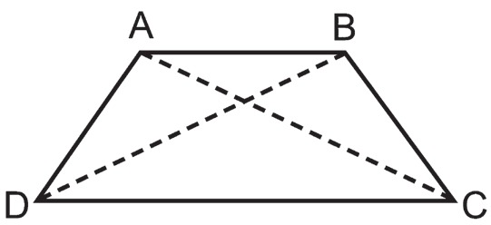
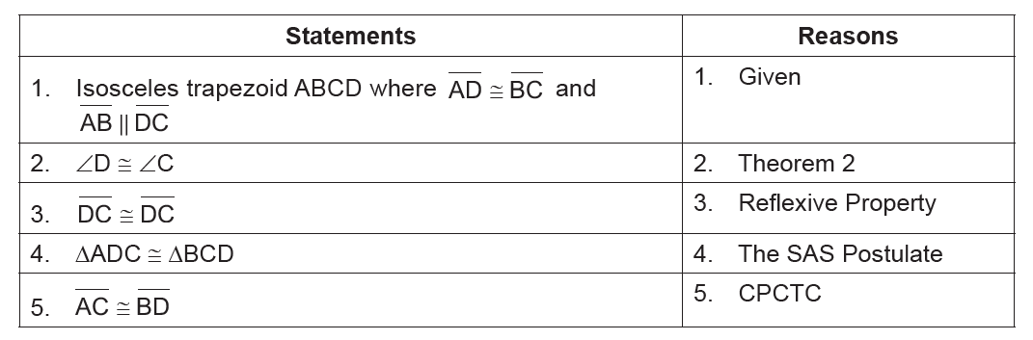
Midline Theorem and Theorems on Trapezoids and Kites
Theorem 4
Given: Isosceles trapezoid ABCD where AD ≅ BC and
AB II DC
Prove: AC ≅ BD
The diagonals of an isosceles trapezoid are congruent. |  | If □ABCD is an isosceles trapezoid, then AC ≅ BD.
Proof:
Rex Curriculum Resource
WWW.REX.COM.PH

Slide 13
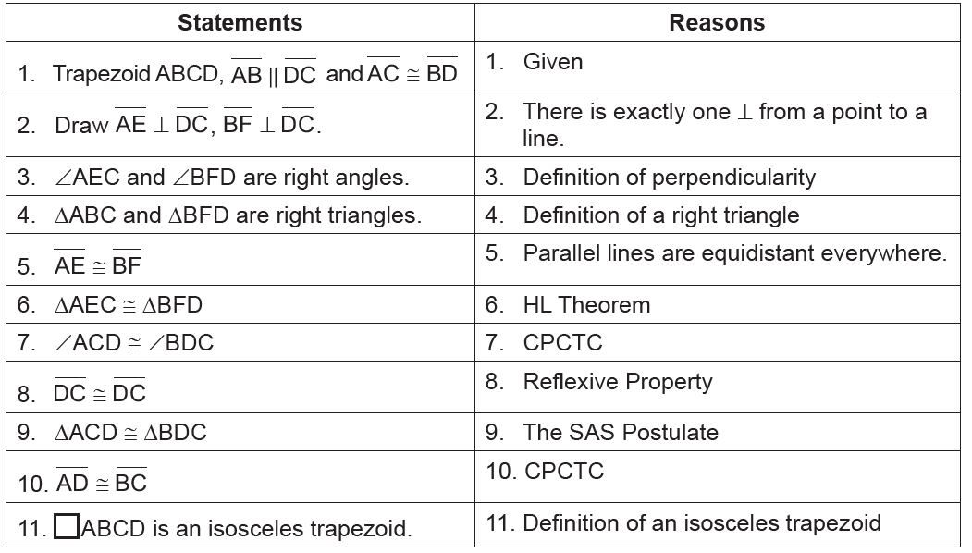
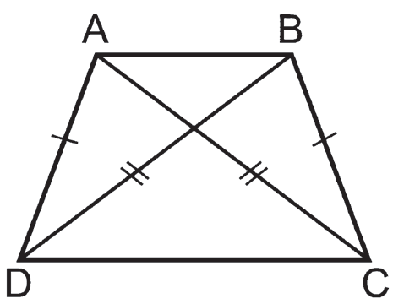
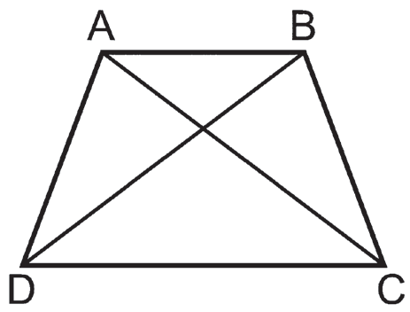
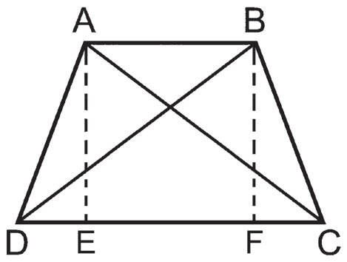
Midline Theorem and Theorems on Trapezoids and Kites
Theorem 5
Proof:
If the diagonals of a trapezoid are congruent, then the trapezoid is an isosceles. |  | If in trapezoid ABCD, AC ≅ BD , then trapezoid ABCD is an isosceles.
To prove that the trapezoid is isosceles:
1. show that the legs are congruent, that is AD ≅ BC;
2. show that a pair of base angles are congruent, that is,
∠A ≅ ∠B ≅ ∠D ≅ ∠C; or
3. show that the diagonals are congruent, that is, AC ≅ BD .
Given: Trapezoid ABCD, AB II DC and BD ≅ BD
Prove: □ABCD is an isosceles trapezoid.
Rex Curriculum Resource
WWW.REX.COM.PH

Slide 14
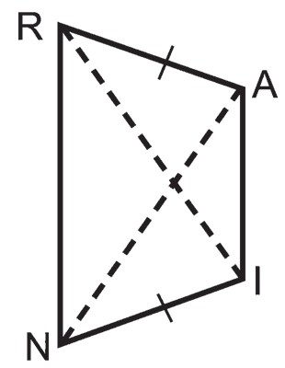
Midline Theorem and Theorems on Trapezoids and Kites
Example 5:
Use the isosceles trapezoid on the right to answer the following.
a. If RI = 10x + 7 and NA = 8x + 15, find x.
b. If RI = 7x – 9 and NA = 6x + 7, find RI.
Solution:
a. By Theorem 4, RI = NA. So,
10x + 7 = 8x + 15
10x − 8x = 15 − 7
2x = 8
2x/2 = 8/2
x = 4
b. By Theorem 4, RI = NA. So,
7 x − 9 = 6x + 7
7x − 6x = 7 + 9
x = 16
Thus, RI = 7x − 9 = 7(16) − 9 or 103.
Rex Curriculum Resource
WWW.REX.COM.PH

Slide 15
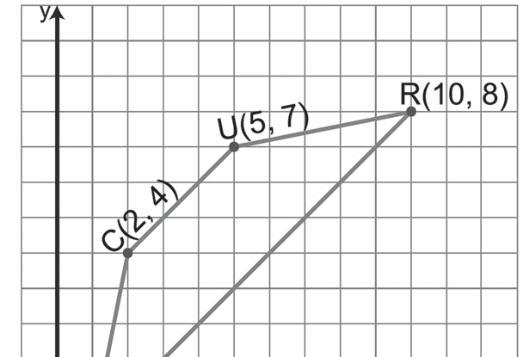
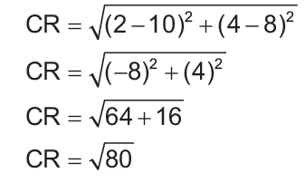
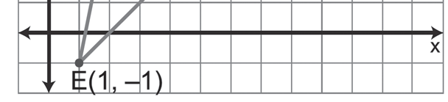
Midline Theorem and Theorems on Trapezoids and Kites
Example 6:
Determine whether trapezoid CURE is an isosceles for
C(2, 4), U(5, 7), R(10, 8), and E(1, -1).
Solution:
a. Graph the trapezoid.
b. Show that CR ≅ UE .
Because CR = UE, then CR ≅ UE and □CURE is an isosceles trapezoid.
Rex Curriculum Resource
WWW.REX.COM.PH

Slide 16
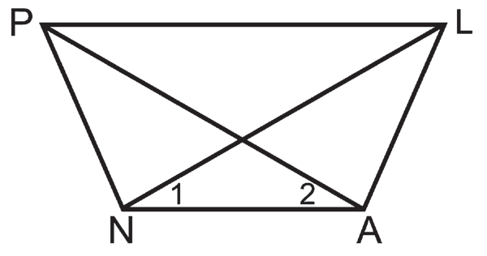
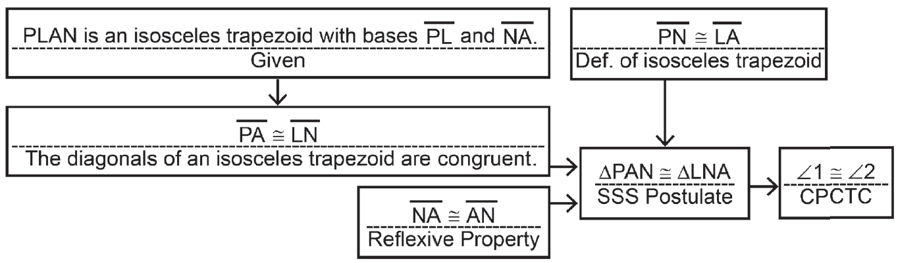
Midline Theorem and Theorems on Trapezoids and Kites
Example 7:
Write a flowchart proof.
Given: PLAN is an isosceles trapezoid with bases PL
and NA .
Prove: ∠1 ≅ ∠2
Proof:
Rex Curriculum Resource
WWW.REX.COM.PH

Slide 17
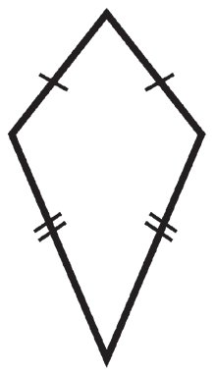
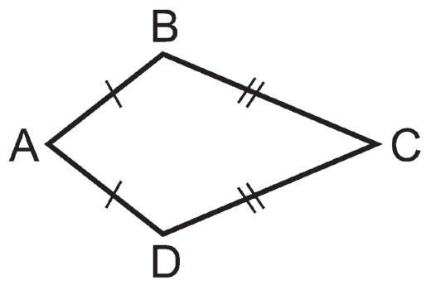
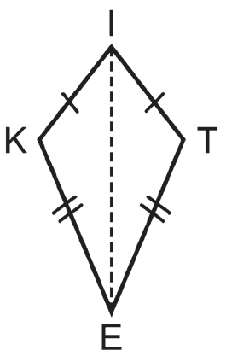
Midline Theorem and Theorems on Trapezoids and Kites
Kite
Another special quadrilateral that is not a parallelogram is a kite.
A kite is a rhombus, and the diagonals of a kite are perpendicular.
Definition
A kite is a quadrilateral with two pairs of adjacent sides that are congruent. There are no congruent opposite sides. |  | In kite ABCD, AB ≅ AD and CB ≅ CD.
The common vertices of the congruent sides of a kite are the ends of the kite. In the kite at the right, I and E are the ends. The line containing the ends of a kite is a symmetry line for the kite. In the given kite KITE, IE is the symmetry line.
Rex Curriculum Resource
WWW.REX.COM.PH

Slide 18
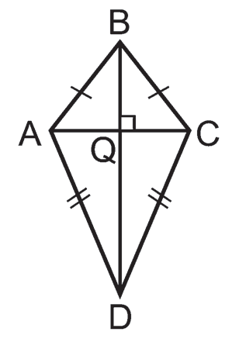
Midline Theorem and Theorems on Trapezoids and Kites
Theorem 6:
The diagonals of a kite are perpendicular. |  | If □ABCD is a kite, then AC ⊥ BD.
Both B and D are equidistant from A and C. B and D lie on the perpendicular
bisector of AC because of the perpendicular bisector theorem. There is exactly one
line at any two points. BD must be the perpendicular bisector of AC , thus AC ⊥ BD.
Rex Curriculum Resource
WWW.REX.COM.PH

Slide 19
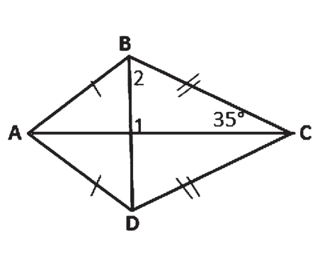
Midline Theorem and Theorems on Trapezoids and Kites
Example 8:
Find m∠1, m∠2, and m∠CBD in the kite DABC.
Solution:
a. m∠1 = 90 The diagonals of a kite are perpendicular.
b. m∠1 + m∠2 + m∠EAD = 180 The sum of the measures of the angles of a triangle is 180°
90 + m∠2 + 35 = 180 Law of Substitution
m∠2 + 125 = 180 Simplify.
m∠2 = 55 Subtract 125 from each side.
c. ΔDEA ≅ ΔDRA by SSS Postulate
By CPCTC, ∠ACD ≅ ∠BDC. Thus, m∠RAD = m∠EAD = 35.
Rex Curriculum Resource
WWW.REX.COM.PH

Slide 20
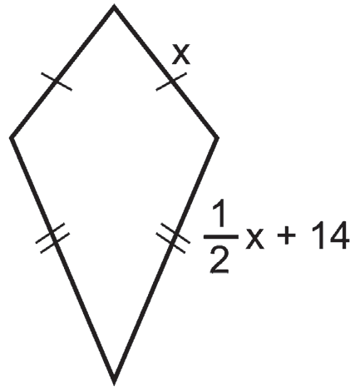
Midline Theorem and Theorems on Trapezoids and Kites
Example 9:
The perimeter of a kite is 64 centimeters. The length of one
of its sides is 14 centimeters more than half the length of
Another. Find the length of each side of the kite.
Solution:
Let x be the length of one side of a kite. Then, 1/2x +14 is the length of the other side.
Since consecutive sides of a kite are congruent:
Perimeter = 2x + 2(1/2x + 14)
64 = 2x + x + 28 Simplify.
64 = 3x + 28
64 − 28 = 3x Subtract 28 from each side.
36 = 3x
36/3 = 3x/3 Divide each side by 3.
12 = x
(1/2)x + 14 = 20
The lengths of the sides of the kite are 12 cm and 20 cm.
Rex Curriculum Resource
WWW.REX.COM.PH

Slide 21
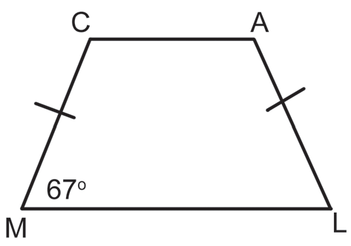
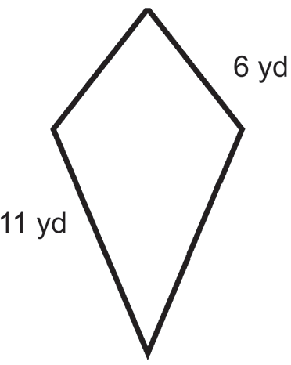
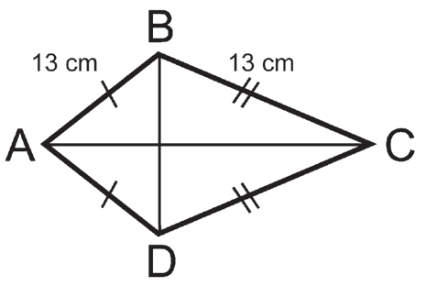
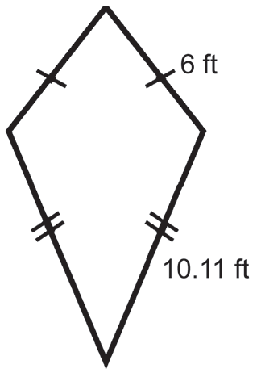
Activity:
A. Find the measure of the following parts indicated in the items below.
1. Quadrilateral CALM is a trapezoid. If m∠M = 67°,
find:
a. m∠C
b. m∠A
c. m∠L
B. Solve for the perimeter of each kite.
1. 2. 3.
C. Find the measure of the sides and angles of the following figures, then explain the theorem used.
1. In isosceles trapezoid MARE where MA ǁ RE if the m∠A = 74°, what is the measure of ∠E, ∠M, and ∠R?
2. If ME = 18, what is AR?
Rex Curriculum Resource
WWW.REX.COM.PH

Slide 22
Activity: Answer Sheet
A. Find the measure of the following parts indicated in the items below.
1. Quadrilateral CALM is a trapezoid. If m∠M = 67°,
find:
a. m∠C a. 113
b. m∠A b. 113
c. m∠L c. 67
B. Solve for the perimeter of each kite.
1. 2. 3.
C. Find the measure of the sides and angles of the following figures, then explain the theorem used.
1. In isosceles trapezoid MARE where MA ǁ RE if the m∠A = 74°, what is the measure of ∠E, ∠M, and ∠R?
2. If ME = 18, what is AR?
1. 34 yd
2. 96 cm
3. 30.22 ft
1. ∠E = 106°, ∠M = 74°, and ∠R = 106°; Definition/Theorem 2
2. AR = 18; Definition
Rex Curriculum Resource
WWW.REX.COM.PH

Slide 23


