Slide 1
Writing Proofs

Slide 2
Writing Proofs
A proof is a logical argument in which each statement you make is backed up by a statement that is accepted as true.
A proof may be presented in different ways. Some of which are the paragraph proof, two-column proof, and flowchart proof.
In a paragraph proof, you write a paragraph to explain why a conjecture for a given situation is true. Logical statements are presented using complete sentences backed up by reasons.

Slide 3
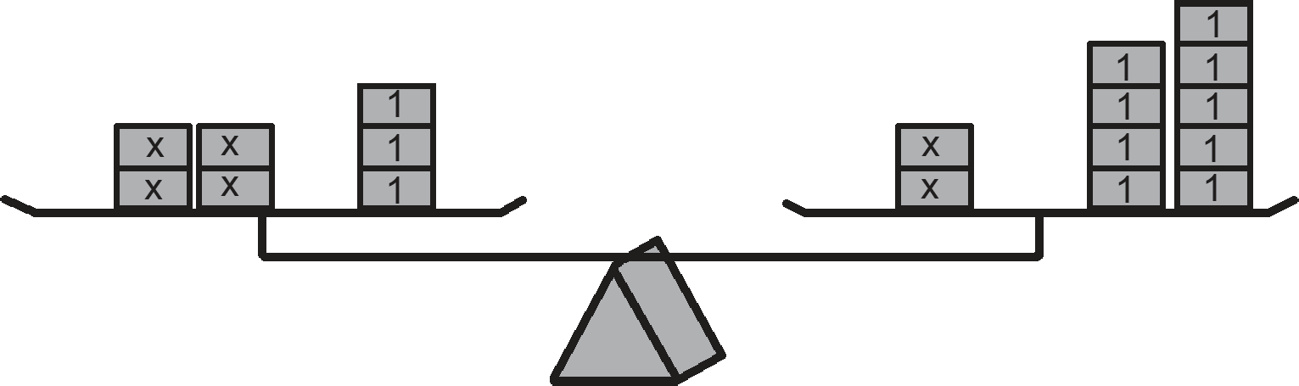
Writing Proofs
Example 1: Using the paragraph proof, prove that in the equation 4x + 3 = 2x + 9, the value of x is 3. Use the table below as guide in writing the paragraph proof.
Balance | Equation | Property
 | 4x + 3 = 2x + 9

Slide 4
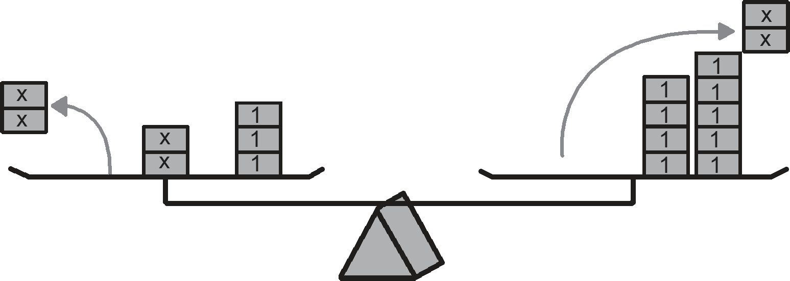
Writing Proofs
Example 1: Using the paragraph proof, prove that in the equation 4x + 3 = 2x + 9, the value of x is 3. Use the table below as guide in writing the paragraph proof.
Balance | Equation | Property
Remove two masses from both sides. | 2x + 3 = 9

Slide 5
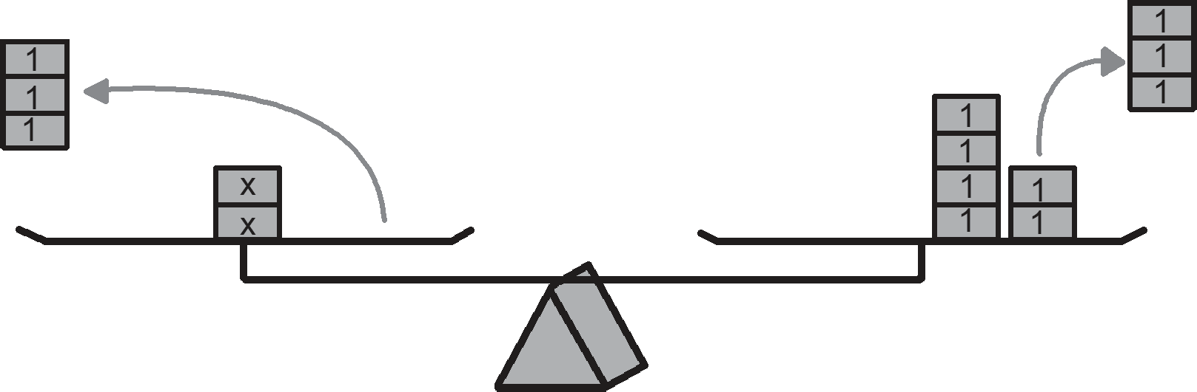
Writing Proofs
Example 1: Using the paragraph proof, prove that in the equation 4x + 3 = 2x + 9, the value of x is 3. Use the table below as guide in writing the paragraph proof.
Balance | Equation | Property
Remove three masses from both sides. | 2x = 6

Slide 6
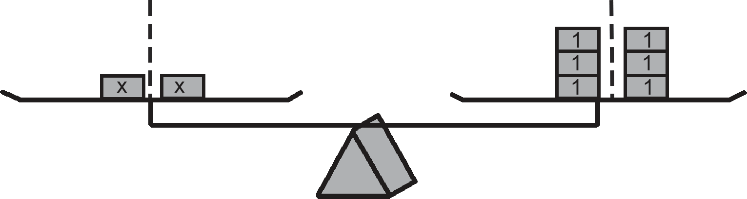

Writing Proofs
Example 1: Using the paragraph proof, prove that in the equation 4x + 3 = 2x + 9, the value of x is 3. Use the table below as guide in writing the paragraph proof.
Balance | Equation | Property
Divide each side into equal parts.

Slide 7
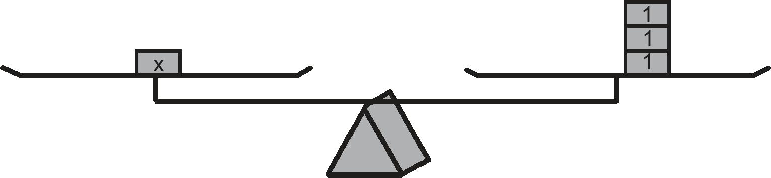
Writing Proofs
Example 1: Using the paragraph proof, prove that in the equation 4x + 3 = 2x + 9, the value of x is 3. Use the table below as guide in writing the paragraph proof.
Balance | Equation | Property
The parts on both sides are equal. | x = 3

Slide 8
Writing Proofs
Paragraph Proof:
Use the Addition Property of Equality (APE) to collect constant terms on the right side of the equation and the terms with x on the left side of the equation. Thus, 2x = 6. Then use the Division Property of Equality (DPE) to divide both sides by 2.
Therefore, x = 3.
Another way of writing a proof is by using a two-column proof. It is a proof in tabular form that lists the statements in the first column and their corresponding reasons on the second column. Using the same example in number 1, prove it using a two-column proof.

Slide 9

Writing Proofs
Example 2: Prove that in the equation 4x + 3 = 2x + 9, the value of x is 3.
Solutions:
Using the two-column proof, the problem can be proven as follows:
Given: 4x + 3 = 2x + 3
Prove: x = 3
Proof:
Statements | Reasons
1. 4x + 3 = 2x + 9 | 1. Given
2. 2x + 3 = 9 | 2. Addition Property of Equality (APE)
3. 2x = 6 | 3. Addition Property of Equality (APE)
4. | 4. Division Property of Equality (DPE)
5. x = 3 | 5. Simplify

Slide 10
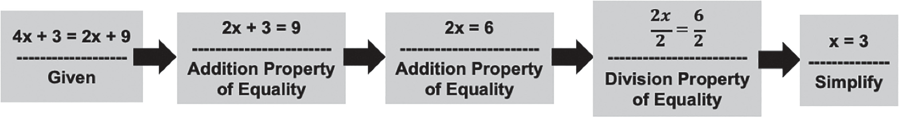
Writing Proofs
Another way to present a proof is by using a flowchart proof. This proof organizes a series of statements in a logical order, starting with the given statements. Each statement together with its reason is written in a box, and arrows are used to show how each statement leads to another. Flowcharts can make your logic visible and can help others follow your reasoning.
Example 3: Using the flowchart proof, prove that in the equation 4x + 3 = 2x + 9, the
value of x is 3.

Slide 11
Writing Proofs
A proof can also be categorized as direct or indirect. In a direct proof, given a conditional statement p ⇒ q, you will assume that the hypothesis p is true, then use reasons to show that the conclusion q is true. These reasons may be properties, theorems, postulates, and definitions. The three examples presented previously are examples of direct proof.
In an indirect proof, you may use the proof by contradiction or proof by contrapositive. When using proof by contradiction, you will assume that the conclusion is false and then show that the consequence of this is not possible. The consequence either contradicts what has just been assumed or contradicts a statement that is known to be true.

Slide 12
Writing Proofs
Example 4: Prove that a triangle has at most one obtuse angle.
Proof:
Assume that DABC has two obtuse angles, say ∠A and ∠B.
Recall that obtuse angles measure more than 90° but less than 180°.
You know that the sum of the angles of a triangle is equal to 180°. With this knowledge, you know that ∠C = 180 - (m∠A + m∠B). Note that m∠A > 90 and m∠B > 90. Subtracting the sum of the measures of ∠A and ∠B from the measure of ∠C will lead to a negative value. This is a contradiction since you cannot have a negative value for ∠C. Therefore, a triangle has at most one obtuse angle.
When using the proof by contrapositive, first you must obtain the contrapositive of the conditional statement p ⇒ q, that is given by ~p ⇒ ~q. You will then assume ~q then prove that ~p is true.

Slide 13
Writing Proofs
Example 5: Prove that if n2 is odd, then n is odd.
Proof:
Consider the contrapositive of the conditional statement given. Its contrapositive is “if n is even, then n2 is even.”
Assume that n is even. So, n = 2k, where k is an integer. Squaring n leads to
n2 = (2k)2 = 4k2. Notice that 4k2 = 2(2k 2) which is even. So, we conclude that n2 is even.
Therefore, if n2 is odd, then n is odd.
Upon your interaction with the concept being presented, you will now apply what
you have learned.

